Slide 1

MICROSOFT MOVIES PROJECT

Slide 2
PROJECT OVERVIEW
The objective of this project is to analyze various datasets containing data on movies to provide Microsoft with three actionable recommendations for making movies. These recommendations will be based on comprehensive data analysis and insights derived from key metrics such as box office sales, genre, popularity and profitability

Slide 3
BUSINESS UNDERSTANDING
Objective
To provide Microsoft with strategic insights and recommendations for making successful and profitable movies based on comprehensive data analysis of various movie datasets.
Key Questions
What genres of movies are most likely to generate high box office revenue?
What factors contribute profitability in the movie business ?
How do audience voting preference correlate with movie profitability and popularity?

Slide 4
IMPORTANCE
The movie industry is highly competitive, with significant investments required for production and marketing. Understanding the key drivers of movie success can help Microsoft:
1. Maximize their Return on Investment
2. Make informed decisions based on data insights on the types of movies to produce.
3. Understand Audience preferences and tailor make Movies to suit their expectations

Slide 5

Data Understanding
Data Collection
Data Description
Data Cleaning

Slide 6
Data Analysis
In this project, the data analysis phase involved systematically exploring and interpreting the various datasets containing information on movies.
This includes examining numerical data such as box office sales, production costs, and audience ratings, as well as categorical data such as genres, release dates, and production companies.
The objective is to uncover patterns, trends, and relationships within the data that can inform our recommendations. Statistical methods and visualization techniques were employed to identify key factors contributing to movie success, enabling us to provide evidence-based recommendations to Microsoft for strategic decision-making in movie production

Slide 7

VISUALIZATIONS FROM OUR DATA ANALYSIS

Slide 8
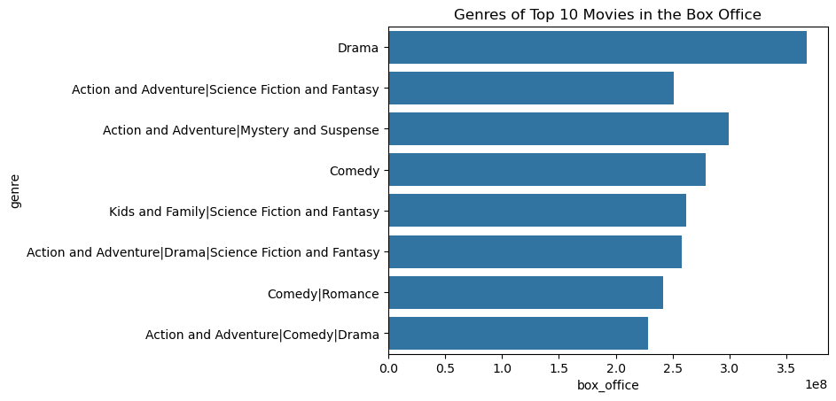
TOP 10 MOVIE GENRES ON THE BOX OFFICE

Slide 9
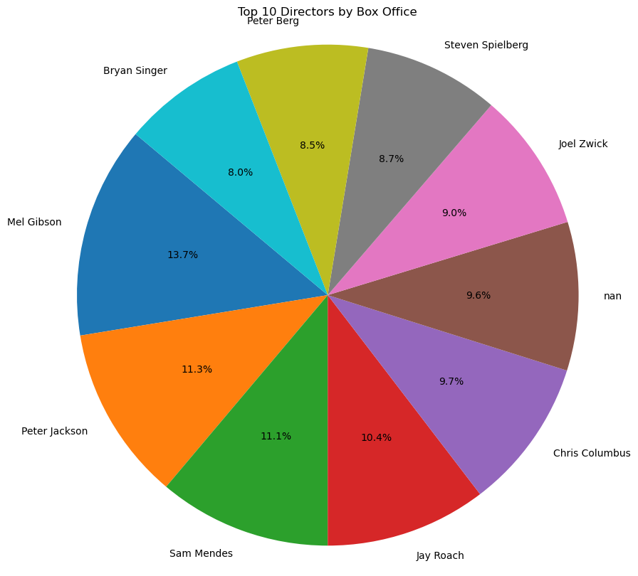
TOP 10 MOVIE DIRECTORS IN THE BOX OFFICE

Slide 10
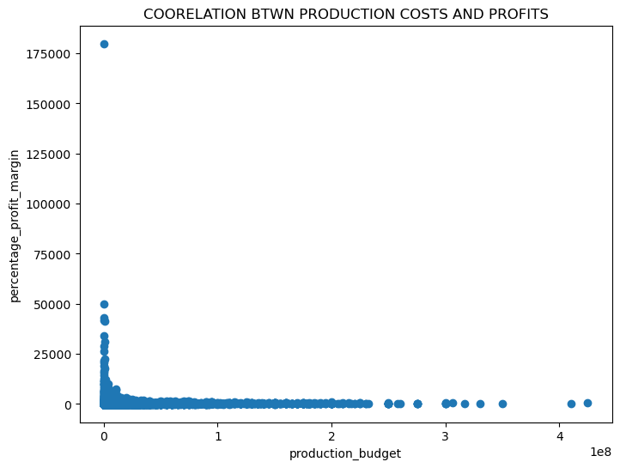
PRODUCTION COSTS VS PRODUCTIVITY

Slide 11
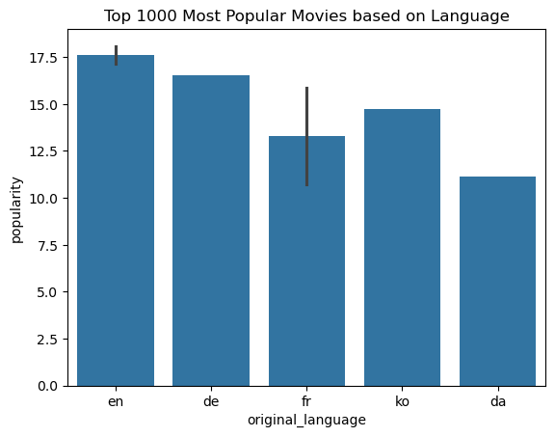
POPULAR MOVIES CATEGORIZD BY ORIGINAL LANGUAGE

Slide 12
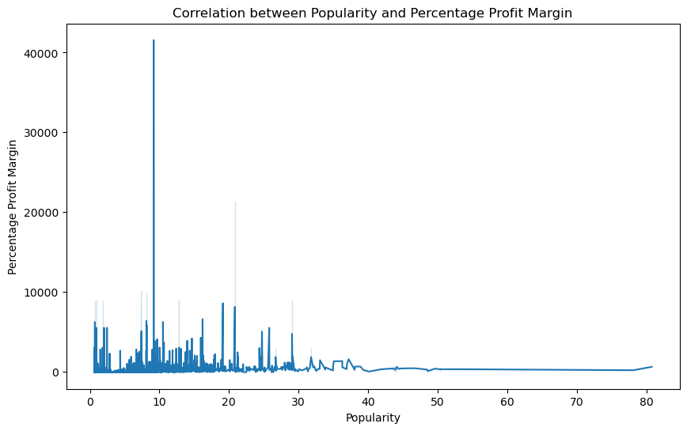
POPULARITY VS PROFIT MARGINS

Slide 13
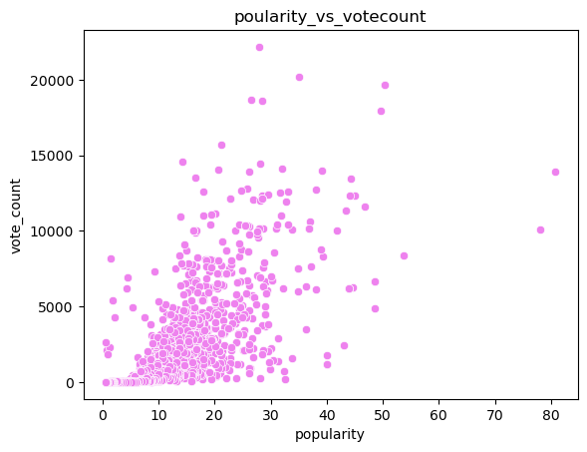
POPULARITY VS VOTE COUNT

Slide 14
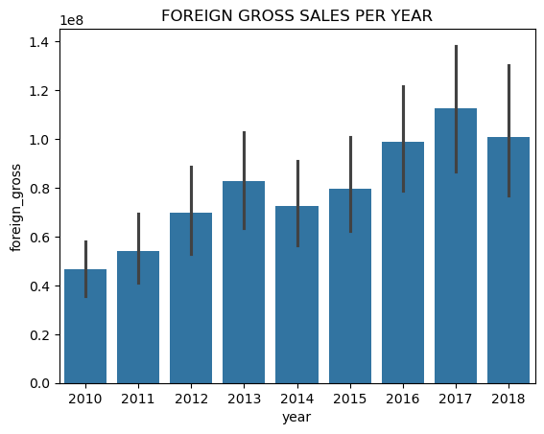
FOREIGN GROSS SALES PER YEAR

Slide 15

RECOMMENDATIONS

Slide 16
1. The stakeholders should consider Movie genres: Drama, Action and Adventure, Comedies, and kids and family when choosing type of movies to produce as they have highest box office sales from our analysis.
2. The Production budget should be within $200,000,000 since production budgets beyond this amount don't have a strong coorelation to profitability.
3. Microsoft should take measures like sending reminder emails to ensures audience submit votes for their movies for their are likely to increase movie popularity and thus movie profitability.
4. Microsoft should liase with top diretors to enable them produce movies with potential high box office sales.

Slide 17

NEXT STEPS
Deep dive analysis into the Movie popularity ratings can be done to gain insights on other factors affecting the same other than vote count.
Further exploratory analysis can be done on top movie directors to understand the movie genres they specialize in producing.

Slide 18

ANY QUESTIONS??

Slide 19


Slide 20

PHASE 1 PROJECT COMPLETED

