Slide 1
SYRIATEL COMPANY CUSTOMER CHURN ANALYSIS
FPPT.com

Slide 2
INTRODUCTION
OVERVIEW
The project's primary objective was to build a classifier model to predict whether a customer will soon stop doing business with SyriaTel.(Churn)
This prediction is crucial for SyriaTel as it directly impacts customer retention strategies, helping to reduce revenue loss from customer churn.

Slide 3
BUSINESS UNDERSTANDING
The business problem revolves around customer churn, a critical issue for SyriaTel since retaining existing customers is often more cost-effective than acquiring new ones.
Predicting churn allows the company to implement proactive retention strategies, improving customer loyalty and profitability.

Slide 4
DATA UNDERSTANDING
PROS
CONS
The dataset provided for includes various features we can use to Understand features in the context of customer behavior
Data’s properties, has class imbalance, which should be carefully handled to ensure accurate model performance and reliable predictions.

Slide 5
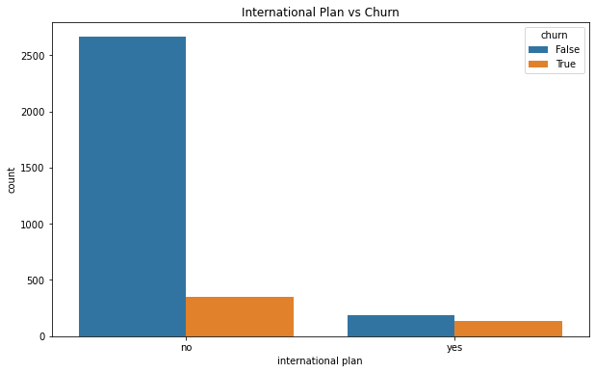
DATA INSIGHTS
Insights
1.Higher Churn Among International Plan Users
2. Low Churn in Non-International Plan Users

Slide 6
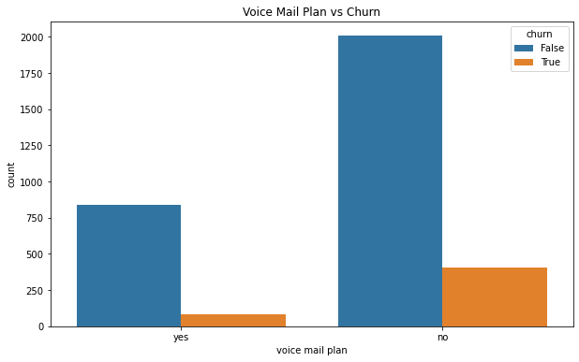
DATA INSIGHTS
Insights
1.Lower Churn Among Voice Mail
Plan users
2. Higher Churn in Non-Voice Mail Plan Users

Slide 7
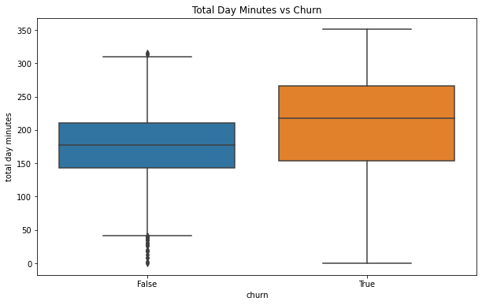
DATA INSGHTS
Insights
Higher usage day time customers are more Likely to Churn

Slide 8
MODELLING
I employed three machine learning models, starting with logistic regression and then moving to decision trees. Logistic regression provided a baseline with interpretable results, while the decision tree model offered more nuanced insights by capturing complex relationships between features.

Slide 9
MODELLING
Feature engineering and data balancing techniques, like SMOTE, were explored to improve model performance. Hyperparameter tuning was applied to the decision tree model, significantly enhancing its predictive power, particularly in identifying customers who are likely to churn.

Slide 10

MODEL EVALUATION

Slide 11
MODEL EVALUATION
Model performance was rigorously evaluated using metrics such as accuracy, precision, recall, F1-score, and ROC-AUC.
The evaluation highlighted the importance of balancing precision and recall, especially in the context of a business problem where false negatives have significant financial implications.

Slide 12

MODEL EVALUATION
WINNER
MODEL PERFORMANCE
Model performance was rigorously evaluated using various metrics
The tuned decision tree model demonstrated superior performance, with a ROC-AUC of 0.9059 and an accuracy of 92.80%
The Model has strong ability to distinguish between customers who will churn and those who will not.

Slide 13
CONCLUSION
Recommendations:
1. Proactive Retention Strategies:
SyriaTel should focus on customers who frequently contact customer service or exhibit decreasing usage patterns, offering them tailored retention offers.
2. Data-Driven Decisions:
Regularly update and retrain the churn prediction model with new data to ensure it adapts to changing customer behaviors.

Slide 14
CONCLUSION
Targeted Marketing
targeted marketing campaigns aimed at high-risk segments such as customers under International plan

Slide 15
MODEL DEPLOYMENT Integrate the tuned decision tree model into SyriaTel’s operational processes
NEXT STEPS

Slide 16


