Slide 1

Clinical Decision Support: Early Identification of High Risk Pneumonia Patients
Isaac Oyediran
Jeremy Haoqing Zhu
Safa Fazili

Slide 2


Problem Overview
Pneumonia is one of the most common cause of death worldwide. Claiming 2.5 million lives in 2019, including 672,000 children. COVID-19 added another 3.5 million to pneumonia's death toll in 2021.
New York State has an age-adjusted influenza/pneumonia death rate of 15.1 per 100,000 population. It is the 8th leading cause of death in New York State.
Emergency Department Impact
Adults ≥85 years are 53 times higher pneumonia hospitalization rates than adults 18-49 years
7.9
Per 1,000 people, higher than for influenza
~19%
pneumonia hospitalizations require ICU admission

Slide 3
Intervention Goal: Enhancing Pneumonia Management at Emergency Department
Identify ED patients at high risk of severe pneumonia
CURB-65 score effectively predicts 30-day mortality in community-acquired pneumonia
Higher specificity (74.6%) compared to PSI (52.2%) for mortality prediction
Calculate risk score based on vital signs and patient factors
Each positive finding contributes one point to the total score (0-5)
Integrate seamlessly into triage workflow
All CURB-65 elements are routinely collected during initial assessment
Can be automatically calculated from electronic medical record data
Requires minimal additional documentation burden for ED staff
Drive recommendations for clinical decision-making
Guides appropriate site-of-care decisions
Supports antibiotic selection and treatment intensity decisions
Improves resource utilization and standardizes care

Slide 4
Intervention Goal: Enhancing Pneumonia Management at Emergency Department
Identify ED patients at high risk of severe pneumonia
CURB-65 score effectively predicts 30-day mortality in community-acquired pneumonia
Higher specificity (74.6%) compared to PSI (52.2%) for mortality prediction
Calculate risk score based on vital signs and patient factors
Each positive finding contributes one point to the total score (0-5)
User Story:
As an ED triage nurse, I want an automated alert identifying patients with a high risk of severe pneumonia based on their initial vital signs, symptoms, and history entered during intake, so that I can efficiently initiate appropriate isolation precautions, notify the physician promptly, and trigger relevant care protocols to ensure timely treatment.
Integrate seamlessly into triage workflow
All CURB-65 elements are routinely collected during initial assessment
Can be automatically calculated from electronic medical record data
Requires minimal additional documentation burden for ED staff
Drive recommendations for clinical decision-making
Guides appropriate site-of-care decisions
Supports antibiotic selection and treatment intensity decisions
Improves resource utilization and standardizes care

Slide 5



Alert Design Assessment: 5 “Rights”
Right Information
Delivers critical, synthesized information including calculated pneumonia risk score
Displays corresponding risk category (Low, Moderate, High)
Right Person
Triage nurses conducting initial evaluation
Attending ED physicians/providers responsible for care plan development
Right Channel
Integrated within the EHR
Embedded in modules used during ED triage and patient assessment
Right Channel
Designed to minimize cognitive load and workflow interruption.
Strategic alert types and color-coding based on clinical priority
Right Time
Delivered during or immediately following initial triage/intake process
Timed to ensure early intervention for high-risk patients

Slide 6




Intake Form Summary:
Primary Driver
Owner
Improve patient safety and outcomes for individuals presenting to the Emergency Department with potential pneumonia by enabling earlier recognition and risk stratification of those at high risk for severe disease.
EM + ER Coordination Team (Planning section lead)
ED Leadership (ED Medical Director and ED Director of Nursing)
Evaluation Plan
Process Metrics: CDS trigger frequency and accuracy User interaction rates Triage to CDS Time Adherence rate
Outcome Metrics: Pneumonia-related mortality rate ICU admission rate
Hospital length of stay (LOS)
Rate of unexpected clinical deterioration
Safety Metrics: Clinician satisfaction Assessment of alert fatigue
False positive and negative rates

Slide 7


OPA Design for Pneumonia Risk CDS
User Types: Triage Nurse
High Risk (Red)
Moderate Risk (Yellow)
Low Risk (Green)
Title Text
"High-Risk Pneumonia: Immediate Action Required"
"Moderate Pneumonia Risk: Clinical Evaluation Needed"
"Low Pneumonia Risk: Monitor Status"
Body Text
CURB-65 Score: [X] + Significant Comorbidities. 30-day mortality risk: [X]%. Recommend:
CURB-65 Score: [X] with Comorbidities. Consider.
CURB-65 Score: [X]. Low complication risk. Suggested.
Relevant Info Display
- CURB-65 components - CCI score - Critical vitals - Prior pneumonia admissions
CURB-65 breakdown Key abnormal values Comorbidity flags
CURB-65 score Normal ranges Outpatient criteria
Follow-up Actions
- ICU consult - Sepsis protocol - Broad-spectrum antibiotics - STAT CXR
- Admission evaluation - Antibiotic timer - Oxygen protocol
- Discharge checklist - Follow-up reminder - Symptom journal

Slide 8
OPA Design for Pneumonia Risk CDS
User Types: Triage Nurse
High Risk (Red)
Moderate Risk (Yellow)
Low Risk (Green)
Trigger Actions:
Title Text
"High-Risk Pneumonia: Immediate Action Required"
"Moderate Pneumonia Risk: Clinical Evaluation Needed"
"Low Pneumonia Risk: Monitor Status"
- Triage form completion - First set of vitals entry - Chief complaint containing "cough"/"SOB" - Initial nursing assessment sign-off
Body Text
CURB-65 Score: [X] + Significant Comorbidities. 30-day mortality risk: [X]%. Recommend:
CURB-65 Score: [X] with Comorbidities. Consider.
CURB-65 Score: [X]. Low complication risk. Suggested.
Trigger Criteria:
High Risk: - CURB-65 ≥3 - SpO₂ <90% on RA - CCI ≥4 Moderate: - CURB-65 1-2 + CCI 2-3 - Temp >38.5°C Low: - CURB-65 0-1 - No comorbidity flags
Relevant Info Display
- CURB-65 components - CCI score - Critical vitals - Prior pneumonia admissions
CURB-65 breakdown Key abnormal values Comorbidity flags
CURB-65 score Normal ranges Outpatient criteria
Follow-up Actions
- ICU consult - Sepsis protocol - Broad-spectrum antibiotics - STAT CXR
- Admission evaluation - Antibiotic timer - Oxygen protocol
- Discharge checklist - Follow-up reminder - Symptom journal

Slide 9
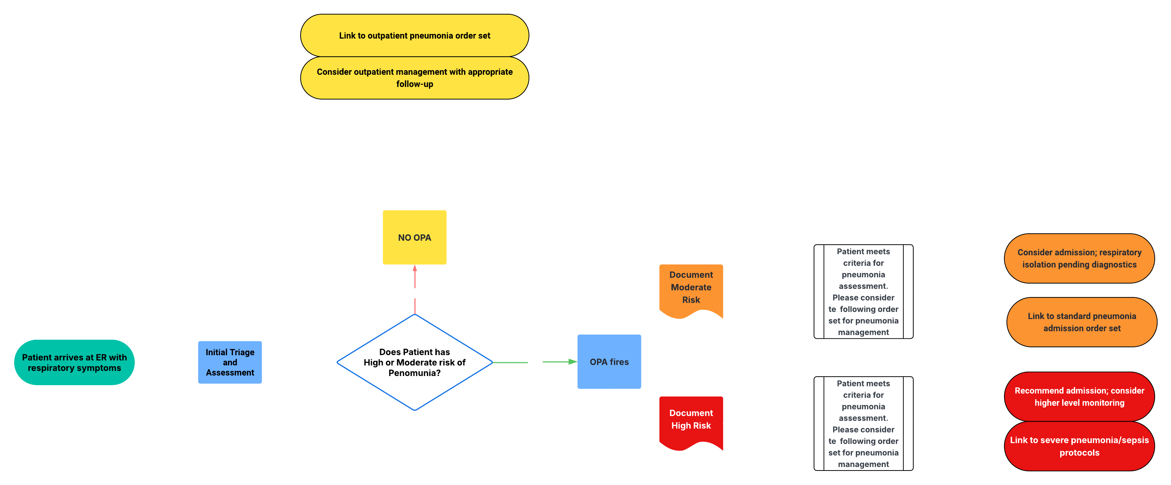


Proposed Workflow
Trigger and Assessment
Silent Background Processing
CURB-65 Integration with CCI Enhancement

Slide 10



Proposed Workflow
Risk Calculation and
Alert Presentation Phase
Risk-Appropriate Alert Presentation
Structured Override Documentation
Actionable Clinical Recommendations
Auto-Documentation in Clinical Notes

Slide 11

ED Pneumonia Risk Stratification: CDS Decision Tree
CDS is triggered once intake form is completed with sufficient data
Patients stratified by point-based risk scoring
Risk categories guide level of intervention and alert type
Scoring criteria based on evidence-aligned clinical flags (vitals, comorbidities, AMS)
Scoring Criteria (Assign 1 point for each of the following risk factors):
Age > 65, Any comorbidity (CHF, COPD, CKD, etc.), RR ≥ 30, SpO₂ < 92%,Temp < 95°F or ≥ 104°F, HR ≥ 125, SBP < 90 or DBP ≤ 60, Altered Mental Status, Nursing Home Resident
Notes:
“This slide shows the core logic behind our Clinical Decision Support tool — a point-based decision tree that activates after the triage/intake form is completed in the Emergency Department.”
“Once enough data is entered into the EHR, the tool automatically assesses whether the patient meets any high-risk criteria. These are not just general symptoms — they’re specific red flags that correlate with a higher likelihood of severe pneumonia or deterioration.”
“If no risk factors are present, no alert is triggered. But if even one is present, the tool proceeds to calculate a total risk score based on how many clinical risk factors are identified.”
[Point to the Scoring Criteria box]:
“Here are the scoring rules. Each item adds 1 point — for example: Age over 65, abnormal vitals like high respiratory rate or low oxygen saturation, altered mental status, or comorbidities like COPD or heart failure. The goal is to quantify severity objectively using available intake data.”
“You’ll notice that basic symptoms like cough, fever, or sputum are not scored here — and that’s intentional. While they’re important for diagnosis, they are too common and nonspecific to be helpful for risk stratification.”
“Instead, we’re looking at clinical instability markers — things that suggest the patient may need urgent intervention, ICU care, or is at risk of rapid decline. This keeps the CDS focused on severity, not just presence of disease.”
“Depending on the score, the patient is classified into Low, Moderate, or High Risk, and the CDS recommends different levels of action — ranging from outpatient follow-up to initiating the Sepsis Protocol or ICU consult.”
“This approach aligns with evidence-based tools like CURB-65, but is tailored to work in the fast-paced ED environment and integrated directly into triage workflows.”

Slide 12
Pseudocode: ED Pneumonia Risk Stratification
Step 1
Step 2
Step 3
Step 4
Gather Intake Data (from ED form or EHR) ---
sample_patient = {
"age": 72,
"residence": "Nursing Home",
"comorbidities": ["CHF", "CKD"],
"RR": 32,
"SpO2": 90,
"temp_f": 101,
"HR": 130,
"SBP": 88,
"DBP": 55,
"AMS": True
}
Notes:
“This pseudocode shows how the CDS logic processes structured intake data to calculate a risk score. Based on the score, it stratifies the patient into low, moderate, or high risk and triggers the appropriate CDS alert, ranging from minimal tagging to interruptive guidance for immediate intervention.”

Slide 13
Pseudocode: ED Pneumonia Risk Stratification
Step 1
Step 2
Step 3
Step 4
Gather Intake Data (from ED form or EHR) ---
sample_patient = {
"age": 72,
"residence": "Nursing Home",
"comorbidities": ["CHF", "CKD"],
"RR": 32,
"SpO2": 90,
"temp_f": 101,
"HR": 130,
"SBP": 88,
"DBP": 55,
"AMS": True
}
Define CDS Risk Scoring Function
def pneumonia_risk_score(patient):
score = 0
Age & Residence Scoring ---
if patient["age"] > 65:
score += 1
if patient["residence"] == "Nursing Home":
score += 1
Comorbidity Scoring
score += len(patient.get("comorbidities", [])) # 1 point per comorbidity
Vital Sign Scoring
if patient["RR"] >= 30:
score += 1
if patient["SpO2"] < 92:
score += 1
if patient["temp_f"] < 95 or patient["temp_f"] >= 104:
score += 1
if patient["SBP"] < 90 or patient["DBP"] <= 60:
score += 1
if patient["HR"] >= 125:
score += 1
CURB-65 Scoring (Confusion)
if patient[”AMS"] :
curb65 += 1
if patient.get [”BUN”, 0] >19 (Uremia)
curb65 += 1
if patient.get [”BUN”, 0] >=65 (Age)
curb65 += 1
Notes:
“This pseudocode shows how the CDS logic processes structured intake data to calculate a risk score. Based on the score, it stratifies the patient into low, moderate, or high risk and triggers the appropriate CDS alert, ranging from minimal tagging to interruptive guidance for immediate intervention.”

Slide 14
Pseudocode: ED Pneumonia Risk Stratification
Step 1
Step 2
Step 3
Step 4
Gather Intake Data (from ED form or EHR)
sample_patient = {
"age": 72,
"residence": "Nursing Home",
"comorbidities": ["CHF", "CKD"],
"RR": 32,
"SpO2": 90,
"temp_f": 101,
"HR": 130,
"SBP": 88,
"DBP": 55,
"AMS": True
}
Define CDS Risk Scoring Function
def pneumonia_risk_score(patient):
score = 0
Age & Residence Scoring ---
if patient["age"] > 65:
score += 1
if patient["residence"] == "Nursing Home":
score += 1
Comorbidity Scoring
score += len(patient.get("comorbidities", []))
# 1 point per comorbidity
Vital Sign Scoring
if patient["RR"] >= 30:
score += 1
if patient["SpO2"] < 92:
score += 1
if patient["temp_f"] < 95 or patient["temp_f"] >= 104:
score += 1
if patient["SBP"] < 90 or patient["DBP"] <= 60:
score += 1
if patient["HR"] >= 125:
score += 1
CURB-65 Scoring (Confusion)
if patient[”AMS"] :
curb65 += 1
if patient.get [”BUN”, 0] >19 (Uremia)
curb65 += 1
if patient.get [”BUN”, 0] >=65 (Age)
curb65 += 1
Risk Stratification
if score <= 1:
category = "Low Risk"
action = "Outpatient; no alert"
elif score <= 3:
category = "Moderate Risk"
action = "Admit; non-interruptive alert"
else:
category = "High Risk"
action = "ICU eval; interruptive BPA"
Notes:
“This pseudocode shows how the CDS logic processes structured intake data to calculate a risk score. Based on the score, it stratifies the patient into low, moderate, or high risk and triggers the appropriate CDS alert, ranging from minimal tagging to interruptive guidance for immediate intervention.”

Slide 15
Pseudocode: ED Pneumonia Risk Stratification
Step 1
Step 2
Step 3
Step 4
Gather Intake Data (from ED form or EHR)
sample_patient = {
"age": 72,
"residence": "Nursing Home",
"comorbidities": ["CHF", "CKD"],
"RR": 32,
"SpO2": 90,
"temp_f": 101,
"HR": 130,
"SBP": 88,
"DBP": 55,
"AMS": True
}
Define CDS Risk Scoring Function
def pneumonia_risk_score(patient):
score = 0
Age & Residence Scoring ---
if patient["age"] > 65:
score += 1
if patient["residence"] == "Nursing Home":
score += 1
Comorbidity Scoring
score += len(patient.get("comorbidities", []))
# 1 point per comorbidity
Vital Sign Scoring
if patient["RR"] >= 30:
score += 1
if patient["SpO2"] < 92:
score += 1
if patient["temp_f"] < 95 or patient["temp_f"] >= 104:
score += 1
if patient["SBP"] < 90 or patient["DBP"] <= 60:
score += 1
if patient["HR"] >= 125:
score += 1
CURB-65 Scoring (Confusion)
if patient[”AMS"] :
curb65 += 1
if patient.get [”BUN”, 0] >19 (Uremia)
curb65 += 1
if patient.get [”BUN”, 0] >=65 (Age)
curb65 += 1
Risk Stratification
if score <= 1:
category = "Low Risk"
action = "Outpatient; no alert"
elif score <= 3:
category = "Moderate Risk"
action = "Admit; non-interruptive alert"
else:
category = "High Risk"
action = "ICU eval; interruptive BPA"
Return Output
return {
"score": score,
"category": category,
"recommended_action": action
}
Run CDS Logic and Print Result
result = pneumonia_risk_score(sample_patient)
print(result)
Notes:
“This pseudocode shows how the CDS logic processes structured intake data to calculate a risk score. Based on the score, it stratifies the patient into low, moderate, or high risk and triggers the appropriate CDS alert, ranging from minimal tagging to interruptive guidance for immediate intervention.”

Slide 16
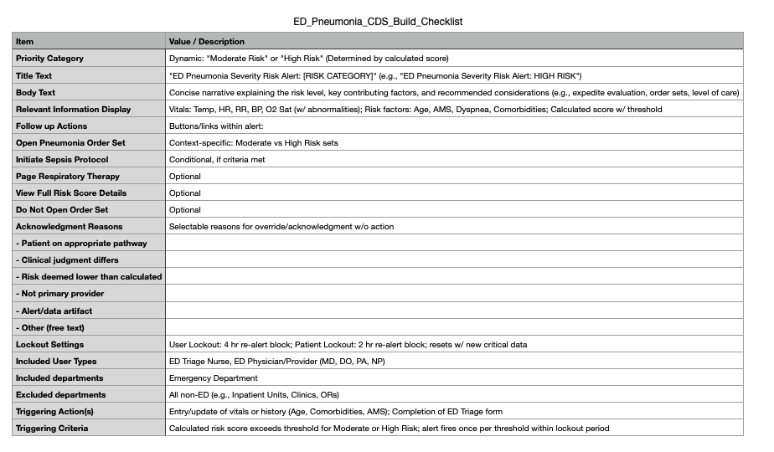
Build Checklist Highlights
Alert content and severity are driven by calculated risk score
Includes optional tools for clinician flexibility (e.g., view score, page specialist or ER physician)
Lockout settings minimize alert fatigue while preserving clinical safety

Slide 17
BPA Alert Mockup
Alert Summary
This patient meets criteria indicating HIGH RISK for severe pneumonia based on current clinical data.
Clinical Rationale
Factors include:
Advanced age
Abnormal vital signs (e.g., hypoxia, tachypnea, hypotension)
Key symptoms (e.g., dyspnea, altered mental status)
Comorbidities (e.g., COPD, CHF, immunosuppression)
Key Patient Data
Vitals: Temp 39.2°C, HR 130 bpm, RR 32, BP 88/54 mmHg, O2 Sat 88%
Risk Score: 5 points (Threshold: ≥4 = High Risk)
Comorbidities: COPD, CHF
Symptoms: Dyspnea, AMS
Residence: Nursing Home

Slide 18


BPA Alert Mockup
Delivery
Recommended Actions (Interactive Buttons):
[Open Pneumonia Order Set]
[Initiate Sepsis Protocol]
[Page Respiratory Therapy]
[View Full Risk Score Details]
[Do Not Open Order Set]
Acknowledgment Reasons (if dismissed)
Vitals: Temp 39.2°C, HR 130 bpm, RR 32, BP 88/54 mmHg, O2 Sat 88%
Risk Score: 5 points (Threshold: ≥4 = High Risk)
Comorbidities: COPD, CHF
Symptoms: Dyspnea, AMS
Residence: Nursing Home
Lockout Logic:
User Lockout: 4 hours (same user, same alert)
Patient Lockout: 2 hours (any user, same alert)

Slide 19
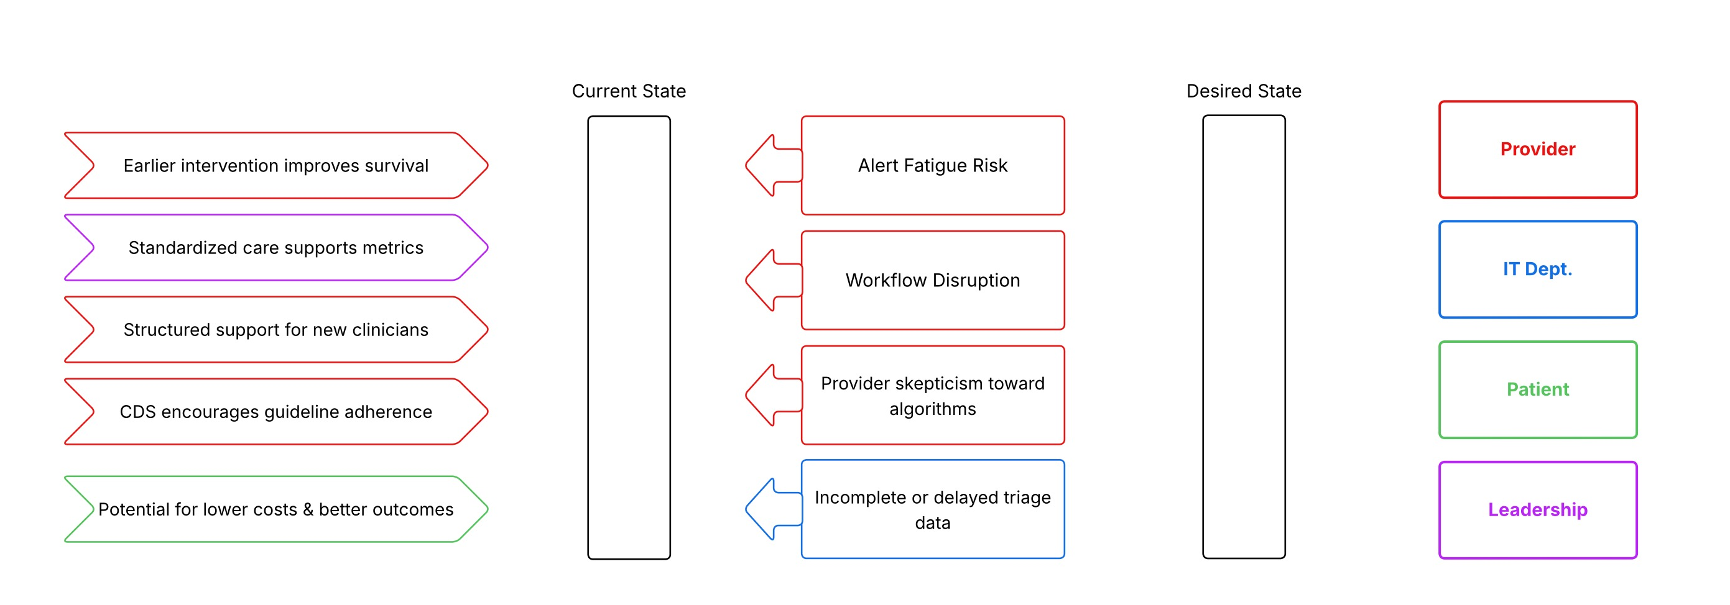
Force Field Analysis

Slide 20
Firing & Logging Strategy
What’s Logged | Details / Examples
Location | Emergency Department Location
CDS firing event | Date/time of logic execution + whether alert was shown or suppressed
Patient ID | Unique identifier (e.g., MRN and Encounter ID)
Clinician ID | Nurse or physician viewing the alert
Triggering event | Example: “Triage form completed”
Input data | Vitals, AMS, comorbidities, age, residence
Algorithm output | Calculated risk score and risk category (Low/Moderate/High)
Recommended CDS action | Suggested orders or next steps based on risk
User interaction (if alert shown) | Action taken, timestamp, acknowledgment reason
User response (if alert shown) | Override reason, optional free-text comment
Purpose: Monitor CDS use, evaluate accuracy, and support quality improvement
Incomplete or delayed data (e.g., vitals, comorbidities) may lead to false scores and undermine clinician trust.

Slide 21



Summary and Next Steps
Context:
Addresses global health burden of pneumonia
Designed for high-paced ED environments where delays in diagnosis lead to increased mortality
Aligns with institutional goals for safety, quality, and efficient resource use
Tool Overview:
Triggered during ED triage or intake
Uses patient data: vitals, symptoms, comorbidities, demographics
Risk stratification algorithm inspired by CURB-65
Expected Benefits:
Standardizes risk assessment
Accelerates care decisions
Reduces delays in antibiotics, diagnostics, and ICU transfers

Slide 22



Summary and Next Steps
CDS Workflow Logic:
Patient data auto-populated from triage form
Point-based decision tree assigns a risk score
Stratification into Low, Moderate, or High risk
CDS output is an inline alert or BPA depending on severity
Interface Features:
BPA includes vital sign flags, risk score, symptom/comorbidity highlights
Interactive options: open order sets, initiate sepsis protocol, view risk rationale
Requires acknowledgment if bypassed
Evaluation Metrics:
Process: time to alert, time to antibiotic, alert acceptance rates
Outcome: mortality, ICU admission, ED/hospital length of stay
Safety: false positives/negatives, clinician satisfaction, alert fatigue

Slide 24
Process Metrics:
CDS Trigger Frequency and Accuracy:
Trigger Frequency = (Number of times CDS alerts were triggered / Total number of patients evaluated) x 100
Accuracy = (Number of accurate alerts / Total number of alerts triggered) x 100
User Interaction Rate:
Alert Acknowledgment Rate = (Number of alerts acknowledged by users / Total number of alerts triggered) x 100
Acceptance Rate = (Number of alerts accepted by users / Total number of alerts triggered) x 100
Override Rate = (Number of alerts overridden by users / Total number of alerts triggered) x 100
Time from Patient Triage Completion to CDS Alert Display:
Average Time = Sum of (Time of CDS alert display - Time of triage completion) / Total number of alerts triggered
Adherence Rate to Recommended Order Sets or Pathway Based on Risk Level:
Adherence Rate = (Number of times recommended order sets or pathway were followed / Total number of relevant alerts triggered) x 100
Outcome Metrics:
Pneumonia-Related Mortality Rate:
Mortality Rate = (Number of pneumonia-related deaths / Total number of pneumonia patients) x 100
ICU Admission Rate Among Pneumonia Patients from ED:
ICU Admission Rate = (Number of pneumonia patients admitted to ICU from ED / Total number of pneumonia patients in ED) x 100
ED Length of Stay for Patients Evaluated for Pneumonia:
Average Length of Stay = Sum of (Discharge time - Admission time) / Total number of pneumonia patients
Rate of Unexpected Clinical Deterioration or Transfer to Higher Level of Care for Patients Initially Stratified as Low/Moderate Risk:
Deterioration/Transfer Rate = (Number of low/moderate risk patients who deteriorated or were transferred to higher level of care / Total number of low/moderate risk patients) x 100
Safety Metrics:
Clinician Satisfaction:
This is typically measured using surveys or interviews, so there isn't a specific formula. The result could be the average score on a satisfaction scale.
Assessment of Alert Fatigue:
Alert Fatigue Rate = (Number of alerts ignored or overridden due to perceived over-alerting / Total number of alerts triggered) x 100
Impact on Overall ED Triage Time per Patient:
Average Impact on Triage Time = Sum of (Triage time with CDS - Triage time without CDS) / Total number of patients
Rate of Potential False Positives and False Negatives:
False Positive Rate = (Number of false positive alerts / Total number of alerts triggered) x 100
False Negative Rate = (Number of false negative alerts / Total number of patients who should have triggered an alert but didn't) x 100

