Slide 1
Clinical Decision Support: Evaluating Virtual Continuous Observation(VCO) Intervention
Issac Oyediran
Jeremy HQ Zhu
Safa Fazili
4/9/2025

Slide 2
Goals of VCO Implementation
Prevent patient falls by identifying high-risk individuals using structured risk scores (e.g., Morse Fall Risk)
01
Enable timely nursing action through real-time, interruptive alerts that prompt evaluation for VCO
02
Improve VCO enrollment rates by ensuring eligible patients are not missed and receive appropriate virtual monitoring
03
04
Optimize clinical resources by prioritizing VCO for patients who would benefit most, avoiding unnecessary observation
05
Standardize fall prevention workflows across inpatient units through embedded CDS tools in the Epic system

Slide 3



Alert Design Assessment: 5 “Rights”
Right Information
Displays the Morse Fall Risk score with a brief explanation
Alert indicates if the patient is at high risk for falls, and if VCO is needed
Right Person
Primary RN is identified as the correct person for assessment and intervention
Right Channel
Interruptive, embedded within the chart
Includes buttons for different VCO eligibility response
Right Format
Structured documentation ("Fall Risk Assessment" document and "Constant Observation Intervention" flowsheet)
Clear visual decision points with Yes/No pathways (Eligible/Not Eligible buttons)
Right Time
Assessment occurs on a regular schedule (every 24 hours)
Decision support triggers at appropriate clinical decision point

Slide 4
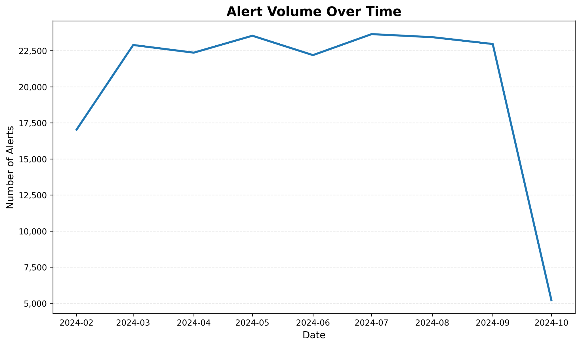
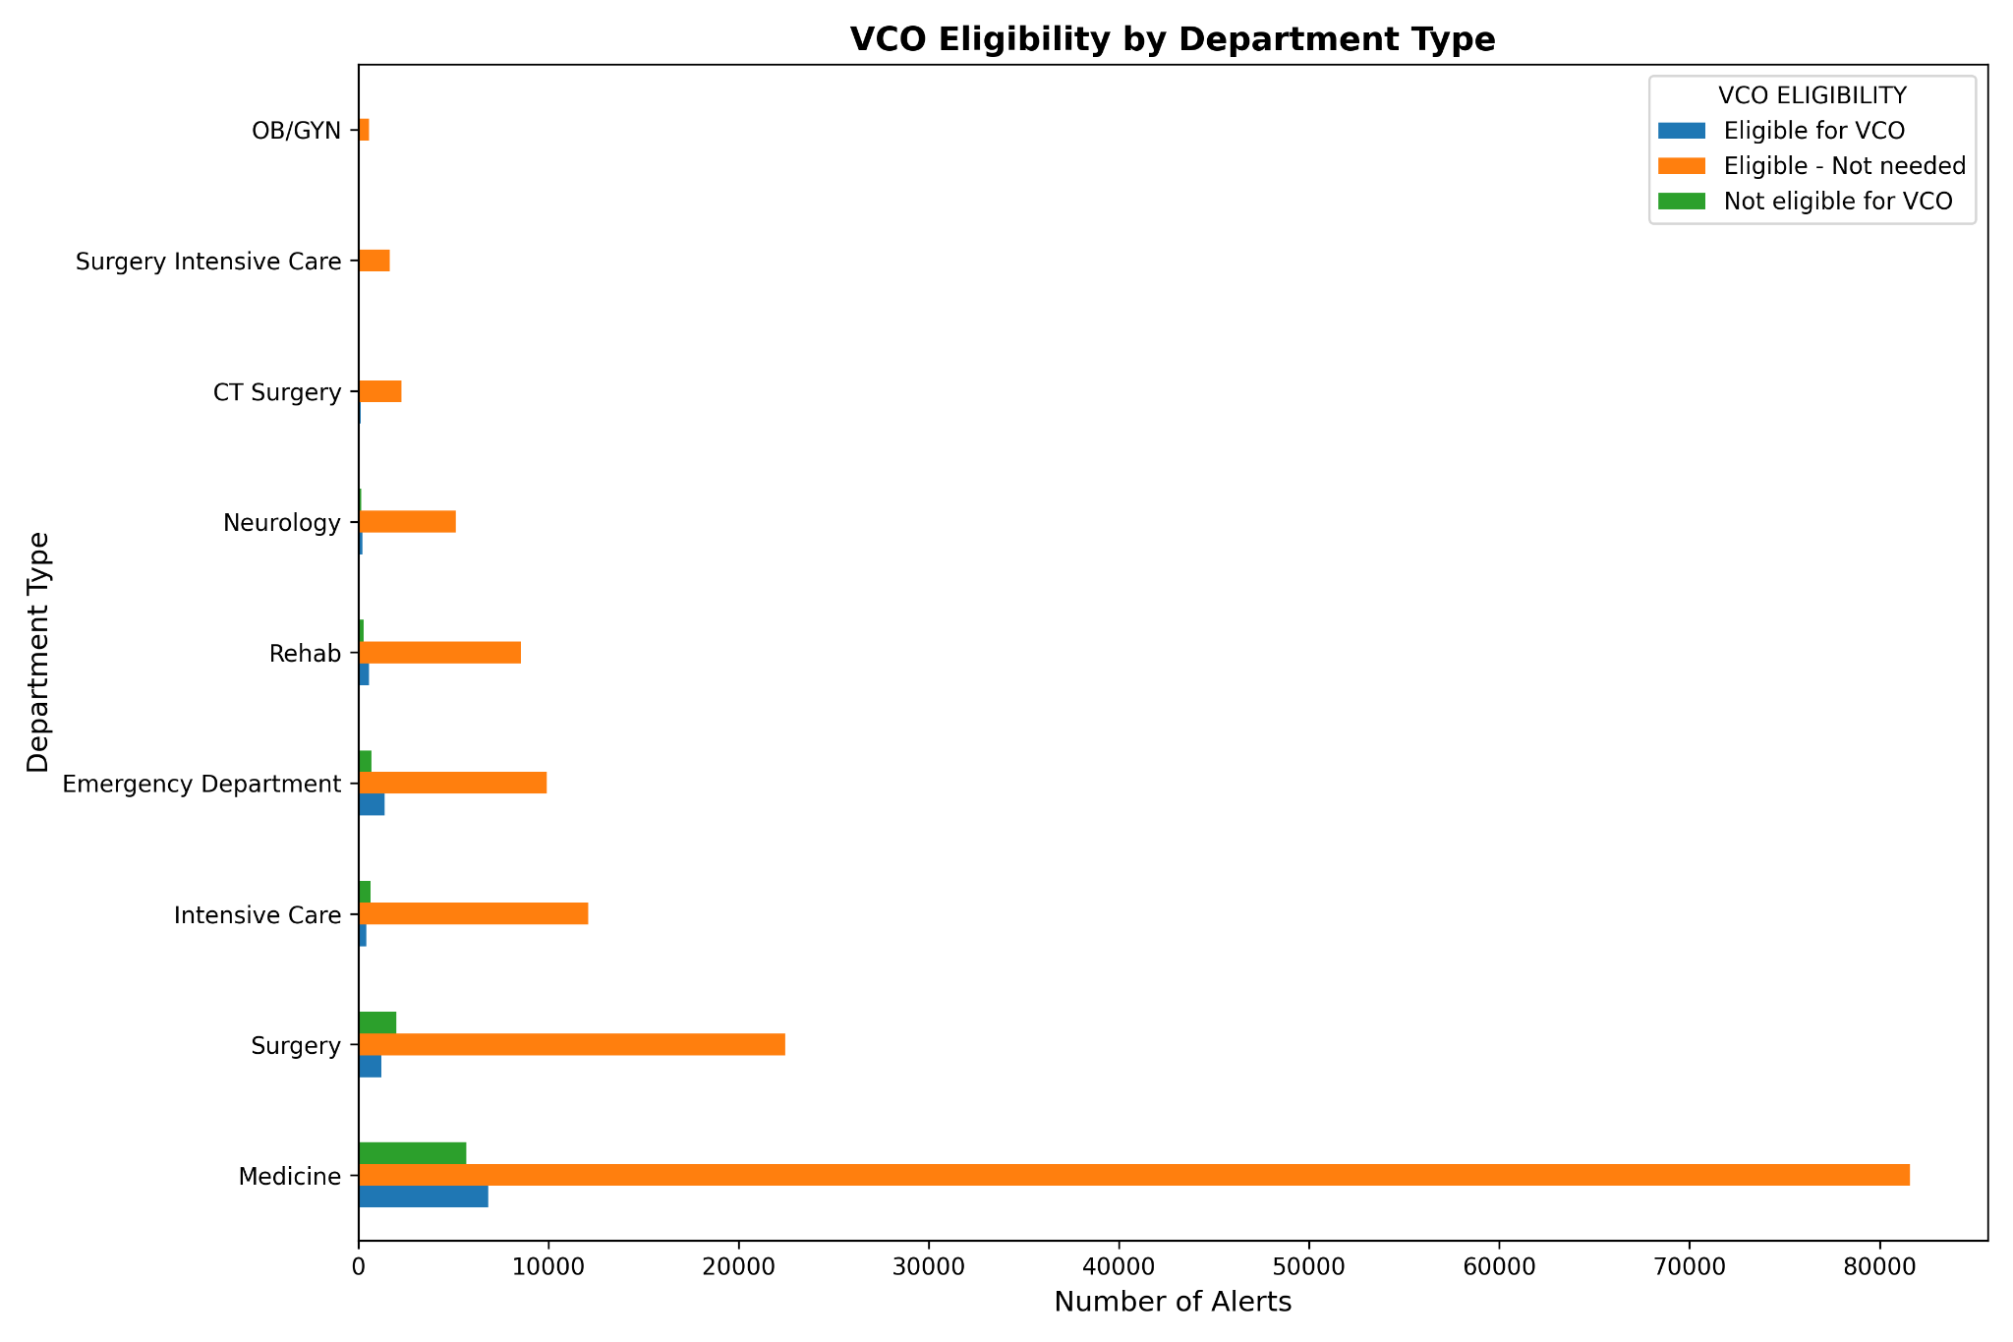
Initial Review of VCO Firing Report Dataset
Fig 1. Alert Firing Volume Over Time
Fig 2. VCO Eligibility Distribution
Scope: Analyzing VCO clinical decision support tool performance across 4 NYU Langone locations from Feb 2024 to Oct 2024.

Slide 5
Key Takeaways: Exploratory Data Analysis
Metric | Value
Total Alert Records | 183,246
Unique Patients | 33,636
Unique Alert Recipients | 3,484
Clinical Departments | 10
Date Range | Feb 7th - Oct 7th 2024
VCO Eligibility
Eligible for VCO | 5.9% (10,838 alerts)
Eligible - Not needed | 78.7% (144,295 alerts)
Not eligible for VCO | 5.2% (9,598 alerts)
Unclassified | 10.1% (18,515 alerts)

Slide 6




Evaluation: Usability A low VCO eligibility rate is discovered despite CDS intervention
Mathematical Formula (Overall Eligibility Rate)
$ER=(\frac{E}{A} )×100$%
ER = Eligibility Rate
E = Eligible alerts = $\sum_{i=1}^{A}{I({VCO Eligibility}_{i}=”Eligible for VCO”}$)
i=1 means true
A = Total alerts = len (firing report)
Overall Eligibility Rate | 5.9%
Not Eligible for VCO
Eligible - VCO
Mathematical Formula (Overall Response Rate)
$\text{Positive} \text{Rate}\text{ = }\frac{\sum_{i=1}^{\text{A}}{I(R_{i}=“Eligible for VCO”)}}{A}$ x 100%
R= Response for the i-th alert
A = Total alerts = len (firing report)
$\text{N}\text{egative} \text{Rate}\text{ (1)= }\frac{\sum_{i=1}^{\text{A}}{I(R_{i}=“Not Eligible for VCO”)}}{A}$ x 100%
$\text{N}\text{egative} \text{Rate}\text{ (2)= }\frac{\sum_{i=1}^{\text{A}}{I(R_{i}=“Eligible −No Needed”)}}{A}$ x 100%
Eligible - No Needed
Notes:
Looking at our mathematical approach, we calculated the Overall Eligibility Rate using a straightforward formula where we divide eligible alerts by total alerts and multiply by 100%. As you can see in the formula, E represents the sum of all instances where VCO Eligibility equals 'Eligible for VCO,' and A represents our total alerts from the firing report. This calculation yielded an Overall Eligibility Rate of just 5.9%, indicating that only a small fraction of alerts resulted in patients being deemed eligible for venous catheter placement.
Moving to response rates, we've broken down clinician interactions with the CDS tool into three distinct categories. The Positive Rate formula measures instances where providers agreed with the 'Eligible for VCO' recommendation. Our two Negative Rate formulas capture different types of override responses: Negative Rate 1 represents when providers explicitly marked patients as 'Not Eligible for VCO,' while Negative Rate 2 captures a more nuanced response where providers acknowledged eligibility but determined the catheter was 'Not Needed' for clinical reasons.
The pie chart visualization tells a compelling story about how this tool functions in clinical practice. Only 6% of alerts resulted in positive agreement with VCO placement, while 5% were deemed not eligible. Most strikingly, 79% of alerts fall into the 'Eligible - No Needed' category, suggesting that while patients technically met eligibility criteria, clinicians determined catheters weren't clinically necessary in the vast majority of cases.

Slide 7
Evaluation: Usability
VCO Positive Alert
VCO Negative Alert
Total Alerts
High Volume Departments: TH EMERGENCY DEPT, LB 4500, and LI NW 1 EMERGENCY DEPT generate the most alerts (6,000+), but their response patterns differ dramatically
LB 4500 demonstrates the highest number of positive actions (1,180) while maintaining a favorable positive-to-negative ratio (1.83:1). In contrast, LI NW 3 NP 3800 has more negative than positive responses (585 vs. 232).
644
464
436
213
232
271
271
128
259
100
202
TH EMERGENCY DEPT
LB 4500
LI NW 1 EMERGENCY DEPT
LB 4900
LI NW 3 NP 3800
TH 16 WEST
LI NW 4 GP 4100
LI NW 6 HP 6500
LI NW 3 MB 3200
TH KP 17
Notes:
The positive to negative ratio represents how frequently clinicians follow CDS recommendations compared to dismissing them. It's calculated by dividing the number of positive actions (when providers accept and act on alerts) by negative actions (when alerts are dismissed or ignored).
This ratio serves as a key indicator of CDS tool effectiveness and clinical workflow integration:
Ratio > 1: More alerts are accepted than rejected (good integration)
Ratio = 1: Equal acceptance and rejection
Ratio < 1: More alerts are rejected than accepted (possible alert fatigue)

Slide 8
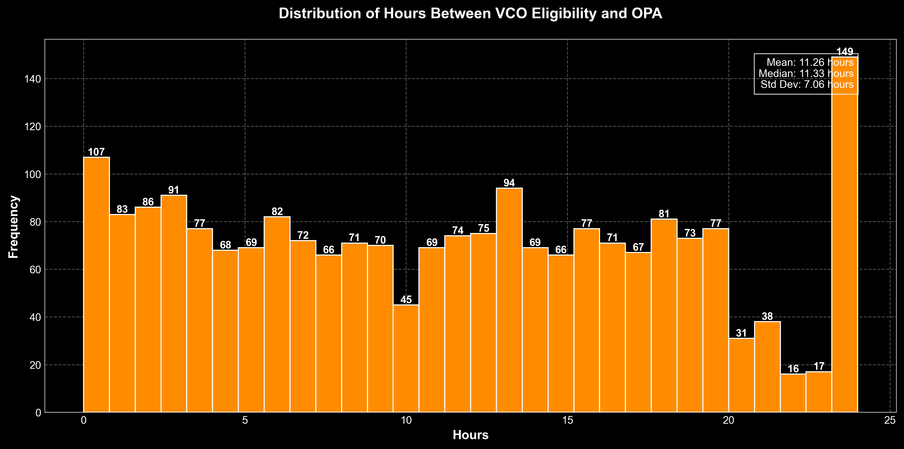
Performance Analysis: VCO Decision Hours
Notes:
As you can see in this orange histogram, we've analyzed 2,131 venous catheter orders from February through October 2024. The distribution shows considerable variation in response times, with several notable patterns. The left side of the chart shows a prominent peak, indicating a substantial number of rapid responses, while the rightmost bar represents cases that approach or reach the 24-hour mark – our maximum observed delay.
Our analysis reveals that providers take an average of 11.3 hours to acknowledge venous catheter orders after eligibility is established. This response time varies considerably, with a standard deviation of approximately 7 hours. The fastest responses occur immediately (0 hours), while the slowest reach our cutoff threshold of 24 hours.
The distribution shows a clear quartile breakdown:
25% of orders are acknowledged within 5 hours
50% are acknowledged within 11.3 hours (our median)
75% are acknowledged within 17 hours

Slide 9
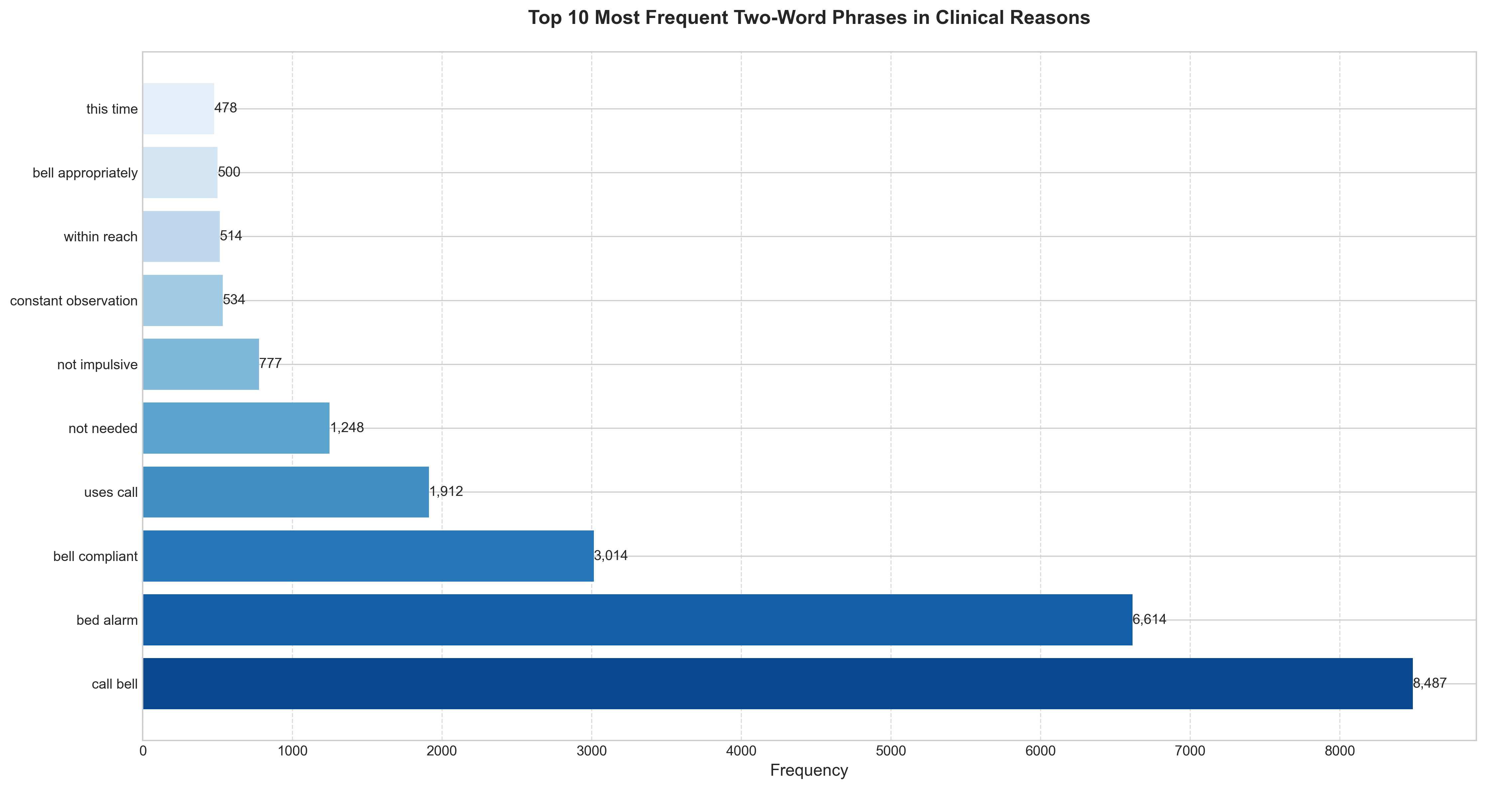
User Feedback Assessment: Bigram Analysis
Use NLTK (Natural Language Toolkit)
Example: "high fall risk" becomes two bigrams: ("high", "fall") and ("fall", "risk")
Apply it on ”Acknowledgement Reason Comment”
9

Slide 10
Feedback Assessment:
Clinical Reason Pattern Analysis
No | Phrases | Frequency | Rate | Example
1 | bed alarm | 1,049 | 3.40% | bed alarm
2 | call bell compliant | 1,038 | 3.36% | call bell compliant
3 | bed alarm on | 987 | 3.20% | bedbound. bed alarm on.
4 | not needed | 812 | 2.63% | not needed
5 | pt call bell compliant | 550 | 1.78% | Pt call bell compliant
6 | on co | 465 | 1.51% | on CO
7 | pt on co | 445 | 1.44% | pt on CO
8 | family at bedside | 367 | 1.19% | family at bedside
9 | not impulsive | 302 | 0.98% | not impulsive
10 | bed alarm in place | 290 | 0.94% | bed alarm in place
11 | uses call bell | 279 | 0.90% | uses call bell
12 | pt compliant with call bell | 207 | 0.67% | pt compliant with call bell
13 | not needed at this time | 191 | 0.62% | not needed at this time
14 | bed alarm activated | 185 | 0.60% | bed alarm activated
15 | pt on bed alarm | 180 | 0.58% | pt on bed alarm
16 | pt alert and oriented | 166 | 0.54% | pt alert and oriented
17 | oriented to own ability | 164 | 0.53% | Oriented to own ability
18 | on bed alarm | 153 | 0.50% | on bed alarm
19 | bed alarm set | 152 | 0.49% | bed alarm set
20 | aox4 | 150 | 0.49% | AOx4. Uses call bell. Bed alarm on.
Notes:
The analysis highlights three key patterns in clinical documentation related to fall prevention protocols. Dominant safety measures emerge through frequent mentions of **bed alarms** (7.6% of notes, **2,346 instances**), particularly variations like **"bed alarm on"** (3.2%) and **"bed alarm activated"** (0.6%), alongside **call bell compliance** (5.2%, **1,603 cases**), often phrased as **"call bell compliant"** (3.4%) or **"uses call bell"** (0.9%). Common overrides appear driven by clinician judgment, with **2.6% of cases** (**812 instances**) explicitly stating interventions were **"not needed"**—sometimes qualified as **"not needed at this time"** (0.6%)—while **1.2% cite family support** (**"family at bedside"**). Cognitive status documentation reveals standardized phrasing, including **"alert and oriented"** (0.5%) and **impulsivity assessments** (**"not impulsive"**) in nearly 1% of cases. These patterns suggest **strong protocol adherence** for mechanical safeguards, while also identifying opportunities to **refine CDS alert criteria** through better integration of **family presence assessments** and **temporal clinical context**.
The clinical documentation patterns reveal critical insights for system optimization: **Protocol adherence** is evident through frequent bed alarm documentation (7.6% of notes), though this may indicate both effective safety compliance and potential redundancy in documenting routine measures. **Alert relevance** opportunities emerge from 812 "not needed" overrides, highlighting the need to refine CDS criteria through dynamic risk stratification that accounts for temporal factors like "at this time" qualifications. Meanwhile, **workflow integration** patterns—such as the 1.4% "pt on CO" notation—expose department-specific documentation habits, suggesting opportunities for location-aware CDS adjustments that align with unit-specific workflows while maintaining standardized safety protocols across care settings. Together, these findings underscore the balance required between protocol fidelity and contextual adaptability in fall prevention systems.

Slide 11
False Positive Observation: 45.04% ”Eligible for VCO” cases are FP
Total 'Eligible for VCO' cases: 131 Potential false positives found: 59 False positive rate: 45.04%
Case 1: Department: LI NW 3 NP 3800 [1084001027] Trigger Date & Time: 2/17/2024 Acknowledgement Reason: Eligible for VCO Comment: pt Alert and oriented x4. VCO not needed
Feedback Report.csv
(Department,
Trigger Date & Time,
Acknowledgement Reason,
Acknowledge Reason Comment)
Filter Eligible Cases
Identify Potential False Positive
Define Negative Language Detector
Notes:
Data Scope:
Analyzed 131 cases where the CDS tool flagged patients as ‘Eligible for VCO’ between February and October 2024.
Focused on clinician comments to understand why recommendations were rejected.
Detection Process:
Step 1: Isolated all cases labeled ‘Eligible for VCO’ in the dataset.
Step 2: Scanned comments for negative language like ‘not needed’, ‘unnecessary’, or ‘contraindicated’ using automated pattern matching.
Step 3: Flagged cases where clinicians explicitly contradicted the CDS recommendation.
Calculation:
False Positive Rate = (Flagged Cases / Total Eligible Cases) × 100
45% of ‘Eligible’ recommendations were potentially incorrect based on clinician feedback.
This suggests nearly 1 in 2 alerts may require refinement to better align with clinical judgment.
Department-Level Insights:
LI NW 3 NP 3800 had the highest volume of flagged cases.
Example Case:
“Patient alert and oriented x4. VCO not needed”
Issue: CDS recommended a venous catheter despite the patient’s stable condition and lack of clinical indication.
Common Themes in Rejections:
Unnecessary intervention (e.g., “Peripheral access already established”)
Contraindications (e.g., “High infection risk—avoid central line”)
Clinical judgment override (e.g., “Not appropriate for this patient’s care plan”)
Implications
Alert Fatigue Risk: High false positive rates may lead clinicians to distrust or ignore future alerts.

Slide 12
Gap Analysis
Reanalyze the validity of Morse Fall Risk Assessment
Should be far more comprehensive
Alert should not come up every single day
High rate of “Eligible – Not Needed” selections (dominant response across all units)
Alert logic often mismatched with clinical judgment (e.g., alerting for AOx4 patients)
Response options are too limited → reliance on “See Comments”
Low engagement with comment fields → limited feedback data
High false positive rate: ~45% of VCO alerts may be unnecessary

Slide 13



Continuous Improvement Process: Enhancement Plan
Refine alert logic to include mental status & supervision
Reduces false positives; better clinical alignment
Expand dropdown options for real-world scenarios
Improves documentation clarity, reduces "See Comments"
Add tiered alert structure
Use passive alerts first, escalate only if no action is taken (supports Right Format & Right Time)

Slide 14
Key Takeaways
CDS aligns with several best practices - but lacks clinical nuance
High false positive rate undermines clinician trust and actionability
Workflow integration is strong, but alert timing and format need refinement
Based on comments, engagement improves with better response options and logic
Suggested enhancements support CDS "5 Rights" and increase long-term value

