Slide 1
Member State 1
Message1
Message3
EU portal
Message2
Message3
Member State 2
EU message exchange
MS endpoint 1
MS endpoint
MS endpoint 2

Slide 2
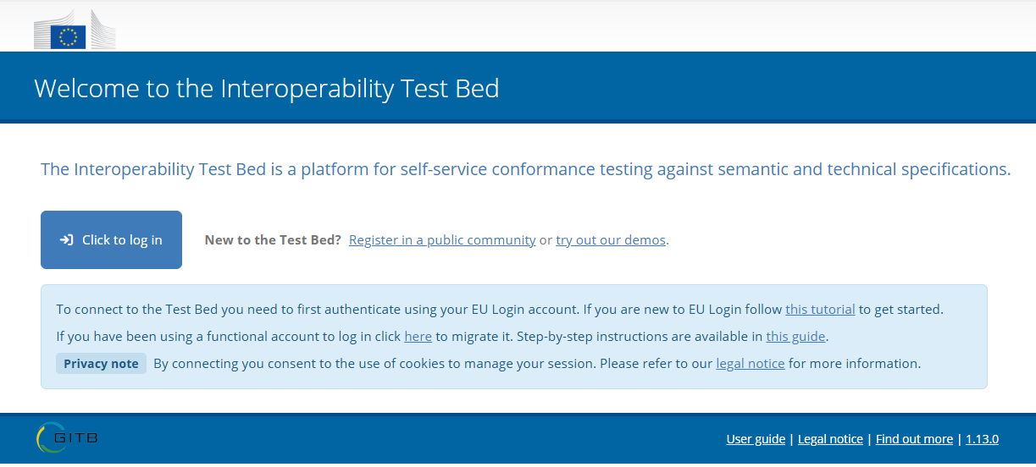

Slide 3
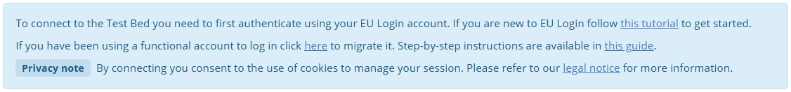

Slide 4


