Slide 1

Purpose-Built Tools for Clinical Research in Emerging Infectious Diseases
Esteban Garcia Gallo
ISARIC, Pandemic Sciences Institute, University of Oxford, UK

Slide 2
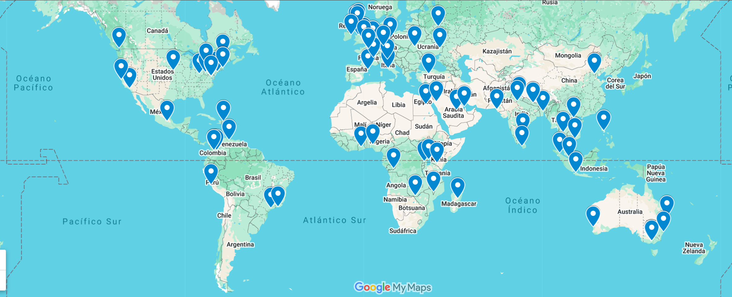

ISARIC
A global federation of clinical research networks providing a coordinated and agile research response to outbreaks.
70 network members across
133 countries over
14 years
WHO?
ISARIC
To generate and disseminate clinical research evidence, whenever and wherever infectious disease outbreaks occur or are a threat.
WHY?
Prepare: standardised protocols, CRFs and pre-approvals
Collaborate: inter-pandemic
Integrate: clinical research into public health response
Share: resource-adaptable tools, expertise and data
Trust: built up over years
HOW?

Slide 3
Global Data Infrastructure for Reliable Clinical Research
Effective and rapid outbreak response depends on timely, high-quality, and well-structured clinical data.
Systematic data design: Our tools help make research more efficient. The platform encourages a structured, modular approach to data collection, reducing complexity and creating consistency across diseases and settings.
Integrated data lifecycle: Evidence-Based, Data-Driven, and Expert-Developed. Data moves through a connected process where insights from collection, design, and analysis reinforce one another, strengthening the system over time.
Human-in-the-loop learning: Shaped by real users and real outputs. Clinicians, researchers, and data specialists contribute continuously, ensuring that methods and tools remain practical, relevant, and grounded in real-world needs.
Global diversity: Supporting higher-quality research. By drawing on data and perspectives from multiple contexts, the platform promotes more robust, fair, and generalisable findings.

Slide 4
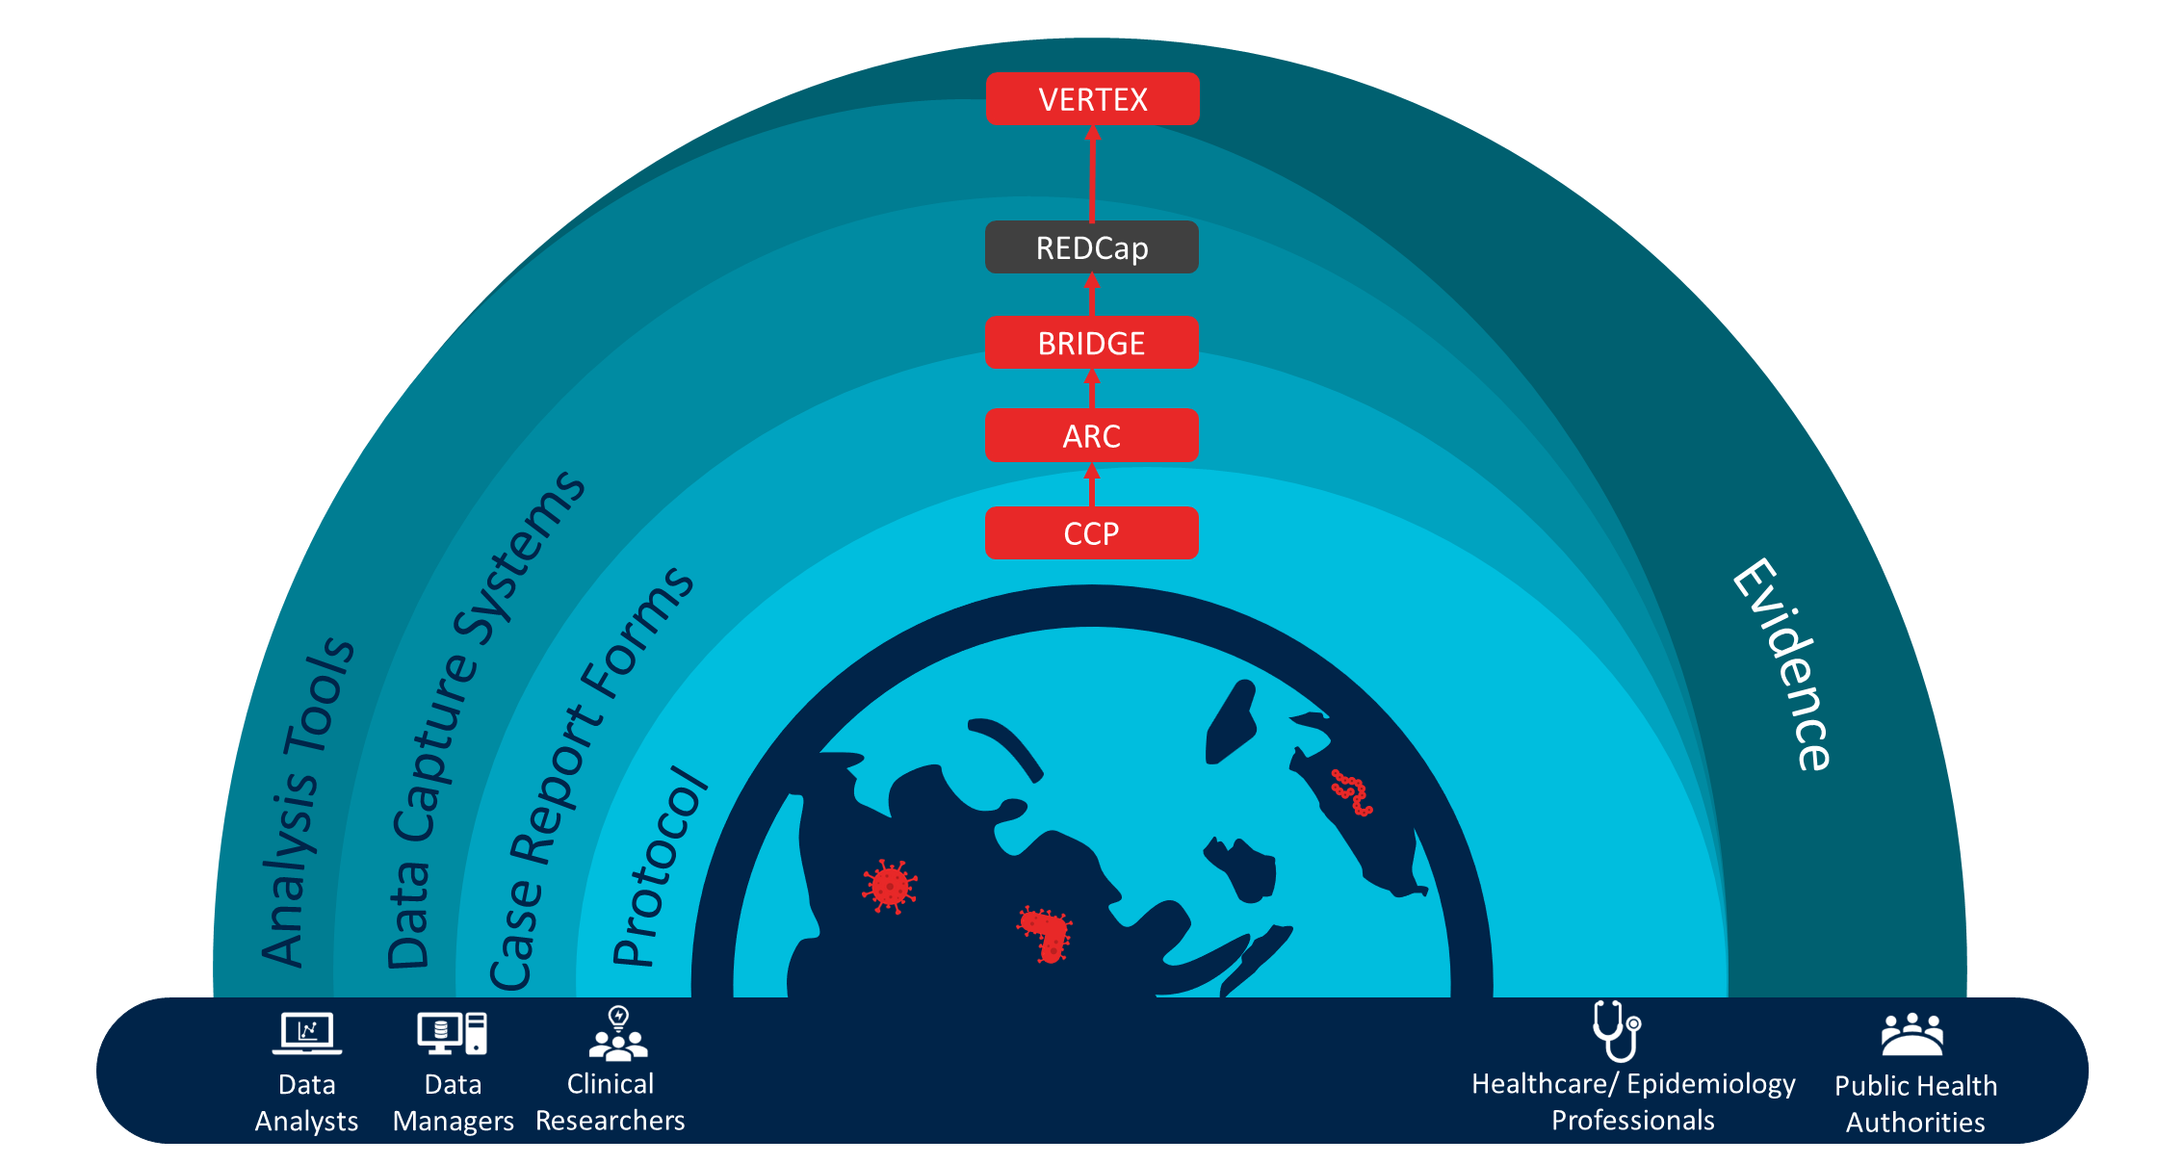
ISARIC clinical epidemiology platform
VERTEX
REDCap
BRIDGE
ARC
CCP
Notes:
At the foundation there is a protocol called CCP which is the ethics approved document which defines research questions addressed and how we answer them
Then the Data tools that enable to operationalise the CCP and ensure standardized high quality data collection and reproducible analytical workflows for diverse outbreak scenarios.
The data tools include :
ARC and BRIDGE to use Case report forms created with a community driven approach on which data should be collected to answer research questions and adapt them to the needs and the context of the research team.
REDCap the Data Capture System to collect CRF data hosted either directly by the local research team etiher by Oxford
VERTEX the analysis toolkit for rapid analysis of the data to share the information to the clinicians and policy makers
Leads to generate evidence that will inform the public health response.

Slide 5
ISARIC clinical epidemiology platform
How to analyse better
VERTEX
REDCap
BRIDGE
How to capture better data
ARC
CCP
Notes:
At the foundation there is a protocol called CCP which is the ethics approved document which defines research questions addressed and how we answer them
Then the Data tools that enable to operationalise the CCP and ensure standardized high quality data collection and reproducible analytical workflows for diverse outbreak scenarios.
The data tools include :
ARC and BRIDGE to use Case report forms created with a community driven approach on which data should be collected to answer research questions and adapt them to the needs and the context of the research team.
REDCap the Data Capture System to collect CRF data hosted either directly by the local research team etiher by Oxford
VERTEX the analysis toolkit for rapid analysis of the data to share the information to the clinicians and policy makers
Leads to generate evidence that will inform the public health response.

Slide 6
How to capture better data

Slide 7

ISARIC CCP ARChetype Case Report Forms
ARChetype CRFs
Haemorrhagic Febrile Infections
Arboviral Infections
Brain Infections
Mucocutaneous Infections
Respiratory Infections
Syndromic
Disease Specific
Arbovirus – Community
Oropouche
Chikungunya
Yellow fever
Dengue
Standardised, outbreak-ready CRFs that capture harmonised, high-quality clinical data and align directly with ISARIC analytical pipelines.
Expert-informed and question-driven, built around core clinical research questions and maintained as a growing library that responds to ISARIC member needs and global health priorities.
ISARIC CCP ARChetype CRF Creation Guidelines

Slide 8
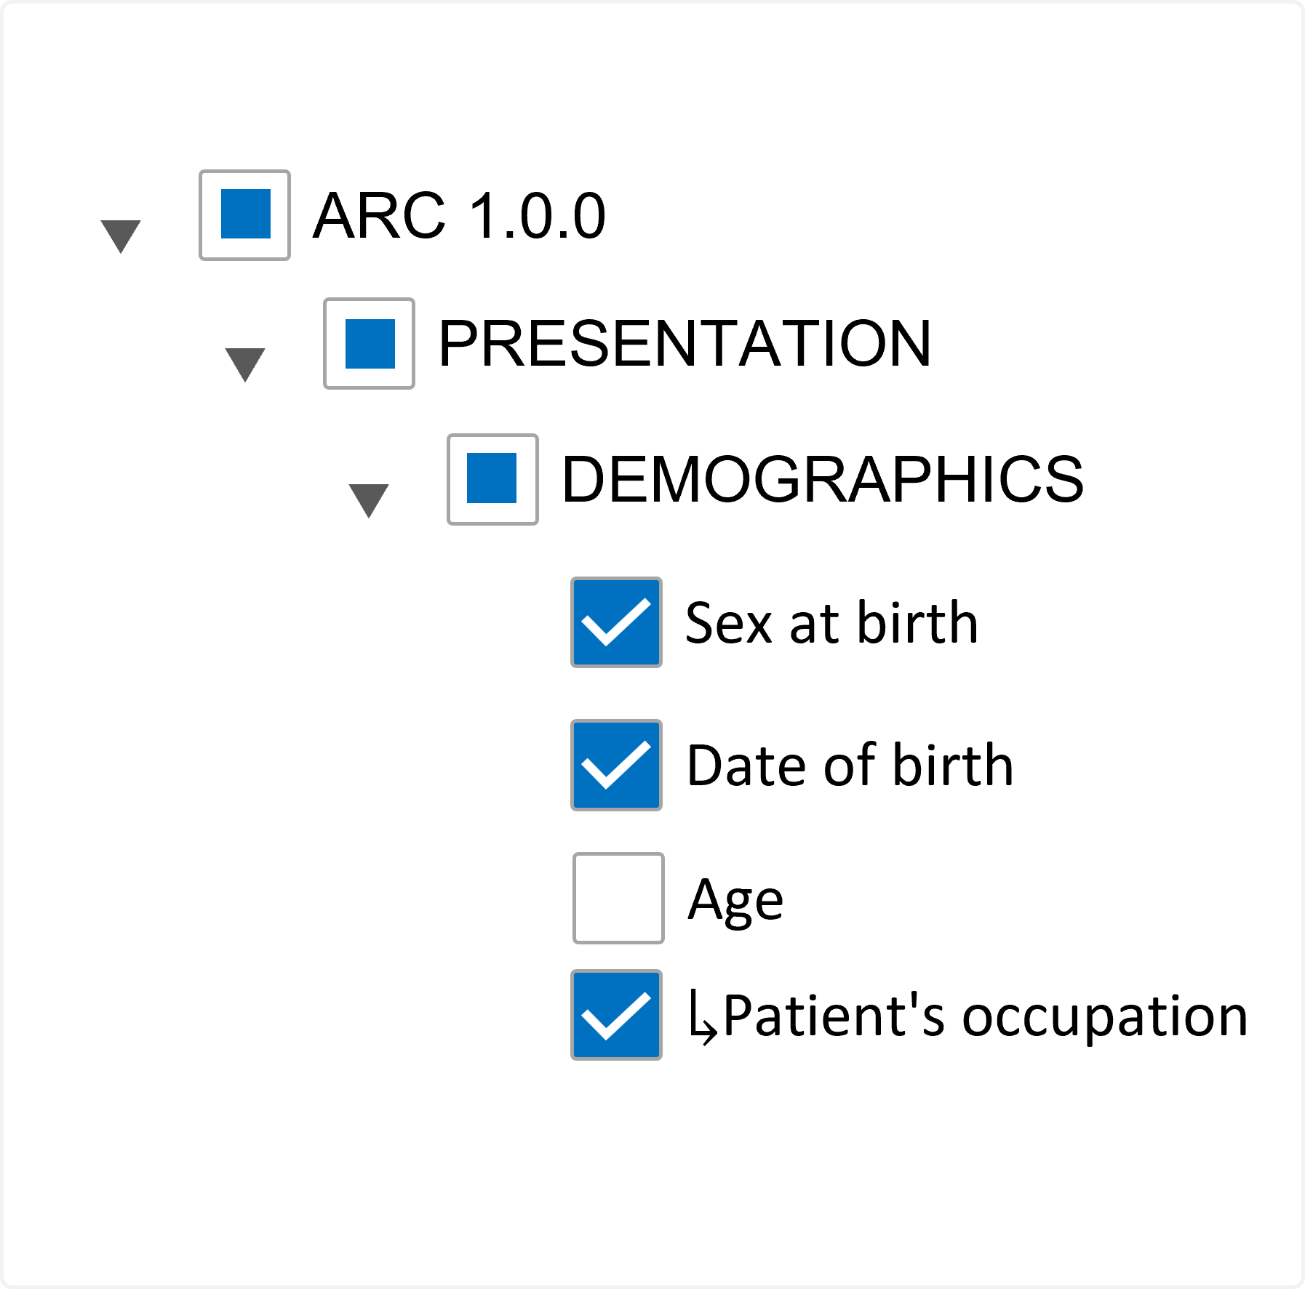
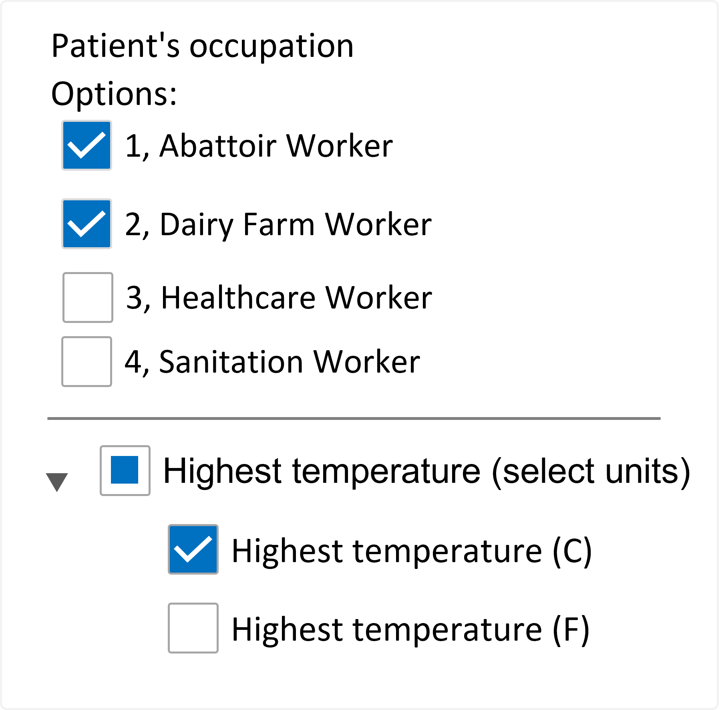
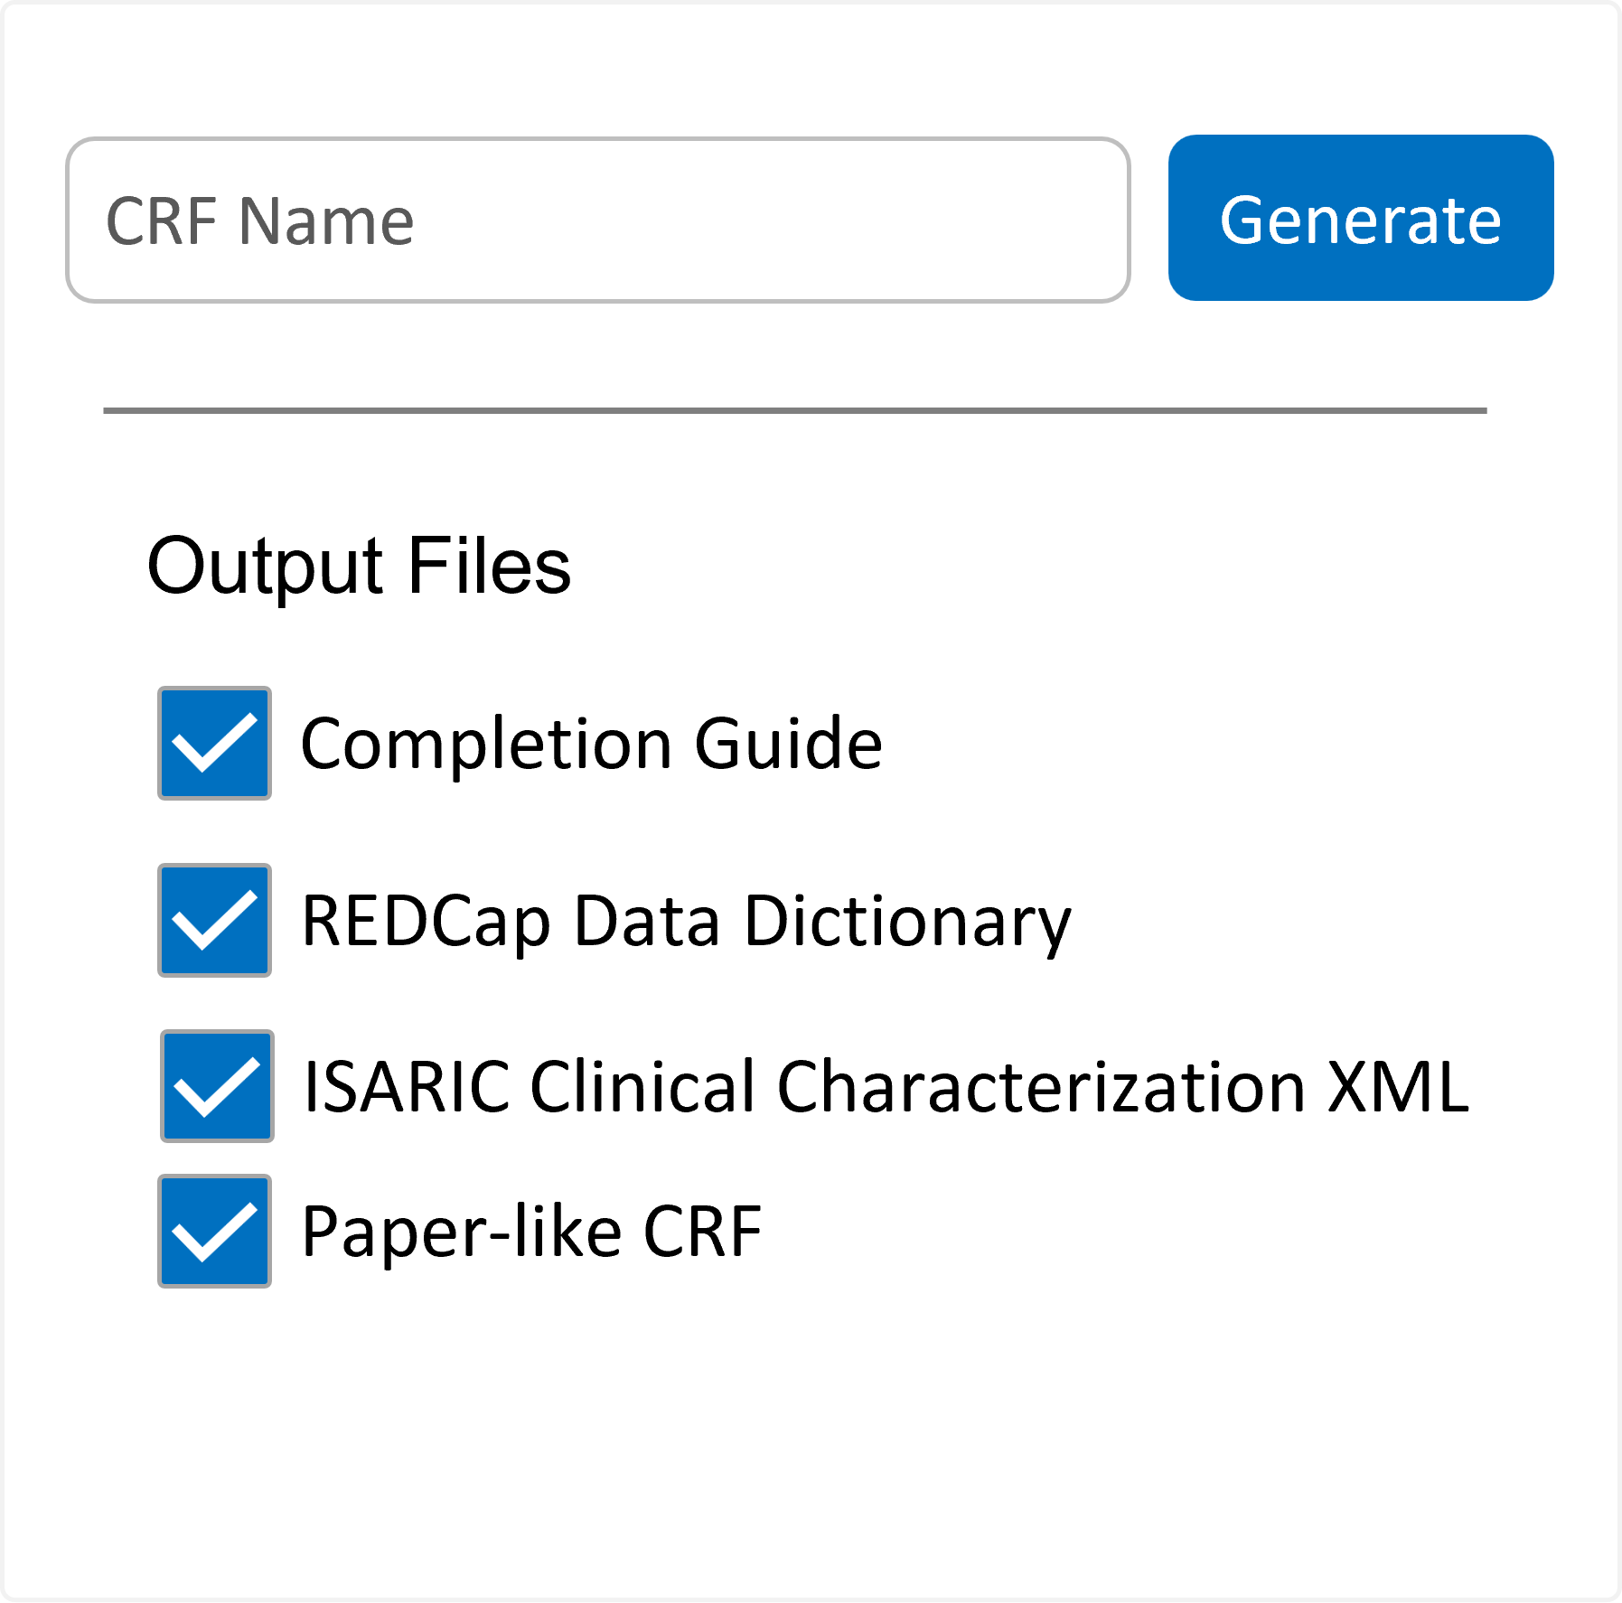
BRIDGE (BioResearch Integrated Data Tool GEnerator)
BRIDGE is developed to operationalize ARC by providing a customizable web-based tool for generating CRFs tailored to specific outbreaks or research contexts.
Choose
Customize
Capture
BRIDGE (isaric-bridge.replit.app)

Slide 9
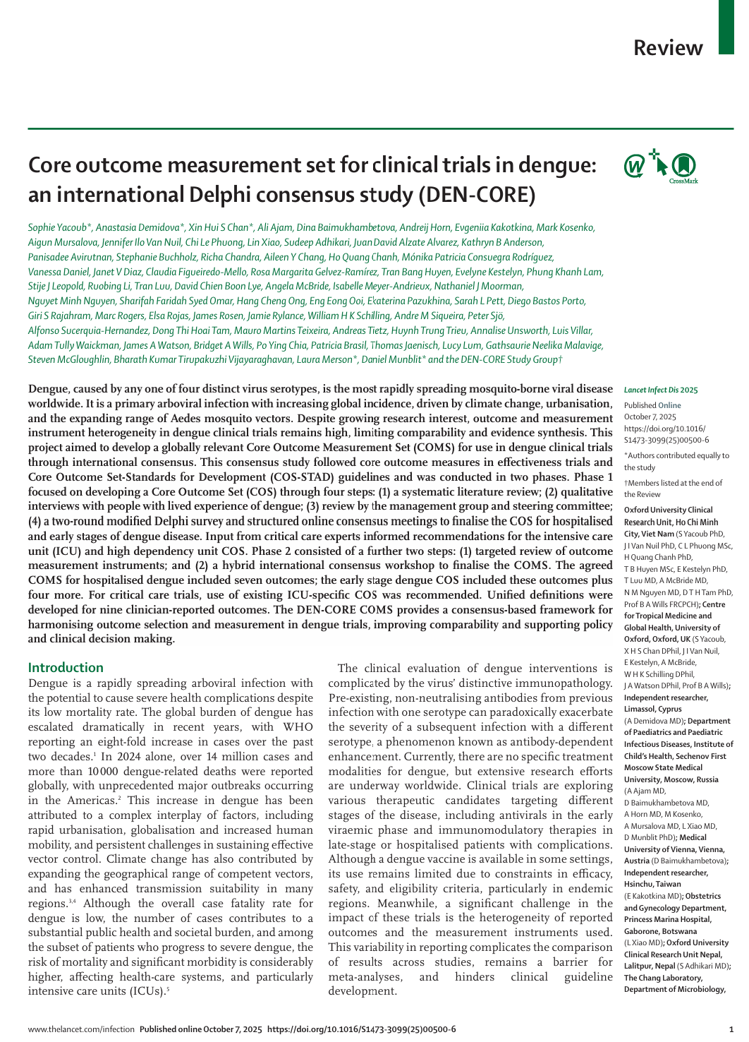
Consensus processes
DENCORE study has developed the first global Core Outcome Set for dengue clinical trials
https://bridge.isaric.org/main/?param=Recommended%Outcomes_Dengue

Slide 10
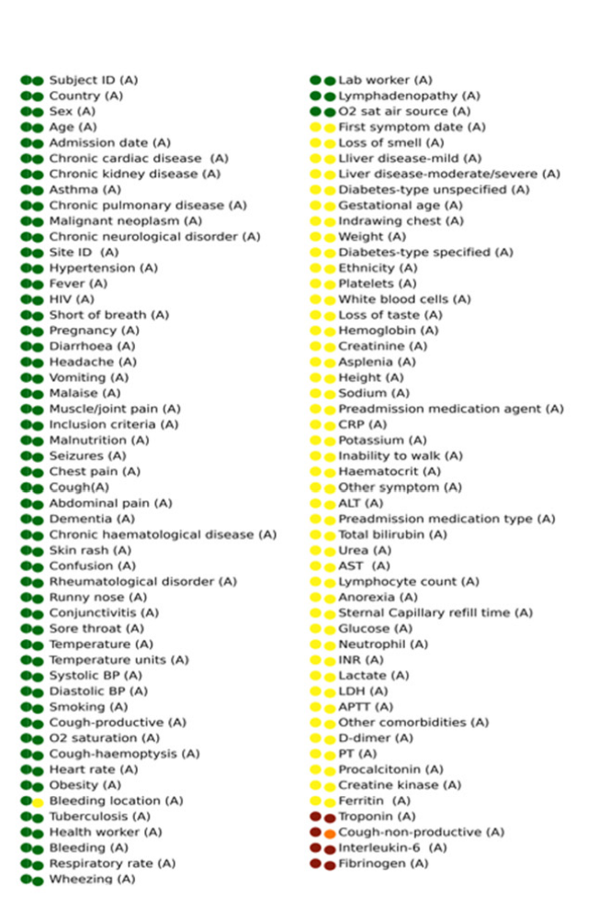

Optimising Clinical Epidemiology in Disease Outbreaks
Data-driven analysis of ISARIC-WHO COVID-19 CRFs (from 950,000 patients across 1,886 hospitals) shows consistent global priorities in field inclusion and completion, guiding the modular, streamlined design of future standardised clinical forms to accelerate high-quality evidence generation in outbreaks.

Slide 11
Improving Data Capture Projects
Bias Detection at Data Capture
This project identifies systematic differences in data completeness and variable availability across demographic groups, sites, and regions before analysis begins. It evaluates whether targeted data augmentation and rebalancing strategies can mitigate capture-related bias, providing evidence-based guidance for CRF redesign and more equitable, representative data collection workflows.
Definition Drift Monitoring
This project monitors how the meaning and operationalisation of clinical variables change over time due to evolving practice, protocols or evidence. By detecting and versioning definition drift, it preserves longitudinal consistency and ensures that variables remain interpretable and comparable across waves, variants, and outbreak phases.

Slide 12
How to analyse better

Slide 13
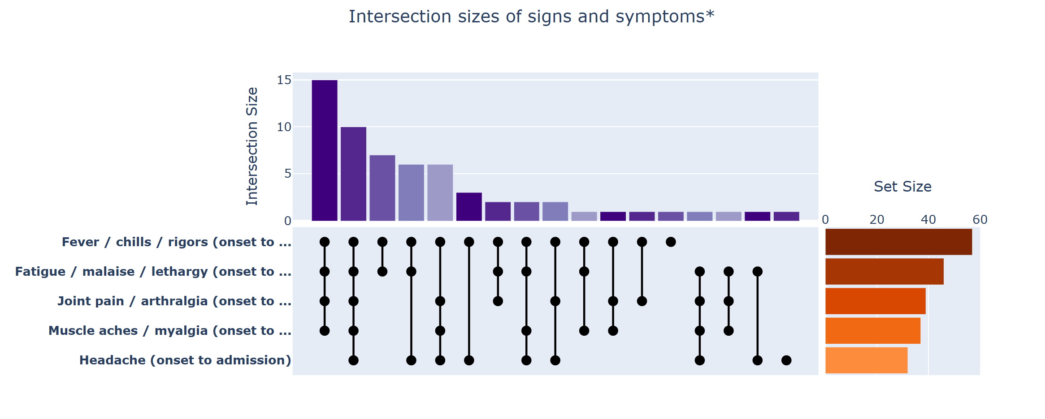
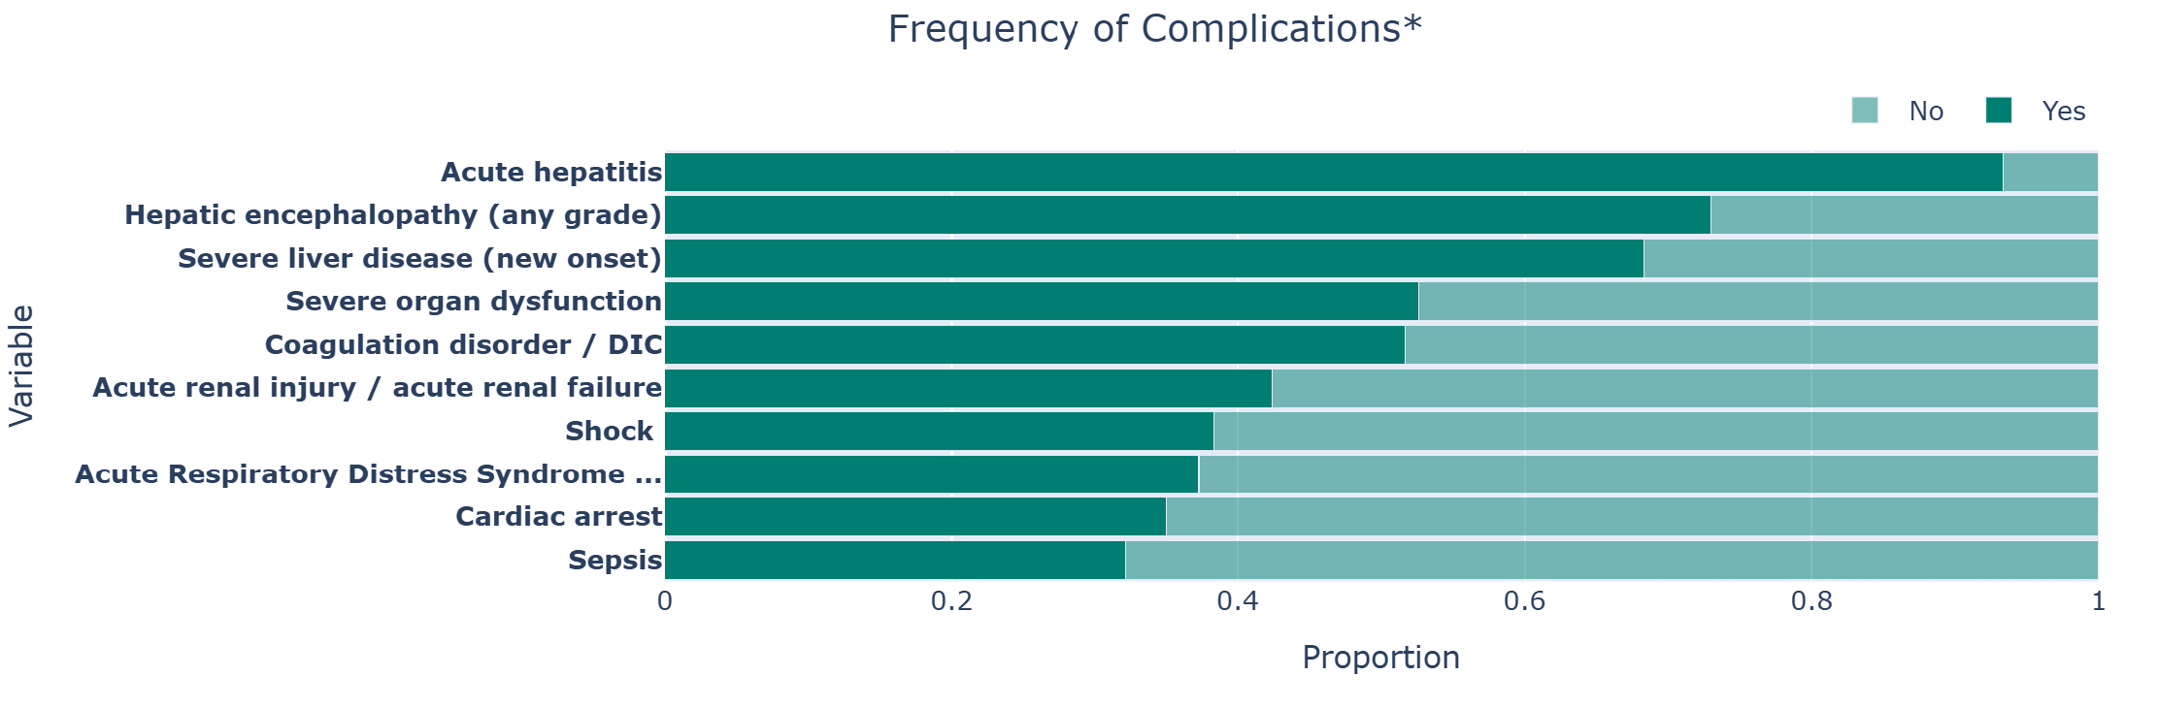

Yellow Fever (Colombia)
Output files
Aggregated IP files
CRFs
Analysis Tools
ARC
VERTEX
BRIDGE
Data Capture
Output files
Data capture schema xml, REDCap data dictionary
REDCap

Slide 14
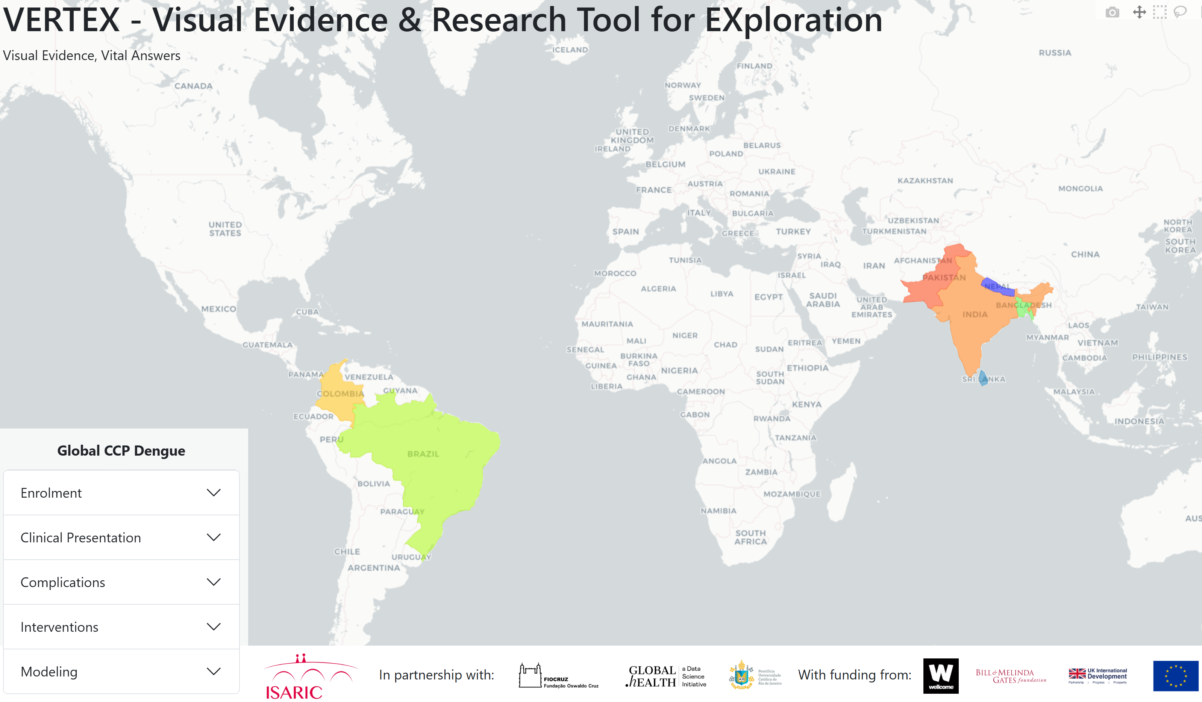
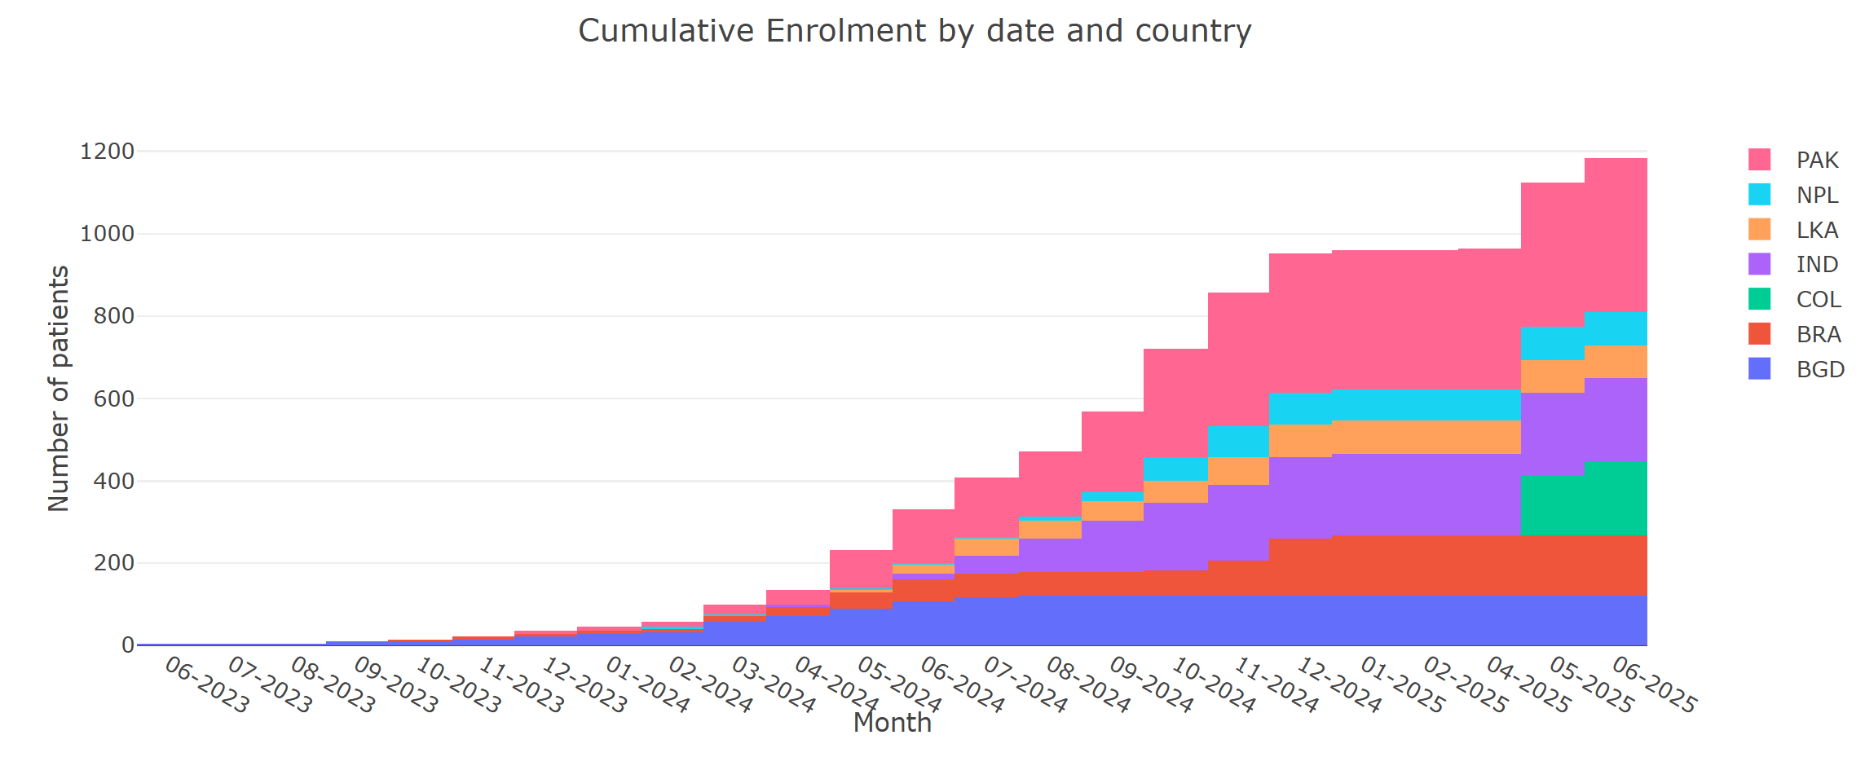
Dengue CCP
Output files
Aggregated IP files
CRFs
Analysis Tools
ARC
VERTEX
BRIDGE
Data Capture
Output files
Data capture schema xml, REDCap data dictionary
REDCap
ISARIC Global Dataset
Partner Analysis Schema

Slide 15
Supporting Higher-Quality Clinical Research

Slide 16
Supporting Higher-Quality Clinical Research
Consistent and harmonised data collection across sites and diseases.
Continuous data quality assurance from capture to analysis.
Expert- and evidence-informed design that evolves with real-world use.
Robust governance and reproducible analytics for fairness and transparency.
Integration of diverse, multi-country data to produce more reliable, generalisable insights.
Facilitates collaboration and shared learning, ensuring that contributors benefit from global outputs.

Slide 17
Initial Projects
Characterization of arbovirus disease over time
Explainable AI Mortality and severity prediction modelling for arbovirus
One Health Determinants of Community-Acquired Pneumonia
Federated learning methods evaluation
Evidence shift over different time

Slide 18




THANK YOU
GRACIAS
Find Out More
Visit www.isaric.org for outputs and updates
Contact: data@isaric.org

