Slide 1
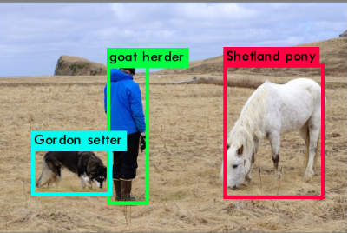
YOLO9000: Better,Faster,Stronger

Slide 2
内容
模型概览
yolo9000的主要思路
相关实验
分析与收获

Slide 3
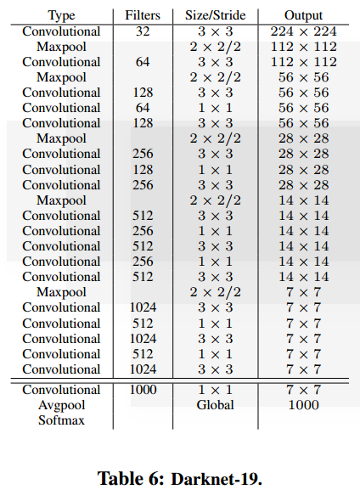
模型概览
Yolo 9000

Slide 4
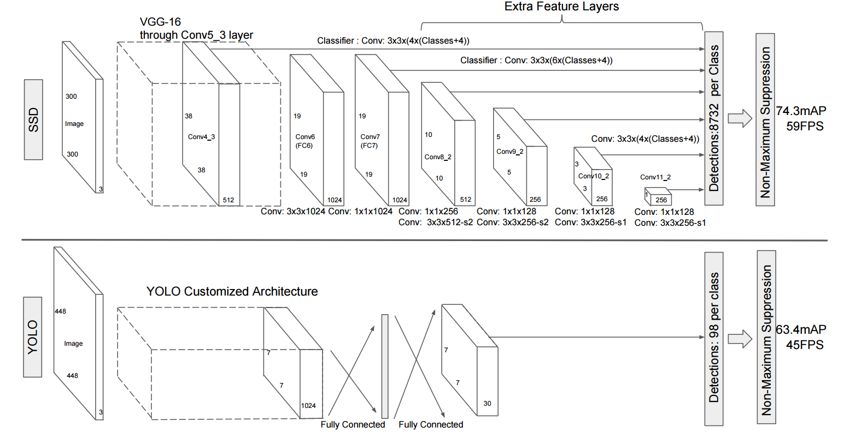
模型概览

Slide 5
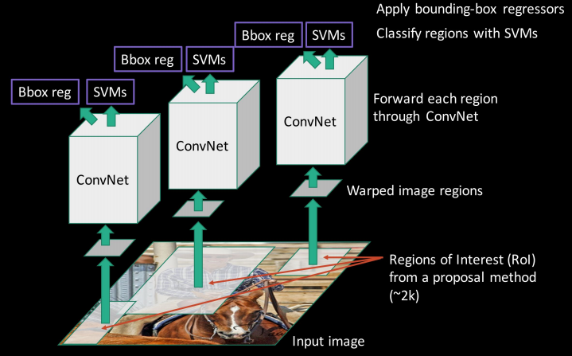
模型概览
RCNN

Slide 6
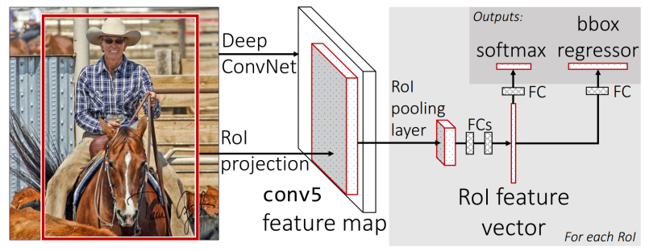
模型概览
Fast RCNN

Slide 7
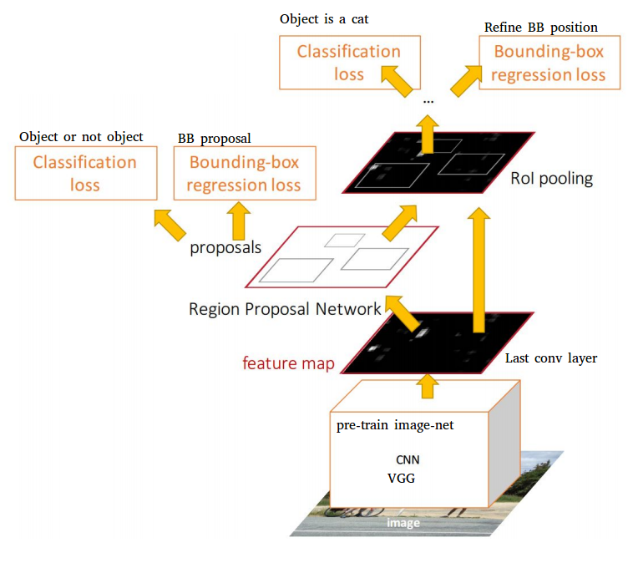
模型概览
Faster RCNN

Slide 8
主要思路
YOLO suffers from a variety of shortcomings relative to state-of-the-art detection systems. Error analysis of YOLO compared to Fast R-CNN shows that YOLO makes a significant number of localization errors. Furthermore, YOLO has relatively low recall compared to region proposal-based methods. Thus we focus mainly on improving recall and localization while maintaining classification accuracy.

Slide 9
主要思路
在yolo的基础上进行改进
  批量归一化 (Batch Normilization)
  高分辨率分类器(224*224 -> 448*448)
  采用基本框进行卷积 (Anchor Boxes)
  维聚类（Dimension Cluster)
  精细的特征(Fine-Grained Feature)
  多样化尺寸训练(Multi-Scale Training)
  ... (Training Methods)

Slide 10
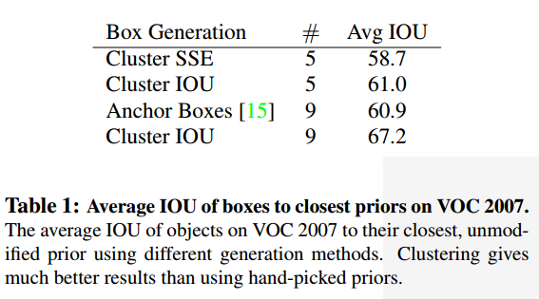
实验
维聚类（Dimension Cluster)

Slide 11
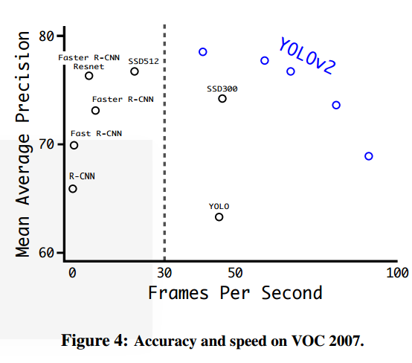
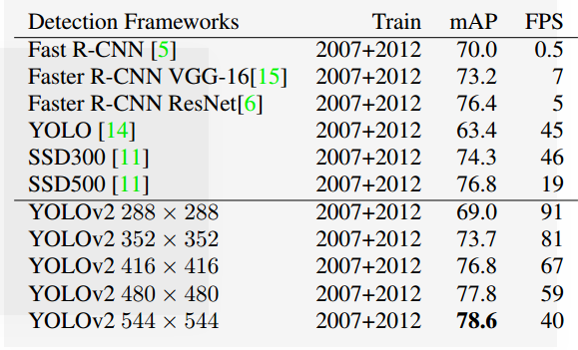
实验
VOC benchmark

Slide 12
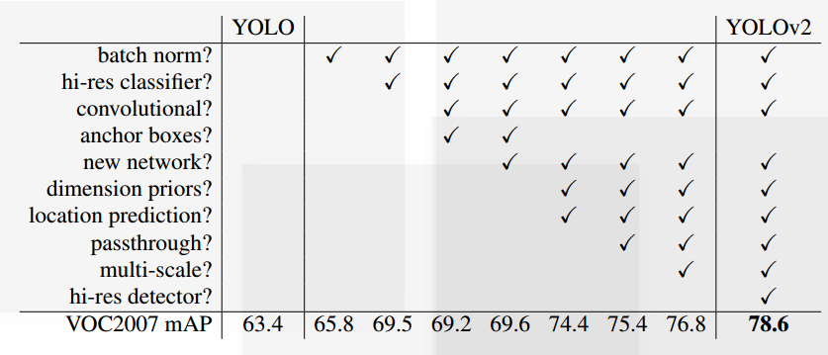
实验
Yolo --> Yolo9000

Slide 13
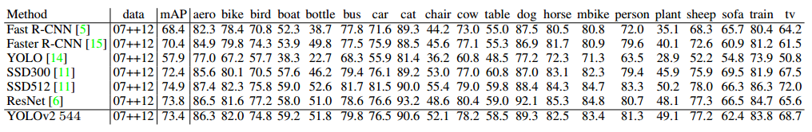
实验
PASCAL VOC2012 test detection results.

Slide 14
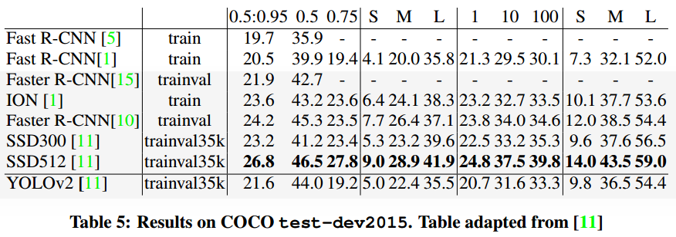
实验
Coco test-dev2015

Slide 15
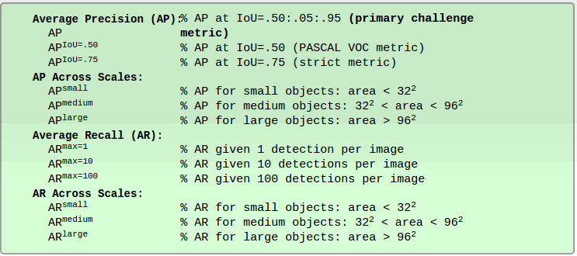
Coco test-dev2015

Slide 16
优缺点分析
优点
  更快 (70fps)
  更准确 (73.4 mAP on Pascal dataset)
  可以检测 9000 类 (yolo 是 20类)
缺点
  小物体的检测准确率及召回率都低

Slide 17
收获
精简模型结构，去除全连接层，保证模型速度
可在运行时改变输入的尺寸，对模型进行训练

