Slide 1
International Soil Carbon Network
Kathe Todd-Brown (PNNL)
ISCN co-coordinator
December 10, 2017
ISCN Hackathon, New Orleans, LA

Slide 2
Welcome!
1-1:30 pm
ISCN and introductions
A quick refresher on git forks, pulls and merges
Layout of the repository
1:30-4:30 pm
Hack the data!
4:30-5:00 pm
Wrap-up

Slide 3
International Soil Carbon Network
Leverage large scale synthesis studies to inform soil carbon understanding by:
Identify big data questions
Develop a common vocabulary around soil measurements
Harmonize soil data from surveys and experiments (both field and lab)
Lots of data in repository but hard to use.
Current data
from 30+ surveys + >50K profiles
Solution: A community open source software project to identify datasets of interest and create a collection of R scripts to harmonize that data.
K Todd-Brown: Data coordinator
http://iscn.fluxdata.org/

Slide 4
Goals of the hackathon
Identify available soil carbon data
Create open source scripts to harmonize SOC data
Develop and improve support scripts
QA/QC
Output formatting
Visualization

Slide 5
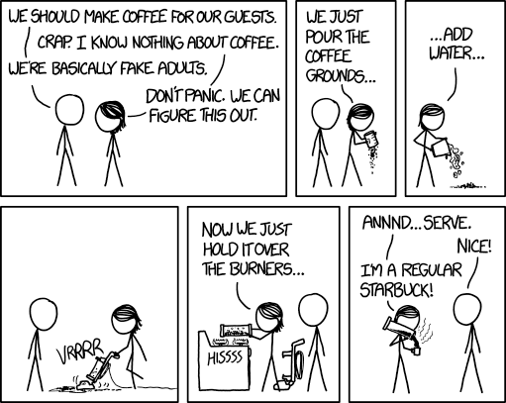
Who are you?
What is your name?
Where are you from?
Why are you here?
How do you take your coffee or tea?
https://m.xkcd.com/1743/

Slide 6


Crash course on git and R
Git
What is the difference between git and GitHub?
How do you track changes in a document using git?
What is a merge?
What is a fork and pull request?
R
Writing a function in R
Tidyverse: orientation to syntax differences from dplyr and ggplot2
Installing packages from github instead of CRAN
Rmarkdown merging documents and code

Slide 7

Git vs GitHub
Git is a way to attribute and manage changes to a text file in group projects.
GitHub is a git repository w/ features supporting collaborative projects.

Slide 8
Git: Tracking changes in a document
Start
Commit similar changes to the repository with a clever comment
Make changes in your working directory
Stage your similar changes for commit
git add green1.txt green2.txt
git commit –m ‘informative comment’
Git will associate every line change with a ’commit’ including who changed the line, when it was changes, and any informative comments they left.
More information: https://git-scm.com/book/en/v1/Getting-Started
http://swcarpentry.github.io/git-novice/

Slide 9
Git: Merging conflicts
The modified file must have the same history as the repository you are committing to otherwise you may get a merge conflict.
Modify 1
Start
Add-commit change to repository
Add-commit change to repository
Modify 2
More info: http://swcarpentry.github.io/git-novice/09-conflict/

Slide 10
Git: forks and pull requests
fork
ktoddbown/
Test_KTB
(original)
cleverPartner/Test_KTB
(original)
add-commit
ktoddbrown/Test_KTB
(no typos)
cleverPartner/Test_KTB
(no typos)
pull request

Slide 11
Crash course on git and R
Git
What is the difference between git and GitHub?
How do you track changes in a document using git?
What is a merge?
What is a fork and pull request?
R
Writing a function in R
Tidyverse: orientation to syntax differences from dplyr and ggplot2
Installing packages from github instead of CRAN
Rmarkdown merging documents and code

Slide 12
R: Functions
A function is a way to bundle a set of commands.
sayHello <- function(from=NA, to){
if(is.na(from)){
print(paste(“hello “, to))
} else {
print(paste(from, ‘says hello to’, to))
}
}
sayHello(to=‘Mary’)
sayHello(from=‘Mary’, to=‘Sue’)

Slide 13
R: Tidyverse
Tidyverse is an opinionated collection of R packages designed for data science
Pipes (%>%) take the output from the previous function and pass it as the first argument of the next.
surveys_sml <- select(filter(surveys, weight < 5),
species_id, sex, weight)
surveys_sml <- surveys %>%
filter(weight < 5) %>%
select(species_id, sex, weight)
https://www.tidyverse.org/
http://www.datacarpentry.org/R-ecology-lesson/03-dplyr.html
http://swcarpentry.github.io/r-novice-gapminder/13-dplyr/

Slide 14
R: Rmarkdown combines narrative text, code, and code outputs.
---
title: "Example"
author: "K Todd-Brown (ktoddbrown@gmail.com)"
date: "11/27/2017"
output: html_document
---
```{r setup, include=FALSE}
knitr::opts_chunk$set(echo = TRUE)
```
## R Markdown
This is an R Markdown document. Markdown is a simple formatting syntax for authoring HTML, PDF, and MS Word documents. For more details on using R Markdown see <http://rmarkdown.rstudio.com>.
When you click the **Knit** button a document will be generated that includes both content as well as the output of any embedded R code chunks within the document. You can embed an R code chunk like this:
```{r cars}
summary(cars)
```
This is the header,
it gives information about the document
and tells markdown what to do.
This is a code ‘chunk’
This is text narrative.
This is a code ‘chunk’

Slide 15
Crash course on git and R
Git
What is the difference between git and GitHub?
How do you track changes in a document using git?
What is a merge?
What is a fork and pull request?
R
Writing a function in R
Tidyverse: orientation to syntax differences from dplyr and ggplot2
Installing packages from github instead of CRAN
Rmarkdown merging documents and code

Slide 16
Demo data ingestion example.
Fork repositories from GitHub
https://github.com/ktoddbrown/soils-long-tail-recovery
Install or fork repository from GitHub
https://github.com/ktoddbrown/soilDataR
Walk through example data set
Create key
Walk through keyed data ingest function
Create example function
Example data plots
Add-commit example function to local repository
Push to your remote repository
Submit pull request to project repository

Slide 17
And go!
Data ingestion
Fork soils-long-tail-recovery
Decide if you can use the key-template function or if you need an entirely new script.
Create a new Rmd or R file in the Hackathon folder
Key out your dataset or write your script here
Make sure it loads correctly with data use comments, maybe make pretty plots
Submit a pull request!
If you brought data, you should archive it before you start hacking!
If you have questions ask, there are no stupid questions.

