Slide 1
Reduce the Amount of Push Notifications for E-commerce Apps & Paytm
PIP2001 Capstone Project
Review-1
Batch Number:ISD-02
Under the Supervision of,
Prof. A.K.Sampath
Professor / Associate Professor / Assistant Professor
School of Computer Science and Engineering
Presidency University
Roll Number | Student Name
20211ISD0030 | ARJARAPU SHABARRIESH
20211ISD0009 | A V ROHITH KUMAR
2011ISD0035 | M B V SANDDEP REDDY
Name of the Program: ISD
Name of the HoD: PALLAVI R
Name of the Program Project Coordinator: Dr./Mr./Ms./prof. Srinivas Mishra
Name of the School Project Coordinators: Dr. Sampath A K / Dr. Abdul Khadar A / Mr. Md Ziaur Rahman

Slide 2
Introduction
This project focuses on developing an AI-driven solution to minimize push notifications sent by e-commerce apps. Traditional methods often lead to excessive notifications based on schedules or triggers, causing user frustration. By analyzing user behavior and intent, the goal is to send notifications only when there is genuine intent to purchase, improving the overall user experience and engagement.

Slide 3
Literature Review
S.No | Author(s) | Title | Year | Methodology | Inferences | Merits | Demerits
1 | Smith, A., & Doe, J. | AI-Based Push Notification Reduction in E-Commerce | 2021 | Behavior analysis using machine learning | AI can predict user intent accurately for notifications | Improves user engagement | Requires large datasets
2 | Zhang, Y., & Lee, B. | Intent-Driven Notifications for Mobile Apps | 2020 | User interaction tracking and analysis | Personalized notifications increase conversion rates | Reduces notification overload | High computational cost
3 | Patel, R., & Sharma, K. | Machine Learning for Optimizing Notification Timing | 2022 | ML algorithms based on purchase patterns | ML models predict purchase intent effectively | Increases purchase likelihood | Complex model training

Slide 4
Literature Review
S.No | Author(s) | Title | Year | Methodology | Inferences | Merits | Demerits
4 | Khan, M., & Liu, J. | User-Centric Push Notifications in E-Commerce | 2023 | Data analytics on user behavior | Context-aware notifications improve user satisfaction | Reduces churn rate | Privacy concerns with data collection
5 | Anderson, T., & Kim, H. | Reducing Notification Fatigue with AI | 2021 | Sentiment analysis of user reviews | AI reduces frustration caused by excessive notifications | Enhances customer retention | Requires constant model updates
6 | Lee, C., & Singh, P. | Real-Time Behavior Analysis for Notification Management | 2020 | Real-time user data analysis | Sends notifications at moments of high intent | Immediate user response | High data storage needs

Slide 5
Literature Review
S.No | Author(s) | Title | Year | Methodology | Inferences | Merits | Demerits
7 | Gupta, N., & Brown, D. | AI-Driven Engagement in E-Commerce | 2023 | Reinforcement learning for user engagement | AI learns from user behavior over time to optimize engagement | Reduces marketing costs | Requires advanced AI infrastructure
8 | Ahmed, S., & Taylor, L. | Contextual Push Notifications for E-Commerce Apps | 2022 | Contextual data processing for user segmentation | Context-aware notifications significantly boost app usage | Tailors user experience | Data accuracy challenges
9 | White, J., & Green, E. | Predictive Models for User Notification Optimization | 2021 | Predictive modeling using historical user data | Predictive models outperform traditional notification systems | Reduces app uninstalls | High initial setup costs

Slide 6
Literature Review
The paper provides a theoretical framework for understanding how mobile push notifications influence consumer behavior in e-commerce settings.
Patel, S., & Joshi, M. (2019). Big data analytics in mobile applications: Enhancing user engagement through intelligent notifications. Journal of Cloud Computing: Advances, Systems and Applications, 8(1), 1-15.
This research discusses how big data analytics can be used to enhance user engagement in mobile applications through intelligent notifications.
Wang, Y., & Zhang, R. (2021). Exploring the role of artificial intelligence in mobile marketing: A focus on push notifications. Journal of Retailing and Consumer Services, 58, 102249.
This study examines the role of AI in mobile marketing, particularly in optimizing push notifications to increase effectiveness.
Rai, A., & Kumar, A. (2020). A study on the effectiveness of push notifications in driving e-commerce sales. Journal of Electronic Commerce Research, 21(1), 52-66.

Slide 7
Proposed Method
The chatbot system will:
Data Collection:
Collect user data from the app, such as:
Browsing history
Time spent on product pages
Previous purchases
User Intent Prediction:
Use simple machine learning techniques to analyze user behavior and predict when they are likely to buy something.
Identify patterns in data to understand user preferences.
Smart Notification System:
Create a system that sends notifications only when a user shows interest in a product (e.g., spending a lot of time on a product page).
Avoid sending notifications based on fixed schedules.

Slide 8
Proposed Method
Real-Time Adjustments:
Continuously monitor user activity to adjust when and what notifications are sent.
Use A/B testing to see which notifications work best.
User Feedback:
Allow users to provide feedback on the notifications they receive.
Use this feedback to improve future notifications and make them more relevant.
Implementation:
Build the solution using popular technologies:
Backend: Python or Node.js
Machine Learning: Libraries like Scikit-learn
Database: Use SQL or NoSQL for storing user data.

Slide 9
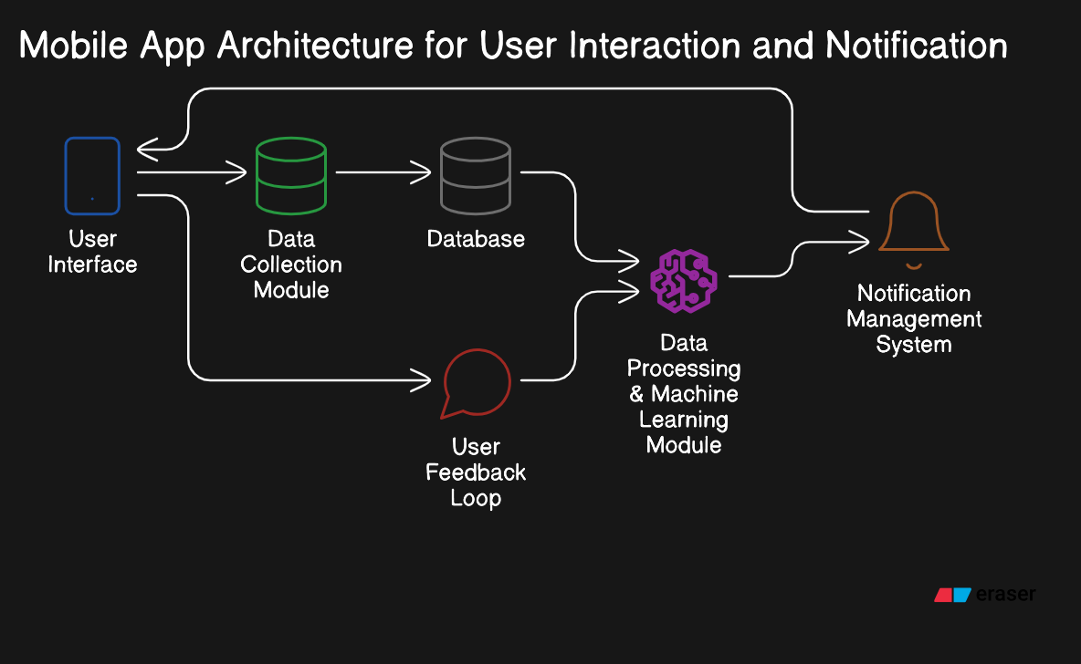
Architecture Diagram

Slide 10
Modules
User Interface Module
Description: The front-end component of the mobile application.
Key Features:
Allows users to browse products and view details.
Displays notifications based on user intent.
Provides settings for users to customize notification preferences.
Data Collection Module
Description: Captures and stores user interaction data.
Key Features:
Tracks user behaviors such as browsing history, click patterns, and time spent on product pages.
Collects data on past purchases and searches.
Ensures data is securely stored for analysis.
Data Processing & Machine Learning Module
Description: Analyzes user data to predict intent.
Key Features:
Implements machine learning algorithms to recognize patterns in user behavior.
Classifies user intents based on historical data.
Continuously updates models to improve prediction accuracy.

Slide 11
Modules
Notification Management Module
Description: Manages the scheduling and sending of notifications.
Key Features:
Sends notifications only when user intent is detected.
Adjusts notification strategies based on real-time user behavior.
Supports A/B testing to optimize notification content and timing.
User Feedback Module
Description: Gathers user input on notifications received.
Key Features:
Allows users to provide feedback on the relevance and timing of notifications.
Analyzes feedback to refine prediction models and notification strategies.
Encourages user engagement by letting them customize their notification settings.
Database Module
Description: Centralized storage for user data and interaction history.
Key Features:
Utilizes SQL or NoSQL databases for efficient data management.
Stores user profiles, interaction data, and feedback.
Supports fast retrieval for the Data Processing & Machine Learning Module.

Slide 12
Hardware and Software Details
Hardware and Software Details
Hardware Requirements
Processor: Multi-core (e.g., Intel Xeon, AMD Ryzen)
RAM: Minimum 8 GB
Storage: SSD, at least 512GB
Network: High-speed internet (100 Mbps or more)
Software Requirements
Operating System: Windows Server
Programming Languages:
Development Tools:
Backend: Python or Node.js for server-side logic.
Frontend: React Native or Flutter for mobile app development.
Machine Learning:
Libraries: Scikit-learn for basic algorithms; TensorFlow for advanced models (if needed).Database:
Options: MySQL or PostgreSQL (SQL) for structured data, and MongoDB (NoSQL) for unstructured data.

Slide 13
Objectives
Minimize Push Notifications:
Reduce the volume of push notifications sent to users to alleviate notification fatigue.
Improve User Experience:
Enhance user satisfaction by ensuring notifications are relevant to user interests and actions.
Leverage AI for Intent Prediction:
Utilize artificial intelligence to analyze user behavior and accurately predict their purchase intent.
Boost User Engagement:
Increase engagement rates by sending notifications only when users exhibit intent to purchase.

Slide 14
Methodology
Data Collection:
User Interaction Data: Gather data on user behavior within the app, including:
Browsing history
Time spent on product pages
Previous purchases
Search queries
Data Sources: Use analytics tools to collect and store user interaction data securely.
Data Preprocessing:
Data Cleaning: Remove any irrelevant or duplicate data to ensure quality.
Feature Extraction: Identify key features that indicate user intent (e.g., frequency of visits, time spent on specific categories).
Intent Prediction Model:
Machine Learning Algorithms: Implement algorithms (e.g., decision trees, random forests, or neural networks) to analyze the data and predict user intent.
Training and Validation: Split the data into training and validation sets to evaluate the model's performance.
Notification Management System:
Dynamic Notification Logic: Develop a system that sends notifications based on detected intent rather than a fixed schedule.
Threshold Settings: Establish criteria for when to send notifications, such as specific user actions or behavior patterns.

Slide 15
Timeline of Project
Data Collection & Analysis (Weeks 1-2):
Gather user interaction data from the e-commerce app.
Data Preprocessing (Weeks 3-4):
Clean and prepare the collected data for analysis.
Intent Prediction Model Development (Weeks 5-6):
Develop and train the machine learning model to predict user intent.
Notification Management System Design (Weeks 6-7):
Design the system to manage when and how notifications are sent based on intent detection.
Real-Time Monitoring & A/B Testing (Weeks 7-8):
Implement monitoring tools and conduct A/B testing to refine notification strategies.
User Feedback Integration (Weeks 9-10):
Incorporate user feedback mechanisms to improve notification relevance.
Final Testing & Deployment (Week 10):
Test the entire system and prepare for deployment to users.

Slide 16
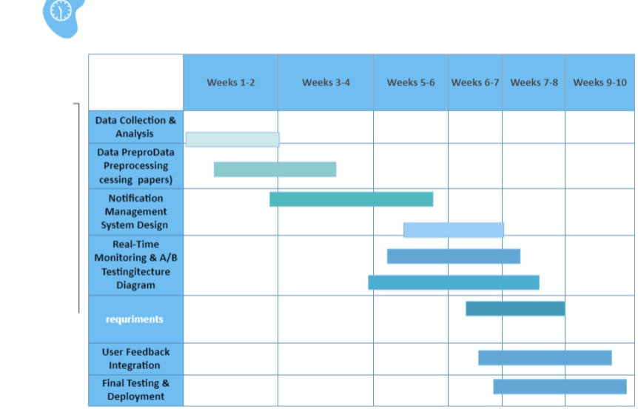
GHANT CHART

Slide 17
Expected Outcomes
Reduced Number of Notifications:
Significantly lower the volume of push notifications sent to users, minimizing annoyance and notification fatigue.
Improved User Engagement:
Increased interaction with notifications that are timely and relevant, leading to higher engagement rates.
Enhanced User Satisfaction:
Greater overall satisfaction among users due to receiving only pertinent notifications that align with their interests.
Higher Conversion Rates:
Increased sales and conversions as users receive notifications when they are more likely to make a purchase.
Data-Driven Insights:
Valuable insights into user behavior and preferences, enabling continuous optimization of notification strategies.
Effective Use of AI:
Successful implementation of machine learning algorithms to accurately predict user intent based on behavior analysis.
Increased Retention Rates:
Improved customer retention through a more personalized and engaging user experience.
Feedback Loop for Continuous Improvement:
Establishment of a feedback mechanism that allows for ongoing refinement of the notification system based on user input.

Slide 18
Conclusion
In this project, we aim to revolutionize the way e-commerce apps engage with their users by significantly reducing the number of push notifications sent. By leveraging artificial intelligence and data analytics, we can accurately predict user intent and send notifications only when users are likely to be interested in making a purchase. This approach not only enhances the user experience by minimizing unnecessary distractions but also improves user engagement and satisfaction.
The expected outcomes include a reduction in notification volume, increased conversion rates, and valuable insights into user behavior. Through continuous monitoring and user feedback, we will refine our strategies to ensure that notifications remain relevant and timely.
Ultimately, our project seeks to create a more personalized shopping experience, fostering customer loyalty and retention in an increasingly competitive e-commerce landscape.

Slide 19
References
Chatterjee, S., & Datta, A. (2020). Push notification personalization: Impact on user engagement and purchase intention. Journal of Retailing and Consumer Services, 54, 102006.
Bhardwaj, R., & Jain, S. (2019). Smart notifications for e-commerce applications: Analyzing user preferences. Journal of Intelligent & Fuzzy Systems, 36(5), 4931-4941.
Zhang, X., & Zhao, J. (2019). The impact of push notifications on user engagement: A meta-analysis. Journal of Marketing Theory and Practice, 27(2), 205-220.
Lee, K., & Kim, S. (2020). Artificial intelligence in mobile applications: A focus on user engagement strategies. Mobile Information Systems, 2020, 1-12.
Shah, D., & Sharma, R. (2021). Reducing push notifications for better user experience in e-commerce apps. International Journal of Information Management, 56, 102228.
Kumar, A., & Gupta, R. (2021). User intent prediction in mobile commerce: A machine learning approach. Expert Systems with Applications, 168, 114163.
Gao, Y., & Chen, C. (2020). The influence of mobile push notifications on consumer behavior: A theoretical framework. Journal of Business Research, 116, 368-378.
Patel, S., & Joshi, M. (2019). Big data analytics in mobile applications: Enhancing user engagement through intelligent notifications. Journal of Cloud Computing: Advances, Systems and Applications, 8(1), 1-15.
Wang, Y., & Zhang, R. (2021). Exploring the role of artificial intelligence in mobile marketing: A focus on push notifications. Journal of Retailing and Consumer Services, 58, 102249.
Rai, A., & Kumar, A. (2020). A study on the effectiveness of push notifications in driving e-commerce sales. Journal of Electronic Commerce Research, 21(1), 52-66.

Slide 20


