Slide 1

Ally
Them: Self-taught

Slide 2
Table of contents
01
02
03
Our team
Idea
Process
04
05
Used Programs
The website

Slide 3
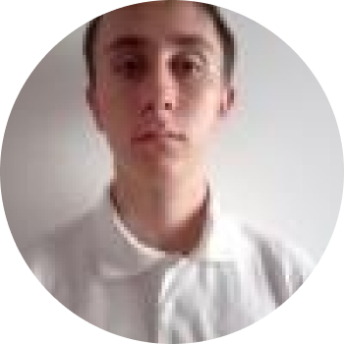
01
Our team
Ivan Delchilov
Backend

Slide 4

02
Idea

Slide 5
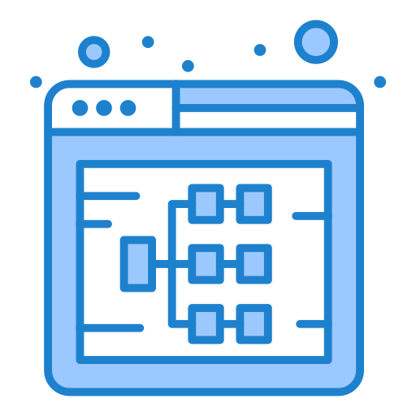
03
Process
Discussing the idea
Coding
Debugging
Present the project

Slide 6


















Used technologies
04

Slide 7

05
Let’s jump to the website

Slide 8
Thank you for your attention!

