Slide 1
PSCS-481 Online Chatbot Based Ticketing System
CSE7101- Capstone Project
Review-5
Batch Number: ISE-45
Roll Number | Student Name
20221ISE0053 | Mohamed Aslam Pasha
20221ISE0083 | Kovuri Nizamuddin
20221ISE0084 | Vaseem B M
Under the Supervision of,
Ms. Smitha S P
Assistant Professor
School of Computer Science and Engineering
Presidency University
Name of the Program: B.Tech
Name of the HoD: Dr.Zafar Ali Khan
Name of the Program Project Coordinator: Ms. Suma N G
Name of the School Project Coordinators: Dr. Sampath A K , Dr. Geetha A

Slide 2
CONTENT
Abstract
Objectives
Proposed methodology & feasibility study
Architecture Diagram
Modules
Git-Hub Link
Screen Shots
Timeline of the Project
References

Slide 3
ABSTRACT:
The aim of this project “AI-Powered Chatbot Based Ticketing System for Museums” is to design an intelligent, automated platform that simplifies the ticket booking process for museums and cultural institutions. By leveraging Natural Language Processing (NLP) and conversational AI, the system enables visitors to interact with a chatbot in natural language, making reservations, purchasing tickets, and receiving exhibition information in real time. The platform is designed to eliminate long queues, reduce manual errors, and provide a seamless visitor experience through a multilingual, user-friendly interface.
Despite its simplicity, the system ensures accuracy, speed, and reliability. The chatbot interface has been developed with inclusivity in mind, catering to diverse audiences with varying levels of digital literacy. It supports multilingual communication, ensuring accessibility for both local visitors and international tourists. Furthermore, the platform integrates secure payment gateways to facilitate safe and contactless transactions, while providing museum administrators with real-time analytics on visitor traffic, ticket sales, and event participation.

Slide 4
OBJECTIVES:
1 Automating Ticket Booking
The primary objective of this project is to automate the ticket booking process in museums through an AI-powered chatbot. The system will enable users to book entry tickets, special exhibition passes, and event reservations seamlessly, eliminating the inefficiencies of manual ticketing.
2 User-Friendly Multilingual Interface
The chatbot will provide a simple and intuitive interface, accessible across web, mobile, and kiosks. It will support multiple languages to cater to both local and international visitors, ensuring inclusivity and ease of use for diverse audiences.
3 AI-Powered Visitor Interaction
Using Natural Language Processing (NLP), the chatbot will engage in natural conversations with visitors, respond to queries, and provide relevant information regarding exhibitions, timings, and events. This will enhance the overall visitor experience by making the interaction more human-like and informative.
4 Personalization and Recommendations
The system will offer personalized suggestions based on visitor preferences, booking history, and exhibition popularity. By doing so, it will not only simplify decision-making for visitors but also promote specific events and exhibitions effectively.

Slide 5
OBJECTIVES:
5 Secure Payment Integration
To complete the booking cycle, the chatbot will integrate reliable and secure payment gateways. This ensures a smooth, contactless, and safe transaction process, reducing manual intervention and human error.
6 Scalability and Performance
The chatbot will be designed to handle high booking volumes during peak hours or special events without system breakdowns. This ensures uninterrupted service availability and improves operational efficiency for museum management.
7 Data Analytics for Management
The system will provide museum administrators with real-time analytics, including visitor traffic, ticket sales, and peak times. These insights will aid in better planning, resource allocation, and promotional strategies.

Slide 6
PROPOSED METHODOLOGY & FEASIBILITY STUDY:
This methodology section gives a thorough overview on how the AI Chatbot Based Ticketing System is conceived, constructed, and deployed. Data gathering, AI model creation, system architecture, user interface, testing, security, and privacy considerations are all included in the process. Along with comprehensive technical explanations, graphics, and case studies when appropriate, it also covers future directions and procedures for continual improvement.
1 Requirements Gathering and Initial Planning
1.1. Project Vision and Context
Problem Identification:
    1.Manual Ticketing Issues: Traditional ticket counters at museums lead to long queues, delays, and human errors.
    2.Visitor Dissatisfaction: Lack of real-time updates and slow processes reduce visitor satisfaction.
    3.Accessibility Challenges: Non-native speakers and differently-abled visitors often struggle with manual or English-only ticketing systems.
    4.Operational Burden: Staff must manually manage records, payments, and reservations, which increases workload.
    5.Scalability Issues: Existing systems are not well equipped to handle peak season demands or large events.
Project Scope:
    1.AI-Powered Chatbot for Visitor Queries – Provides instant responses to FAQs, event schedules, and museum services.
    2.Automated Ticket Booking System – Visitors book entry, special exhibitions, and events through a chatbot with instant confirmations.
    3.Personalized Recommendations – AI suggests exhibitions and events based on visitor profiles and booking history.
    4.Multilingual & Voice Support – Chatbot supports multiple languages and voice commands for inclusivity.

Slide 7
PROPOSED METHODOLOGY & FEASIBILITY STUDY:
1.2. Feasibility Analysis
Technical viability: The system is based on Flask/Django for backend, React/Flutter for frontend, and MySQL/PostgreSQL for databases. AI chatbot is powered by transformer-based NLP models fine-tuned for visitor queries. Cloud deployment (AWS ) ensures scalability, reliability, and performance.
Economic viability: Automation reduces operational costs for museums, minimizes manpower, and improves efficiency. Development costs include AI model training, integration with payment gateways, and infrastructure hosting, but long-term benefits include higher visitor satisfaction and revenue.
Legal Viability: The system complies with GDPR and IT Act regulations for data protection. All user data is stored securely with consent. Compliance with financial transaction standards ensures trustworthy online payments.
2 Data Collection, Preprocessing, and Annotation
2.1. Data Collection
Data collection is the foundation of the AI-powered ticketing system for museums. High-quality datasets are gathered from multiple sources, including museum FAQs, event guides, and ticketing archives, which contain essential details about exhibitions, pricing, and booking procedures. Visitor interaction data and anonymized chatbot logs are also collected to better understand real-world user queries and behaviors. In addition, open datasets in tourism and cultural heritage are incorporated to enrich the knowledge base with relevant domain-specific information.

Slide 8
PROPOSED METHODOLOGY & FEASIBILITY STUDY:
2.2. Data Annotation and Labeling
Collected data is annotated to prepare it for training AI models. Visitor queries are labeled according to specific intents such as ticket booking, event information, or refund requests. Entities like exhibition names, dates, times, and visitor categories are extracted and classified to provide structured information for the NLP models. Multilingual intent-response datasets are developed to ensure inclusivity for both local and international visitors. This structured annotation and labeling process enables the system to accurately classify visitor needs and provide precise, context-specific responses.
2.3 Preprocessing
Before feeding data into the AI models, preprocessing is applied to ensure clean and standardized input. Irrelevant text is removed, and ticket/event formats are normalized for consistency. Tokenization and lemmatization techniques break down visitor queries into machine-readable components while preserving their semantic meaning. Named Entity Recognition (NER) is employed to identify specific elements such as “Modern Art Exhibition – 5 PM.” Vectorization then converts queries into embeddings, making them suitable for intent classification and response generation. This preprocessing pipeline ensures that the AI system can effectively interpret a wide range of visitor queries.

Slide 9
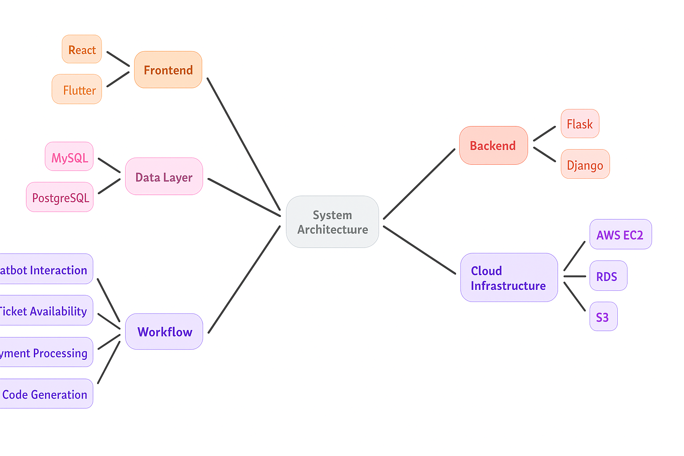
ARCHITECTURE DIAGRAM:

Slide 10
MODULES:
1. Overview of the System
1.1 Frontend Layer
The frontend layer of the system emphasizes usability, accessibility, and inclusivity to deliver a seamless ticketing experience across desktop, mobile, and on-site kiosks. The responsive design ensures compatibility with multiple screen sizes and devices, catering to diverse visitors, including tourists, families, and differently-abled individuals.
Users interact with the chatbot through text or voice commands in multiple languages to book tickets, check event schedules, or inquire about museum facilities. The chatbot provides real-time responses, including ticket confirmations, QR codes for entry, and personalized recommendations for exhibitions.
1.2 Backend Layer
The backend layer, built using the Flask/Django framework, forms the core of the system, handling business logic, chatbot processing, and integration with external APIs. Core functions include ticket reservation, payment gateway processing, visitor authentication, and real-time availability updates.
At its heart, NLP-driven AI models interpret visitor queries, provide exhibition information, and assist in ticket booking. These models leverage frameworks such as TensorFlow, PyTorch, and Hugging Face Transformers for multilingual understanding and context-aware interactions.

Slide 11
MODULES:
1.3 Data Layer
The data layer manages structured information such as user registrations, booking details, payment records, QR codes, and visitor queries. A MySQL/PostgreSQL relational database is used for transaction integrity and scalability.
To maintain security and compliance, sensitive data is encrypted at rest using AES-256 and protected during transmission with TLS protocols. Comprehensive audit logging captures all ticketing operations (bookings, cancellations, refunds) for accountability and compliance with tourism and data protection regulations.
2. Data Management
2.1 Data Collection
For training and optimizing chatbot responses, data is collected from museum FAQs, ticketing archives, visitor queries, and open datasets in tourism and cultural heritage. Multilingual conversational corpora are incorporated to support both local and international audiences.
Additionally, real-time user interactions (with consent) are anonymized and used to improve chatbot performance, ensuring it adapts to evolving visitor needs. Data collection strictly follows GDPR and Indian IT Act guidelines to ensure privacy and informed consent.

Slide 12
MODULES:
2.2 Preparation
The collected data undergoes a preparation pipeline for chatbot training and response optimization, including:
  Cleaning: Removing irrelevant text such as outdated announcements.
  Normalization: Standardizing ticket types, exhibition codes, and event metadata.
  Anonymization: Masking personal identifiers like phone numbers and payment details.
  Tokenization & Lemmatization: Processing multilingual visitor queries for better NLP interpretation.
  Entity Recognition: Identifying key entities such as exhibition names, dates, times, and visitor categories.
This preprocessing ensures that the chatbot generates accurate, relevant, and context-aware responses.
3. AI Model Development
3.1 Choosing a Model
To address the diverse tasks in museum ticketing and visitor support, a combination of AI models is used:
  Transformer-based GPT/NLP models: For natural conversations, ticket inquiries, and event information.
  Classification models (SVM, Random Forest): To categorize visitor intents (e.g., booking tickets, refund queries, exhibition info).
  Named Entity Recognition (NER): To extract structured details like exhibition names, ticket types, or dates.
  Recommendation models: To suggest exhibitions or events based on visitor profiles and history.
This multi-model approach ensures adaptability, personalization, and reliable visitor interaction.

Slide 13
MODULES:
3.2 Optimization and Training
Training uses museum-specific datasets, tourism FAQs, and anonymized visitor interactions. Data is split into training, validation, and testing sets for robust evaluation.
  Regularization techniques like Dropout prevent overfitting.
  Cross-validation ensures performance across different query types.
  Hyperparameter tuning (grid search, Bayesian optimization) optimizes model performance.
  Optimizers like Adam are applied for faster convergence.
This pipeline produces well-generalized models capable of handling diverse visitor scenarios.
3.3 Metrics for Evaluation
Different metrics are applied depending on the chatbot tasks:
  Precision, Recall, F1-Score: For intent detection and classification accuracy.
  BLEU & ROUGE scores: For evaluating conversational response quality.
  Confusion matrices & accuracy: For ticket category classification.
  Mean Reciprocal Rank (MRR) & NDCG: For recommendation relevance.
These metrics ensure high-quality, contextually accurate chatbot performance.

Slide 14
MODULES:
4. Implementation Details
4.1 Voice-Activated Interface
The system supports voice-enabled ticket booking and inquiry, using Speech-to-Text APIs (Google Speech, Azure Cognitive Services). Visitors can request tickets, ask about exhibitions, or confirm reservations using natural speech in multiple languages. Text-to-Speech functionality allows the chatbot to read out confirmations and exhibition details, improving accessibility for visually impaired users or non-digital-native visitors.
4.2 Integration with the Cloud
The platform is deployed on scalable cloud infrastructure (AWS/Azure) with auto-scaling and load balancing to ensure smooth performance during peak seasons. Disaster recovery measures include automated backups, replication across regions, and failover support.
4.3 Security Measure
To safeguard visitor and transaction data:
  AES-256 encryption secures data at rest.
  TLS 1.3 secures communication in transit.
  Role-Based Access Control (RBAC) limits sensitive data access to authorized museum staff.
  Threat monitoring and audit logs provide real-time security alerts and regulatory compliance.

Slide 15
Git-Hub Link
Git-Hub Link:- https://github.com/ISE-45/PSCS-481-Online-Chatbot-Based-Ticketing-System

Slide 16
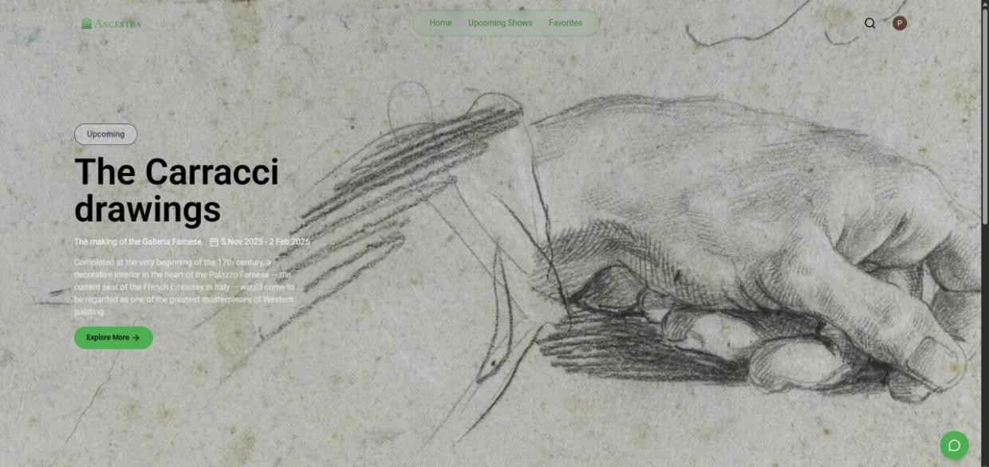
Screenshots
The figure represents the home page user interface of an AI-based museum tickets and visitor assistance system, to illustrate how digital integration converges with cultural heritage. In the foreground, we observe a detailed copy of a human hand from The Carracci Drawings as well, symbolizing the museum’s commitment to preserving classical art through contemporary methods. This easy and clear layout makes the visitator focused both on the works and on the main exhibition information.

Slide 17
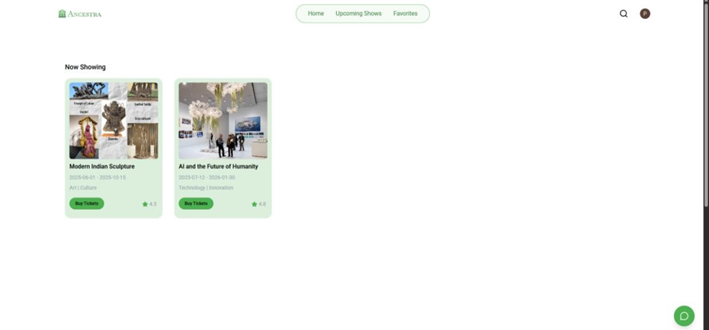
Screenshots
As seen on the "Now Showing" page of the museum's AI blank ticketing site, displaying current exhibitions in a clean and compelling fashion style. The front of each exhibition card features a mesmerising show image, dates and category where potential visitors can at an instant see what the show is all about and hence why it should not to be missed. There are big “Buy Tickets” buttons to facilitate quick, frictionless, get-your-GO-oriented booking on the spot: part of what the system is trying to do — eliminate long lines and cumbersome visitor experience

Slide 18
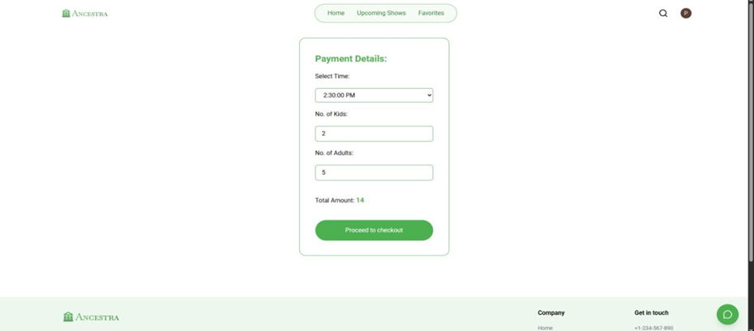
Screenshots
As shown in the Figure, The Booking Page the Booking Page has an unobtrusive/simple design where the visitor can easily finalize their ticket amount and proceed to payment as seen in the figure above. Customers can easily choose their preferred time slot and enter both number of adults/children attending with the system calculating the total bill for them. The crisp design, contained in a centered card, helps users stay on task and lightens cognitive load

Slide 19
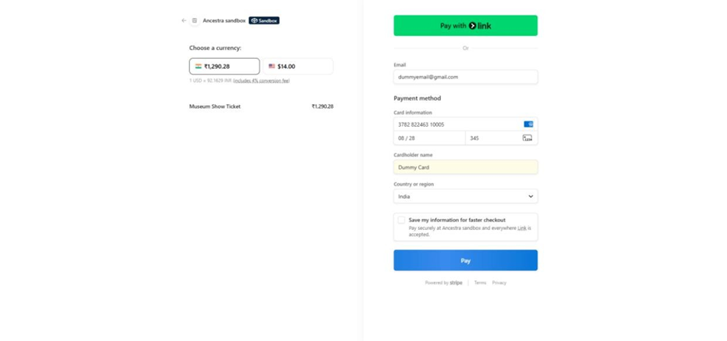
Screenshots
The Payment Page The secure and well-designed interface for customers to complete the last step of ticket booking. Users can select their preferred currency, compare ticket cost and enter crucial payment information such as email ID, card numbers and billing regions. The 'Pay with Link' alongside standard 'Pay' button as easy and use wherever you can purchase goods, works or services on line.

Slide 20
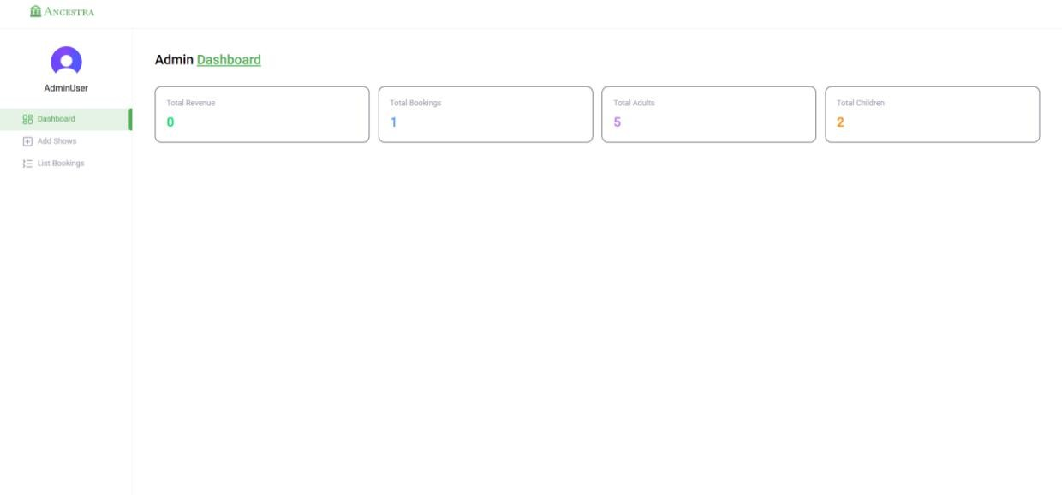
Screenshots
The Data- cloaking Admin Home Page This view displays the primary functional elements that are intended to be available for administrators in a museum context. The dashboard shows important information such as total revenue, bookings and their ratio or the adult/child guest count. This streamlined set-up makes it easy for administrators to see live how their visitors are interacting and booking online. An additional left-hand sidebar navigation also allows easy access to show management and booking lists, enabling an efficient working process.

Slide 21
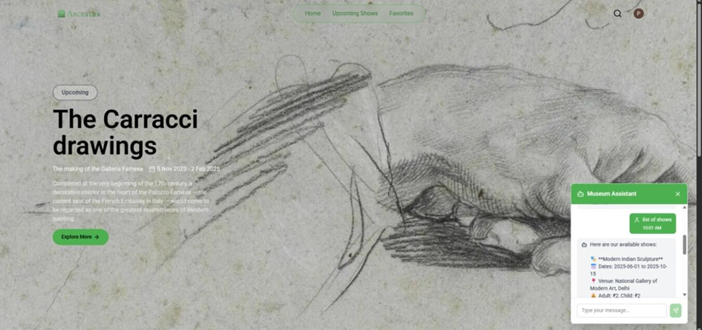
Screenshots
The AI Chat-Bot Tickets Booking interface indicates that the system offers an interactive and conversational way to browse through museum shows. The chatbot is accessible directly from the exhibition home page, so users instantly get a list of available shows and dates as well as visitor information via plain text interaction. The bot gives a brief list of some options, just in time Modern Indian Sculpture and Show dates / Ticket categories show us that we cannot get long lists back.

Slide 22
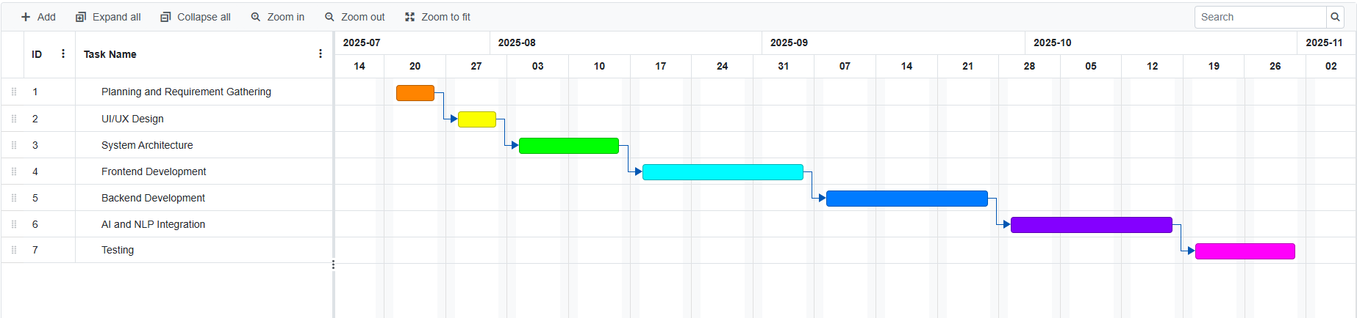
TIMELINE OF THE PROJECT (Gantt Chart)
Phase | Timeline
Planning and Requirement Gathering | Jul 21 - Jul 25
Desgin | Jul 28 - Aug 1
System Architecture | Aug 4 - Aug 15
Frontend Development | Aug 18 - Sep 5
Backend Development | Sep 8 - Sep 26
AI and NLP Integration | Sep 29 - Oct 17
Testing | Oct 20 - Oct 31

Slide 23
References (IEEE Paper format)
[1]. Basha, M.S.B. (2025) ‘Online Chatbot Based Ticketing System for Museums Using ...’, Vol. 22, No. 2, pp. 41–60
[2]. IJIRT (2025) ‘Online Chatbot Ticketing Based System’, IJIRT Journal, Vol. 11, No. 5, pp. 250–264.
[3]. IJCRT (2025) ‘Museum Chatbot Ticketing System: An AI-Driven Approach’, IJCRT Journal, Vol. 13, No. 4, pp. 98–115.
[4]. IRE Journals (2025) ‘Online Chatbot Based Ticketing System’, IRE Journals, Vol. 9, No. 6, pp. 72–85.
[5]. IRJMETS (2025) ‘Chatbot Based Ticketing System for Museum’, IRJMETS Journal, Vol. 5, No. 2, pp. 140–159.
[6]. Schäffer, J. (2024) ‘Chatbot in the Museum – A Field Study of User Experience (Städel Museum)’ Vol. 18, No. 1, pp. 120–145.,
[7]. Wang, Y. (2024) ‘Enhancing Art Museum Experience With a Chatbot Tour Guide’ Vol. 15, No. 4, pp. 110–132.
[8]. Fabbri, R., et al. (2023) ‘AI and Chatbots as a Storytelling Tool to Personalize the Visitor Experience’, Vol. 3, No.1, pp. 221–239.

Slide 24
References (IEEE Paper format)
[9]. Tsitseklis, S., et al. (2023) ‘RECBOT: Virtual Museum Navigation Through a Chatbot Assistant and Personalized Recommendations’, Journal of Cultural Heritage Technology,
[10]. Štekerová, K. (2022) ‘Chatbots in Museums: Is Visitor Experience Measured?’, Vol.11, No. 1–2, pp. 14–31
[11]. Nafis, M., et al. (2022) ‘Chatbots for Cultural Heritage: A Real Added Value’, Vol. 6, No. 1, pp. 502–506.
[12]. Noh, S., et al. (2021) ‘Designing Reenacted Chatbots to Enhance Museum Learning’, Vol. 12, No. 1, pp. 77–98.
[13]. Duguleană, M. & Briciu, A. (2021) ‘A Virtual Assistant for Natural Interactions in Museums’Vol. 4, No. 2, pp. 55–76.
[14]. Authors (2019/2020) ‘Towards Implementing an AI Chatbot Platform for Museums (MuBot)’ Vol. 9, No. 3, pp. 89–112.
[15]. A. Max, et al. (2005) ‘A Conversational Agent as Museum Guide — Design and Evaluation’, Vol. 19, No. 3, pp. 201–220

Slide 25


