Slide 1
HW2 Part 1
We able to K-NN to find the cluster that have the potential to be pregnant from data of products that usually bought by pregnant only.
After scoping the target (group of pregnant women), we can use data to group the target who have to same stage of pregnancy.

Slide 2
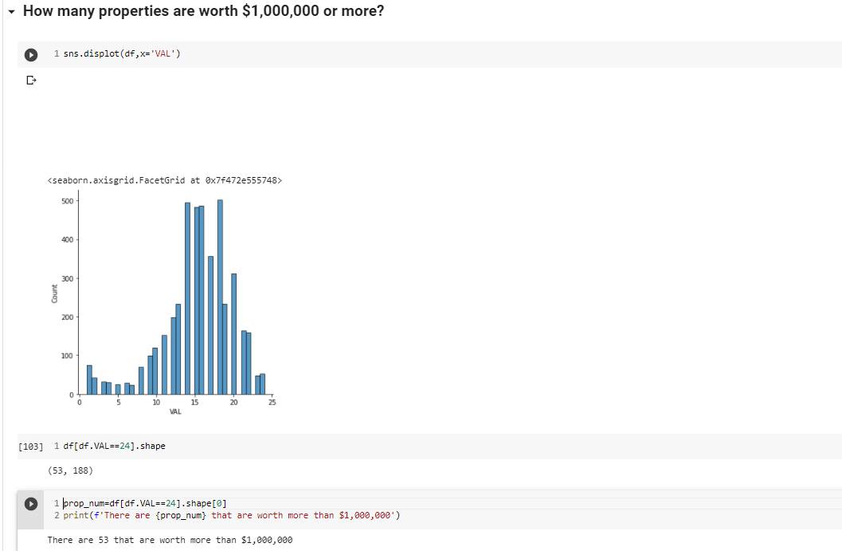
HW2 Part 2
https://colab.research.google.com/drive/1uMvJk2PeqkAT_SWIp4DCjCFM6IMXkT_5?usp=sharing

Slide 3
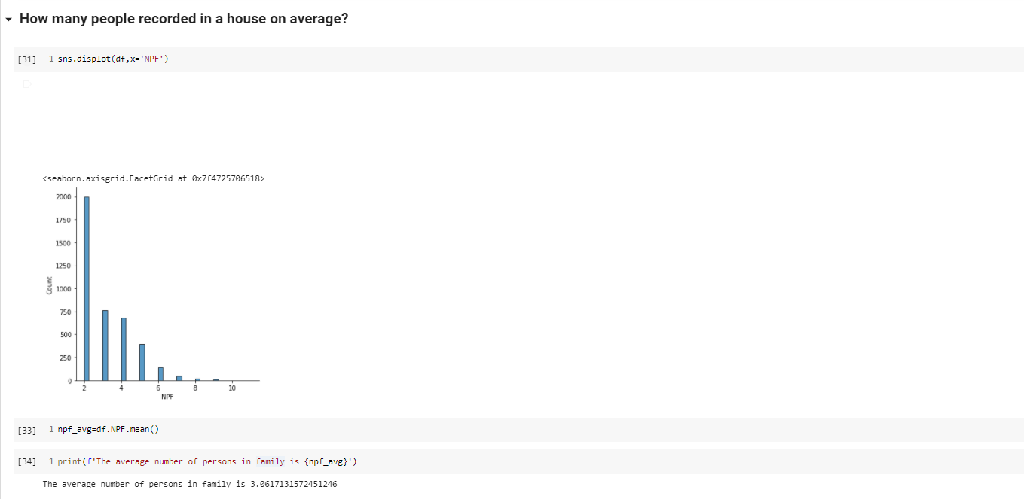
HW2 Part 2

Slide 4
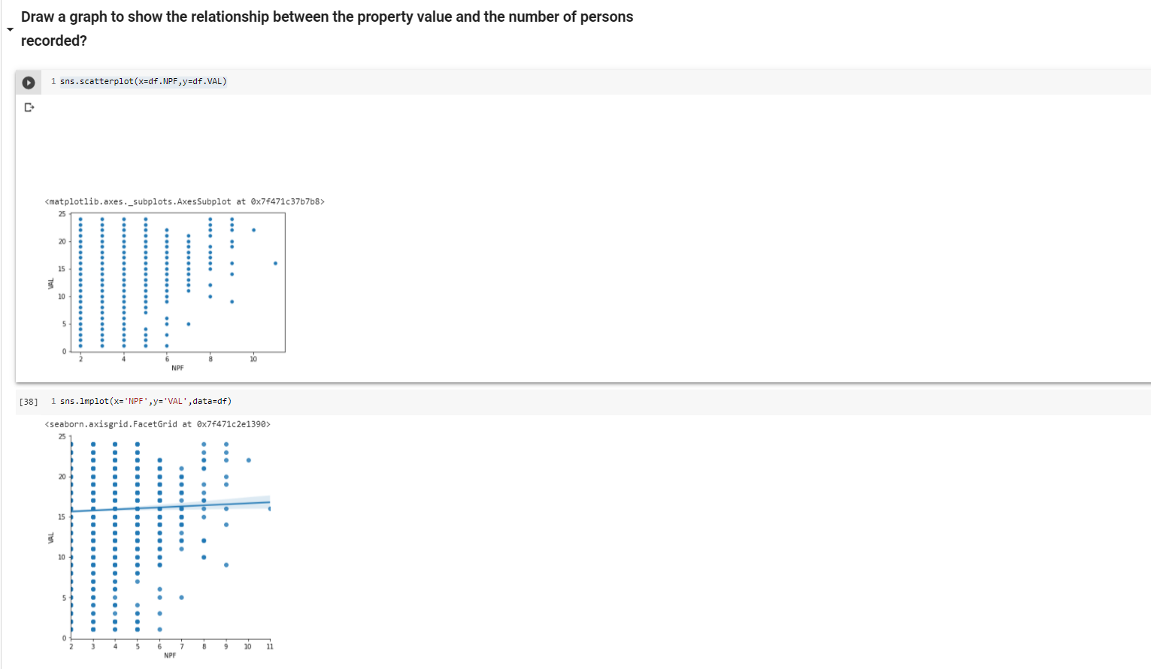
HW2 Part 2

Slide 5
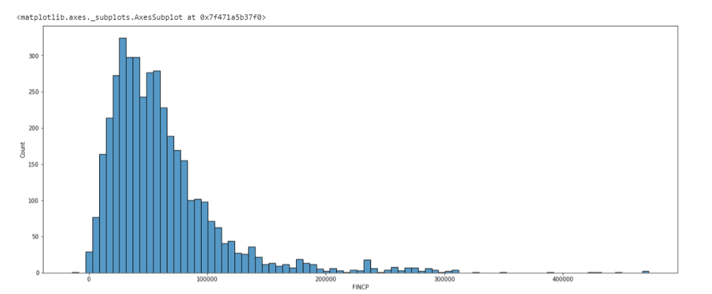
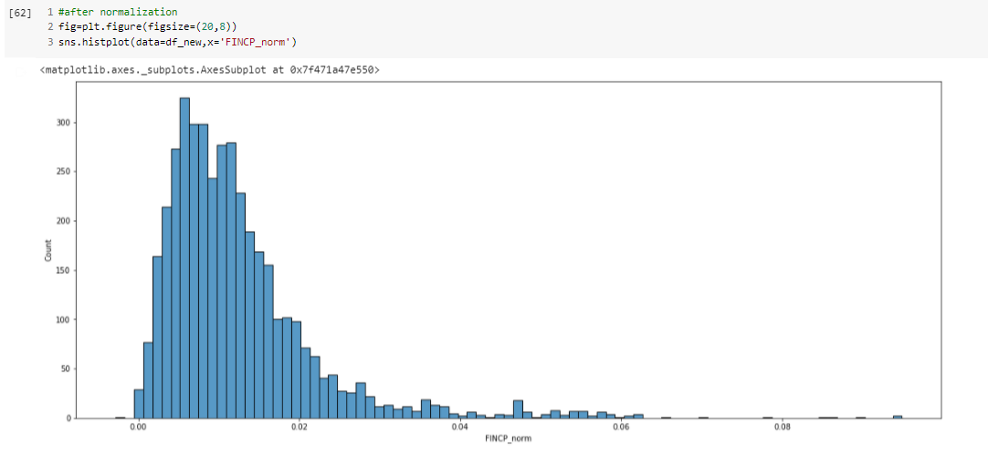
HW2 Part 2

Slide 6

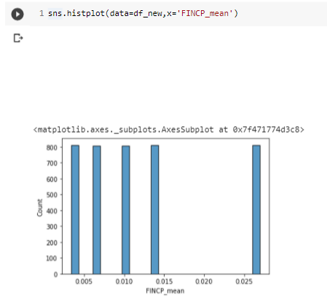
HW2 Part 2
https://colab.research.google.com/drive/1uMvJk2PeqkAT_SWIp4DCjCFM6IMXkT_5?usp=sharing

