Slide 1
DTW (Dynamic Time Warping)
Processamento Digital de Fala
Carlos Eduardo de Meneses Ribeiro

Slide 2
Sumary
Introduction
DTW algorithm
Training
Recognizing
Words outside lexicon
Processamento de Fala - DTW

Slide 3
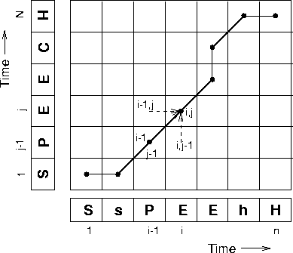
Introduction
Search for the best path to align two sequences with different durations.
Minimizes a cost function (global distance) which is the sum of local Euclidean distances.
Proposed for isolated words recognition and small lexicons.
Simple technique although there are more robust methods for recognition (e.g. HMM)
Processamento de Fala - DTW

Slide 4
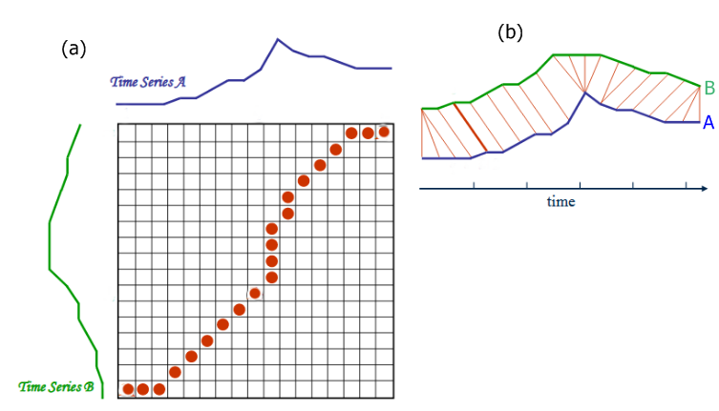
Introdução
Search for the best path to align two sequences with different durations.
a) Matriz de alinhamento b) Alinhamento no tempo
Processamento de Fala - DTW

Slide 5
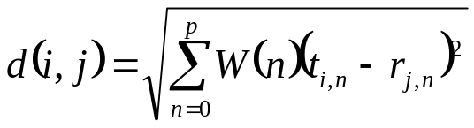
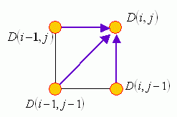

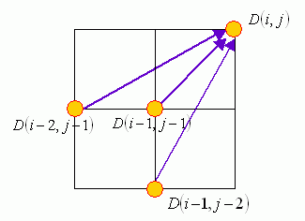
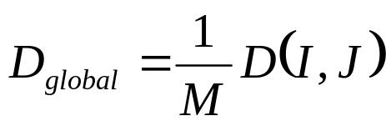
DTW - Distances
Local distance (Euclidian):
Constrição local
Accumulated distance:
Normalized global distance
(M - number of nodes visited):
Processamento de Fala - DTW

Slide 6
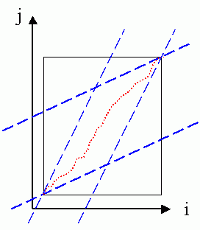

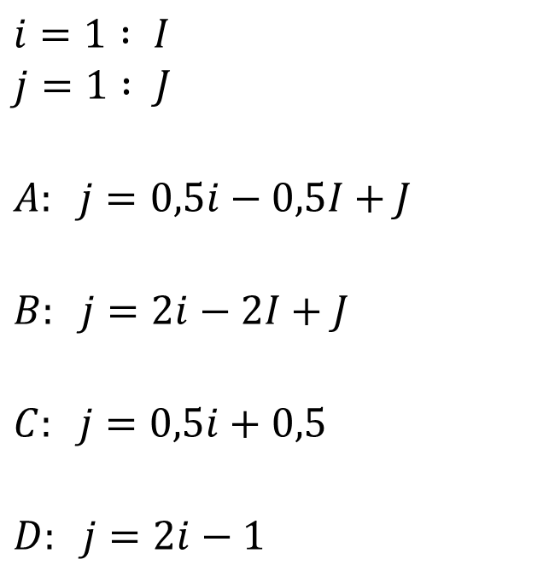

DTW – Global restrition
Double time restriction:
A
D
B
C
Processamento de Fala - DTW
5

Slide 7

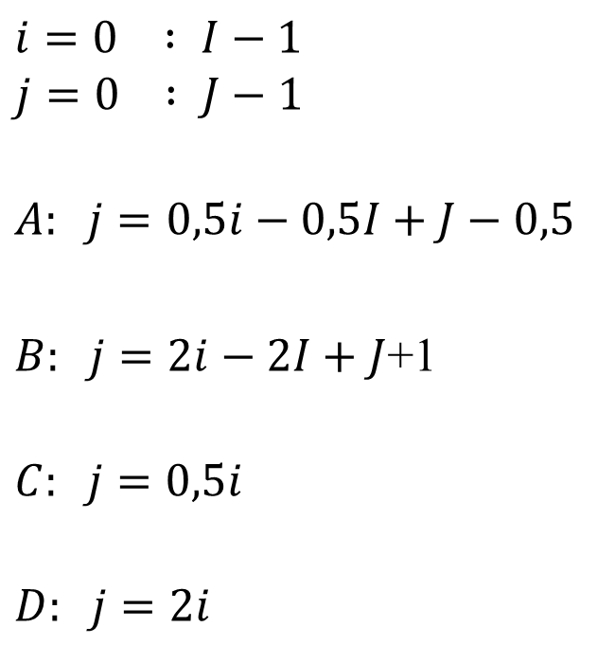

DTW – Global restrition
Double time restriction:
A
D
B
C
Processamento de Fala - DTW
5

Slide 8
DTW - Alignment
The accumulated distances are calculated for the entire grid (with the exception of the global restriction zones), starting at the node (1,1).
The final node is taken (I,J)
The previous node with the smallest accumulated distance that gave rise to the present node is recursively chosen.
Ends in node (1,1).
Processamento de Fala - DTW

Slide 9
Training
Assuming N classes to recognize
If each class has only 1 instance:
This instance is chosen as the representative of the class.
If each class has multiple instances:
  The central instance (centroid) is chosen as the representative of each class, which obtains the smallest sum of global distances to the other instances.
Processamento de Fala - DTW

Slide 10
Recognition
Given a sequence to recognize :
Method 1
It is assumed the sequence to be recognized as belonging to the class that obtains the smallest global distance in relation to its representative.
1
?
2
3
4
Processamento de Fala - DTW

Slide 11
Recognition
Method 2
  Choose the k classes that obtain the smallest global distance in relation to their representative.
  The global distance is computed in relation to all instances of the chosen k classes.
  Assumes that the sequence to be recognized belongs to the class of the instance that obtains the smallest global distance.
  At the limit, the distance for all instances of all classes can soon be calculated.
1
?
2
3
4
Processamento de Fala - DTW

Slide 12

Words outside lexicon
When trying to recognize a word outside the lexicon, a word is still wrongly recognized.
Solution:
In the training phase, the maximum distances of each recognized class Dmax(k) are computed, corresponding to the maximum distance between all instances of each class.
In the recognition phase, a sequence is assumed as not belonging to the lexicon if the minimum distance calculated is greater than the maximum distance of the recognized class Dmax(k):
Dmin
Dmax(k)
Processamento de Fala - DTW

Slide 13
END
Processamento de Fala - DTW

