Slide 1
ICT 201:
INTRODUCTION TO INFORMATION AND COMMUNICATION TECHNOLOGY

Slide 2
Lecturers/Instructors
Dr. S. Akinboro
Dr. Ufuoma C. Ogude
0803 820 7103

Slide 3
Course Schedule
Lecture Schedule:
Mondays: 8:00am - 10:00am
Class Venue: Physical (Room S006) and Virtual
Please attend your lectures. Attendance is mandatory
Classroom Policy
Review recommended material before coming to class
Must be on time
Turn off cell phones
Expectations
Read assigned readings
Attend lectures and participate in discussions
Bring your ideas and concerns to class
Work effectively in a group setting
Learn how to use the tools and understand your project very well when necessary

Slide 4
Learning Outcomes
At the end of the course, students should be able to:
1. Identify components of the computer and know-how the components communicate;
2. Know the concept of data transfer and memory types and management;
3. Be comfortable with graphics processing;
4. Identify and be able to use different communication ports;
5. Know the software types;
6. State different computer network topologies and their sizes;
7. Be able to use office applications and the internet.

Slide 5
Course Contents
Basic principle of computers. Computer "backbone". Data transmission. Random Access Memory. Permanent Memory. Graphic processing. Communication Ports. Input and Output Devices. Software types. Accessibility options. Computer types. Portable digital devices. Network Types. Internet. Instant messaging. Voice over Internet Protocol. Really Simple Syndication. Network communication. Internet data transfer. Data rate units. Internet access. Virtual (online) communities. Computer in the workplace. Office Applications (word processing, spreadsheets, presentation, etc.). Other well-known applications. Telecommuting (telework).

Slide 6
Course Module
Module 1 Introduction to Information Communication Technology
Unit 1: Information Communication Technology: Principles, Practices, and Opportunities.
Unit 2: Essentials of Computing
Unit 3: The System Unit and the Central Processing Unit
Unit 4: Input Devices, Output Devices and Storage Devices and Memory
Module 2 Computer Networks, Distributed Networks and the Internet
Unit 5: Computer Networks, Networking Technologies and Communications Networks
Unit 6: Enterprise and Wireless Communications Networks
Unit 7: Essentials of the Internet and World Wide Web
Unit 8: Electronic Commerce and Electronic Business
Unit 9: Launching Information Technology Applications Projects
Module 3 Managing Information and Communication Technology Applications in the Enterprise.
Unit 10: Creating Enterprise Applications and Project Management
Unit 11: Web Based Application and Information Systems in the Enterprise
Unit 12: Issues in Information Technology and Careers in ICT

Slide 7
Course Outline
Week 1: Information Communication Technology: Principles, Practices, and Opportunities.
Week 2: Essentials of Computing
Week 3: The System Unit and the Central Processing Unit
Week 4: Input Devices, Output Devices and Storage Devices and Memory
Week 5: Computer Networks, Networking Technologies and Communications Networks
Week 6: Enterprise and Wireless Communications Networks
Week 7: Essentials of the Internet
Week 8: Electronic Commerce and Electronic Business
Week 9: Launching Information Technology Applications Projects
Week 10: Creating Enterprise Applications and Project Management
Week 11: Web Based Application and Information Systems in the Enterprise
Week 12: Issues in Information Technology and Careers in ICT
Week 13: Continuous Assessment
Week 14: Examination

Slide 8
Books and References
Use and Effects By: Harry Bouwman, Bart van den Hooff, Lidwien van de Wijngaert & Jan van Dijk, Publisher: SAGE Publications Ltd, Publication year: 2005, Online pub date: June 19, 2012
Discovering Computers. Living in a Digital World. FUNDAMENTALS, 2011 EDITION. Gary B. Shelly. Misty E. Vermaat. Shelly Cashman
Charles S. Parker, Understanding Computers: Today and Tomorrow, Course Technology, 25 Thomson Place, Boston, Massachusetts 02210, USA
Livesley, Robert Kenneth. An introduction to automatic digital computers. Cambridge University Press, 2017.
Zawacki-Richter, Olaf, and Colin Latchem. "Exploring four decades of research in Computers & Education." Computers & Education 122 (2018): 136-152.
Sinha, Pradeep K., and Priti Sinha. Computer fundamentals. BPB publications, 2010.
Goel, Anita. Computer fundamentals. Pearson Education India, 2010.

Slide 9
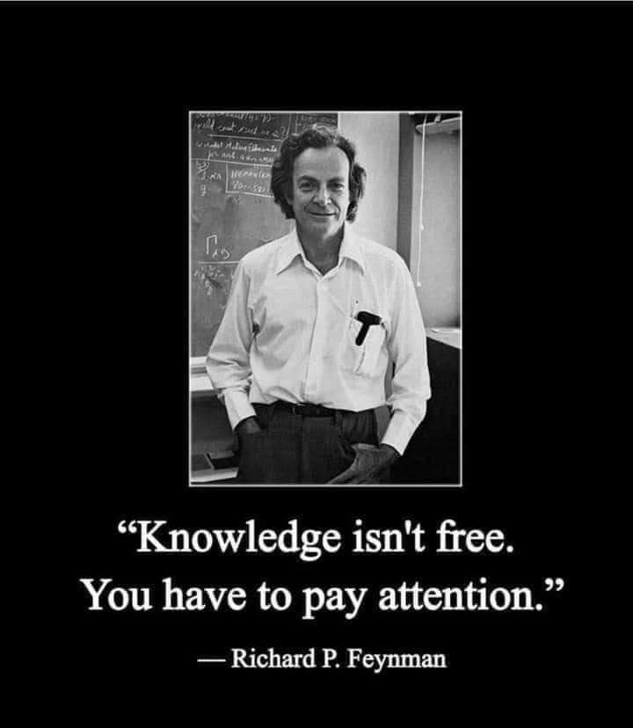
Pre-Requisite

Slide 10
Course Evaluation
Final Examination: 70%
Continuous Assessment: 30%
Written test
Assignments/Project

Slide 11
Week 11
WEB BASED APPLICATION AND INFORMATION SYSTEMS IN THE ENTERPRISE

Slide 12
Presentation Outline
How Web-Based Application Work
Procedures of Using Web-Based Application
Forces behind Web-Enabled Systems

Slide 13
APPLICATION SERVICE PROVIDER (ASPS)
Special web sites, called Application Service Providers (ASPs), allow access to their application programs.
To use one of these Web-based applications, you would connect to the ASP, copy the application program to your computer system’s memory, and then run the application.
Most ASPs provide access to a wide range of application programs and charge a fee for their services

Slide 14
HOW WEB-BASED APPLICATION WORK
Step 1: Connect
Step 2: Download
Step 3: Run
Step 4: Save and Exit
Step 5: Remove Application

Slide 15
Step 1: Connect
The user connects to a Web-site known as application service provider (ASPs).
While some ASPs are free, most charge a fee to access and to use their applications.
These applications may be general purpose application such as Microsoft Office applications or specialized
applications such as Web authoring programs.
The user then requests a specific application to use.

Slide 16
Step 2: Download
The Application Service Provider (ASP) downloads or sends a copy of all or part of the requested application to the user.
This copy is stored unto the user’s hard disk drive and is ready to be run.
The copy will remain their either for a specific period of time or until the user runs and then exits the program.

Slide 17
Step 3: Run
The user runs the application form his hard disk drive.
For example a user might download Microsoft Word document and use it to create a document.

Slide 18
Step 4: Save and Exit
When the user has completed work with the application, the created files can be saved on the user’s computer system and/or at the ASP.
The user then exits the application program.

Slide 19
Step 5: Remove Application
Once the user has exited the program, the program is automatically erased from his/her hard disk and is not available to be run again.
If the user wants to run the program again he/she must start again with step 1.

Slide 20
PROCEDURES OF USING WEB-BASED APPLICATION
Registration:
Several ASP sites exist on the Web and some of their services are free.
One of the best known site is WebOS.
Their only requirement is that you register for their services.

Slide 21
PROCEDURES OF USING WEB-BASED APPLICATION
Accessing Applications:
Each time you connect to the WebOS site and log in, your Webbased desktop will appear.
It will display numerous icons that can be used to access Webbased applications.
These include notes, personal information manager, calendar, and a variety of games.

Slide 22
PROCEDURES OF USING WEB-BASED APPLICATION
Web-Based Desktop:
The Web-based desktop looks and operates like the traditional windows desktop.
It consist of a variety of icons that are used to load and run applications.

Slide 23
FORCES BEHIND WEB-ENABLED SYSTEMS
Web-enablement: The tendency of systems developers to incorporate features of the Internet in enterprise systems.
Widespread Use of Browsers
New computers shipped with Web browsers
Large installed base of browser users
Browsers appearing on other IT devices
Flexibility
Plug-ins: Software programs that extend the capabilities of your Internet browser, giving it added features.

Slide 24
FORCES BEHIND WEB-ENABLED SYSTEMS
Universal front-end application
Legacy System
Legacy System: Refers to the many mainframe, midrange, client/server or PC applications that are used to manage business functions.

Slide 25
FORCES BEHIND WEB-ENABLED SYSTEMS
Interconnected Enterprises
Interoperability: The perfect exchange of data and information in all forms (data, text, sound, and image, including animation) between the individual components of an application (hardware, software, and network).
Heterogeneous Applications: May be written in different programming languages, run on different types of computers, and use varying communications networks and transmission methods.

Slide 26
CONCLUSION
Some suggest that Web-based applications may replace traditional application software sometime in the future.
They point out that Web-based applications offer advantages beyond universal access to software and to data.
One advantage is that user may no longer need to upgrade software on their hard disk when a new version becomes available.
One challenge of the Web-based applications relates to privacy and security of personal data stored as an ASP.

Slide 27
SUMMARY
In this unit you learnt that:
The concepts of Internet and WWW brought a lot of opportunities, where you can exchange documents and now use applications on the fly.
Web based applications provide and ease to the high cost of maintaining software and the ICT department of most organizations.
One challenge relates to privacy and security of personal data stored as an ASP.
To use the Web application you need to- Register, Access the application and the Web-Based Desktop

Slide 28
INFORMATION SYSTEMS IN THE ENTERPRISE

Slide 29
INFORMATION SYSTEM
A system in which data and information flow from one person or department to another.

Slide 30
ENTERPRISE INFORMATION SYSTEMS
Enterprise Information System/Business Information System:
Used to refer to the family of IT applications that underlies the activities of running and managing a business.
Transaction-Processing System (TPS):
A shared business information system that uses a combination of information communication technology and manual procedures to process data and information and to manage transactions.

Slide 31
THE TRANSACTION-PROCESSING SEQUENCE AND TPS OUTPUT AND REPORTS
Action Document: A document designed to trigger a specific action or to signify that a transaction has taken place.
Detail Report/Transaction Log: A report describing each processed transaction.
Summary Report: A report that shows the overall results of processing for a period of time or for a batch of transactions and includes a grand total for all listed transactions and the average transaction amount.

Slide 32
THE TRANSACTION-PROCESSING SEQUENCE AND TPS OUTPUT AND REPORTS
Exception Report: A report that lists unusual, erroneous, or unacceptable transactions or results.
Updated Master Data: An adjustment of all records in a system in response to a processed transaction.

Slide 33
Characteristics of TPS
Processes high volume of similar business transactions
Supports multiple users in routine, everyday transactions
Use relatively simple procedures to control processing and to ensure accuracy
Produces documents and reports
Updates files and databases

Slide 34
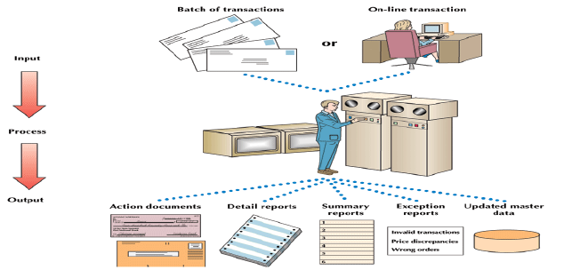
The Transaction-Processing Sequence and TPS Output

Slide 35
Week 12
ISSUES IN INFORMATION TECHNOLOGY AND CAREERS IN ICT

Slide 36
Presentation Outline
Security
Types of Security Breach
Results of Security Breach
Sources of Security Breach
Security Measures
Reliability: Ensuring It Service Reliability
Ethics
Ethics and ICT Usage In Business
An Ethics Challenge
Privacy
Spam and Privacy
Private Networks
Digital Piracy: Protecting Against Software Piracy
Public Domain Software
Ergonomics
The Environment

Slide 37
OBJECTIVES
After you have read this unit, you should be able to:
Identify the types of security breaches, sources of security breaches, and ways to protect a system against intrusion
Describe the importance of ethics in the use of information technology
Describe the concern over piracy of digital content.
Understand the reliability of IT systems

Slide 38
SECURITY
Security is the means of safeguarding and protecting an enterprise’s information technology assets, that is by keeping away from criminals, natural hazards, and other threats, while a breach is a breakdown in security.
Types of Security
Site Security
Resource Security
Network Security
Service Security

Slide 39
SECURITY
Security Program: The policies and protective measures that will be used, the responsibilities of individuals involved in maintaining security, as well as the responsibilities of those who abide by established security policies.
Harden: Designing a security program to a potential IT target, making the level of effort greater than the value of breaking into a system, network, or facility.

Slide 40
TYPES OF SECURITY BREACH
Intrusion: Forced and unauthorized entry into a system.
Interception: Aimed at preventing the capture of data and information transmitted over an enterprise network or other communications link.

Slide 41
RESULTS OF SECURITY BREACH
Destruction of Resources
Corruption of Data and Applications
Denial of Services
Theft of Services
Theft of Resources

Slide 42
RESULTS OF SECURITY BREACH
Denial-of-Services Attack:
Depriving, usually intentionally and temporarily, an enterprise or its users of the services they would normally expect to have, usually involving a network service (such as e-mail) or access to a location on the network (such as a Web site).
Internet Scam:
Are fraudulent or deceptive acts or operations designed to trick individuals into spending their time and money with little or no return.
Common scams include identity theft, chain letters, auction fraud, vacation prizes, and advance free loans.
Almost all Internet scams initiated by mass e-mails.

Slide 43
RESULTS OF SECURITY BREACH
Malicious programs: also known as malware (malicious software), include viruses, worms, and Trojan horse.
Viruses migrate through networks and operating systems and most attached to programs and databases.
Worms are special viruses that self replicate to slow or stop a computer’s operation
Trojan Horses are programs that come into a computer system disguised as something else. While not a virus, Trojan horses deposit viruses onto unsuspecting computer systems.

Slide 44
SOURCES OF SECURITY BREACH
Employees
This is the largest category of computer and enterprise criminals where an employee (insider) who gain access to certain records or files without prior permission in order to tamper (manipulate figures, steal records or damage files).
Identify Theft: Loss of personal identity through a security breach.
Computer Viruses
Virus: A hidden program that alters without the user’s knowledge, the way a computer operates or that modifies the data and programs stored on the computer.

Slide 45
SOURCES OF SECURITY BREACH
Hacker and Crackers: Hackers gains access to a system illegally for fun and challenge while crackers do it for malicious purpose.
Organized Crime: including counterfeiting and forgery.
Terrorist: Someone who conducts a “premeditated, politically motivated attack against information, computer systems, computer programs, and data, which results in violence against non-combatant targets by sub-national groups or clandestine agent.”
A terrorist usually cause potential crime to satellites and wage economic warfare.
Cyberterrorism: Terrorist attack on computer facilities in companies that rely on IT to produce their services.

Slide 46
SECURITY MEASURES
Security involves keeping enterprise hardware, software, data and programs safe.
Some measures are encrypting messages, restricting access through passwords and firewalls, anticipating disasters (hot sites are emergency facilities; cold sites are empty shells), backing up data and storing the data in a safe remote location.

Slide 47
SECURITY POLICIES AND PROCEDURES
The general Security Policies and Procedures are:
Change access passwords frequently
Restrict system use
Limit access to data
Set up physical access controls
Partition responsibilities
Encrypt data
Establish procedural controls
Institute educational programs
Audit system activities
Log all transactions and user activities

Slide 48
SECURITY POLICIES AND PROCEDURES
Virus Protection Software/Antivirus
Norton
Bit defender
Kerpersky
Avast
Panda
PC Cillin
Digital Signatures
Digital Signature Encryption: Relies on a mathematical coding scheme designed to foil a virus’s attempt to attack programs and data.
Encryption

Slide 49
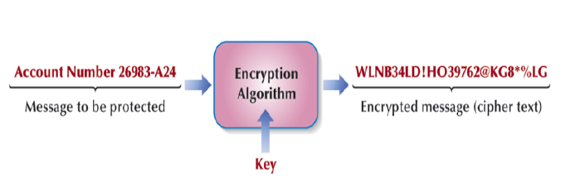
ENCRYPTION PROCEDURE FOR PROTECTING DATA AND MESSAGES

Slide 50
METHODS OF ENCRYPTION
Public Key Infrastructure (PKI):
A public key is made available in a directory that all parties can search.
Thus a sender wishing to transmit a secured message searches a digital certificate directory to find the recipient’s public key, using it to encrypt the message.
Secure Electronic Transaction (SET):
An adaptation of public key encryption and the digital certificate (which the industry calls an electronic wallet) for securing financial transactions over the Internet.

Slide 51
METHODS OF ENCRYPTION
Pretty Good Privacy (PGP):
A program used to encrypt and decrypt e-mail and to encrypt digital signatures, so the recipient knows the transmission was not changed along the way.
Virtual Private Network (VPN):
A way to use a public telecommunication infrastructure, such as the Internet, to provide secure communication between individuals or client computers at remote locations and an enterprise network.

Slide 52
METHODS OF ENCRYPTION
Tunneling Protocols:
By encrypting data at the sending end and decrypting it at the receiving end, the protocols send the data (and if an enterprise chooses, the originating and receiving network addresses as well) through a tunnel that cannot be entered by data that is not properly encrypted.

Slide 53
SECURITY POLICIES AND PROCEDURES
Firewall:
A special-purpose software program located at a network gateway server.
Proxy Server:
Act as an intermediary between a PC and the Internet, separating an enterprise network from an outside network

Slide 54
RELIABILITY
Reliability:
The assurance that computers and communications systems will do what they should when they should.
ENSURING IT SERVICE RELIABILITY
Fault-tolerant Computer: A computer designed with duplicate components to ensure reliability.
Uninterruptible Power Supply (UPS) System: A system that ensures the continued flow of electricity when the primary source of power fails.

Slide 55
RELIABILITY
Disaster Recovery Plan: A procedure for restoring data lost when a system stops functioning.
Off-site Backup Facility: A backup computer center located away from a company’s main facility.
Hot Site: A fully equipped backup computer center to which a company can take its backup copies of data and software and resume processing.
Cold Site: A backup facility outfitted with electrical power and environmental controls so that it is ready for a company to install a computer system.

Slide 56
ETHICS
Ethics are guidelines for moral computer use. The standards of conduct and moral behavior that people are expected to follow are:
Privacy – concerns collection and use of data about individuals
Accuracy – relates to the responsibility of those who collect data to ensure correctness.
Property - relates to who owns the data.
Access – relates to the responsibilities of those who have data to control and who is able to use it.

Slide 57
ETHICS AND ICT USAGE IN BUSINESS
E-mail Privacy
Software Licenses
Software Copyrights
Hardware Access
Intellectual Property Ownership
File Access
Data Ownership

Slide 58
ETHICS CHALLENGE
Developing a Code of Ethics
Informed Consent
The Higher Ethic
Most Restrictive Action
Kantian Universality Rule
Descartes’ Change in Rule
The Owner’s Conservative Rule
The User’s Conservative Rule
Social Responsibility:
The concept that businesses need to balance their commitments to investors, employees, customers, other businesses, and the communities in which they operate.

Slide 59
PRIVACY
Privacy in IT is the term used to refer to how personal information is collected, used, and protected.
SPAM AND PRIVACY
Spam: Unsolicited e-mail.
Opt-in E-mail/Permission-based E-mail: If customers check a box agreeing to receive postings about the company’s products, they have actually given approval for the mailing.

Slide 60
PRIVACY
Cookies: are specialized programs deposited onto you computer system that record sites visited, activity at sites and other information.
Traditional cookies – monitor activities at a single site
Ad network cookies – also known as adware cookies, monitor activities across all sites visited
Web bugs – programs typically hidden within the HTML codes as a graphic image. They migrate when ever an unsuspecting user visits a web site containing a Web bug or open an infected e-mail message.

Slide 61
PRIVACY
Computer monitoring – record every activity and keystroke made on your computer system. Also known as sniffer programs and keystroke loggers, these programs are used by businesses, CIA, SSS, FBI, private investigators and others.
A new program known as spy ware removal programs has recently evolved designed to detect Web bugs and monitoring software.

Slide 62
PRIVATE NETWORKS
Many organizations monitor employee e-mail and computer files using special software called snoopware.
Most online information services restrict libelous, obscene, or other offensive material.

Slide 63
DIGITAL PIRACY
Digital Piracy: The making of illegal copies of copyrighted information.
PROTECTING AGAINST SOFTWARE PIRACY
Software Piracy: The making of illegal copies of software.
Software Copyright Protection
Copyright: Legal protection of original works against unauthorized use, including duplication.
Copy Protection: A software protection scheme that defeats attempts to copy a program or makes the copies software unreliable
Software Site Licensing
Site License: An agreement under which a software purchaser pays a fee to the manufacturer to make a specified number of copies of a particular program.

Slide 64
PUBLIC DOMAIN SOFTWARE
Public Domain Software: Any non copyrighted software that can be used by the general public.
Shareware: Software that is given away and freely distributed.
The developer retains ownership, asks users to register with the owner, and requests a nominal fee for using the program.

Slide 65
ERGONOMICS
Ergonomics is the study of human factors related to things people use, including computers.
Physical health problems and their solutions include:
Eyestrain and headache – take frequent breaks; avoid glare on the monitor.
Back and neck pain – use adjustable chairs, tables, monitor stands, keyboards, and footrests.
Repetitive Strain Injury (RSI), also known as repetitive motion industry, includes carpal tunnel syndrome – take frequent breaks, use good posture; adopt healthy lifestyle; use ergonomic keyboards.

Slide 66
THE ENVIRONMENT
Microcomputers are the greatest users of electricity in the work place.
The Energy Protection Agency EPA has established the Energy Star Program ESP to promote energy efficient computer use to reduce or eliminate hazards.
The computer industry has responded with the concept of the GREEN PC.

Slide 67
The Green PC
The basic elements of the green PC include:
System units with energy-saving processors, sleep-mode capability, efficient adapters, and no cooling fans.
Display units that replace CRT displays with flat panels, use special power-down monitors, and use screen savers software.
Manufacturing that eliminates or reduces the use of harmful chemicals such as chlorofluorocarbons (CFCs), nickel, and other heavy metals.

Slide 68
Personal Responsibility
As a responsible computer user, you can help protect the environment by:
Conserving energy by turning off computer systems at night and using screen-savers.
Educating yourself and others about ecological dangers and using ecologically sound products.
Recycling paper, computer boxes, packaging materials, printer cartridges, and floppy disks.

Slide 69
CONCLUSION
To be a competent and knowledgeable ICT end user you need to be aware of the potential impact of technology on people and your surrounding.
You need to be sensitive and knowledgeable about personal privacy, organizational security, ergonomics, and the environmental impact of technologies.

Slide 70
SUMMARY
In this unit you learnt that:
Security involves keeping enterprise hardware, software, data and programs safe.
Reliability is the assurance that computers and communications systems will do what they should when they should
Privacy refers to how personal information is collected, used, and protected.
Ethics are guidelines for moral computer use.

Slide 71
CAREERS IN ICT

Slide 72
CAREERS
A few important career development paths are:
Webmaster
Computer Trainers
Desktop publisher
Computer support specialist
Computer technician
Data entry
Technical writers
Software engineers
Network administrator
Cryptographer
Information system manager
Database administrators
Systems analyst
Computer programmers

Slide 73
Webmaster
Webmasters develop and maintain Web sites and web resources.
The job may include backup of the company Web site, updating resources, or developing of new resources.
Webmasters are involved in the design and development of website. Part of their job may also include monitoring and updating the interface design.
Some webmasters monitor traffic on site.
Webmasters may also work with marketing personnel to increase the site traffic and may be involved in development of Web promotions.

Slide 74
Computer Trainers
Computer trainers instruct new user on the latest software or hardware. They are usually expected to prepare new materials for instruction and may be asked to write and maintain course manual.
A position may also include design and development of a website for the course.
Computer trainers typically teach new users how to use the latest software and hardware.
Experience with the most popular business software is an advantage.

Slide 75
Desktop Publisher & Computer Support Specialist
Desktop Publisher:
Desktop publishers use computers to format and create publication-ready material.
They may create books, magazines newsletter, and newspapers on computers using special applications software’s large part of the job is designing page layout, importing text, and manipulating graphics.
Most desktop publishers work for companies that handle commercial printing accounts.
Computer Support Specialist
Computer support specialists provide technical support to customers and other users.
They may also be called technical support specialist or help desk technicians.
They manage the everyday problems faced by computer users.
They resolve common networking problems and may use troubleshooting programs to diagnose problems.

Slide 76
Computer Technician
Computer technicians may repair and install computer components and systems.
They may work on everything from personal computers to mainframe servers or printers.
Some Computer technicians are responsible for setting up and maintaining computer networks.
Experience computer technicians may work with computer engineers to diagnose problems and run routine maintenance on complex systems.
Certification – CompTIA’s A+ hardware examination and Network+

Slide 77
Data Entry & Technical Writers
Data Entry:
Data entry workers input customer information, lists, and other type of data.
Input devices are typically limited to keyboards, mice, and scanners.
Because the accuracy of recorded data is so Important, data entry workers are often required to verify the accuracy of data they and others have entered.
Technical writers:
Technical writers prepare instructional manuals, technical reports, and other scientific or technical documents.
Most Technical writers work for software firms, government agencies, and research institutions.

Slide 78
Software Engineers
Most Software engineers analyze user need and create application software.
Software engineers usually have experience in programming, but focus on the design and development of programs using the principles of mathematics and engineering.
They rarely write codes themselves.

Slide 79
Network Administrator
Network administrator manages a company’s LAN and WAN networks.
They may be responsible for the design, implementation and maintenance of networks.
Responsibilities usually include the maintenance of both hardware and software relating to a company’s intranet and internet networks.
Some are responsible for planning and implementing the security measures as well.
Certification - Microsoft Certified Systems Engineer (MCSE), Certified Novell Administrator (CNA), and Certified Novell Engineer (CNE).

Slide 80
Cryptographer
Cryptography is the science of disguising and revealing encrypted information.
In ICT cryptography means keeping any intercepted information private.
For example information like financial data, banking and credit card information used in online shopping or private email and correspondence.
Cryptographers design systems, break systems, and do research on encryption.

Slide 81
Information System Manager & Database Administrators
Information system manager
Information system managers oversee the work of programmers, computer specialists, system analysts, and other computer professionals.
They create and implement corporate computer policy and systems.
These professionals consult with management, staff and customers to achieve goals.
Database administrators
Database administrators use database management software to determine the most efficient ways to organize and access a company’s data.
They are responsible for maintaining database security and backing up systems.
Certifications – MySQL Server, Oracle, and Sybase.

Slide 82
Systems Analyst & Computer Programmers
Systems analyst
A Systems analyst follows the steps described in the systems development life cycle.
Analysts plan and design new systems or reorganize a company’s computer resources to best utilize them.
Computer programmers
Computer programmers create, test, and troubleshoot programs used by computers.
Programmers may also update and repair existing programs.
Certifications – Java, C++, Visual Basic and knowledge of SQL.

Slide 83
OTHER AREAS OF EXPERTISE/ORGANAISATION
Hardware
Cisco Products
D-link
Linksys
Software
Microsoft Products
Linux (Red Hat, Unbutu, and Fedora)
Open Source: Free
Database
Oracle
MySQL
Open Source: Free
Web design
PHP - Open Source: Free
Dream Weaver

Slide 84
CONCLUSION
Knowing the ICT positions and their responsibilities help you to prepare your CV and make yourself marketable.

Slide 85
SUMMARY
In this unit we learnt that
Most ICT professions does not require a degree in Computer Science
Professional Certifications will boost your CV.
You can start today and develop a career in ICT
Some key position requires knowledge in two or three field.

Slide 86
EXERCISE
Briefly explain the measures taken to ensure ICT service reliability.

Slide 87
ANSWER
The measures taken to ensuring IT service reliability are:
Fault-tolerant Computer: A computer designed with duplicate components to ensure reliability.
Uninterruptible Power Supply (UPS) System: A system that ensures the continued flow of electricity when the primary source of power fails.
Disaster Recovery Plan: A procedure for restoring data lost when a system stops functioning.
Off-site Backup Facility: A backup computer center located away from a company’s main facility.
Hot Site: A fully equipped backup computer center to which a company can take its backup copies of data and software and resume processing.
Cold Site: A backup facility outfitted with electrical power and environmental controls so that it is ready for a company to install a computer system.

