Slide 1


SEN 201: Introduction to Software Engineering
Lecture #2

Slide 2
Topics covered
System analysis and design
Software process and software process models
System development life cycle
Process activities
Coping with change
Process improvement

Slide 3
The software process
A structured set of activities required to develop a software system.
Many different software processes but all involve:
Specification – defining what the system should do;
Design and implementation – defining the organization of the system and implementing the system;
Validation – checking that it does what the customer wants;
Evolution – changing the system in response to changing customer needs.
A software process model is an abstract representation of a process. It presents a description of a process from some particular perspective.

Slide 4
Software process descriptions
When we describe and discuss processes, we usually talk about the activities in these processes such as specifying a data model, designing a user interface, etc. and the ordering of these activities.
Process descriptions may also include:
Products, which are the outcomes of a process activity;
Roles, which reflect the responsibilities of the people involved in the process;
Pre- and post-conditions, which are statements that are true before and after a process activity has been enacted or a product produced.

Slide 5
A Modern Approach to Systems Analysis and Design
1950s: focus on efficient automation of existing processes
1960s: advent of 3GL, faster and more reliable computers
1970s: system development becomes more like an engineering discipline

Slide 6
A Modern Approach to Systems Analysis and Design (Cont.)
1980s: major breakthrough with 4GL, CASE tools, object oriented methods
1990s: focus on system integration, GUI applications, client/server platforms, Internet
The new century: Web application development, wireless PDAs, component-based applications

Slide 7
A Modern Approach to Systems Analysis and Design (Cont.)
Application Software
Computer software designed to support organizational functions or processes
Systems Analyst
Organizational role most responsible for analysis and design of information systems

Slide 8
Plan-driven and agile processes
Plan-driven processes are processes where all of the process activities are planned in advance and progress is measured against this plan.
In agile processes, planning is incremental and it is easier to change the process to reflect changing customer requirements.
In practice, most practical processes include elements of both plan-driven and agile approaches.
There are no right or wrong software processes.

Slide 9
Software process models

Slide 10
Systems Development Life Cycle (SDLC)
Traditional methodology used to develop, maintain, and replace information systems.
Phases in SDLC:
Planning
Analysis
Design
Implementation
Maintenance

Slide 11
Software process models
The waterfall model
Plan-driven model. Separate and distinct phases of specification and development.
Incremental development
Specification, development and validation are interleaved (alternating). May be plan-driven or agile.
Integration and configuration
The system is assembled from existing configurable components. May be plan-driven or agile.
In practice, most large systems are developed using a process that incorporates elements from all of these models.

Slide 12
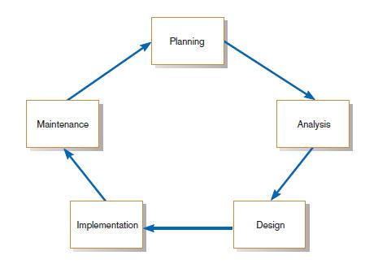
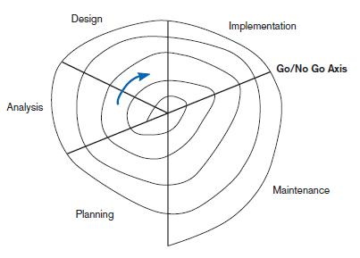
Standard and Evolutionary Views of SDLC
Evolutionary model
The systems development life cycle

Slide 13
Systems Development Life Cycle (SDLC) (Cont.)
Planning – an organization’s total information system needs are identified, analyzed, prioritized, and arranged
Analysis – system requirements are studied and structured

Slide 14
Systems Development Life Cycle (SDLC) (Cont.)
Design – a description of the recommended solution is converted into logical and then physical system specifications
Logical design – all functional features of the system chosen for development in analysis are described independently of any computer platform

Slide 15
Systems Development Life Cycle (SDLC) (Cont.)
Physical design – the logical specifications of the system from logical design are transformed into the technology-specific details from which all programming and system construction can be accomplished

Slide 16
Systems Development Life Cycle (SDLC) (Cont.)
Implementation – the information system is coded, tested, installed and supported in the organization
Maintenance – an information system is systematically repaired and improved

Slide 17
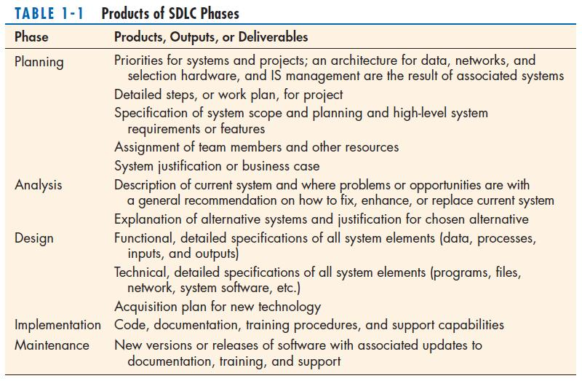

Slide 18
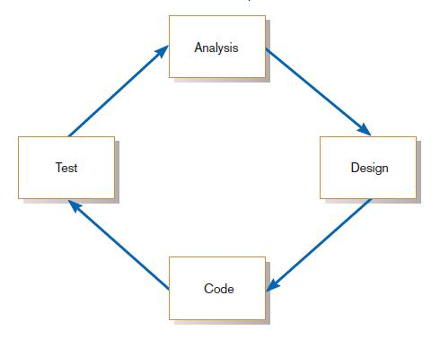
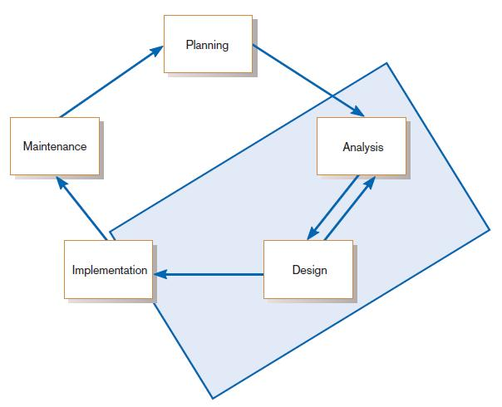
The Heart of the Systems Development Process
The analysis–design–code–test loop
Current practice combines analysis, design, and implementation into a single iterative and parallel process of activities.

Slide 19
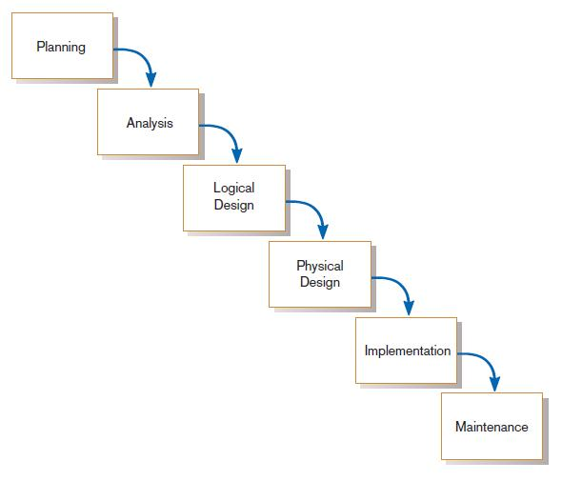
Traditional Waterfall SDLC
One phase begins when another completes, with little backtracking and looping.
A traditional waterfall SDLC

Slide 20
The waterfall model

Slide 21
Waterfall model phases
There are separate identified phases in the waterfall model:
Requirements analysis and definition
System and software design
Implementation and unit testing
Integration and system testing
Operation and maintenance
The main drawback of the waterfall model is the difficulty of accommodating change after the process is underway. In principle, a phase has to be complete before moving onto the next phase.

Slide 22
Waterfall model problems
Inflexible partitioning of the project into distinct stages makes it difficult to respond to changing customer requirements.
Therefore, this model is only appropriate when the requirements are well-understood and changes will be fairly limited during the design process.
Few business systems have stable requirements.
The waterfall model is mostly used for large systems engineering projects where a system is developed at several sites.
In those circumstances, the plan-driven nature of the waterfall model helps coordinate the work.

Slide 23
Different Approaches to Improving Development
CASE Tools
Rapid Application Development (RAD)
Agile Methodologies
eXtreme Programming

Slide 24
Computer-Aided Software Engineering (CASE) Tools
Diagramming tools enable graphical representation.
Computer displays and report generators help prototype how systems “look and feel”.

Slide 25
Computer-Aided Software Engineering (CASE) Tools (Cont.)
Analysis tools automatically check for consistency in diagrams, forms, and reports.
A central repository provides integrated storage of diagrams, reports, and project management specifications.

Slide 26
Computer-Aided Software Engineering (CASE) Tools (Cont.)
Documentation generators standardize technical and user documentation.
Code generators enable automatic generation of programs and database code directly from design documents, diagrams, forms, and reports.

Slide 27
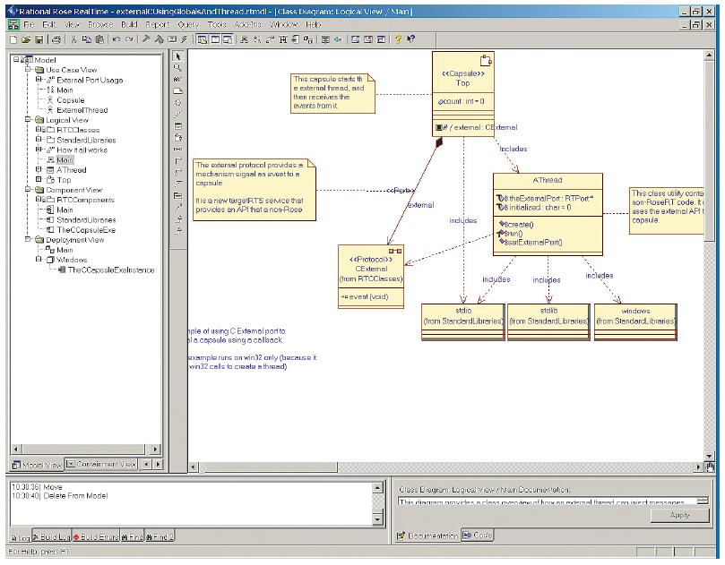
Computer-Aided Software Engineering (CASE) Tools (Cont.)
A class diagram from IBM’s Rational Rose
(Source: IBM)

Slide 28
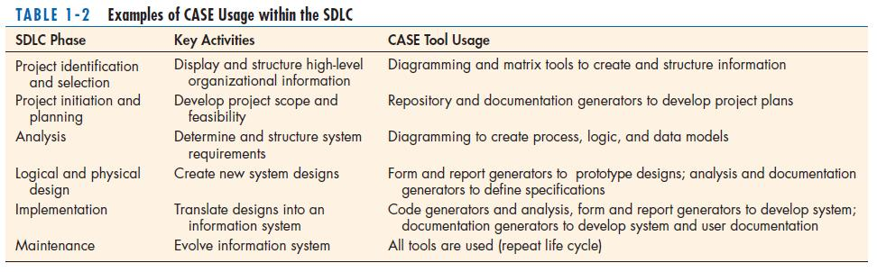
CASE Tools (Cont.)

Slide 29
Rapid Application Development (RAD)
Methodology to radically decrease design and implementation time
Involves: extensive user involvement, prototyping, JAD sessions, integrated CASE tools, and code generators

Slide 30
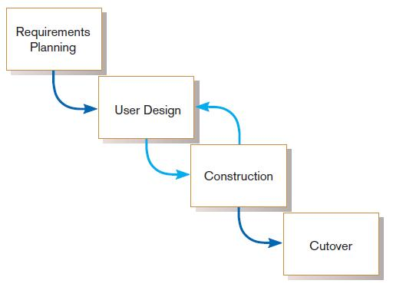
Rapid Application Development (RAD) (Cont.)
RAD life cycle

Slide 31
Service-Oriented Architecture (SOA)
An approach to systems development based on building complete systems through assembling software components, each of which model generic business functions

Slide 32
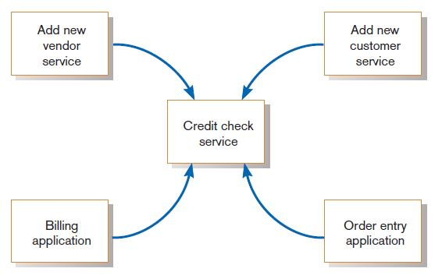
Service-Oriented Architecture (SOA) (Cont.)
Illustration of a service, a credit check,
used by applications and other services

Slide 33
Agile Methodologies
Motivated by recognition of software development as fluid, unpredictable, and dynamic
Three key principles
Adaptive rather than predictive
Emphasize people rather than roles
Self-adaptive processes

Slide 34
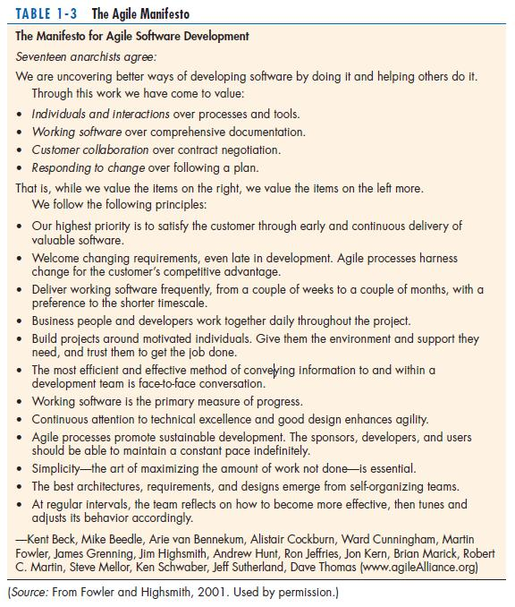
The Agile Methodologies group argues that software development methodologies
adapted from engineering generally do not fit with real-world software development.

Slide 35
When to use Agile Methodologies
If your project involves:
Unpredictable or dynamic requirements
Responsible and motivated developers
Customers who understand the process and will get involved

Slide 36
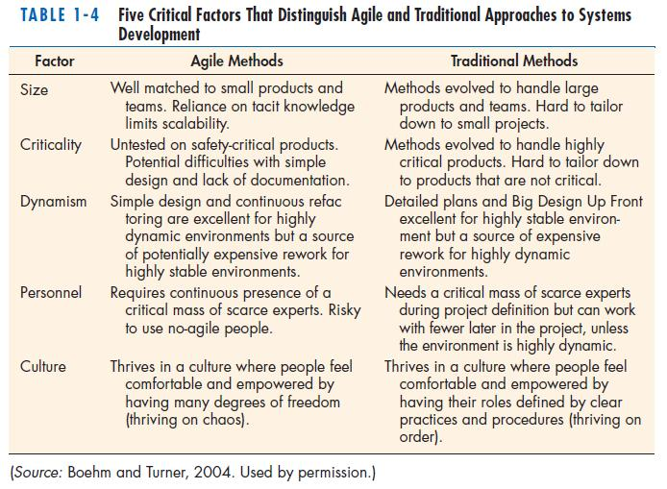

Slide 37
eXtreme Programming
Short, incremental development cycles
Automated tests
Two-person programming teams

Slide 38
eXtreme Programming (Cont.)
Coding and testing operate together
Advantages:
Communication between developers
High level of productivity
High-quality code

Slide 39
Object-Oriented Analysis and Design (OOAD)
Based on objects rather than data or processes
Object: a structure encapsulating attributes and behaviors of a real-world entity

Slide 40
Object-Oriented Analysis and Design (OOAD) (Cont.)
Object class: a logical grouping of objects sharing the same attributes and behaviors
Inheritance: hierarchical arrangement of classes enable subclasses to inherit properties of superclasses

Slide 41
Rational Unified Process (RUP)
An object-oriented systems development methodology
RUP establishes four phase of development: inception, elaboration, construction, and transition.
Each phase is organized into a number of separate iterations.

Slide 42
Incremental development

Slide 43
Incremental development benefits
The cost of accommodating changing customer requirements is reduced.
The amount of analysis and documentation that has to be redone is much less than is required with the waterfall model.
It is easier to get customer feedback on the development work that has been done.
Customers can comment on demonstrations of the software and see how much has been implemented.
More rapid delivery and deployment of useful software to the customer is possible.
Customers are able to use and gain value from the software earlier than is possible with a waterfall process.

Slide 44
Incremental development problems
The process is not visible.
Managers need regular deliverables to measure progress. If systems are developed quickly, it is not cost-effective to produce documents that reflect every version of the system.
System structure tends to degrade as new increments are added.
Unless time and money is spent on refactoring to improve the software, regular change tends to corrupt its structure. Incorporating further software changes becomes increasingly difficult and costly.

Slide 45
Integration and configuration
Based on software reuse where systems are integrated from existing components or application systems (sometimes called COTS -Commercial-off-the-shelf) systems).
Reused elements may be configured to adapt their behaviour and functionality to a user’s requirements
Reuse is now the standard approach for building many types of business system
Reuse covered in more depth in Chapter 15.

Slide 46
Types of reusable software
Stand-alone application systems (sometimes called COTS) that are configured for use in a particular environment.
Collections of objects that are developed as a package to be integrated with a component framework such as .NET or J2EE.
Web services that are developed according to service standards and which are available for remote invocation.

Slide 47
Reuse-oriented software engineering

Slide 48
Key process stages
Requirements specification
Software discovery and evaluation
Requirements refinement
Application system configuration
Component adaptation and integration

Slide 49
Advantages and disadvantages
Reduced costs and risks as less software is developed from scratch
Faster delivery and deployment of system
But requirements compromises are inevitable so system may not meet real needs of users
Loss of control over evolution of reused system elements

Slide 50
Process activities

Slide 51
Process activities
Real software processes are inter-leaved sequences of technical, collaborative and managerial activities with the overall goal of specifying, designing, implementing and testing a software system.
The four basic process activities of specification, development, validation and evolution are organized differently in different development processes.
For example, in the waterfall model, they are organized in sequence, whereas in incremental development they are interleaved.

Slide 52
The requirements engineering process

Slide 53
Software specification
The process of establishing what services are required and the constraints on the system’s operation and development.
Requirements engineering process
Requirements elicitation and analysis
What do the system stakeholders require or expect from the system?
Requirements specification
Defining the requirements in detail
Requirements validation
Checking the validity of the requirements

Slide 54
Software design and implementation
The process of converting the system specification into an executable system.
Software design
Design a software structure that realises the specification;
Implementation
Translate this structure into an executable program;
The activities of design and implementation are closely related and may be inter-leaved.

Slide 55
A general model of the design process

Slide 56
Design activities
Architectural design, where you identify the overall structure of the system, the principal components (subsystems or modules), their relationships and how they are distributed.
Database design, where you design the system data structures and how these are to be represented in a database.
Interface design, where you define the interfaces between system components.
Component selection and design, where you search for reusable components. If unavailable, you design how it will operate.

Slide 57
System implementation
The software is implemented either by developing a program or programs or by configuring an application system.
Design and implementation are interleaved activities for most types of software system.
Programming is an individual activity with no standard process.
Debugging is the activity of finding program faults and correcting these faults.

Slide 58
Software validation
Verification and validation (V & V) is intended to show that a system conforms to its specification and meets the requirements of the system customer.
Involves checking and review processes and system testing.
System testing involves executing the system with test cases that are derived from the specification of the real data to be processed by the system.
Testing is the most commonly used V & V activity.

Slide 59
Stages of testing

Slide 60
Testing stages
Component testing
Individual components are tested independently;
Components may be functions or objects or coherent groupings of these entities.
System testing
Testing of the system as a whole. Testing of emergent properties is particularly important.
Customer testing
Testing with customer data to check that the system meets the customer’s needs.

Slide 61
Testing phases in a plan-driven software process (V-model)

Slide 62
Software evolution
Software is inherently flexible and can change.
As requirements change through changing business circumstances, the software that supports the business must also evolve and change.
Although there has been a demarcation between development and evolution (maintenance) this is increasingly irrelevant as fewer and fewer systems are completely new.

Slide 63
System evolution

Slide 64
Coping with change

Slide 65
Coping with change
Change is inevitable in all large software projects.
Business changes lead to new and changed system requirements
New technologies open up new possibilities for improving implementations
Changing platforms require application changes
Change leads to rework so the costs of change include both rework (e.g. re-analysing requirements) as well as the costs of implementing new functionality

Slide 66
Reducing the costs of rework
Change anticipation, where the software process includes activities that can anticipate possible changes before significant rework is required.
For example, a prototype system may be developed to show some key features of the system to customers.
Change tolerance, where the process is designed so that changes can be accommodated at relatively low cost.
This normally involves some form of incremental development. Proposed changes may be implemented in increments that have not yet been developed. If this is impossible, then only a single increment (a small part of the system) may have be altered to incorporate the change.

Slide 67
Coping with changing requirements
System prototyping, where a version of the system or part of the system is developed quickly to check the customer’s requirements and the feasibility of design decisions. This approach supports change anticipation.
Incremental delivery, where system increments are delivered to the customer for comment and experimentation. This supports both change avoidance and change tolerance.

Slide 68
Software prototyping
A prototype is an initial version of a system used to demonstrate concepts and try out design options.
A prototype can be used in:
The requirements engineering process to help with requirements elicitation and validation;
In design processes to explore options and develop a UI design;
In the testing process to run back-to-back tests.

Slide 69
Benefits of prototyping
Improved system usability.
A closer match to users’ real needs.
Improved design quality.
Improved maintainability.
Reduced development effort.

Slide 70
The process of prototype development

Slide 71
Prototype development
May be based on rapid prototyping languages or tools
May involve leaving out functionality
Prototype should focus on areas of the product that are not well-understood;
Error checking and recovery may not be included in the prototype;
Focus on functional rather than non-functional requirements such as reliability and security

Slide 72
Throw-away prototypes
Prototypes should be discarded after development as they are not a good basis for a production system:
It may be impossible to tune the system to meet non-functional requirements;
Prototypes are normally undocumented;
The prototype structure is usually degraded through rapid change;
The prototype probably will not meet normal organisational quality standards.

Slide 73
Incremental delivery
Rather than deliver the system as a single delivery, the development and delivery is broken down into increments with each increment delivering part of the required functionality.
User requirements are prioritised and the highest priority requirements are included in early increments.
Once the development of an increment is started, the requirements are frozen though requirements for later increments can continue to evolve.

Slide 74
Incremental development and delivery
Incremental development
Develop the system in increments and evaluate each increment before proceeding to the development of the next increment;
Normal approach used in agile methods;
Evaluation done by user/customer proxy.
Incremental delivery
Deploy an increment for use by end-users;
More realistic evaluation about practical use of software;
Difficult to implement for replacement systems as increments have less functionality than the system being replaced.

Slide 75
Incremental delivery

Slide 76
Incremental delivery advantages
Customer value can be delivered with each increment so system functionality is available earlier.
Early increments act as a prototype to help elicit requirements for later increments.
Lower risk of overall project failure.
The highest priority system services tend to receive the most testing.

Slide 77
Incremental delivery problems
Most systems require a set of basic facilities that are used by different parts of the system.
As requirements are not defined in detail until an increment is to be implemented, it can be hard to identify common facilities that are needed by all increments.
The essence of iterative processes is that the specification is developed in conjunction with the software.
However, this conflicts with the procurement model of many organizations, where the complete system specification is part of the system development contract.

Slide 78
Process improvement

Slide 79
Process improvement
Many software companies have turned to software process improvement as a way of enhancing the quality of their software, reducing costs or accelerating their development processes.
Process improvement means understanding existing processes and changing these processes to increase product quality and/or reduce costs and development time.

Slide 80
Approaches to improvement
The process maturity approach, which focuses on improving process and project management and introducing good software engineering practice.
The level of process maturity reflects the extent to which good technical and management practice has been adopted in organizational software development processes.
The agile approach, which focuses on iterative development and the reduction of overheads in the software process.
The primary characteristics of agile methods are rapid delivery of functionality and responsiveness to changing customer requirements.

Slide 81
The process improvement cycle

Slide 82
Process improvement activities
Process measurement
You measure one or more attributes of the software process or product. These measurements forms a baseline that helps you decide if process improvements have been effective.
Process analysis
The current process is assessed, and process weaknesses and bottlenecks are identified. Process models (sometimes called process maps) that describe the process may be developed.
Process change
Process changes are proposed to address some of the identified process weaknesses. These are introduced and the cycle resumes to collect data about the effectiveness of the changes.

Slide 83
Process measurement
Wherever possible, quantitative process data should be collected
However, where organisations do not have clearly defined process standards this is very difficult as you don’t know what to measure. A process may have to be defined before any measurement is possible.
Process measurements should be used to assess process improvements
But this does not mean that measurements should drive the improvements. The improvement driver should be the organizational objectives.

Slide 84
Process metrics
Time taken for process activities to be completed
E.g. Calendar time or effort to complete an activity or process.
Resources required for processes or activities
E.g. Total effort in person-days.
Number of occurrences of a particular event
E.g. Number of defects discovered.

Slide 85
Capability maturity levels

Slide 86
The SEI capability maturity model
Initial
Essentially uncontrolled
Repeatable
Product management procedures defined and used
Defined
Process management procedures and strategies defined and used
Managed
Quality management strategies defined and used
Optimising
Process improvement strategies defined and used

Slide 87
Key points
Software processes are the activities involved in producing a software system. Software process models are abstract representations of these processes.
General process models describe the organization of software processes.
Examples of these general models include the ‘waterfall’ model, incremental development, and reuse-oriented development.
Requirements engineering is the process of developing a software specification.

Slide 88
Key points
Design and implementation processes are concerned with transforming a requirements specification into an executable software system.
Software validation is the process of checking that the system conforms to its specification and that it meets the real needs of the users of the system.
Software evolution takes place when you change existing software systems to meet new requirements. The software must evolve to remain useful.
Processes should include activities such as prototyping and incremental delivery to cope with change.

Slide 89
Key points
Processes may be structured for iterative development and delivery so that changes may be made without disrupting the system as a whole.
The principal approaches to process improvement are agile approaches, geared to reducing process overheads, and maturity-based approaches based on better process management and the use of good software engineering practice.
The SEI process maturity framework identifies maturity levels that essentially correspond to the use of good software engineering practice.

Slide 90
Next Lecture
Agile Software Development

Slide 91
References
Ian Sommerville; “Software Engineering”, 10th Global Ed., Pearson, 2016.
Jeffrey A. Hoffer, Joey F. George, Joseph S. Valacich; “Modern Systems Analysis and Design”, 7th International Ed., Pearson, 2014.

