Slide 1
Group 21
SEN 201
SOFTWARE PROTOTYPING TECHNIQUES
MEMBERS
IFIDON ABRAHAM AYOMIDE 251901513
ELEBIEMAYO ISEOLUWA EMMANUEL 240805045
LEMCHUKWU PASCAL IFEANYICHUKWU 240805076
AMINULAHI TAOFEEK 251901536
ADEBAYO OLOLADE ADETOLA 240805079

Slide 2
Case study:
Development of a Mobile Application for Local Event Discovery

Slide 3
“Lagos events app”
OVERVIEW
Lagos events app is an application that addresses a common real-life challenge in a vibrant city like Lagos, Nigeria: discovering and participating in local events such as cultural festivals, business networking meetups, concerts, workshops, and community gatherings
Currently, event information is scattered across social media, websites, and word-of-mouth, leading to missed opportunities, especially for busy professionals, students, and tourists

Slide 4
TARGET FUNCTION
The app would aggregate events from various sources (e.g., APIs from event platforms, user submissions, and partnerships with local organizers), allow users to search by location, category, date, or price, view details, register/RSVP, and receive notifications
It's feasible and implementable using cross-platform frameworks like Flutter or React Native, with backend support from Firebase or AWS for data storage and real-time updates.

Slide 5
PROTOTYPE IMPLEMENTATION SUMMARY
The development will adopt a prototyping-based methodology, combining throw-away and low-fidelity prototype). This approach emphasizes early feedback, risk reduction, and iterative refinement to ensure the app meets user needs while minimizing development costs and time. It allows exploration of the problem space (e.g., user pain points in event discovery) and solution space (e.g., UI/UX designs for intuitive navigation on mobile devices).

Slide 6
Prototyping Technique Applied
Prototyping Technique Applied
Throwaway and low-fidelity prototyping
Why? Quick to create, low cost, focuses on layout & flow, gathers early feedback

Slide 7
Step-by-step process followed:
Define basic requirements
Create simple wireframes (screens & user flow
Show to potential users for feedback
Refine layout & features

Slide 8
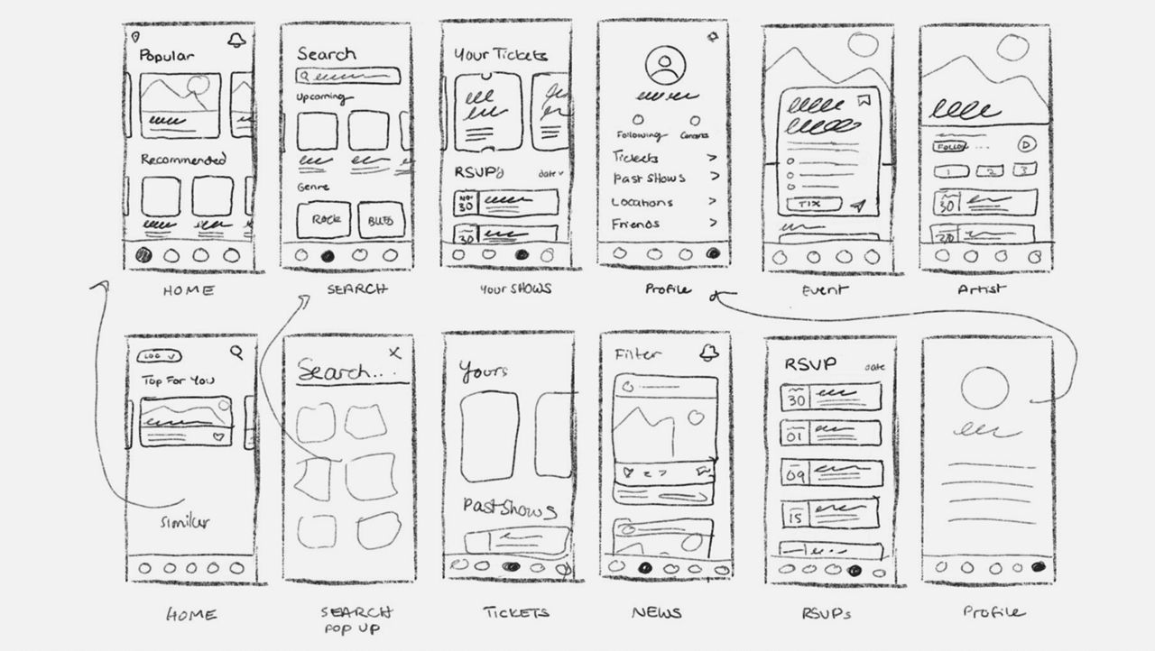
Throw away prototype – Main User Flow
Fig 1. search and home main user flow
Description: the main landing screen helps users see after opening the app it also helps users find specific content or features within the app

Slide 9
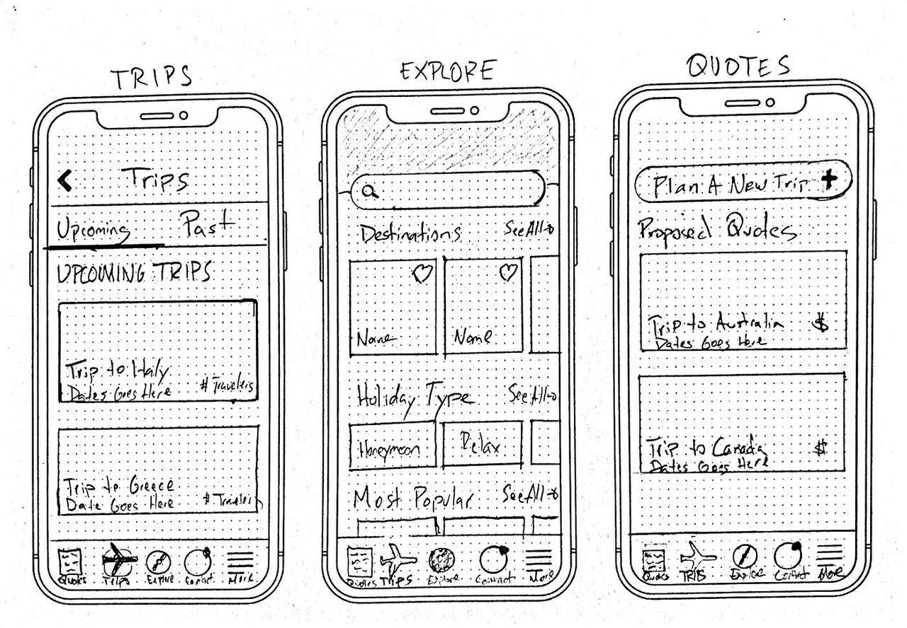
Fig2 rsvp/confirmation page
Description:
helps users action e.g place orders or join events, it shows details of the events time and shows order summary, also provides next steps or additional info

Slide 10
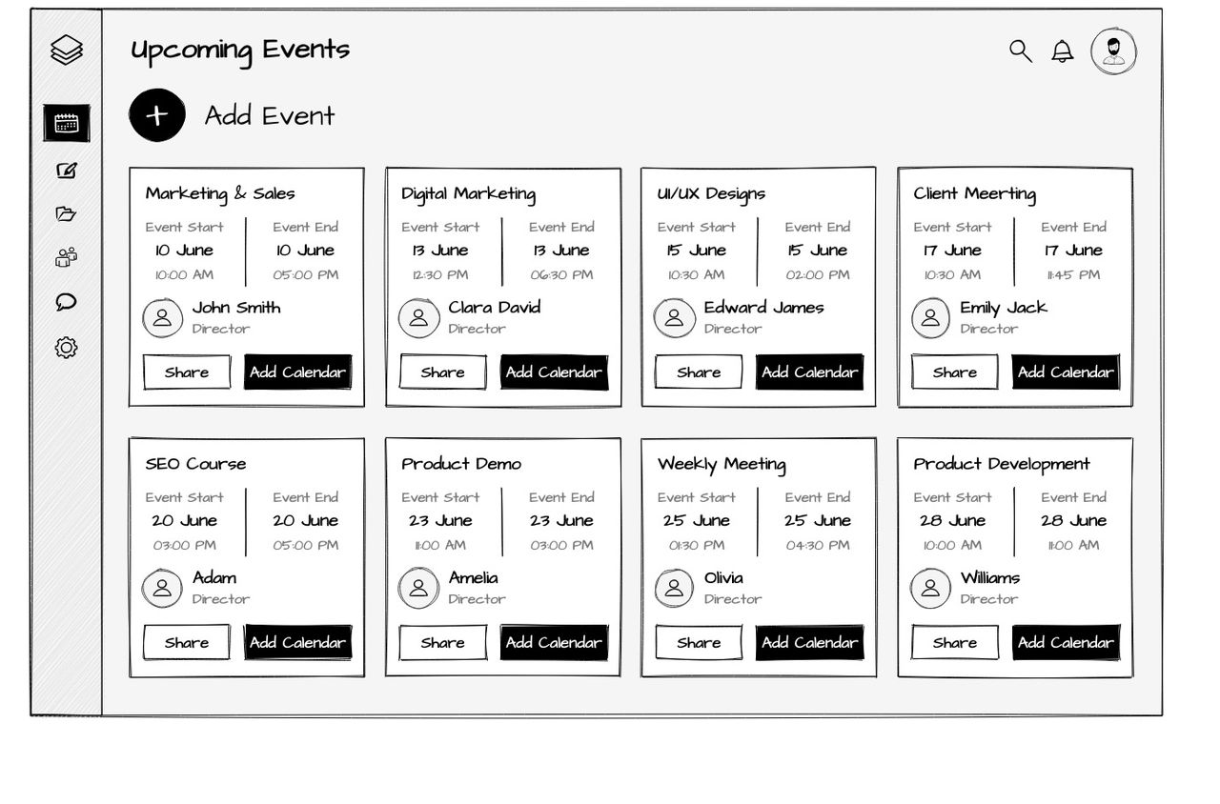
Fig3 mapping page
Description:
gives users eligibility to asses events faster

Slide 11
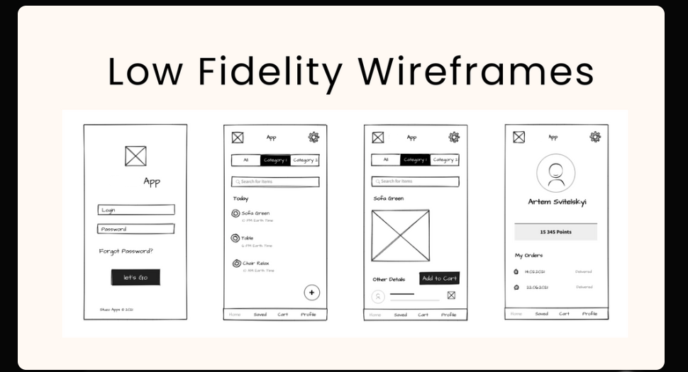
Low-Fidelity Prototypes
This helps users feel how the actual software will look
Fig4 login and profile wireframes

Slide 12
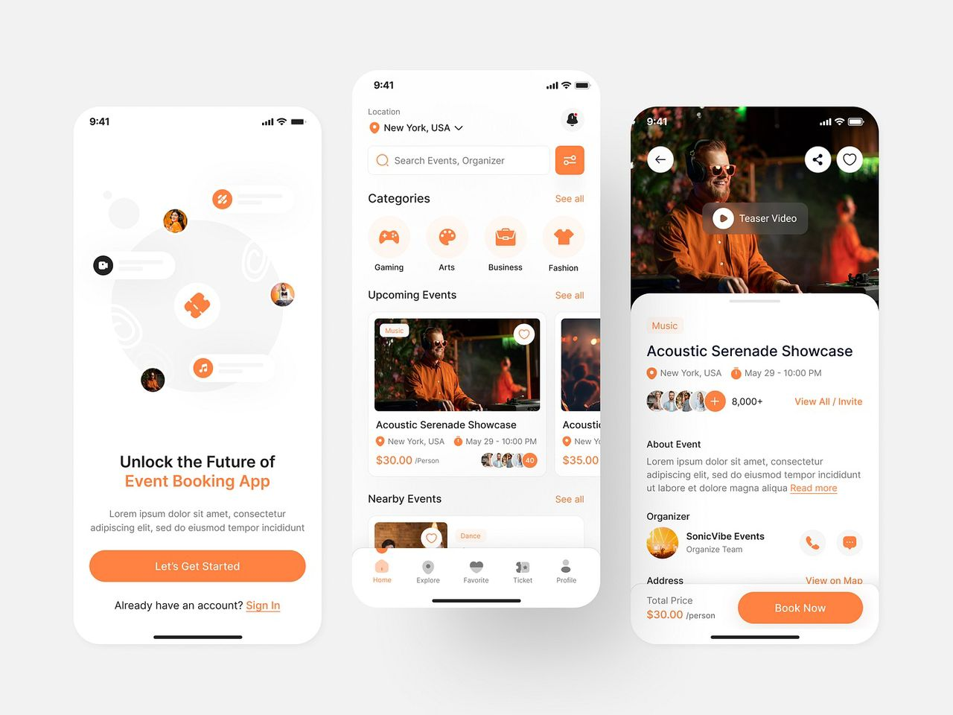
Fig5 Navigation wireframe prototype

Slide 13
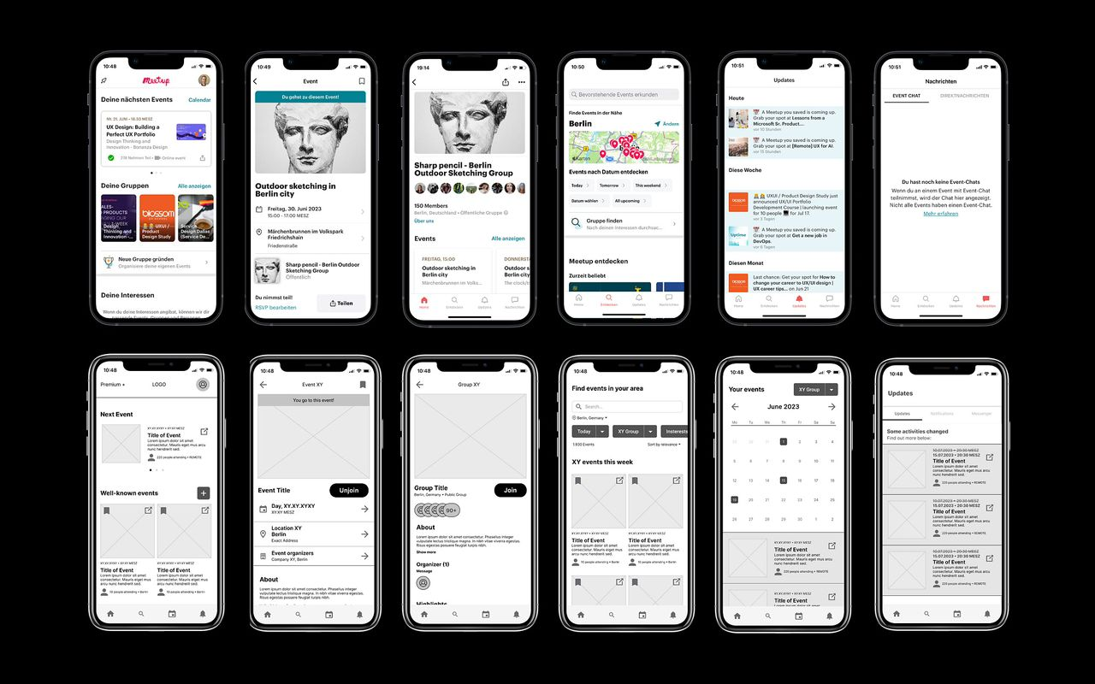
Fig6 overall overview mainframe prototype of Lagos events app

Slide 14
These wireframes were created quickly to visualize ideas and get user feedback on navigation and layout before coding
Thank you

