Slide 1
The Proper Way to Plan- The Waterfall Method!
STEM and Industrial Engineering
Toyota Production Systems Lab
Project Management & Leadership

Slide 2
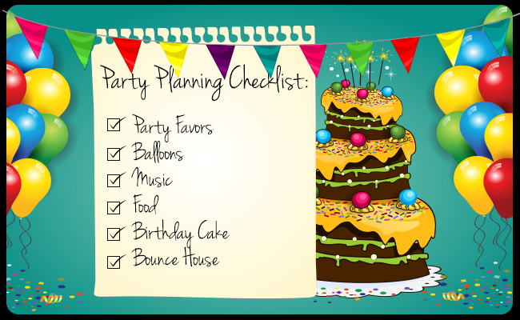
What does it mean to plan?
Planning is laying out what you are going to do, before you do it!
It’s very helpful with big, important tasks but it helps a lot with small ones too

Slide 3
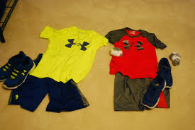
Who uses Planning?
Everyone uses planning!
Your friends, your family, and you use it all the time!
Can you think of any times you use it?
The next slide has an example

Slide 4

How You Might Use Planning
You know that feeling when you’re at school and you really want to play Roblox or Minecraft with your friends BUT you have to finish your homework first? That’s planning!
You want to reach your goal, and you plan out what you need to do first.
In this situation, your goal is to play games with friends.
First you have to get home
Next you have to finish your homework
Then you reach your goal!

Slide 5
How Your Parents Use Planning
You might not notice, but your parents are super busy!
Planning helps adults organize their week, so they don’t fall behind or forget about anything.
They might plan to drop you off at sports practice or dance and then pick up groceries!

Slide 6
Why is planning so important?
Planning things out saves so much time!
If you try to do everything without planning, you’ll run into problems.
Think about this: What if nobody planned out when you would do your homework?
Would it get done? (Hint: Probably not!)

Slide 7
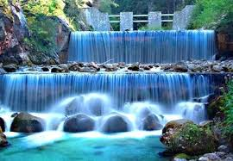
The Waterfall Method
What is the Waterfall Method?
It’s a type of planning that is used for simple tasks.
It got its name because it has steps that flow down like a waterfall!

Slide 8
How Can You Use it?
Let’s use an example: Going to school in the morning
What are the steps?
Step 1: Wake up
Step 2: Get dressed
Step 3: Eat breakfast
Step 4: Get on the bus
These are the steps, now let’s make it look like a waterfall

Slide 9

The Waterfall Method
In this order you can easily see which step is first!
This makes sense, because you can’t get dressed without waking up first.
Wake up
Get Dressed
Eat Breakfast
Get on the bus

Slide 10
Waterfall Planning Activity
One exciting way to use Waterfall planning is for planning your birthday party!
Grab some paper or use your computer to write down some things as we go through the process
Go to the next slide to start!

Slide 11
Waterfall Planning Activity
First, let’s make a BIG list of everything you might need to do before the party. Let’s pretend we’re going to a trampoline park.
Click for some ideas
Did you get them all?
Order the cake
Invite your friends
Decide what cake you want
Decide who will be invited
Figure out the food/drinks
Decide the party’s theme
Decide where the party will be and schedule it

Slide 12
Waterfall Planning Activity
Now, let’s arrange them in order of when we should do them! (Try it out and click to reveal the answer)
Decide who will be invited
Decide the party’s theme
Decide where the party will be and schedule it
Invite your friends!
Figure out the food/drinks
Decide what cake you want
Order the cake

Slide 13
Waterfall Planning Activity
Does the order of stuff really matter?
The answer is yes!
Planning helps organize your tasks so that you don’t make any mistakes.

Slide 14

Waterfall Planning Activity
What might happen if you invited everyone before you called the store and they didn’t have any spots open?
You can probably guess, it’ll be a big mess!
You would have to call everybody and tell them that you messed up and have to find another place for the party ☹
Invite your friends
Decide where the party will be and schedule it
Decide where the party will be and schedule it
Invite your friends

Slide 15
Some more examples!
Here are some more things you can try planning in your own house!
Making dinner with your parents (steps would be: choose a recipe, find out where they sell the ingredients, get the ingredients, cook!)
Baking cookies! (you would use the same steps as making dinner)
Getting a 100 on your test (steps would be: knowing what will be on the test, practicing the stuff on the test, knowing how to do everything very well, try your best, get a 100!)

Slide 16
What did we learn?
Planning makes complicated tasks easier
Everyone uses it!
Planning keeps you organized

Slide 17

Thank you!

