Slide 1
ICT 201:
INTRODUCTION TO INFORMATION AND COMMUNICATION TECHNOLOGY

Slide 2
Lecturers/Instructors
Dr. S. Akinboro
Dr. Ufuoma C. Ogude
0803 820 7103

Slide 3
Course Schedule
Lecture Schedule:
Mondays: 8:00am - 10:00am
Class Venue: Physical (Room S006) and Virtual
Please attend your lectures. Attendance is mandatory
Classroom Policy
Review recommended material before coming to class
Must be on time
Turn off cell phones
Expectations
Read assigned readings
Attend lectures and participate in discussions
Bring your ideas and concerns to class
Work effectively in a group setting
Learn how to use the tools and understand your project very well when necessary

Slide 4
Learning Outcomes
At the end of the course, students should be able to:
1. Identify components of the computer and know-how the components communicate;
2. Know the concept of data transfer and memory types and management;
3. Be comfortable with graphics processing;
4. Identify and be able to use different communication ports;
5. Know the software types;
6. State different computer network topologies and their sizes;
7. Be able to use office applications and the internet.

Slide 5
Course Contents
Basic principle of computers. Computer "backbone". Data transmission. Random Access Memory. Permanent Memory. Graphic processing. Communication Ports. Input and Output Devices. Software types. Accessibility options. Computer types. Portable digital devices. Network Types. Internet. Instant messaging. Voice over Internet Protocol. Really Simple Syndication. Network communication. Internet data transfer. Data rate units. Internet access. Virtual (online) communities. Computer in the workplace. Office Applications (word processing, spreadsheets, presentation, etc.). Other well-known applications. Telecommuting (telework).

Slide 6
Course Module
Module 1 Introduction to Information Communication Technology
Unit 1: Information Communication Technology: Principles, Practices, and Opportunities.
Unit 2: Essentials of Computing
Unit 3: The System Unit and the Central Processing Unit
Unit 4: Input Devices, Output Devices and Storage Devices and Memory
Module 2 Computer Networks, Distributed Networks and the Internet
Unit 5: Computer Networks, Networking Technologies and Communications Networks
Unit 6: Enterprise and Wireless Communications Networks
Unit 7: Essentials of the Internet and World Wide Web
Unit 8: Electronic Commerce and Electronic Business
Unit 9: Launching Information Technology Applications Projects
Module 3 Managing Information and Communication Technology Applications in the Enterprise.
Unit 10: Creating Enterprise Applications and Project Management
Unit 11: Web Based Application and Information Systems in the Enterprise
Unit 12: Issues in Information Technology and Careers in ICT

Slide 7
Course Outline
Week 1: Information Communication Technology: Principles, Practices, and Opportunities.
Week 2: Essentials of Computing
Week 3: The System Unit and the Central Processing Unit
Week 4: Input Devices, Output Devices and Storage Devices and Memory
Week 5: Computer Networks, Networking Technologies and Communications Networks
Week 6: Enterprise and Wireless Communications Networks
Week 7: Essentials of the Internet
Week 8: Electronic Commerce and Electronic Business
Week 9: Launching Information Technology Applications Projects
Week 10: Creating Enterprise Applications and Project Management
Week 11: Web Based Application and Information Systems in the Enterprise
Week 12: Issues in Information Technology and Careers in ICT
Week 13: Continuous Assessment
Week 14: Examination

Slide 8
Books and References
Use and Effects By: Harry Bouwman, Bart van den Hooff, Lidwien van de Wijngaert & Jan van Dijk, Publisher: SAGE Publications Ltd, Publication year: 2005, Online pub date: June 19, 2012
Discovering Computers. Living in a Digital World. FUNDAMENTALS, 2011 EDITION. Gary B. Shelly. Misty E. Vermaat. Shelly Cashman
Charles S. Parker, Understanding Computers: Today and Tomorrow, Course Technology, 25 Thomson Place, Boston, Massachusetts 02210, USA
Livesley, Robert Kenneth. An introduction to automatic digital computers. Cambridge University Press, 2017.
Zawacki-Richter, Olaf, and Colin Latchem. "Exploring four decades of research in Computers & Education." Computers & Education 122 (2018): 136-152.
Sinha, Pradeep K., and Priti Sinha. Computer fundamentals. BPB publications, 2010.
Goel, Anita. Computer fundamentals. Pearson Education India, 2010.

Slide 9
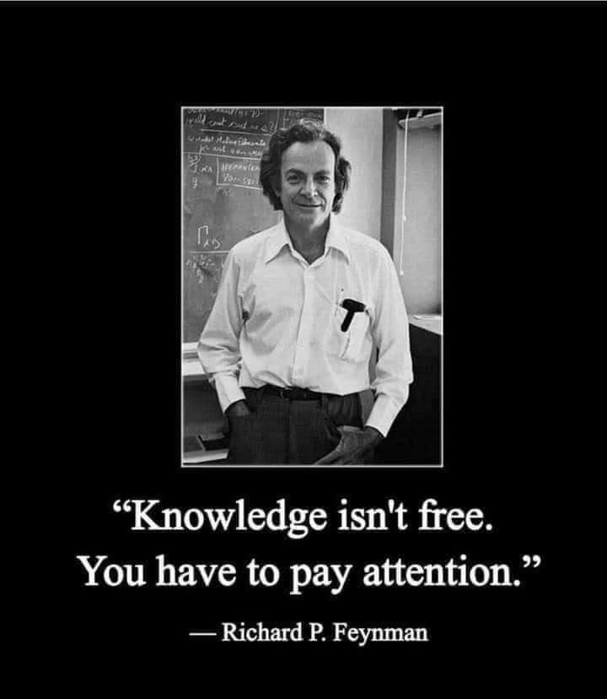
Pre-Requisite

Slide 10
Course Evaluation
Final Examination: 70%
Continuous Assessment: 30%
Written test
Assignments/Project

Slide 11
Week 10
CREATING ENTERPRISE APPLICATIONS AND PROJECT MANAGEMENT

Slide 12
Presentation Outline
Developing Open Shared Systems
Development Alternatives
Open Systems for Sharing
Shifting Development

Slide 13
DEVELOPING OPEN SHARED SYSTEMS
In an enterprise system, two or more users share computers, communication technology, and applications.
The introduction of an enterprise system into an organization affects everyone who interacts with the application or receives information generated by the system.
For this reason enterprise systems are not developed by individual staff members, but rather by the organizations information group known as the Management Information System (MIS) department.

Slide 14
DEVELOPMENT ALTERNATIVES
The information technology group can take any of the three approaches to developing an application:
Build the application itself.
Purchase a prewritten application.
Contract out the application development.

Slide 15
OPEN SYSTEMS FOR SHARING
Open System: A software system that runs on different computer and communications hardware.
Interoperability: The perfect exchange of data and information in all forms (data, text, sound, and image, including animation) between the individual components of an application (hardware, software, and network).

Slide 16
SHIFTING DEVELOPMENT
Craft Approach
Assembly Approach
Object: A component that contains data about itself and how it is to be processed.

Slide 17
PROJECT MANAGEMENT
Project management is the art of matching a project's goals, tasks, and resources to accomplish a goal.
To accomplish a goal one need limited time, money, and resources (human and machinery).
One can think of a project as a process that involves inputs and outputs.
Successful projects require doing the right things, with the right tools, and in the right way.

Slide 18
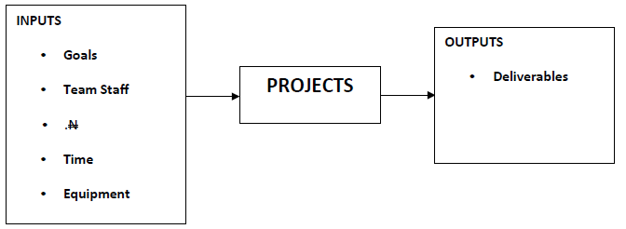
Simple Project Management System

Slide 19
STAGES OF A PROJECT AND HOW TO COMPLETE THEM
Stage 1: Defining the goals of the project
Stage 2: Define project tasks/activities
Stage 3: Determine and verify resource requirements
Stage 4: Identify risks and develop mitigation (backup) plans
Stage 5: Develop a schedule
Stage 6: Execute the schedule
Stage 7: Finish the project and assessing performance

Slide 20
CONCLUSION
Project Management provides the basic skills and knowledge needed to effectively manage a group project through project scheduling, understanding and handling risk.
Project management can be managed by either an IT staff or a Specialist with management skills or by Software

Slide 21
SUMMARY
In this unit, you learnt that:
Project management is a team work
Responsibilities should be shared among team members
Project Managers are designed to schedule, plan, and control project resources.
Pert charts and Gant charts are tools used in scheduling activities
Having a vision, setting a goal and working towards achieving it reduces missing target.

Slide 22
Week 11
WEB BASED APPLICATION AND INFORMATION SYSTEMS IN THE ENTERPRISE

Slide 23
Presentation Outline
How Web-Based Application Work
Procedures of Using Web-Based Application
Forces behind Web-Enabled Systems: Web Services

Slide 24
APPLICATION SERVICE PROVIDER (ASPS)
Special web sites, called Application Service Providers (ASPs), allow access to their application programs.
To use one of these Web-based applications, you would connect to the ASP, copy the application program to your computer system’s memory, and then run the application.
Most ASPs provide access to a wide range of application programs and charge a fee for their services

Slide 25
HOW WEB-BASED APPLICATION WORK
Step 1: Connect

