Slide 1
ICT 201:
INTRODUCTION TO INFORMATION AND COMMUNICATION TECHNOLOGY

Slide 2
Lecturers/Instructors
Dr. S. Akinboro
Dr. Ufuoma C. Ogude
0803 820 7103

Slide 3
Course Schedule
Lecture Schedule:
Mondays: 8:00am - 10:00am
Class Venue: Physical (Room S006) and Virtual
Please attend your lectures. Attendance is mandatory
Classroom Policy
Review recommended material before coming to class
Must be on time
Turn off cell phones
Expectations
Read assigned readings
Attend lectures and participate in discussions
Bring your ideas and concerns to class
Work effectively in a group setting
Learn how to use the tools and understand your project very well when necessary

Slide 4
Learning Outcomes
At the end of the course, students should be able to:
1. Identify components of the computer and know-how the components communicate;
2. Know the concept of data transfer and memory types and management;
3. Be comfortable with graphics processing;
4. Identify and be able to use different communication ports;
5. Know the software types;
6. State different computer network topologies and their sizes;
7. Be able to use office applications and the internet.

Slide 5
Course Contents
Basic principle of computers. Computer "backbone". Data transmission. Random Access Memory. Permanent Memory. Graphic processing. Communication Ports. Input and Output Devices. Software types. Accessibility options. Computer types. Portable digital devices. Network Types. Internet. Instant messaging. Voice over Internet Protocol. Really Simple Syndication. Network communication. Internet data transfer. Data rate units. Internet access. Virtual (online) communities. Computer in the workplace. Office Applications (word processing, spreadsheets, presentation, etc.). Other well-known applications. Telecommuting (telework).

Slide 6
Course Module
Module 1 Introduction to Information Communication Technology
Unit 1: Information Communication Technology: Principles, Practices, and Opportunities.
Unit 2: Essentials of Computing
Unit 3: The System Unit and the Central Processing Unit
Unit 4: Input Devices, Output Devices and Storage Devices and Memory
Module 2 Computer Networks, Distributed Networks and the Internet
Unit 5: Computer Networks, Networking Technologies and Communications Networks
Unit 6: Enterprise and Wireless Communications Networks
Unit 7: Essentials of the Internet and World Wide Web
Unit 8: Electronic Commerce and Electronic Business
Unit 9: Launching Information Technology Applications Projects
Module 3 Managing Information and Communication Technology Applications in the Enterprise.
Unit 10: Creating Enterprise Applications and Project Management
Unit 11: Web Based Application and Information Systems in the Enterprise
Unit 12: Issues in Information Technology and Careers in ICT

Slide 7
Course Outline
Week 1: Information Communication Technology: Principles, Practices, and Opportunities.
Week 2: Essentials of Computing
Week 3: The System Unit and the Central Processing Unit
Week 4: Input Devices, Output Devices and Storage Devices and Memory
Week 5: Computer Networks, Networking Technologies and Communications Networks
Week 6: Enterprise and Wireless Communications Networks
Week 7: Essentials of the Internet and World Wide Web
Week 8: Electronic Commerce and Electronic Business
Week 9: Launching Information Technology Applications Projects
Week 10: Creating Enterprise Applications and Project Management
Week 11: Web Based Application and Information Systems in the Enterprise
Week 12: Issues in Information Technology and Careers in ICT
Week 13: Continuous Assessment
Week 14: Examination

Slide 8
Books and References
Use and Effects By: Harry Bouwman, Bart van den Hooff, Lidwien van de Wijngaert & Jan van Dijk, Publisher: SAGE Publications Ltd, Publication year: 2005, Online pub date: June 19, 2012
Discovering Computers. Living in a Digital World. FUNDAMENTALS, 2011 EDITION. Gary B. Shelly. Misty E. Vermaat. Shelly Cashman
Charles S. Parker, Understanding Computers: Today and Tomorrow, Course Technology, 25 Thomson Place, Boston, Massachusetts 02210, USA
Livesley, Robert Kenneth. An introduction to automatic digital computers. Cambridge University Press, 2017.
Zawacki-Richter, Olaf, and Colin Latchem. "Exploring four decades of research in Computers & Education." Computers & Education 122 (2018): 136-152.
Sinha, Pradeep K., and Priti Sinha. Computer fundamentals. BPB publications, 2010.
Goel, Anita. Computer fundamentals. Pearson Education India, 2010.

Slide 9
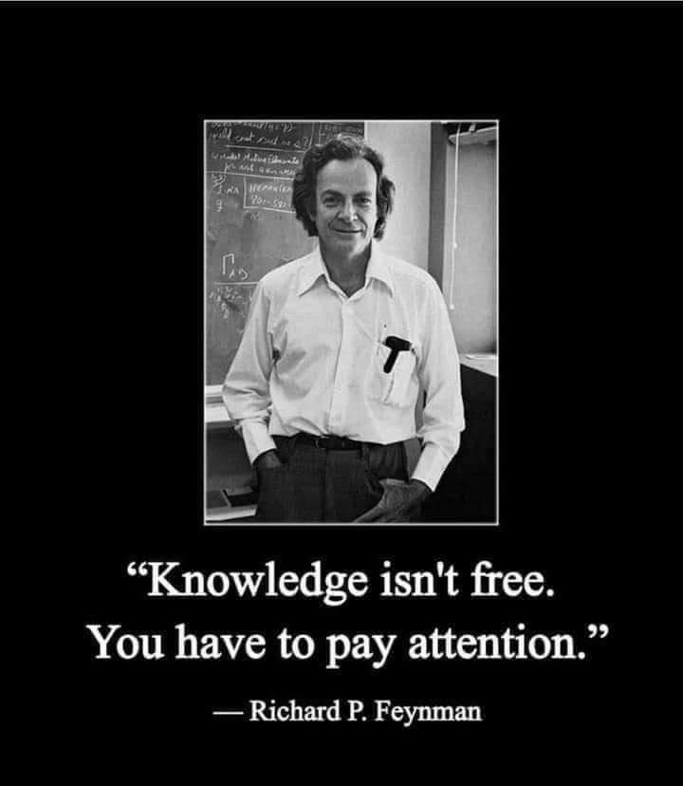
Pre-Requisite

Slide 10
Course Evaluation
Final Examination: 70%
Continuous Assessment: 30%
Written test
Assignments/Project

Slide 11
Week 1
INFORMATION COMMUNICATION TECHNOLOGY:
PRINCIPLES, PRACTICES, AND OPPORTUNITIES.

Slide 12
Presentation Outline
INFORMATION AND COMMUNICATION TECHNOLOGY
CONCEPT OF INFORMATION AND COMMUNICATION TECHNOLOGIES (ICT)
THE PRINCIPLES OF INFORMATION TECHNOLOGY
THE OPPORTUNITIES OF INFORMATION TECHNOLOGY

Slide 13
INFORMATION AND COMMUNICATION TECHNOLOGY
Information and communication technologies (ICT) is an umbrella term that covers all advanced technologies in manipulating and communicating Information.
The term is sometimes used in preference to Information Technology (IT) or "InfoTech".
It is sometimes said to have been coined by Jim Domsic of Michigan in November 1981, to modernize the outdated phrase "data processing".
Information Technology means the processing and distribution of data using computer hardware and software, telecommunications, and digital electronics.
This unit will give us a background view on Information Communications Technology (ICT).

Slide 14
CONCEPT OF INFORMATION AND COMMUNICATION TECHNOLOGIES (ICT)
Focusing on the three words behind ICT:
INFORMATION
COMMUNICATIONS
TECHNOLOGY
We can deduce that ICT is concerned with the storage, retrieval, manipulation, transmission or receipt of digital data. Importantly, it is also concerned with the way these different uses can work with each other in business.

Slide 15
CONCEPT OF INFORMATION AND COMMUNICATION TECHNOLOGIES (ICT)
The nature of information (the "I" in ICT) covers areas such as the meaning and value of information; how information is controlled;
Management of information - this covers how data is captured, verified and stored for effective use; the manipulation, processing and distribution of information; keeping information secure; networks design to share information.
Information systems strategy - this considers how ICT can be used within a business or organization as part of achieving goals and objectives.
The C part of ICT refers to the communication of data by electronic means, usually over some distance.
This is often achieved via networks of sending and receiving equipment, wires and satellite links.
The T part of ICT refers to the more recent, and fast-growing range of digital technologies which allow people and organizations to communicate and share information digitally

Slide 16
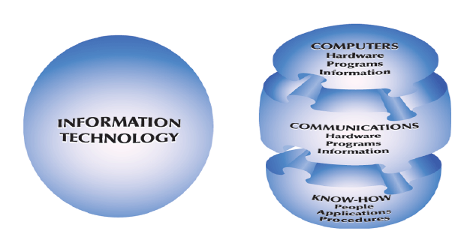
CONCEPT OF INFORMATION AND COMMUNICATION TECHNOLOGIES (ICT)
ICT three main components are
Computers; used to process data into information,
Communications networks; transmission of information,
Know-how; the technology used for the transmission

Slide 17
COMPUTERS
A computer is an electronic system that can be instructed to accept, process, store, and present data and information.
It is made up of two component parts: hardware and software.
Hardware: The computer and its associated equipment.
Software: The general term for a set of instructions that controls a computer or a communications network.
Program: A set of instructions that directs a computer to perform certain tasks and produce certain results.
System: A set of components that interact to accomplish a purpose.
Data: Raw facts, figures, and details.

Slide 18
COMPUTERS
Information: An organized, meaningful, and useful interpretation of data.
Knowledge: An awareness and understanding of a set of information and how that information can be put to the best use.
Information System: A business information system designed to produce the information needed for successful management of a structured problem, process, department, or business.
Computers come in four sizes:
Microcomputers
Midrange computers
Mainframes
Supercomputers

Slide 19
COMMUNICATIONS NETWORKS
Communications Network can be defined as a set of locations, or nodes, consisting of hardware, programs, and information linked together as a system that transmits and receives data and information.
Communication: The sending and receiving of data and information over a communications network.
Data Communication: The transmission of data and information through a communications medium.

Slide 20
KNOW-HOW
Know-how is the capability to do something well. Information technology know-how consists of:
Familiarity with the tools of IT; including the Internet
Possession of the skills needed to use these tools
An understanding of when to use IT to solve a problem or create an opportunity

Slide 21
PRINCIPLES OF INFORMATION TECHNOLOGY
A principle is a fundamental rule, guideline, or motivating idea that, when applied to a situation, produces a desired result.
ICT’s great usefulness is an aid in solving problems, unlocking creativity, and making people more effective than they would be if they did not apply ICT to their activities.

Slide 22
FUNCTIONS OF INFORMATION TECHNOLOGY
Information Technology is made up of nine (9) major functions, namely;
Capture,
Verifying,
Processing/Manipulation,
Storage,
Retrieval,
Data Update,
Reproducing,
Transmit/Communication, and
Generation.

Slide 23
FUNCTIONS OF INFORMATION TECHNOLOGY
Capture: The process of compiling detailed records of activities. This could be by recording of data from an event or occurrence, in some form such as sales slips, personnel forms, purchase orders, meters, course registration forms, etc.
Verifying: Is the operation for checking or validating of data to ensure it was captured and recorded correctly.
Processing/Manipulation: The process of converting, analyzing, computing, and synthesizing all forms of data or information.
Classifying: Is the operation for placing data elements into specific categories such as size, type, customer, etc.

Slide 24
FUNCTIONS OF INFORMATION TECHNOLOGY
Arranging (Sorting): This is placing data elements in a specified or predefined sequence.
Calculating: This entails the arithmetic and /or logical manipulation of data e.g. computations to derive employee’s pay, customer’s bills etc.
Summarizing: Reducing data in logical sense. For example the school principal may only be interested in the total amount of the development levies collected out of the total school fees.
Storage: This entails placing data onto some storage media such as magnetic disk, etc where it can be retrieved when needed.

Slide 25
FUNCTIONS OF INFORMATION TECHNOLOGY
Retrieval: this entails searching out and gaining access to specific data elements from the medium where it was stored for further processing or for transmission to another user.
Data Update: This involves making changes to the stored data. Such changes may be to insert new records or modify some data items of the existing record. However, this is usually the exclusive preserve of a class of authorized data users
Reproducing: This entails duplicating data from one medium to another or into another position in the same medium. Example a file of data stored on a magnetic disk may be reproduced onto another disk or onto a magnetic tape for further processing or for security reasons.

Slide 26
FUNCTIONS OF INFORMATION TECHNOLOGY
Transmission/Communication: The computer process of distributing information over a communications network. This entails transfer of data from one place to another e.g. data can be transferred from a device to a user in form of a report or a display on the screen of a computer controlled terminal.
Electronic Mail, or E-Mail
Voice Messaging, or Voice Mail
Generation: The process of organizing information into a useful form, whether as numbers, text, sound, or visual image.

Slide 27
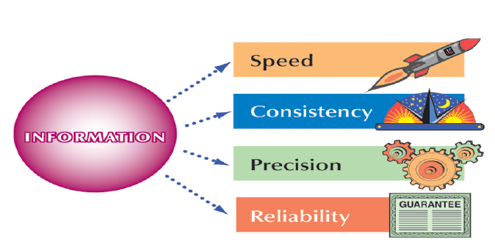
BENEFITS OF INFORMATION TECHNOLOGY
The benefits of ICT are Information processing speed, consistency, accuracy and reliability as illustrated in the diagram bellow.

Slide 28
OPPORTUNITIES OF INFORMATION TECHNOLOGY
Helping People
Solving Problems
Problem: A perceived difference between an existing condition and a desired condition.
Problem Solving: The process of recognizing a problem, identifying alternatives for solving it, and successfully implementing the chosen solution.

Slide 29
OPPORTUNITIES OF INFORMATION TECHNOLOGY
Information technology is all around us, improving our lives especially in areas such as:
Media
Print (Newspaper, Magazines, Posters and Billboard)
Electronic (Television, Radio and Internet)
Education, Training, Entertainment, Shipping, Paperwork,
Money and Investments, Agriculture, Taxation and Accounting, Health and Medicine, Manufacturing, Journalism, Energy, and Sports.

Slide 30
CONCLUSION
Organizations today now require tools that will enable them to get relevant information easily and on time.
The responsibilities of using Information and Communication Technology (ICT) is to get people informed, make proper use of the technology and protect the information against unauthorized access by hackers and unethical users.

Slide 31
SUMMARY
The concepts, methods and applications involved in ICT are constantly evolving on an almost daily basis. A good way to think about ICT is to;
Consider all the uses of digital technology that already exist to help individuals, businesses and organizations use information,
Know the technique used to store, retrieve, manipulate, transmit or receive information electronically in a digital form,
Believe information and communication technology (ICT) has truly turned the world into a global village.

Slide 32
Exercise
Explain the term “Information”
List the Classification of Information
Mention any five ways by which information can be transmitted.
Name the three stages of information evolution.
Enumerate the Evolution of the Information Age
List the Characteristics of the Information Age
Why do we need computers to process data into information?

Slide 33
Week 2
ESSENTIALS OF COMPUTING

Slide 34
Presentation Outline
COMPUTER AND COMPUTER SYSTEM
FOUR CATEGORIES OF HARDWARE
RELATIONSHIP BETWEEN HARDWARE AND SOFTWARE.
USERS OF INFORMATION TECHNOLOGY AND IT PROFESSIONALS.

Slide 35
COMPUTER AND COMPUTER SYSTEM
Computer:
An electronic system that can be instructed to accept data as an input, process it and gives a result as an output, and in turn stores the data for retrieval in the long run is a computer

Slide 36
COMPUTER AND COMPUTER SYSTEM
Computer System:
The computer system is made up of two components parts (Hardware and Software). These components integrate and interrelate. They do this independently by interacting together to perform the basic operations of the computer system.
These components are linked together via cords and interface connectors, except for the user who is the people ware, the processes (procedures), and information (processed data).
Hardware
Software (Programs)
Information
People (People Ware)
Procedures

Slide 37
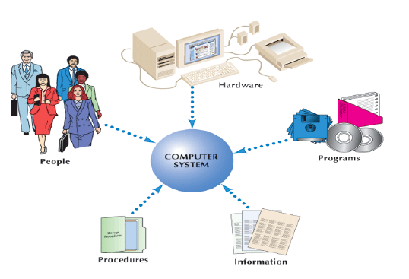
FIVE COMPONENTS OF A COMPUTER SYSTEM

