Slide 1
ICT 201:
INTRODUCTION TO INFORMATION AND COMMUNICATION TECHNOLOGY

Slide 2
Lecturers/Instructors
Dr. S. Akinboro
Dr. Ufuoma C. Ogude
0803 820 7103

Slide 3
Course Schedule
Lecture Schedule:
Mondays: 8:00am - 10:00am
Class Venue: Physical (Room S006) and Virtual
Please attend your lectures. Attendance is mandatory
Classroom Policy
Review recommended material before coming to class
Must be on time
Turn off cell phones
Expectations
Read assigned readings
Attend lectures and participate in discussions
Bring your ideas and concerns to class
Work effectively in a group setting
Learn how to use the tools and understand your project very well when necessary

Slide 4
Learning Outcomes
At the end of the course, students should be able to:
1. Identify components of the computer and know-how the components communicate;
2. Know the concept of data transfer and memory types and management;
3. Be comfortable with graphics processing;
4. Identify and be able to use different communication ports;
5. Know the software types;
6. State different computer network topologies and their sizes;
7. Be able to use office applications and the internet.

Slide 5
Course Contents
Basic principle of computers. Computer "backbone". Data transmission. Random Access Memory. Permanent Memory. Graphic processing. Communication Ports. Input and Output Devices. Software types. Accessibility options. Computer types. Portable digital devices. Network Types. Internet. Instant messaging. Voice over Internet Protocol. Really Simple Syndication. Network communication. Internet data transfer. Data rate units. Internet access. Virtual (online) communities. Computer in the workplace. Office Applications (word processing, spreadsheets, presentation, etc.). Other well-known applications. Telecommuting (telework).

Slide 6
Course Module
Module 1 Introduction to Information Communication Technology
Unit 1: Information Communication Technology: Principles, Practices, and Opportunities.
Unit 2: Essentials of Computing
Unit 3: The System Unit and the Central Processing Unit
Unit 4: Input Devices, Output Devices and Storage Devices and Memory
Module 2 Computer Networks, Distributed Networks and the Internet
Unit 5: Computer Networks, Networking Technologies and Communications Networks
Unit 6: Enterprise and Wireless Communications Networks
Unit 7: Essentials of the Internet and World Wide Web
Unit 8: Electronic Commerce and Electronic Business
Unit 9: Launching Information Technology Applications Projects
Module 3 Managing Information and Communication Technology Applications in the Enterprise.
Unit 10: Creating Enterprise Applications and Project Management
Unit 11: Web Based Application and Information Systems in the Enterprise
Unit 12: Issues in Information Technology and Careers in ICT

Slide 7
Course Outline
Week 1: Information Communication Technology: Principles, Practices, and Opportunities.
Week 2: Essentials of Computing
Week 3: The System Unit and the Central Processing Unit
Week 4: Input Devices, Output Devices and Storage Devices and Memory
Week 5: Computer Networks, Networking Technologies and Communications Networks
Week 6: Enterprise and Wireless Communications Networks
Week 7: Essentials of the Internet and World Wide Web
Week 8: Electronic Commerce and Electronic Business
Week 9: Launching Information Technology Applications Projects
Week 10: Creating Enterprise Applications and Project Management
Week 11: Web Based Application and Information Systems in the Enterprise
Week 12: Issues in Information Technology and Careers in ICT
Week 13: Continuous Assessment
Week 14: Examination

Slide 8
Books and References
Use and Effects By: Harry Bouwman, Bart van den Hooff, Lidwien van de Wijngaert & Jan van Dijk, Publisher: SAGE Publications Ltd, Publication year: 2005, Online pub date: June 19, 2012
Discovering Computers. Living in a Digital World. FUNDAMENTALS, 2011 EDITION. Gary B. Shelly. Misty E. Vermaat. Shelly Cashman
Charles S. Parker, Understanding Computers: Today and Tomorrow, Course Technology, 25 Thomson Place, Boston, Massachusetts 02210, USA
Livesley, Robert Kenneth. An introduction to automatic digital computers. Cambridge University Press, 2017.
Zawacki-Richter, Olaf, and Colin Latchem. "Exploring four decades of research in Computers & Education." Computers & Education 122 (2018): 136-152.
Sinha, Pradeep K., and Priti Sinha. Computer fundamentals. BPB publications, 2010.
Goel, Anita. Computer fundamentals. Pearson Education India, 2010.

Slide 9
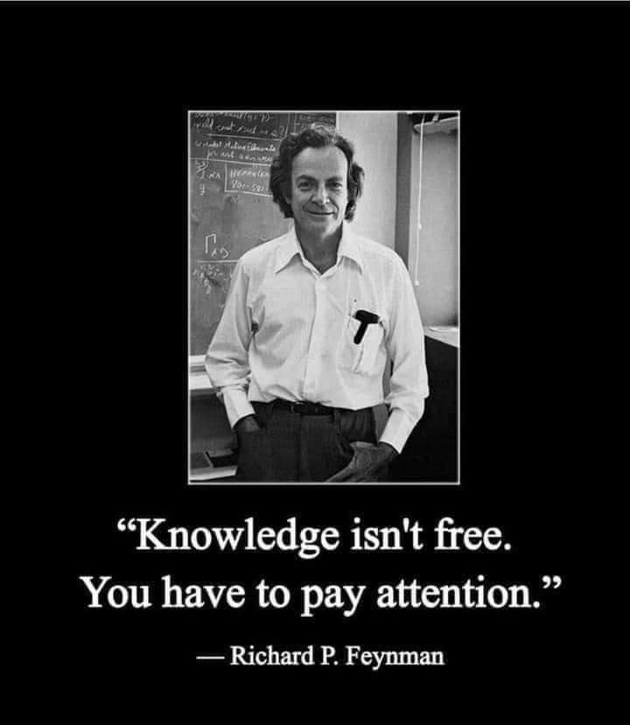
Pre-Requisite

Slide 10
Course Evaluation
Final Examination: 70%
Continuous Assessment: 30%
Written test
Assignments/Project

Slide 11
Week 2
ESSENTIALS OF COMPUTING

Slide 12
Presentation Outline
COMPUTER AND COMPUTER SYSTEM
FOUR CATEGORIES OF HARDWARE
RELATIONSHIP BETWEEN HARDWARE AND SOFTWARE.
USERS OF INFORMATION TECHNOLOGY AND IT PROFESSIONALS.

Slide 13
COMPUTER AND COMPUTER SYSTEM
Computer:
An electronic system that can be instructed to accept data as an input, process it and gives a result as an output, and in turn stores the data for retrieval in the long run is a computer

Slide 14
COMPUTER AND COMPUTER SYSTEM
Computer System:
The computer system is made up of two components parts (Hardware and Software). These components integrate and interrelate. They do this independently by interacting together to perform the basic operations of the computer system.
These components are linked together via cords and interface connectors, except for the user who is the people ware, the processes (procedures), and information (processed data).
Hardware
Software (Programs)
Information
People (People Ware)
Procedures

Slide 15
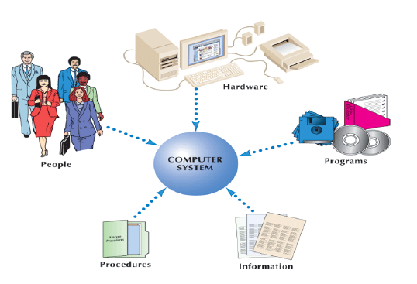
FIVE COMPONENTS OF A COMPUTER SYSTEM

Slide 16
HARDWARE (COMPUTER HARDWARE OR DEVICES)
The hardware component is the physical component of a computer system i.e. those parts of the computer that can be touched, felt and seen physically.
More or less, the hardware component consists of a combination of different devices which play specific roles in the operation of the computer system.
These devices that make up the hardware are classified into one of four units depending on the role they play in the computer system as follows:
Input devices (Keyboard, Mouse, Scanner, Camera etc)
Output devices (Printers, plotters etc)
Storage (Hard disk, floppy disk, CD, flash drives etc)
System unit (SU).

Slide 17
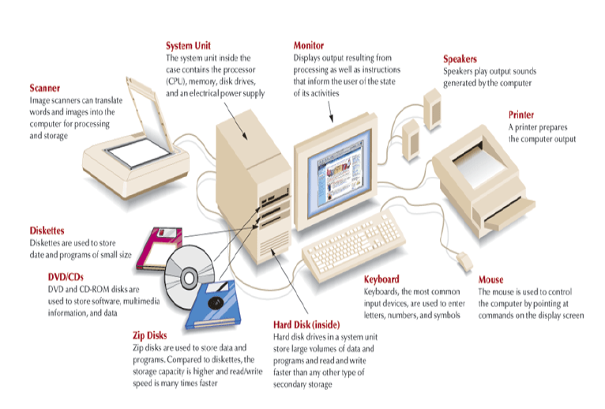
FOUR CATEGORIES OF HARDWARE AND COMMONLY USED MEDIA

Slide 18
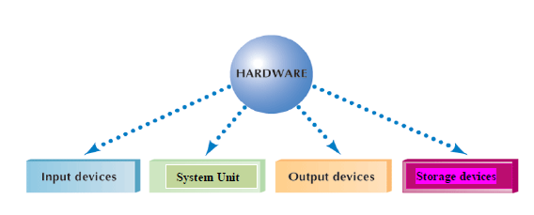
FOUR CATEGORIES OF HARDWARE

Slide 19
SOFTWARE
Software is the general term for the set of programs and data, which direct the hardware on what to do.
A program is an independent set of instructions, which work to direct the hardware to perform specified tasks.
In other words, software’s are set of logical instructions that put the hardware to tasks assigned to it. Software's are subdivided into Application and System software.
System software focuses on handling technical details.
Application software focuses on completing specific tasks or application.

Slide 20
SYSTEM SOFTWARE
These are programs expressly designed to make the computer more efficient and flexible as a human tool.
System software works with end users, application programs, and computer hardware to handle many details relating to computer operations.
Not a single program but a collection or system of programs. These programs handle hundreds of technical details with little or no user intervention.
Four kinds of system programs are operating systems, utilities, device drivers, and language translators.

Slide 21
SYSTEM SOFTWARE
Operating Systems (OS): coordinates resources, provide an interfaces between users and the computer, and run programs.
Utility (service programs): performs specific tasks related to managing computer resources.
Device Drivers: This is a program developed by the manufacturer of a device or computer hardware component to make the devices work on different software platforms.
The examples of such devices are network interface cards (NIC), sound cards, printers, and other computer peripherals.
Language Translator: converts programming instructions written by programmers into a language that computers can understand and process.

Slide 22
OPERATING SYSTEMS
Operating Systems, also known as software environments or platforms, consist of a collection of programs to handle technical details.
Operating systems perform a variety of functions. These functions can be classified into three groups:
Resources manager – coordinates and monitor all computer resources.
Provides user interface – provides interface between users, application programs, and computer hardware. Character based interface uses written commands. Graphical user interface (GUI) uses graphical elements.
Applications control – load and run programs. It has the ability to switch between applications stored in memory. Current program run in foreground. Others run in background.

Slide 23
OPERATING SYSTEMS
Categories: There are hundreds of operating systems but only three basic categories:
Embedded for handheld computers and small devices
Network (NOS) control and coordinate computers on a network. Network server coordinates all network communication.
Stand-alone (desktop) for desktop and notebook computers; called client operating systems in networked environment.
Propriety operating systems are owned and licensed by a corporation; non proprietary are free and called open source programs.

Slide 24
APPLICATION SOFTWARE
Application software: There are two categories:
Basic applications (general-purpose applications, productivity applications) are widely use.
Specialized applications (special-purpose applications) are more specialized.

Slide 25
APPLICATION SOFTWARE
Common Features
Common features of most application programs include:
User interface – most have graphical user interface (GUI) that displays icons. Graphic User Interface (GUI) is a link to an operating system that allows users to use icons rather than command words to start processing. An Interface is the means by which a person interacts with a computer.
Windows – rectangular areas that can contain documents, programs, and messages.
Menus – present commands listed on the menu bar; use pull-down (drop down) menus. Help menu provides access to online assistance.
Dialog box – provides additional information or requests user input.
Toolbars – contains buttons and menus; standard toolbar common to most applications

Slide 26
APPLICATION SOFTWARE
Some of the most popular applications software’s are data management packages, spread sheets, graphics packages; word-processing packages, communication packages; presentation software and integrated packages.
We now look at some application software’s in detail.

Slide 27
SOFTWARE PACKAGE
An application that focuses on a particular subject, such as word processing, and is sold to businesses and the general public.
Examples are:
Spreadsheet: A table of columns and rows used by people responsible for tracking revenues, expenses, profits, and losses.
Word-processing (WP) Program: A program that allows the user to enter, change (edit), move, store, and print text information.
Desktop Publishing (DTP) Program: A program that combines text and image handling features with document-design capabilities.
Graphics Presentation Program: A program that translates data into visual representations using charts, graphs, and map.

Slide 28
SOFTWARE PACKAGE
Photo Editing Program: A program used to touch up, remove, or add features to a digital version of photographs.
Illustration Program: A program in which the computer screen becomes a drawing board on which artists translate their ideas into visual form.
Database Management Program: A program that makes it possible for users to manage the data in ways that increase accessibility and productivity.
– Database: A collection of data and information describing items of interest to an organization.
Browser: Client computer program designed to locate and display information on the World Wide Web.

Slide 29
SOFTWARE PACKAGE
Information System or Management Information System (MIS): A business information system designed to produce the information needed for successful management of a structured problem, process, department, or business.
Transaction Processing: A shared business information system that uses a combination of information technology and manual procedures to process data and information and to manage transactions.
Computer Programming Language: A series of commands or codes that a computer can translate into the electronic pulses that underlie all computing activities.

Slide 30
SOFTWARE PACKAGE
Utility Program (Utilities): Special programs used to perform tasks that occur repeatedly using processing.
Custom Software: Software written specially for a particular business.
– Documentation: An instruction manual that accompanies software. Also, a technical, detailed written description of the specific facts of a program.

Slide 31
INFORMATION
Information: An organized, meaningful, and useful interpretation of data.
Data
Text
Sound
Images
Data: Raw facts, figures, and details.
Spoken Information: Information that is conveyed by sound.

Slide 32
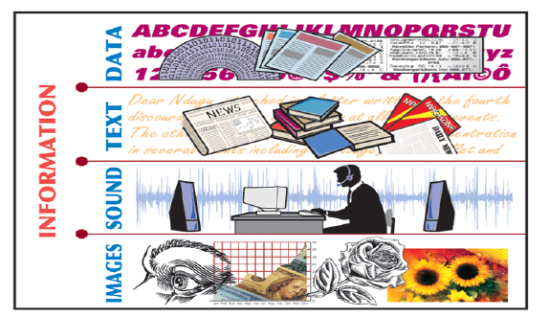
FOUR COMPONENTS OF INFORMATION

Slide 33
IT USERS AND PROFESSIONALS
The following are the users of IT resources:
Hands-on users: these are the people who use computers or communications systems directly, interacting with them to enter data, do processing, store and retrieve information, transmit details, or produce output.
Indirect end users: these individuals do not directly operate a computer but benefit from IT as the recipients of reports, electronic messages, communications, or multimedia presentations.
User managers: people who have supervisory responsibility for activities that involve or are affected by IT are known as user managers.
Senior managers: these managers evaluate the organization's dependence on IT and identify the problems that could arise if appropriate operating procedures are not established or followed.

Slide 34
IT USERS AND PROFESSIONALS
Information Technology Professional is a person who is responsible for acquiring developing, maintaining, or operating the hardware associated with computers and communications networks.
They are:
Programmers: write codes using programming languages to solve problems.
Systems Analysts: work with users to determine the requirements an application must meet.
System Designers: they formulate application specification and design the features of custom software.
Web Designers: these are specialists who focus primarily on developing applications for the internet and the World Wide Web.

Slide 35
IT USERS AND PROFESSIONALS
Project Managers: coordinate the development of a project and manage the team of programmer / analyst.
Network Specialists: design, operate, and manage computer communications networks, including networks that interconnect with the internet.
Trainers: work with end users, helping them to become comfortable with and skilled at using hardware and software.
Computer Operators: oversee the operations of computers in data centers. They also perform support activities, such as starting applications, loading magnetic tapes, and any other job that will ensure the smooth operation of the computer facilities.

Slide 36
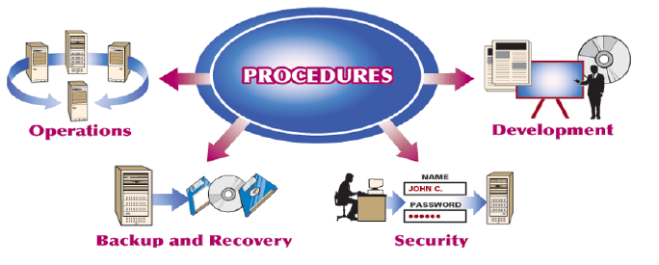
IT PROCEDURES
A Procedure is a step-by-step process or a set of instructions for accomplishing specific results.
These are: Operations, Backup and Recovery, Security, Development.

Slide 37
IT PROCEDURES
A Procedure is a step-by-step process or a set of instructions for accomplishing specific results.
These are: Operations, Backup and Recovery, Security, Development.
Operations Procedure: A procedure that describes how a computer system or application is used, how often it can be used, who is authorized to use it, and where the results of processing should go.
Backup Procedure: A procedure that describes how and when to make extra copies of information or software to protect against losses.
Recovery Procedure: An action taken when information or software must be restored.
Security Procedure: A procedure designed to safeguard data centers, communications networks, computers, and other IT components from accidental intrusion or intentional damage.
Security Software: Software that is designed to protect systems and data.
Development Procedure: A procedure that explains how IT professionals should describe user needs and develop applications to meet those needs.

Slide 38
AN INTRODUCTION TO SYSTEMS
A System is a set of components that interact to accomplish a purpose.
Single-User System (Personal Computer):
An IT system used by only one person. A system that stands alone and is not interconnected with other companies or shared by other people.
Multi-user System:
A communication system in which more than one user share hardware, programs, information, people, and procedures.
– To share a computer
– To share hardware
– To share software
– To share information
– To share communications

Slide 39
CONCLUSION
A computer is a device used in computing data into information. It can be used as a stand alone system or as a communication system comprising of five components, namely: hardware, programs, information, people, and procedures.
The components interact with each other to achieve a business set goal.

Slide 40
SUMMARY
In this unit, you learnt that while hardware and software are the essential components of computing, the real reason for using them is to produce the information that people need.
The information processing and information handling functions of IT are the means by which these components deliver useful results to their users.

Slide 41
EXERCISE
a. List the four categories of hardware with examples.
b. Define an operating system and an application program.
c. Define four OS you know
d. Define the four kinds of Systems program you know.

Slide 42
Week 3
THE SYSTEM UNIT AND THE CENTRAL PROCESSING UNIT

Slide 43
Presentation Outline
THE SYSTEM UNIT
THE PROCESSOR
FUNCTIONS OF THE CENTRAL PROCESSING UNIT (CPU)
PROCESSOR CHIPS
THE PROCESSING SEQUENCE
PROCESSOR SPEED
DETERMINING PROCESSOR SPEED
PORTS
UNIVERSAL SERIAL BUS (USB)
ADD-IN BOARDS
PLUG AND PLAY

