Slide 1
ICT 201:
INTRODUCTION TO INFORMATION AND COMMUNICATION TECHNOLOGY

Slide 2
Lecturers/Instructors
Dr. S. Akinboro
Dr. Ufuoma C. Ogude
0803 820 7103

Slide 3
Course Schedule
Lecture Schedule:
Mondays: 8:00am - 10:00am
Class Venue: Physical (Room S006) and Virtual
Please attend your lectures. Attendance is mandatory
Classroom Policy
Review recommended material before coming to class
Must be on time
Turn off cell phones
Expectations
Read assigned readings
Attend lectures and participate in discussions
Bring your ideas and concerns to class
Work effectively in a group setting
Learn how to use the tools and understand your project very well when necessary

Slide 4
Learning Outcomes
At the end of the course, students should be able to:
1. Identify components of the computer and know-how the components communicate;
2. Know the concept of data transfer and memory types and management;
3. Be comfortable with graphics processing;
4. Identify and be able to use different communication ports;
5. Know the software types;
6. State different computer network topologies and their sizes;
7. Be able to use office applications and the internet.

Slide 5
Course Contents
Basic principle of computers. Computer "backbone". Data transmission. Random Access Memory. Permanent Memory. Graphic processing. Communication Ports. Input and Output Devices. Software types. Accessibility options. Computer types. Portable digital devices. Network Types. Internet. Instant messaging. Voice over Internet Protocol. Really Simple Syndication. Network communication. Internet data transfer. Data rate units. Internet access. Virtual (online) communities. Computer in the workplace. Office Applications (word processing, spreadsheets, presentation, etc.). Other well-known applications. Telecommuting (telework).

Slide 6
Course Module
Module 1 Introduction to Information Communication Technology
Unit 1: Information Communication Technology: Principles, Practices, and Opportunities.
Unit 2: Essentials of Computing
Unit 3: The System Unit and the Central Processing Unit
Unit 4: Input Devices, Output Devices and Storage Devices and Memory
Module 2 Computer Networks, Distributed Networks and the Internet
Unit 5: Computer Networks, Networking Technologies and Communications Networks
Unit 6: Enterprise and Wireless Communications Networks
Unit 7: Essentials of the Internet and World Wide Web
Unit 8: Electronic Commerce and Electronic Business
Unit 9: Launching Information Technology Applications Projects
Module 3 Managing Information and Communication Technology Applications in the Enterprise.
Unit 10: Creating Enterprise Applications and Project Management
Unit 11: Web Based Application and Information Systems in the Enterprise
Unit 12: Issues in Information Technology and Careers in ICT

Slide 7
Course Outline
Week 1: Information Communication Technology: Principles, Practices, and Opportunities.
Week 2: Essentials of Computing
Week 3: The System Unit and the Central Processing Unit
Week 4: Input Devices, Output Devices and Storage Devices and Memory
Week 5: Computer Networks, Networking Technologies and Communications Networks
Week 6: Enterprise and Wireless Communications Networks
Week 7: Essentials of the Internet and World Wide Web
Week 8: Electronic Commerce and Electronic Business
Week 9: Launching Information Technology Applications Projects
Week 10: Creating Enterprise Applications and Project Management
Week 11: Web Based Application and Information Systems in the Enterprise
Week 12: Issues in Information Technology and Careers in ICT
Week 13: Continuous Assessment
Week 14: Examination

Slide 8
Books and References
Use and Effects By: Harry Bouwman, Bart van den Hooff, Lidwien van de Wijngaert & Jan van Dijk, Publisher: SAGE Publications Ltd, Publication year: 2005, Online pub date: June 19, 2012
Discovering Computers. Living in a Digital World. FUNDAMENTALS, 2011 EDITION. Gary B. Shelly. Misty E. Vermaat. Shelly Cashman
Charles S. Parker, Understanding Computers: Today and Tomorrow, Course Technology, 25 Thomson Place, Boston, Massachusetts 02210, USA
Livesley, Robert Kenneth. An introduction to automatic digital computers. Cambridge University Press, 2017.
Zawacki-Richter, Olaf, and Colin Latchem. "Exploring four decades of research in Computers & Education." Computers & Education 122 (2018): 136-152.
Sinha, Pradeep K., and Priti Sinha. Computer fundamentals. BPB publications, 2010.
Goel, Anita. Computer fundamentals. Pearson Education India, 2010.

Slide 9
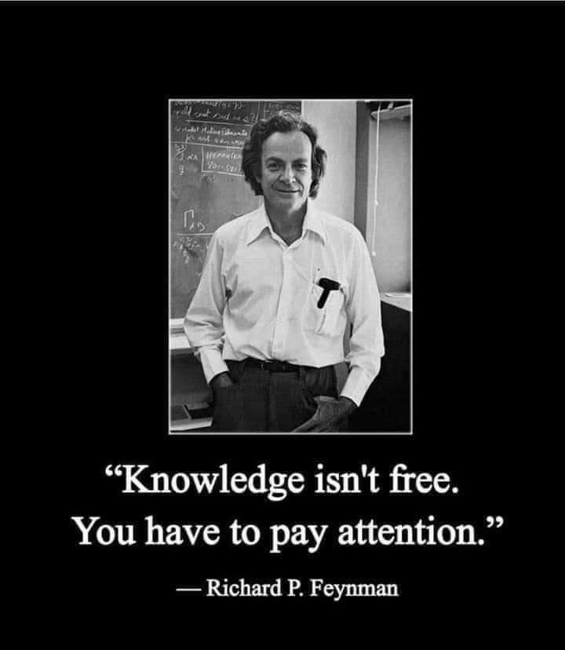
Pre-Requisite

Slide 10
Course Evaluation
Final Examination: 70%
Continuous Assessment: 30%
Written test
Assignments/Project

Slide 11
Week 3
THE SYSTEM UNIT AND THE CENTRAL PROCESSING UNIT

Slide 12
Presentation Outline
THE SYSTEM UNIT
THE PROCESSOR
FUNCTIONS OF THE CENTRAL PROCESSING UNIT (CPU)
PROCESSOR CHIPS
THE PROCESSING SEQUENCE
PROCESSOR SPEED
DETERMINING PROCESSOR SPEED
PORTS
UNIVERSAL SERIAL BUS (USB)
ADD-IN BOARDS
PLUG AND PLAY

Slide 13
THE SYSTEM UNIT
In its general interpretation, a system is a collection of inter-related parts, working together to achieve a common goal.
For our purpose however, a system shall be considered as a set of inter-relating elements responding to input to produce output.
The System Unit is the hardware unit that houses a computer’s processor, ports, power supply, casing, motherboard and add-in boards and memory chips

Slide 14
THE PROCESSOR
Central Processing Unit (CPU) or Processor is the computer hardware that executes program instructions and performs the computer’s processing actions.
It is made up of the following components housed in the Computer System Unit:
Integrated Circuits/Chip/Microchip: A collection of thousands or millions of transistors placed on a small silicon chip.
Transistor: An electrical switch that can be in one of two states: open or closed.
Integrating: The process of packing more transistors onto a single chip.
Control Unit: The part of the CPU that oversees and controls all computer activities according to the instructions it receives.
Instructions: Detailed descriptions of the actions to be carried out during input, processing, output, storage, and transmission.
Arithmetic/Logic Unit (ALU): The part of the CPU that performs arithmetic and logical operations.
– Arithmetic Operations: Addition, Subtraction, Multiplication, and Division.
– Logical Operations: Greater Than (>), Less Than (<), Equal To (=)

Slide 15
FUNCTIONS OF THE CENTRAL PROCESSING UNIT (CPU)
The Central Processing Unit (CPU) is known to be the brain and the computational unit of the System Unit (SU).
It performs the following major functions;
Coordinating the activities of all units or devices associated with the computer system.
Accepting and executing instructions to cause the computer system unit to perform tasks.

Slide 16
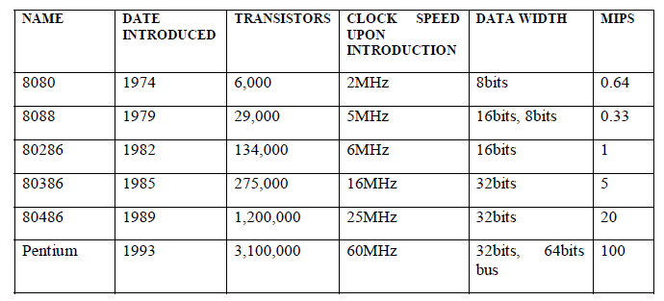
PROCESSOR CHIPS
Microprocessor is the smallest type of processor, with all of the processing capabilities of the control unit and ALU located on a single chip.
Evolution of Intel Pentium Family of Microprocessors
Table 1 Evolution of Intel Pentium Family of Microprocessors

Slide 17
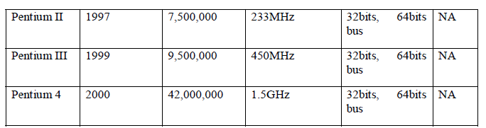
PROCESSOR CHIPS

Slide 18
PROCESSOR CHIPS
Intel Microprocessors
Intel Celeron Processors (R, M, Duo Core, 2Duo Core)
Intel Pentium-M Processors
Intel Celeron-M Processors
Intel Xeon Processors
Intel Itanium Processors
Evolution of Microprocessors for Macintosh Computers

Slide 19
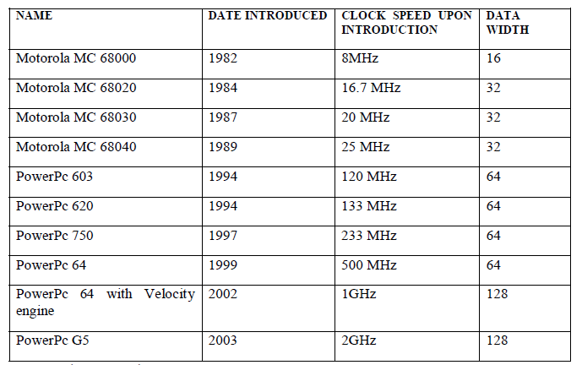
PROCESSOR CHIPS
Table 2 Evolution of Microprocessors for Macintosh Computers

Slide 20
PROCESSOR CHIPS
Other Microprocessor Chips
AMD
Digital Equipment Corp.
Mercury
Hewlett-Packard
MIPS Technologies
Sun Microcomputers

Slide 21
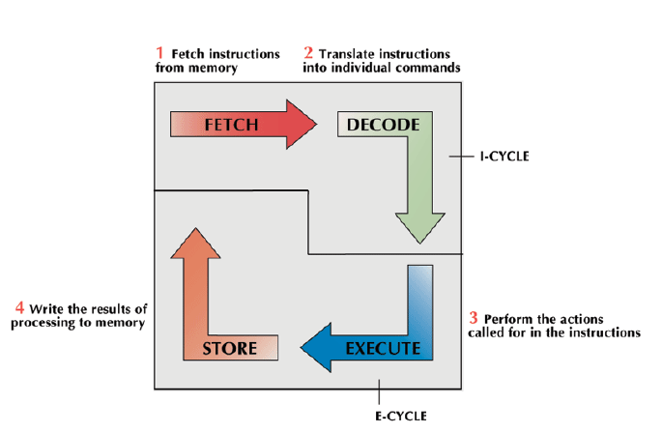
THE PROCESSING SEQUENCE
Machine Cycle: The four processing steps performed by the control unit: fetch, decode, execute, and store.

Slide 22
THE PROCESSING SEQUENCE
Instruction Cycle (I-cycle): The first two steps of the machine cycle (fetch and decode), in which instructions are obtained and translated.
Execution Cycle (E-cycle): The last two steps of the machine cycle (execute and store), which produce processing results.
Register: A temporary storage area in the processor that can move data and instructions more quickly than main memory can, and momentarily hold the data or instructions used in processing as well as the results that are generated. There are four types:
Storage Registers
Address Registers
Accumulators
General-Purpose Registers

Slide 23
PROCESSOR SPEED
Millisecond: One thousandth of a second
Microsecond: One millionth of a second.
Nanosecond: One billionth of a second.
Picoseconds: One trillionth of a second.
Millions of Instructions per Second (MIPS): The number of instructions the processor can execute per second – a measure of processor speed.
Megaflops: Millions of floating point operations per second – a measure of how many detailed arithmetic calculations the computer can perform per second.

Slide 24
DETERMINING PROCESSOR SPEED
In determining Processor Speed, four elements are considered:
System Clock
Bus Width
Word Size
Available Memory
System Clock: A circuit that generates electronic impulses at a fixed rate to synchronize processing activities.
Megahertz (MHz): Millions of electric pulses per second – a measure of a computer’s speed.
Gigahertz (GHz): Billions of pulses per second
Bus Width
Input/Output (I/O) bus: A bus (electronic circuit) that moves data into and out of the processor.
Data Bus: A bus that moves data between the central processor and memory.
Word Size
Word: The number of bits a computer can process at one time.

Slide 25
DETERMINING PROCESSOR SPEED
Cache Memory: A form of high-speed memory that acts as a temporary holding/processing cell.
Other factors include:
Coprocessors: A special-purpose chip mounted on a processor board; it is designed to handle common functions quickly and efficiently.
Accelerator Boards: An add-in circuit board that increases a computer’s processing speed.
Reduced Instruction Set Computer (RISC)
Complex Instruction Set Computing (CISC): A computing instruction set that moves data to and from main memory so often that it limits the use of registers.
Microcode: The instructions that coordinate the execution of the instructions to move data and from memory.
Reduced Instruction Set Computing (RISC): A computing instruction set that takes data for the execution of an instruction only from registers.

Slide 26
DETERMINING PROCESSOR SPEED
Pipelining: A computer starts processing a new instruction as soon as the previous instruction reaches its next step in the processing cycle.
Parallel Processing: Processing in which a computer handles different parts of a problem by executing instructions simultaneously.
Sequential Processing: Processing in which the execution of one instruction is followed by the execution of another.
Single Instruction/Multiple Data (SIMD) method: A parallel-processing method that executes the same instruction on many data values simultaneously.
Multiple Instruction/Multiple Data (MIMD) method: A parallel-processing method that connects a number of processors that run different programs or parts of a program on different sets of data.
Grid and Cloud Computing: A process that harnesses idle time on computers and then uses them to provide processing for an application that needs more speed and capability than may be available on a single computer, or even on a supercomputer.

Slide 27
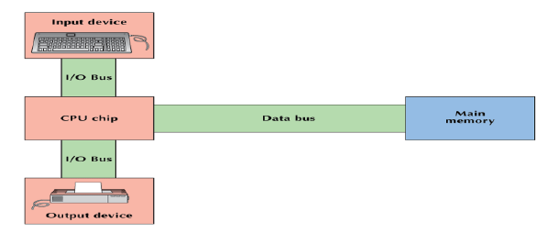
THE TWO TYPES OF BUS

Slide 28
THE TWO TYPES OF BUS
PORTS
Port: A connector through which input/output devices can be plugged into the computer.
Expansion Slot: A slot inside a computer that allows a user to add an additional circuit board.
UNIVERSAL SERIAL BUS (USB)
Universal Serial Bus (USB): A general purpose port that can connect up to 128 devices, and also hot swappable, meaning that devices can be plugged in or unplugged without having to shut down or reboot the system.
PLUG AND PLAY
Plug and Play: The ability to install devices into a computer when the computer itself makes any necessary internal adjustments.

Slide 29
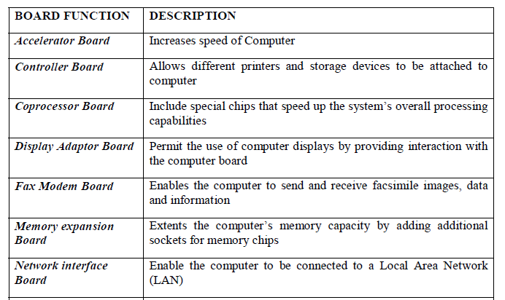
ADD-IN BOARDS
Add-in Boards: A board that can be added to a computer to customize its features and capabilities.
Types of Add-In Boards for Microcomputers

Slide 30
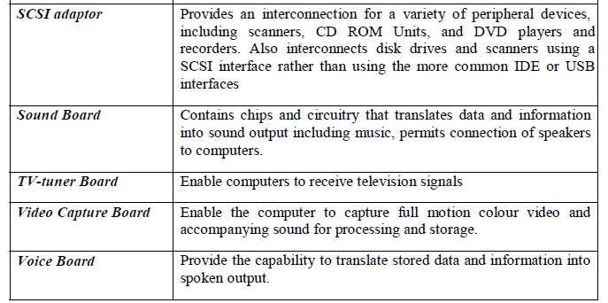
ADD-IN BOARDS

Slide 31
CONCLUSION
The System Unit is more or less synonymous with the computer because it represents the processing capability, which is unique to Computers. Generally speaking, a computer system is recognized by the type and nature of its system unit (SU).

Slide 32
SUMMARY
We learnt that the system unit housed some important components which play a great role in the purchase of a computer system.
The processor - controls operations and performs arithmetic and logical operations.
The memory - serves the purpose of storage (holding data and instruction) and also used to boot the computer system.
Expansion Slots-allows external devices to connect and expand a computer capabilities.

Slide 33
EXERCISE
a. List the four elements to be considered when determining processor speed?
b. What are the functions of the Central Processing Unit (CPU)?
c. What is the difference between the System Unit and the Central Processing Unit?
d. Define Grid Computing?

Slide 34
Week 4
INPUT DEVICES, OUTPUT DEVICES AND STORAGE DEVICES AND MEMORY
Add Table 1 and 2

Slide 35
Assignment/Project 1a Presentation Outline
INPUT DEVICES
Interaction with Computers Using Input Devices
Keyboard
Terminal
Scanners
Optical Character Recognition (OCR)
Digitizers
Pointing Devices
Digitizing Table
Digital Camera
Digital Video Camcorders
Voice and Sound Input Devices
Bar Code
Wand
Multimedia
The Purpose of the Mouse

Slide 36
OBJECTIVES
At the end of this unit, you should be able to:
Identify the six special key groups on a standard computer keyboard
Name the functional keys on a keyboard
Describe the purpose of a mouse and the role it plays in computing
Identify other input devices apart from the mouse and keyboard

Slide 37
CONCLUSION
Input Devices are devices which enable data, information and instructions to be transmitted into the Computer system.
They act as a gateway for receiving input usually in user understandable form from the outside world and convert it to machine understandable form which the Computer can understand.

Slide 38
SUMMARY
In summary you have learnt about:
The special keys on the keyboard
Purpose of the mouse
Other input devices, such as: scanning devices, image capturing devices, digitizing devices, audio input devices and assistive input devices.

Slide 39
EXERCISE
a. List three pointing devices
b. Which category of device is the Optical Character Recognition (OCR)?
c. What are the basic functions of a mouse?
d. What category of device is the joystick and what is it used for?

Slide 40
Assignment/Project 1b Presentation Outline
OUTPUT DEVICES
Output and Information Distribution Devices
Types of Output Devices
Visual Displays (Monitors)
Data Projector
Printers
Audio Response Unit
Television
Plotter
Film Recorder

Slide 41
OBJECTIVES
At the end of this unit, you should be able to:
Define an Output device.
Identify the types of output devices and their properties.
State their various functions and uses in business.

Slide 42
CONCLUSION
Output Device is a device that makes the results of processing available outside of the computer to be used in business decision making.
It brings out the information after the data has been processed.

Slide 43
SUMMARY
In summary you have learnt that the input and output devices:
Play a great role in enhancing business decision taking, through outputting of information.
Are of different types and technology.
Transform data in machine form, to human understandable forms e.g. text and pictures.

Slide 44
EXERCISE
a. Briefly define an output device.
b. Discuss the use of a data project and list its types.
c. What does RGB stands for in a monitor?
d. Define the following: film recorder, speaker and laser printer.

Slide 45
Assignment/Project 1c Presentation Outline
STORAGE DEVICES AND MEMORY
Storage
Characteristics
Types of Storage
Storage Technologies
Other Magnetic Disk Storage Systems
Memory
The Differences between Storage and Memory

Slide 46
OBJECTIVES
At the end of this unit, you are expected to:
Understand what storage is, types and technology
Know the types of memory and their sizes.
Identify the differences between storage and memory.
Distinguish between primary storage (also called memory) and secondary storage (also called storage), and between RAM and ROM.

Slide 47
CONCLUSION
Storage and memory look similar but perform different tasks. Memory is used to load program files and is volatile, while storage are used to hold data permanently and to be retrieved for future use.

Slide 48
SUMMARY
In this unit, we learnt that the:
• The functions of storage and memory are similar, they work in different ways.
• The memory - serves the purpose of temporary storage (holding data and instruction) and also used to boot the computer system.
• Storage come in different types, sizes, and are made of various technologies.
• Storage can be used on a local area network- allowing different kinds of storage
devices, such as tape drives and disk arrays, to be shared by all users through network servers.

Slide 49
EXERCISE
a. What does SAN stands for in storage?
b. What are the other magnetic disk storage systems?
c. Is memory and storage the same? Explain.
d. What does the following means in memory?
Byte
Kilobyte/K-byte/KB/K.
Megabyte/M-byte/MB/Meg
Gigabyte/G-byte/GB/Gig
Terabyte/T-byte/TB
Address

Slide 50
Week 5
COMPUTER NETWORKS, NETWORKING TECHNOLOGIES AND COMMUNICATIONS NETWORKS

Slide 51
Presentation Outline
Types of Network Connection
Basic Components of a Network
Network Software
Application Software
Network Hardware
Standards for Networks
Networking Checklist

