Slide 1
ICT 201:
INTRODUCTION TO INFORMATION AND COMMUNICATION TECHNOLOGY

Slide 2
Lecturers/Instructors
Dr. S. Akinboro
Dr. Ufuoma C. Ogude
0803 820 7103

Slide 3
Course Schedule
Lecture Schedule:
Mondays: 8:00am - 10:00am
Class Venue: Physical (Room S006) and Virtual
Please attend your lectures. Attendance is mandatory
Classroom Policy
Review recommended material before coming to class
Must be on time
Turn off cell phones
Expectations
Read assigned readings
Attend lectures and participate in discussions
Bring your ideas and concerns to class
Work effectively in a group setting
Learn how to use the tools and understand your project very well when necessary

Slide 4
Learning Outcomes
At the end of the course, students should be able to:
1. Identify components of the computer and know-how the components communicate;
2. Know the concept of data transfer and memory types and management;
3. Be comfortable with graphics processing;
4. Identify and be able to use different communication ports;
5. Know the software types;
6. State different computer network topologies and their sizes;
7. Be able to use office applications and the internet.

Slide 5
Course Contents
Basic principle of computers. Computer "backbone". Data transmission. Random Access Memory. Permanent Memory. Graphic processing. Communication Ports. Input and Output Devices. Software types. Accessibility options. Computer types. Portable digital devices. Network Types. Internet. Instant messaging. Voice over Internet Protocol. Really Simple Syndication. Network communication. Internet data transfer. Data rate units. Internet access. Virtual (online) communities. Computer in the workplace. Office Applications (word processing, spreadsheets, presentation, etc.). Other well-known applications. Telecommuting (telework).

Slide 6
Course Module
Module 1 Introduction to Information Communication Technology
Unit 1: Information Communication Technology: Principles, Practices, and Opportunities.
Unit 2: Essentials of Computing
Unit 3: The System Unit and the Central Processing Unit
Unit 4: Input Devices, Output Devices and Storage Devices and Memory
Module 2 Computer Networks, Distributed Networks and the Internet
Unit 5: Computer Networks, Networking Technologies and Communications Networks
Unit 6: Enterprise and Wireless Communications Networks
Unit 7: Essentials of the Internet and World Wide Web
Unit 8: Electronic Commerce and Electronic Business
Unit 9: Launching Information Technology Applications Projects
Module 3 Managing Information and Communication Technology Applications in the Enterprise.
Unit 10: Creating Enterprise Applications and Project Management
Unit 11: Web Based Application and Information Systems in the Enterprise
Unit 12: Issues in Information Technology and Careers in ICT

Slide 7
Course Outline
Week 1: Information Communication Technology: Principles, Practices, and Opportunities.
Week 2: Essentials of Computing
Week 3: The System Unit and the Central Processing Unit
Week 4: Input Devices, Output Devices and Storage Devices and Memory
Week 5: Computer Networks, Networking Technologies and Communications Networks
Week 6: Enterprise and Wireless Communications Networks
Week 7: Essentials of the Internet and World Wide Web
Week 8: Electronic Commerce and Electronic Business
Week 9: Launching Information Technology Applications Projects
Week 10: Creating Enterprise Applications and Project Management
Week 11: Web Based Application and Information Systems in the Enterprise
Week 12: Issues in Information Technology and Careers in ICT
Week 13: Continuous Assessment
Week 14: Examination

Slide 8
Books and References
Use and Effects By: Harry Bouwman, Bart van den Hooff, Lidwien van de Wijngaert & Jan van Dijk, Publisher: SAGE Publications Ltd, Publication year: 2005, Online pub date: June 19, 2012
Discovering Computers. Living in a Digital World. FUNDAMENTALS, 2011 EDITION. Gary B. Shelly. Misty E. Vermaat. Shelly Cashman
Charles S. Parker, Understanding Computers: Today and Tomorrow, Course Technology, 25 Thomson Place, Boston, Massachusetts 02210, USA
Livesley, Robert Kenneth. An introduction to automatic digital computers. Cambridge University Press, 2017.
Zawacki-Richter, Olaf, and Colin Latchem. "Exploring four decades of research in Computers & Education." Computers & Education 122 (2018): 136-152.
Sinha, Pradeep K., and Priti Sinha. Computer fundamentals. BPB publications, 2010.
Goel, Anita. Computer fundamentals. Pearson Education India, 2010.

Slide 9
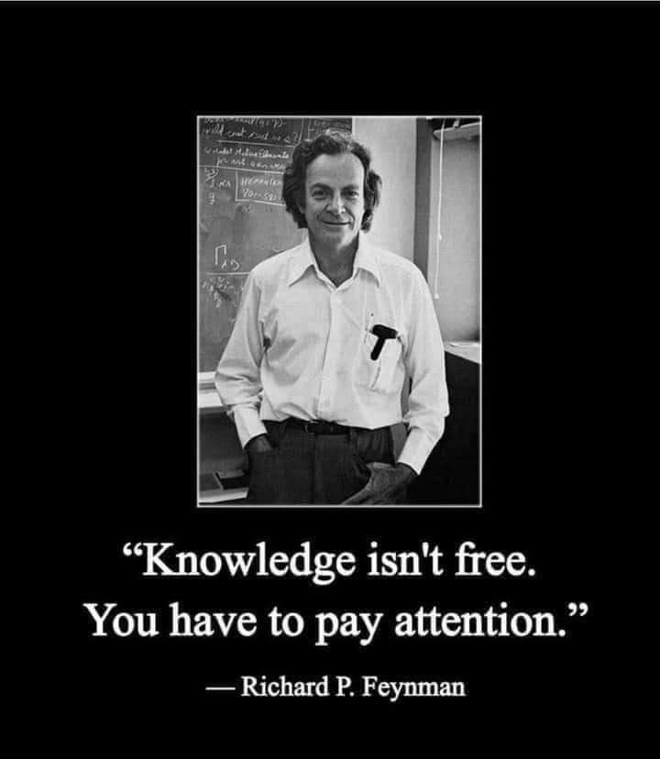
Pre-Requisite

Slide 10
Course Evaluation
Final Examination: 70%
Continuous Assessment: 30%
Written test
Assignments/Project

Slide 11
Week 4
INPUT DEVICES, OUTPUT DEVICES AND STORAGE DEVICES AND MEMORY
Add Table 1 and 2

Slide 12
Assignment/Project 1a Presentation Outline
INPUT DEVICES
Interaction with Computers Using Input Devices
Keyboard
Terminal
Scanners
Optical Character Recognition (OCR)
Digitizers
Pointing Devices
Digitizing Table
Digital Camera
Digital Video Camcorders
Voice and Sound Input Devices
Bar Code
Wand
Multimedia
The Purpose of the Mouse

Slide 13
OBJECTIVES
At the end of this unit, you should be able to:
Identify the six special key groups on a standard computer keyboard
Name the functional keys on a keyboard
Describe the purpose of a mouse and the role it plays in computing
Identify other input devices apart from the mouse and keyboard

Slide 14
CONCLUSION
Input Devices are devices which enable data, information and instructions to be transmitted into the Computer system.
They act as a gateway for receiving input usually in user understandable form from the outside world and convert it to machine understandable form which the Computer can understand.

Slide 15
SUMMARY
In summary you have learnt about:
The special keys on the keyboard
Purpose of the mouse
Other input devices, such as: scanning devices, image capturing devices, digitizing devices, audio input devices and assistive input devices.

Slide 16
EXERCISE
a. List three pointing devices
b. Which category of device is the Optical Character Recognition (OCR)?
c. What are the basic functions of a mouse?
d. What category of device is the joystick and what is it used for?

Slide 17
Assignment/Project 1b Presentation Outline
OUTPUT DEVICES
Output and Information Distribution Devices
Types of Output Devices
Visual Displays (Monitors)
Data Projector
Printers
Audio Response Unit
Television
Plotter
Film Recorder

Slide 18
OBJECTIVES
At the end of this unit, you should be able to:
Define an Output device.
Identify the types of output devices and their properties.
State their various functions and uses in business.

Slide 19
CONCLUSION
Output Device is a device that makes the results of processing available outside of the computer to be used in business decision making.
It brings out the information after the data has been processed.

Slide 20
SUMMARY
In summary you have learnt that the input and output devices:
Play a great role in enhancing business decision taking, through outputting of information.
Are of different types and technology.
Transform data in machine form, to human understandable forms e.g. text and pictures.

Slide 21
EXERCISE
a. Briefly define an output device.
b. Discuss the use of a data project and list its types.
c. What does RGB stands for in a monitor?
d. Define the following: film recorder, speaker and laser printer.

Slide 22
Assignment/Project 1c Presentation Outline
STORAGE DEVICES AND MEMORY
Storage
Characteristics
Types of Storage
Storage Technologies
Other Magnetic Disk Storage Systems
Memory
The Differences between Storage and Memory

Slide 23
OBJECTIVES
At the end of this unit, you are expected to:
Understand what storage is, types and technology
Know the types of memory and their sizes.
Identify the differences between storage and memory.
Distinguish between primary storage (also called memory) and secondary storage (also called storage), and between RAM and ROM.

Slide 24
CONCLUSION
Storage and memory look similar but perform different tasks. Memory is used to load program files and is volatile, while storage are used to hold data permanently and to be retrieved for future use.

Slide 25
SUMMARY
In this unit, we learnt that the:
• The functions of storage and memory are similar, they work in different ways.
• The memory - serves the purpose of temporary storage (holding data and instruction) and also used to boot the computer system.
• Storage come in different types, sizes, and are made of various technologies.
• Storage can be used on a local area network- allowing different kinds of storage
devices, such as tape drives and disk arrays, to be shared by all users through network servers.

Slide 26
EXERCISE
a. What does SAN stands for in storage?
b. What are the other magnetic disk storage systems?
c. Is memory and storage the same? Explain.
d. What does the following means in memory?
Byte
Kilobyte/K-byte/KB/K.
Megabyte/M-byte/MB/Meg
Gigabyte/G-byte/GB/Gig
Terabyte/T-byte/TB
Address

Slide 27
Week 5
COMPUTER NETWORKS, NETWORKING TECHNOLOGIES AND COMMUNICATIONS NETWORKS

Slide 28
Presentation Outline
Types of Network Connection
Basic Components of a Network
Network Software
Application Software
Network Hardware
Standards for Networks
Networking Checklist

