Slide 1
ICT 201:
INTRODUCTION TO INFORMATION AND COMMUNICATION TECHNOLOGY

Slide 2
Lecturers/Instructors
Dr. S. Akinboro
Dr. Ufuoma C. Ogude
0803 820 7103

Slide 3
Course Schedule
Lecture Schedule:
Mondays: 8:00am - 10:00am
Class Venue: Physical (Room S006)
Please attend your lectures. Attendance is mandatory
Classroom Policy
Review recommended material before coming to class
Must be on time
Turn off cell phones
Expectations
Read assigned readings
Attend lectures and participate in discussions
Bring your ideas and concerns to class
Work effectively in a group setting
Learn how to use the tools and understand your project very well when necessary

Slide 4
Learning Outcomes
At the end of the course, students should be able to:
1. Identify components of the computer and know-how the components communicate;
2. Know the concept of data transfer and memory types and management;
3. Be comfortable with graphics processing;
4. Identify and be able to use different communication ports;
5. Know the software types;
6. State different computer network topologies and their sizes;
7. Be able to use office applications and the internet.

Slide 5
Course Contents
Basic principle of computers. Computer "backbone". Data transmission. Random Access Memory. Permanent Memory. Graphic processing. Communication Ports. Input and Output Devices. Software types. Accessibility options. Computer types. Portable digital devices. Network Types. Internet. Instant messaging. Voice over Internet Protocol. Really Simple Syndication. Network communication. Internet data transfer. Data rate units. Internet access. Virtual (online) communities. Computer in the workplace. Office Applications (word processing, spreadsheets, presentation, etc.). Other well-known applications. Telecommuting (telework).

Slide 6
Course Module
Module 1 Introduction to Information Communication Technology
Unit 1: Information Communication Technology: Principles, Practices, and Opportunities.
Unit 2: Essentials of Computing
Unit 3: The System Unit and the Central Processing Unit
Unit 4: Input Devices, Output Devices and Storage Devices and Memory
Module 2 Computer Networks, Distributed Networks and the Internet
Unit 5: Computer Networks, Networking Technologies and Communications Networks
Unit 6: Enterprise and Wireless Communications Networks
Unit 7: Essentials of the Internet and World Wide Web
Unit 8: Electronic Commerce and Electronic Business
Unit 9: Launching Information Technology Applications Projects
Module 3 Managing Information and Communication Technology Applications in the Enterprise.
Unit 10: Creating Enterprise Applications and Project Management
Unit 11: Web Based Application and Information Systems in the Enterprise
Unit 12: Issues in Information Technology and Careers in ICT

Slide 7
Course Outline
Week 1: Information Communication Technology: Principles, Practices, and Opportunities.
Week 2: Essentials of Computing
Week 3: The System Unit and the Central Processing Unit
Week 4: Input Devices, Output Devices and Storage Devices and Memory
Week 5: Computer Networks, Networking Technologies and Communications Networks
Week 6: Enterprise and Wireless Communications Networks
Week 7: Essentials of the Internet and World Wide Web
Week 8: Electronic Commerce and Electronic Business
Week 9: Launching Information Technology Applications Projects
Week 10: Creating Enterprise Applications and Project Management
Week 11: Web Based Application and Information Systems in the Enterprise
Week 12: Issues in Information Technology and Careers in ICT
Week 13: Continuous Assessment
Week 14: Examination

Slide 8
Books and References
Use and Effects By: Harry Bouwman, Bart van den Hooff, Lidwien van de Wijngaert & Jan van Dijk, Publisher: SAGE Publications Ltd, Publication year: 2005, Online pub date: June 19, 2012
Discovering Computers. Living in a Digital World. FUNDAMENTALS, 2011 EDITION. Gary B. Shelly. Misty E. Vermaat. Shelly Cashman
Charles S. Parker, Understanding Computers: Today and Tomorrow, Course Technology, 25 Thomson Place, Boston, Massachusetts 02210, USA
Livesley, Robert Kenneth. An introduction to automatic digital computers. Cambridge University Press, 2017.
Zawacki-Richter, Olaf, and Colin Latchem. "Exploring four decades of research in Computers & Education." Computers & Education 122 (2018): 136-152.
Sinha, Pradeep K., and Priti Sinha. Computer fundamentals. BPB publications, 2010.
Goel, Anita. Computer fundamentals. Pearson Education India, 2010.

Slide 9

Pre-Requisite

Slide 10
Course Evaluation
Final Examination: 70%
Continuous Assessment: 30%
Written test
Assignments/Project

Slide 11
Week 5
COMPUTER NETWORKS, NETWORKING TECHNOLOGIES AND COMMUNICATIONS NETWORKS

Slide 12
Presentation Outline
Types of Network Connection
Basic Components of a Network
Network Software
Application Software
Network Hardware
Standards for Networks
Networking Checklist

Slide 13
COMPUTER NETWORKING
Computer Networking refers to the techniques, physical connections, and programs used to interlink two or more computers together.
This is fundamentally to enable the networked computers share resources such as hard discs, modems, printers.

Slide 14
TYPES OF NETWORK CONNECTION
There are two basic types of network connections:
Physical connections and
Logical or virtual connections

Slide 15
Physical Connections
It let computers directly transmit and receive signals.
Physical connections are defined by the medium used to carry the signal, the geometric arrangement of the computers (topology), and the method used to share information.

Slide 16
Logical or Virtual
It allow computer applications, such as e-mail programs and the browsers used to explore the World Wide Web, to exchange information.
Logical connections are created by network protocols and allow data sharing between applications on different types of computers, such as a personal computer (PC) running the Microsoft Corporation Windows operating system, in a network.
Some logical connections use clientserver application software and are primarily for file and printer sharing.
The Transmission Control Protocol/Internet Protocol (TCP/IP) suite is the set of logical connections used by the Internet, the worldwide consortium of computer networks.

Slide 17
BASIC COMPONENTS OF A NETWORK
A classical computer network has three essential components or segments.
They are as follows:
Network Software.
Application Software, &
Network Hardware

Slide 18
NETWORK SOFTWARE
This consists of computer programs that establish protocols, or rules for computers to talk to one another.
These protocols are carried out by sending, and receiving formatted instructions of data called packets.
Protocols make reasonable connections between network applications, direct the movement of packets through the physical network, and reduce the chances of clashes between packets sent at the same time.

Slide 19
APPLICATION SOFTWARE
This consist of computer programs that interface with network users and permit the sharing of information such as files, graphics, videos, and other resources like printers and disks.
The types of application software are called client-server and peer-to-peer.
Client/Server Application: -
Client computers send requests for information or requests to use resources to other computers in a network, called Servers.
Network and web servers control data and applications commonly.
Often, as a network grows and more computers are added, one computer will act as a server.
A server is a central storage point for files or application programs shared on the network.

Slide 20
APPLICATION SOFTWARE
Peer-to-peer: -
In a peer-to-peer network, (sometimes called workgroup) you don’t need to have a dedicated server in your network, because all nodes on the network have equal relationship to all others.
Therefore, computers send messages and requests directly to other computers of their social class on the network without a Server linkage.

Slide 21
NETWORK HARDWARE
This consists of the computers, nodes and the physical components such as: cables, connectors and network adapter (Network Interface Card, modem, wireless cards, e.t.c.) that interconnect them together.
Whereas the cables and connectors serve as a pathway for the smooth flow of electrical signals in-between devices,
the network adapter makes it possible for different computers, with different speeds, voltages and codes to work together, following a set of rules, or a standard known as a Protocol.

Slide 22
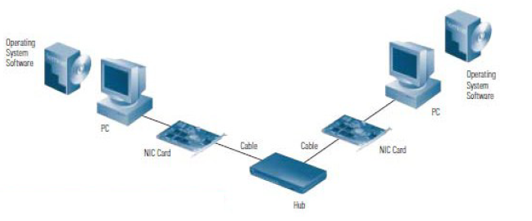
Basic Components of a Network

Slide 23
NETWORKING DEVICES
Network Interface Cards
Hubs
Switches
Routers
Modems
Bridges
Uninterruptible Power Supplies
Wiring and Cable

Slide 24
NETWORK MANAGEMENT
Network management software allows you to monitor traffic flows, configure new equipment, and troubleshoot network problems.
“Managed” hubs and switches have the ability to tell network management software “console” how much data they are handling, sound alarms when problems occur, and record traffic volumes over time to help you understand when users are placing the heaviest demands on the network throughout the day.
While not essential for very small networks, network management becomes increasingly important as the network grows.
Without it, keeping traffic flowing smoothly throughout the network, adding or moving users, and troubleshooting problems can be difficult.

Slide 25
SECURITY
Your network is bound to carry at least some information you want to protect from certain users—students’ grades and attendance records, for example.
For this reason, you’ll want to consider some form of network security.
Security solutions come in three basic forms:
user authentication and authorization, audits, and firewalls.
Authentication designates who can access the network, and Authorization governs what they can see when they’re connected.
Audits enable you to track user activity to help spot unauthorized activity before it becomes a full-fledged security breach.
Firewalls protect your internal network from invasion through the Internet or other external sources.
Firewalls can restrict access to certain users and control which users can use which applications when dialing in from outside.

Slide 26
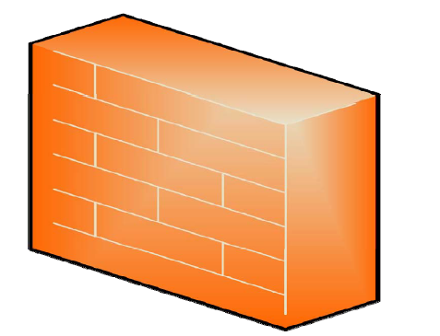
SYMBOL OF A FIREWALL

Slide 27
STANDARDS FOR NETWORKS
Communication between interconnected computer systems is a complex activity which takes place at a number of different levels.
At the lowest level there is the physical transmission of signals and at the highest level there may be communication of messages in everyday languages.
In an attempt to form a basis for standardizing such interconnections the International Standard Organisation (ISO) has devised a standard based upon seven distinct levels or layers of communication.

Slide 28
Open Systems Interconnectivity (OSI)
The Open Systems Interconnectivity (OSI) model has seven layers from the lowest to the highest as follows;
The physical layer is the level of electrical connections, signal transmission and data in raw form.
The data link layer is the level at which data is transmitted in small units using suitable protocols to control and correct transmission.
The units of data are “frames”, that is, asynchronously transmitted characters (i.e. individually at will) or synchronously transmitted bocks of characters (i.e. fixed intervals at a fixed rate).
The network layer is the level which provides control among adjacent sending and receiving points in a network.
The sending and receiving points which are able to switch transmission are nodes in the network called IMPs.

Slide 29
Open Systems Interconnectivity (OSI)
The transport layer is the level which provides an end-to-end service between host computers.
It deals with addressing, error controls and regulated data transfer.
The session layer is the level which handles the establishment of connections between host and the management of the dialogue.
Messages created at this level are addressed by the transport layer and split into packets at the network layer.
The presentation layer is the level which handles the standard forms for presenting data, e.g. the layouts used for VDU displays.
The Application layer is the level which the user has control over in determining what data is to be transmitted and how it is to be sent or received.

Slide 30
NETWORKING CHECKLIST
Every network includes:
at least two computers
a network interface on each computer , that is the device that lets the computer talk to the network. It is usually called a network interface card [NIC] or adapter
a connection medium: this is usually a wire or cable, but wireless communication between networked computers and peripherals is also possible.
Network operating system software: such as Microsoft Windows 95 or Windows NT, Novell NetWare, AppleShare, Linux or Unix.
a hub or a switch to act as a connection point between the computers and a router to connect different networks together.

Slide 31
NETWORKING TECHNOLOGIES
There are basically two types of computer networks namely:
Local Area Networks (LAN), and
Wide Area Networks (WAN).
Other types of networks co-exist due to the combination of the LAN or WAN networks. Depending upon the size, computer networks are further classified:
Metropolitan Area Networks (MAN),
Campus Area Networks (CAN) and
Personal Area Networks (PAN).
The topology (topology is the way the computer networks and network resources are connected) of the networking can be classified as:
Bus Network,
Ring Network and
Star Network.

Slide 32
NETWORKING TECHNOLOGIES
The networking hardware basically consists of wiring, network cards and a hub.
Computer network cards are required so that one computer can understand what the other computer is “talking”.
Network cards have a unique MAC address to identify computers on a computer network.
Hubs connect all the computers in the network.
Hubs can also be used to connect to other hubs to increase the size of the computer network.
Two computers can be connected using Ethernet cards or phone lines or power lines for communication.

Slide 33
NETWORK TOPOLOGY
A network topology is the geometric arrangement or layout of computers in a network.
The following types of layouts are common:
Point-To-Point Network Topology
Bus Network Topology
Star Network Topology
Ring Network Topology, and
Tree Network Topology.

Slide 34
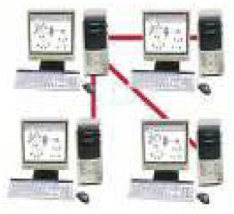
Point-To-Point Network Topology
Point-to-point topology is the simplest, consisting of two connected computers

Slide 35
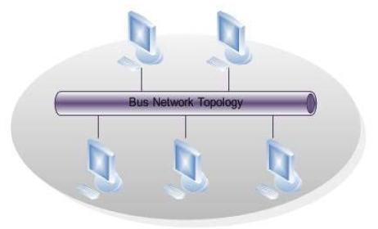
Bus Network Topology
The bus topology is composed of a single link connected to many computers.
All computers on this common connection receive all signals transmitted by any attached computer.

Slide 36
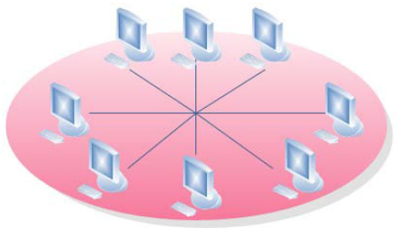
Star Network Topology
A star topology connects many computers to a common hub computer.
This hub can be inactive, repeating any input to all computers similar to the bus topology, or it can be active, selectively switching inputs to specific destination computers.

Slide 37
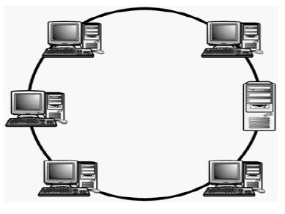
Ring Network Topology
The ring topology uses multiple links to form a circle of computers.
Each link carries information in one direction.
Information moves around the ring in sequence from its source to its destination.

Slide 38
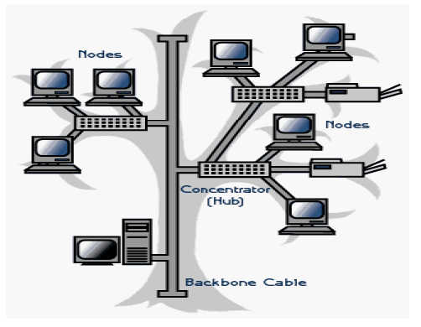
Tree Network Topology
A Tree topology combines characteristics of bus and star topologies.
It consists of groups of star-configured workstations connected to a bus backbone cable.
Tree topologies allow for the expansion of an existing network, and enables institutions to configure networks to meet their needs.

Slide 39
BASIC ADVANTAGES OF USING NETWORKS
There are many possible advantages of using networks. The basic ones are:
The sharing of resources (e.g computers and staff) and information
The provision of local facilities without the loss of central control
The even distribution of work, processing loads, e.t.c. Shared risk and mutual support.
Improved and more economic communication facilities in general, e.g. including voice communications.

Slide 40
COMMUNICATIONS NETWORKS
A communication network is a set of locations, or nodes, consisting of hardware, programs, and information that are linked together as a system that transmit and receives data and information.

Slide 41
PRINCIPLES OF COMMUNICATIONS NETWORKS
Communication: The sending and receiving of data and information over a communications network.
Multiuser System: A communications system in which more than one user share hardware, programs, information, people, and procedures.

Slide 42
ROLE OF COMMUNICATIONS NETWORKS
Communications Network: A set of locations, or nodes, consisting of hardware, programs, and information linked together as a system that transmits and receives data and information.
Node: A communication station within a network.

Slide 43
NETWORK SERVICE APPLICATIONS
Network Services are the applications available on a communications network.
Electronic Mail: sometime called e-mail are designed to overcome the communication barrier created by time and distance over a phone.
E-mail is a service that transports text messages from a sender to one or more receivers.
Electronic Mailbox: An area of space on magnetic disk in a server or host computer that is allocated for storing an individual’s e-mail.

Slide 44
NETWORK SERVICE APPLICATIONS
Voice Mail: A system that captures, stores, and transmits spoken messages using an ordinary telephone connected to a computer network.
PPTs (post, telephone, and telegraph companies): A general term for telephone companies outside the United States.
Unified Messaging Systems: Offers users the ability to manage several communications media, including telephone, fax, e-mail (including those from the Web), and voice mail through a central message manager.

Slide 45
NETWORK SERVICE APPLICATIONS
Videoconferencing: A type of conferencing in which video cameras and microphones capture the sight and sound of participants for transmission over a network.
Webcasting: Uses the reach of the Internet to link people from anywhere in the world into a conference.
Work Group Conferencing: A type of conferencing that uses a software package called groupware to interconnect participants’ computers at their various locations.
Participants interact through a microcomputer directly linked to a server and their comments are broadcast to all others taking part in the conference.
Electronic Bulletin Board: A network service application that allows messages and announcements to be posted and read. It is accessed by dialing a telephone number and interconnecting with the bulletin board through a modem.

Slide 46
NETWORK SERVICE APPLICATIONS
Electronic Funds Transfer (EFT): The movement of money over a network.
Electronic Data Interchange (EDI): A form of electronic communication that allows trading partners to exchange business transaction data in structured formats that can be processed by application software.
Videotex: A two-way, interactive, text-only service operating on mainframe computers that combines a video screen with easy-to-follow instructions.

Slide 47
NETWORK CHANNELS
Communications Channel/Communications Medium is the physical or cableless media that link the different components of a network.
Physical Channels:
Twisted Pair: A physical communications channel that uses strands of copper wire twisted together in pairs to form a telephone wire.
Coaxial Cable/Co-ax: A physical communications channel that uses one or more central wire conductors surrounded by an insulator and encased in either a wire mesh or metal sheathing.
Coaxial Cable/Co-ax:
Baseband Cable: Carries a single communication or message at very high megabit speeds, is often used in local area networks.
Broadband Cable: Carries multiple signals – data, voice, and video – simultaneously; each signal can be a different speed.
Fiber-optic Cable: A physical communications channel that uses light and glass fibers.

Slide 48
NETWORK CHANNELS
Wireless Channels
Wireless channels transmit data using radio signals sent through air or space rather than over wire or optical cables.
Microwave: A cableless medium that uses high-frequency radio signals to send data or information through the air.
Satellite: A cableless medium in which communications are beamed from a microwave station to a communications satellite to orbit above the earth and relayed to other earth stations.
Low-earth-orbit satellite (LEO): Because they circle Earth at a distance far closer than other satellites, LEO satellite systems offer significant advantages: they do not have the comparatively long propagation delays, do not require use of bulky, expensive, directional antennas, less expensive to produce and to launch into orbit.
However, greater numbers are needed to provide coverage for a geographic because they do orbit closer to Earth.
Very Small Aperture Terminal (VSAT): A satellite earth station with an antenna diameter of under one meter.

Slide 49
NETWORK CHANNELS
Wireless Channels
Infrared: A cableless medium that transmits data and information in coded form by means of an infrared light beamed from one transceiver to another.
Transceiver: A combination transmitter and receiver that transmits and receives data and information.
Radio Waves
Radio Wave Transmission/Radio Frequency (RF) Transmission: A cableless medium that uses frequencies rented from public radio networks to transmit data and information.

Slide 50
COMMUNICATION CHANNELS FOR WANS, MAN AND LANS
Public Access Networks: A network maintained by common carriers for use by the general public.
Switched Network/Circuit Switched: The complete set of public access networks, so named because the telephone company operates and maintains the switching centers that make it possible to transmit data and information.
Packet Switching: A network communication method in which messages are divided into packets. Each packet is then transmitted individually and can even follow different routes to its destination.
Packet: A piece or section of a transmitted message that contains both data and address information enabling the network to deliver the packet to its intended destination.

Slide 51
COMMUNICATION CHANNELS FOR WANS, MAN AND LANS
Private Network: A network made up for leased (dedicated) communications lines.
Leased Line/Dedicated Line: A communications line reserved from a carrier by a company for its exclusive use.
Value-added Network (VAN): A public data communications network that provides basic transmission facilities plus enhancements (e.g. temporary data storage and error detection).

Slide 52
Connecting to the Channel
The devices used as channels to connect to networks are:
Modem: A device that connects a computer to a communications medium and translates the data or information from the computer into a form that can be transmitted over the channel. Used in WANs.
Multiplexer: A device that converts data from digital to analog form and vice versa in order to allow a single communications channel to carry simultaneous data transmissions from the many terminals that are sharing the channel.
Network Interface Card (NIC): A circuit board used in LANs to transmit digital data or information.

Slide 53
Interconnecting Networks
Bridge/Router: A device that interconnects compatible LANs.
Gateway: A device that connects two otherwise incompatible networks, network nodes, or devices.

Slide 54
Extending Networks
Microwave/RF Radios
Switch
Hub

Slide 55
Week 6
ENTERPRISE AND WIRELESS COMMUNICATIONS NETWORKS

Slide 56
Presentation Outline
Wireless Communications Networks
Network Operating Systems
Enterprise Architectures

Slide 57
OBJECTIVES
By the end of this unit you should be able to:
Describe the four forms of wireless communications.
Explain the role of a network operating system.
Discuss the activities involved in network administration.
Explain the three types of enterprise architectures and the advantages offered by each.

Slide 58
WIRELESS COMMUNICATIONS NETWORKS
Wireless communication has gained a lot of interest for a wide range of ICT applications.
The four wireless forms of interest are:
Cellular Communication Service
Wireless LAN (WLAN)
Bluetooth Personal Area Network/Personal Area Network
Wireless Data Networks

