Slide 1
ICT 201:
INTRODUCTION TO INFORMATION AND COMMUNICATION TECHNOLOGY

Slide 2
Lecturers/Instructors
Dr. S. Akinboro
Dr. Ufuoma C. Ogude
0803 820 7103

Slide 3
Course Schedule
Lecture Schedule:
Mondays: 8:00am - 10:00am
Class Venue: Physical (Room S006) and Virtual
Please attend your lectures. Attendance is mandatory
Classroom Policy
Review recommended material before coming to class
Must be on time
Turn off cell phones
Expectations
Read assigned readings
Attend lectures and participate in discussions
Bring your ideas and concerns to class
Work effectively in a group setting
Learn how to use the tools and understand your project very well when necessary

Slide 4
Learning Outcomes
At the end of the course, students should be able to:
1. Identify components of the computer and know-how the components communicate;
2. Know the concept of data transfer and memory types and management;
3. Be comfortable with graphics processing;
4. Identify and be able to use different communication ports;
5. Know the software types;
6. State different computer network topologies and their sizes;
7. Be able to use office applications and the internet.

Slide 5
Course Contents
Basic principle of computers. Computer "backbone". Data transmission. Random Access Memory. Permanent Memory. Graphic processing. Communication Ports. Input and Output Devices. Software types. Accessibility options. Computer types. Portable digital devices. Network Types. Internet. Instant messaging. Voice over Internet Protocol. Really Simple Syndication. Network communication. Internet data transfer. Data rate units. Internet access. Virtual (online) communities. Computer in the workplace. Office Applications (word processing, spreadsheets, presentation, etc.). Other well-known applications. Telecommuting (telework).

Slide 6
Course Module
Module 1 Introduction to Information Communication Technology
Unit 1: Information Communication Technology: Principles, Practices, and Opportunities.
Unit 2: Essentials of Computing
Unit 3: The System Unit and the Central Processing Unit
Unit 4: Input Devices, Output Devices and Storage Devices and Memory
Module 2 Computer Networks, Distributed Networks and the Internet
Unit 5: Computer Networks, Networking Technologies and Communications Networks
Unit 6: Enterprise and Wireless Communications Networks
Unit 7: Essentials of the Internet and World Wide Web
Unit 8: Electronic Commerce and Electronic Business
Unit 9: Launching Information Technology Applications Projects
Module 3 Managing Information and Communication Technology Applications in the Enterprise.
Unit 10: Creating Enterprise Applications and Project Management
Unit 11: Web Based Application and Information Systems in the Enterprise
Unit 12: Issues in Information Technology and Careers in ICT

Slide 7
Course Outline
Week 1: Information Communication Technology: Principles, Practices, and Opportunities.
Week 2: Essentials of Computing
Week 3: The System Unit and the Central Processing Unit
Week 4: Input Devices, Output Devices and Storage Devices and Memory
Week 5: Computer Networks, Networking Technologies and Communications Networks
Week 6: Enterprise and Wireless Communications Networks
Week 7: Essentials of the Internet
Week 8: Electronic Commerce and Electronic Business
Week 9: Launching Information Technology Applications Projects
Week 10: Creating Enterprise Applications and Project Management
Week 11: Web Based Application and Information Systems in the Enterprise
Week 12: Issues in Information Technology and Careers in ICT
Week 13: Continuous Assessment
Week 14: Examination

Slide 8
Books and References
Use and Effects By: Harry Bouwman, Bart van den Hooff, Lidwien van de Wijngaert & Jan van Dijk, Publisher: SAGE Publications Ltd, Publication year: 2005, Online pub date: June 19, 2012
Discovering Computers. Living in a Digital World. FUNDAMENTALS, 2011 EDITION. Gary B. Shelly. Misty E. Vermaat. Shelly Cashman
Charles S. Parker, Understanding Computers: Today and Tomorrow, Course Technology, 25 Thomson Place, Boston, Massachusetts 02210, USA
Livesley, Robert Kenneth. An introduction to automatic digital computers. Cambridge University Press, 2017.
Zawacki-Richter, Olaf, and Colin Latchem. "Exploring four decades of research in Computers & Education." Computers & Education 122 (2018): 136-152.
Sinha, Pradeep K., and Priti Sinha. Computer fundamentals. BPB publications, 2010.
Goel, Anita. Computer fundamentals. Pearson Education India, 2010.

Slide 9
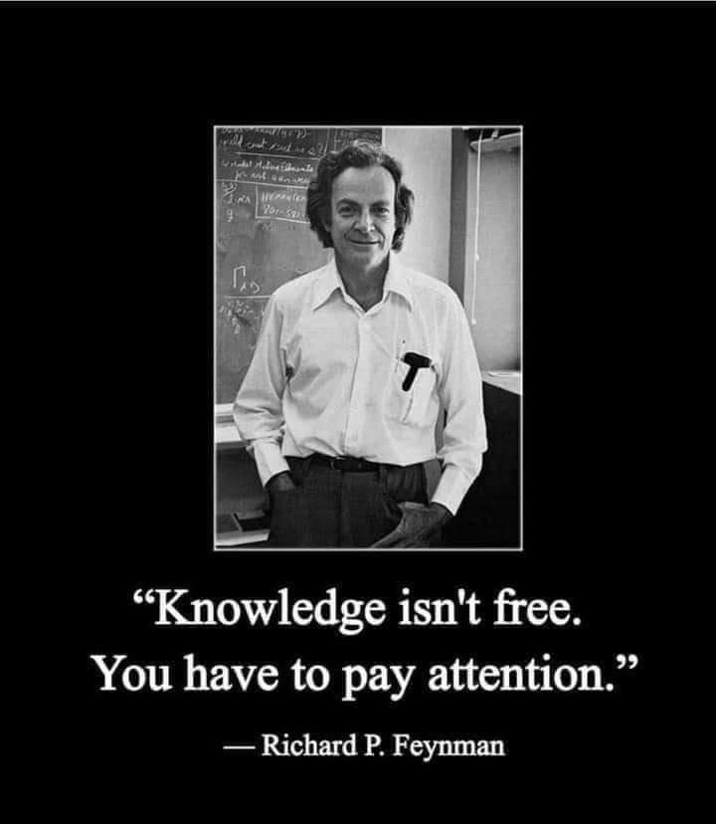
Pre-Requisite

Slide 10
Course Evaluation
Final Examination: 70%
Continuous Assessment: 30%
Written test
Assignments/Project

Slide 11
Week 6
ENTERPRISE AND WIRELESS COMMUNICATIONS NETWORKS

Slide 12
Presentation Outline
Wireless Communications Networks
Network Operating Systems
Enterprise Architectures

Slide 13
OBJECTIVES
By the end of this unit you should be able to:
Describe the four forms of wireless communications.
Explain the role of a network operating system.
Discuss the activities involved in network administration.
Explain the three types of enterprise architectures and the advantages offered by each.

Slide 14
WIRELESS COMMUNICATIONS NETWORKS
Wireless communication has gained a lot of interest for a wide range of ICT applications.
The four wireless forms of interest are:
Cellular Communication Service
Wireless LAN (WLAN)
Bluetooth Personal Area Network/Personal Area Network
Wireless Data Networks

Slide 15
CELLULAR COMMUNICATION SERVICE
Cellular Communications Service: A wireless technology that transmits radio messages between a mobile device (such as mobile telephone, PDA, or wireless laptop) and a cell site.
Cellular Radio System
Mobile Telecommunications Switching Office (MTSO): The switch used in a cellular (mobile) telephone system that links the cell tower to a traditional telephone switch in the public switched telephone network (PSTN).

Slide 16
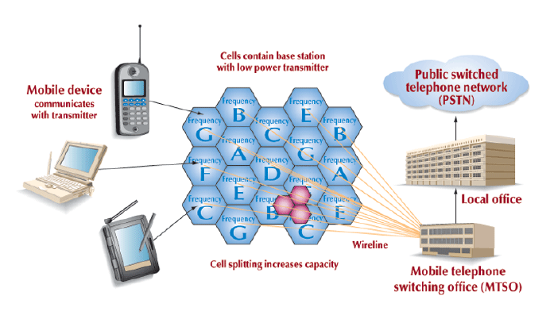
A Cellular Radio System

Slide 17
CELLULAR COMMUNICATION SERVICE
Analog and Digital Cellular Service
Time Division Multiple Access (TDMA): A digital cellular transmission technology that divides a radio frequency into time slots and then allocates slots to an individual device’s conversation or message, thereby distinguishing it from other transmissions.
Code Division Multiple Access (CDMA): A digital cellular transmission technology that encodes each device’s conversation or message with a unique identification code to distinguish it from other transmissions.

Slide 18
CELLULAR COMMUNICATION SERVICE
Next Generation Cellular Service
Generalized Packet Radio Service (GPRS): GPRS (or 2.5G) features higher speed transmission rates than preceding telecom generations and uses packet switching rather than circuit switching, to transmit messages.
Third-generation Service (3G): Uses packet switching and transmits at higher bandwidths that provide faster downloads of information – rates ranging from 384 Kbs to 2 Mbs, depending on the location of the user
Global Positioning System (GPS): A satellite navigation system and a worldwide navigation system that uses information received from orbiting satellites

Slide 19
WIRELESS LAN (WLAN)
Local area networks that transmit data using radio frequencies instead of cables.
Components
Access Point: A device that converts wired LAN signals into radio frequency.
802.11 Wireless Ethernet
Wireless LAN Security
Wired Equivalent Privacy (WEP): A system of security protection that is a standard for encrypting data (converting the data into a protective code) over an 802.11 b wireless network.
Service Set Identity (SSID): An encrypted code keyed into the LAN devices, so that only devices with similar code can access the network resources.

Slide 20
BLUETOOTH PERSONAL AREA NETWORK/PERSONAL AREA NETWORK
A wireless technology for communicating between devices that enable short-range radio links (30 feet or 10 meters) between devices, such as between a PC and a laptop, or a PDA and a printer.

Slide 21
WIRELESS DATA NETWORKS
Wireless Data Networks (WDNs): Networks that use cellular communications services to support mobile users seeking to interconnect with networks using wireless laptops and PDAs.
Virtual Private Network (VPN): A network constructed of public channels to connect client computers to server, incorporating encryption and other security mechanisms to ensure that only authorized users can gain access and that the data cannot be intercepted

Slide 22
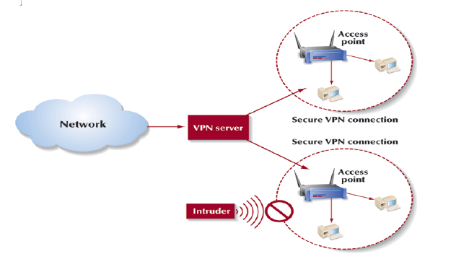
A Virtual Private Network Architecture

Slide 23
NETWORK OPERATING SYSTEMS
Network Operating System (NOS): A software program that runs in conjunction with the computer’s operating system and applications programs and manages the network.
Protocol and Communications Control
– Protocol: The rules and conventions guiding data communications, embedded as coded instructions in the network software.
Network Administration/Network Management: The management of a network, consisting of those procedures and services that keep the network running properly.
The ICT professional responsible for this job is called a Network Administrator.

Slide 24
ENTERPRISE ARCHITECTURES
Architecture: The structure of a communications network, which determines how the various components of the network are structured, how they interact, and when cooperation between the system’s components is needed.
Centralized Architecture
Centralized Architecture: A communications architecture in which a computer at a central site hosts all of the network’s hardware and software, performs all of the processing, and manages the network.
Host-based Computing: Centralized computing.

Slide 25
ENTERPRISE ARCHITECTURES
Teleprocessing: The processing capability made possible by connecting desktop computers to a remote computer through telephone lines.
Front-end Computer: In a centralized system, a minicomputer loaded with specific programs to handle all incoming and outgoing communications traffic.

Slide 26
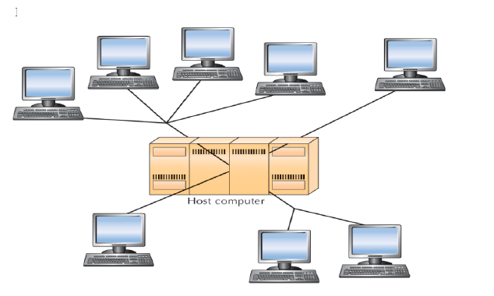
A Centralized Architecture

Slide 27
Distributed Architecture
Distributed Architecture: A communications architecture in which the computers reside at different locations and are interconnected by a communications network.
Distributed Processing: Processing in which an application runs on one or more locations of the network simultaneously.
Distributed Database: A database that resides in more than one system in a distributed network. Each component of the database can be retrieved from any node in the network.

Slide 28
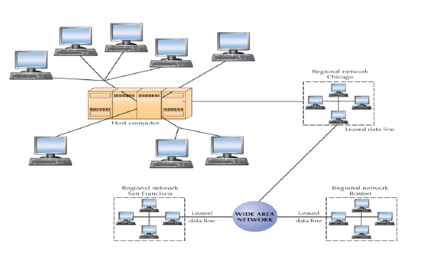
A Distributed Architecture with Distributed Processing

Slide 29
Combining Architectures
Hybrid Network: A communications architecture that combines centralized and distributed architectures to take advantage of the strengths of both.
Virtual Company: A company that joins with another company operationally, but not physically, to design and manufacture a product.

Slide 30
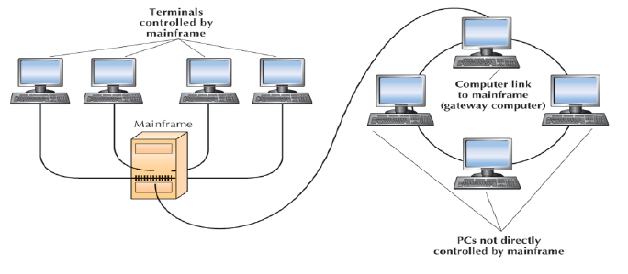
Hybrid Architecture

Slide 31
CONCLUSION
Wireless communication networks are mostly used to implement enterprise networks, because it is easier and faster to connect branch offices at different cities over a wide distance to share resources.

Slide 32
SUMMARY
In this unit you learnt about:
the four types of wireless communication networks
Cellular Communication Service
Wireless LAN (WLAN)
Bluetooth Personal Area Network/Personal Area Network
Wireless Data Networks
the three types of Enterprise Architectures
Centralized Architecture
Distributed Architecture
Combining Architectures (Hybrid Network: combines centralized and distributed architectures )

Slide 33
Week 7
ESSENTIALS OF THE INTERNET

Slide 34
Presentation Outline
The Internet: Basic Concepts
The Origins of the Internet
Computers on the Internet
Capabilities of the Internet
The Internet Community

Slide 35
OBJECTIVES
By the end of this unit you should be able to:
Discuss the origin and uses of the Internet
Describe the three types of capabilities of the Internet.
Identify the principal communication and retrieval capabilities of the Internet.
Know the difference between Intranets, Extranets and Internet.

Slide 36
Introduction
A network is a communication system connecting two or more computers.
Networks connect people as close as the next office and as far away as halfway around the world.
The largest network in the world is the Internet.
The internet is a huge computer network available to nearly everyone with a microcomputer and a means to connect to it.

Slide 37
INTERNET
The internet is often referred to as the information Superhighway; it is a highway that connects to millions of other people and organizations.
the internet moves your ideas and information.
Rather the moving through geographic space, you move through cyberspace-the space of electronic movement of ideas and information.

Slide 38
BASIC CONCEPTS
Connectivity
Connectivity is the capability of the microcomputer to share information with other computers.
Data and information can be sent over telephone lines or cable and through air.
This means that, the microcomputer can be connected to other computers, to the internet, and too many computerized data banks and other sources of information worldwide.
The most dramatic change in connectivity in the past decade has been the widespread use of mobile and wireless communication devices.
It was used in the past for telephone communications, these devices are widely used to connect people and computers located almost anywhere in the world.

Slide 39
BASIC CONCEPTS
Wireless Revolution
The telephone, mobile and wireless communication systems are the beginning of wireless revolution, a revolution that is expected to dramatically affect the way we communicate and use computer technology.
Connectivity and the wireless revolution are significant developments, for they expand the uses of the microcomputer several fold.
Central to the concept of connectivity is the network or computer network.

Slide 40
ORIGINS OF THE INTERNET
The Internet, or the Net, was launched in 1969 when the United States funded a project that developed a national computer network called Advanced Research Agency Network (ARPANET).
The Internet is a large network that connects smaller networks all over the globe together.

Slide 41
COMPUTERS ON THE INTERNET
Client Computer: The computer that accesses the information stored on a server computer.
Server Computer: The computer that contains data and information that can be accessed by a client computer.
Client-server Computing: A type of computing in which all data and information retrieval requests and responses pass over a network. Much of the processing is performed on the server and the results of the processing are transmitted to the client.
Surf or Surfing: Moving among a number of networks that are linked together, or inter-networked.

Slide 42
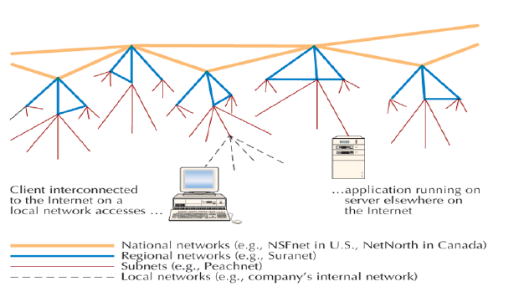
Structure of the Internet

Slide 43
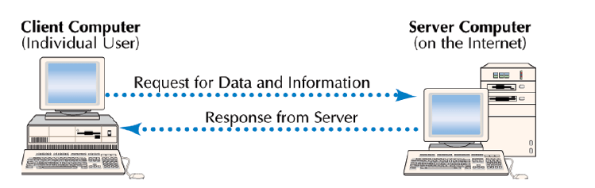
Client/Server Computing

Slide 44
CAPABILITIES OF THE INTERNET
The Internet is used by billion of users in different countries in the world to perform the following activities;
Communicate
Retrieve
Research on the Web
Shopping or Cybermalls

Slide 45
Communications Capabilities
E-mail or Electronic Mail
Mailing Lists
Newsgroups
Chat Session or Internet Relay Chat (IRC)
Instant Messages
Internet Telephony or Voice Over the Internet or Voice over IP
Telnet

Slide 46
Retrieval Capabilities
FTP (File Transfer Protocol)
Web Directory
Search Engines
Portal
Webcasting
Streaming

Slide 47
Research on the Web
The Web being an important research tool for materials to write thesis, has three basic procedures: locating information, evaluating the information and citing references.
Locating information: with all the numerous information available on the Web, it is very difficult for you to locate the right material you are looking for. Discussion groups (www.liszt.com) that can link you to experts are being overlooked.
Evaluating the information: locating information is not all because not everything you find on the Web is useful, nearly anyone can publish anything.
Citing references: Plagiarism is the illegal copying of someone else’s words or ideas.
You can use someone’s words or ideas without committing plagiarism by simply acknowledging or citing the source.

Slide 48
Shopping or Cybermalls
Electronic Commerce/e-commerce: Conducting commercial activities on the Internet..

Slide 49
THE INTERNET COMMUNITY
The way you connect a phone to a telephone system that is how you connect a computer to the Internet.
The computer becomes an extension of a giant network of computers with branches all over the world that allow the use of a browser program to the Web.
Internet Users – you, organizations, schools, hospitals, e.t.c
Providers - The providers or host computers provide a path or connection for individuals to access the Internet.
The follow are Companies that act as providers in different capacities:
Service Providers or Internet Service Providers (ISPs)
Application Service Providers (ASPs)
Content Providers
Infrastructure Providers
Internet Support Agencies

Slide 50
CONCLUSION
The internet is the actual physical network. It is made up of wires, cables, and satellites.
Being connected to this network is often described as being Online.
The Internet connects to over 100 million computers and resources worldwide.
The internet has changed the world into a global village.

Slide 51
SUMMARY
The Internet is the world’s largest network.
The internet is made up of a community of end-users and providers.
The Internet is used to Communicate, Retrieve, Research and E-Commerce

