Slide 1
ICT 201:
INTRODUCTION TO INFORMATION AND COMMUNICATION TECHNOLOGY

Slide 2
Lecturers/Instructors
Dr. S. Akinboro
Dr. Ufuoma C. Ogude
0803 820 7103

Slide 3
Course Schedule
Lecture Schedule:
Mondays: 8:00am - 10:00am
Class Venue: Physical (Room S006) and Virtual
Please attend your lectures. Attendance is mandatory
Classroom Policy
Review recommended material before coming to class
Must be on time
Turn off cell phones
Expectations
Read assigned readings
Attend lectures and participate in discussions
Bring your ideas and concerns to class
Work effectively in a group setting
Learn how to use the tools and understand your project very well when necessary

Slide 4
Learning Outcomes
At the end of the course, students should be able to:
1. Identify components of the computer and know-how the components communicate;
2. Know the concept of data transfer and memory types and management;
3. Be comfortable with graphics processing;
4. Identify and be able to use different communication ports;
5. Know the software types;
6. State different computer network topologies and their sizes;
7. Be able to use office applications and the internet.

Slide 5
Course Contents
Basic principle of computers. Computer "backbone". Data transmission. Random Access Memory. Permanent Memory. Graphic processing. Communication Ports. Input and Output Devices. Software types. Accessibility options. Computer types. Portable digital devices. Network Types. Internet. Instant messaging. Voice over Internet Protocol. Really Simple Syndication. Network communication. Internet data transfer. Data rate units. Internet access. Virtual (online) communities. Computer in the workplace. Office Applications (word processing, spreadsheets, presentation, etc.). Other well-known applications. Telecommuting (telework).

Slide 6
Course Module
Module 1 Introduction to Information Communication Technology
Unit 1: Information Communication Technology: Principles, Practices, and Opportunities.
Unit 2: Essentials of Computing
Unit 3: The System Unit and the Central Processing Unit
Unit 4: Input Devices, Output Devices and Storage Devices and Memory
Module 2 Computer Networks, Distributed Networks and the Internet
Unit 5: Computer Networks, Networking Technologies and Communications Networks
Unit 6: Enterprise and Wireless Communications Networks
Unit 7: Essentials of the Internet and World Wide Web
Unit 8: Electronic Commerce and Electronic Business
Unit 9: Launching Information Technology Applications Projects
Module 3 Managing Information and Communication Technology Applications in the Enterprise.
Unit 10: Creating Enterprise Applications and Project Management
Unit 11: Web Based Application and Information Systems in the Enterprise
Unit 12: Issues in Information Technology and Careers in ICT

Slide 7
Course Outline
Week 1: Information Communication Technology: Principles, Practices, and Opportunities.
Week 2: Essentials of Computing
Week 3: The System Unit and the Central Processing Unit
Week 4: Input Devices, Output Devices and Storage Devices and Memory
Week 5: Computer Networks, Networking Technologies and Communications Networks
Week 6: Enterprise and Wireless Communications Networks
Week 7: Essentials of the Internet
Week 8: Electronic Commerce and Electronic Business
Week 9: Launching Information Technology Applications Projects
Week 10: Creating Enterprise Applications and Project Management
Week 11: Web Based Application and Information Systems in the Enterprise
Week 12: Issues in Information Technology and Careers in ICT
Week 13: Continuous Assessment
Week 14: Examination

Slide 8
Books and References
Use and Effects By: Harry Bouwman, Bart van den Hooff, Lidwien van de Wijngaert & Jan van Dijk, Publisher: SAGE Publications Ltd, Publication year: 2005, Online pub date: June 19, 2012
Discovering Computers. Living in a Digital World. FUNDAMENTALS, 2011 EDITION. Gary B. Shelly. Misty E. Vermaat. Shelly Cashman
Charles S. Parker, Understanding Computers: Today and Tomorrow, Course Technology, 25 Thomson Place, Boston, Massachusetts 02210, USA
Livesley, Robert Kenneth. An introduction to automatic digital computers. Cambridge University Press, 2017.
Zawacki-Richter, Olaf, and Colin Latchem. "Exploring four decades of research in Computers & Education." Computers & Education 122 (2018): 136-152.
Sinha, Pradeep K., and Priti Sinha. Computer fundamentals. BPB publications, 2010.
Goel, Anita. Computer fundamentals. Pearson Education India, 2010.

Slide 9
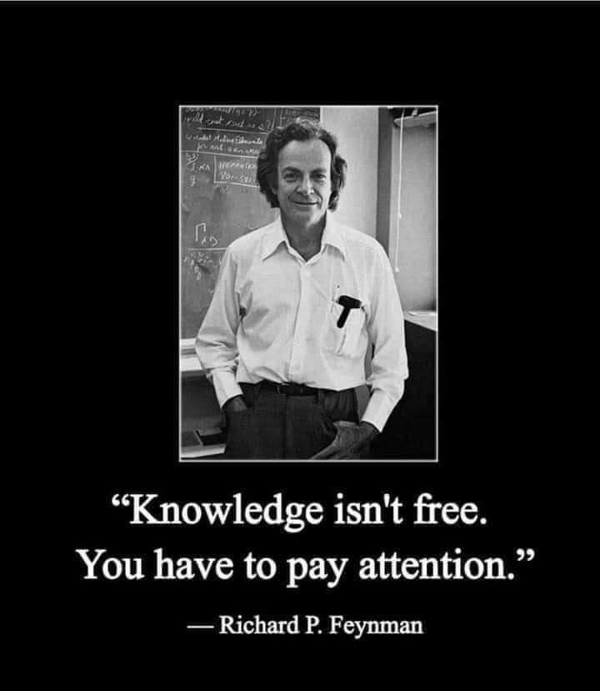
Pre-Requisite

Slide 10
Course Evaluation
Final Examination: 70%
Continuous Assessment: 30%
Written test
Assignments/Project

Slide 11
Week 8
ELECTRONIC COMMERCE AND ELECTRONIC BUSINESS

Slide 12
Presentation Outline
Players in the Game
Types of E-Commerce
Benefits of E-Commerce
Mode of Payment in E-Commerce

Slide 13
OBJECTIVES
After you have read this unit, you should be able to know:
Concept of E-Commerce
The advantages and disadvantages of E-commerce
Types of E-commerce

Slide 14
Introduction
Electronic commerce, also known as e-commerce is the buying and selling of goods over the Internet.
Shopping on the Internet is growing rapidly because E-commerce provides incentives for both buyers and sellers.

Slide 15
PLAYERS IN THE GAME
There are two major parties in the e-commerce business world.
They are:
Buyers
Sellers.
Buyer
From the buyer’s perspective, goods and services can be purchased at any time of the day or night.
Traditional commerce, also known as bricks and mortar business, is typically limited to standard business hours when the seller is open.
Buyers don’t have to travel physically to the seller’s location.
Busy parents don’t have to arrange for a nanny or baby sitter in order to visit the market or go for shopping.

Slide 16
PLAYERS IN THE GAME
Seller
From the sellers perspective the cost associated with renting a shop is eliminated.
For example a supermarket can operate on the Web without a physical store or employing a lot of sales staff.
Traditional stores maintain an inventory of goods in their stores and periodically replenish this inventory from warehouses.
With e-commerce, there is no in-store inventory and products are shipped directly from warehouse.

Slide 17
TYPES OF E-COMMERCE
There are three basic types of electronic commerce: business-to-consumer (B2C), consumer-to-consumer (C2C), business-to-business (B2B).
Business-to-consumer (B2C)
B2C e-commerce is the fastest growing type of e-commerce.
It is used by large corporation, small corporations and start-up corporations.
This involves the sale of a product or service to the general public or end-users.
Most times this arrangement eliminates the middleman by allowing the manufacturers to sell directly to customers.
Existing retailers use B2C ecommerce to create a presence on the Web as a means of reaching out to customers.

Slide 18
TYPES OF E-COMMERCE
The three most widely used B2C applications are:
Online banking
Financial trading
Shopping

Slide 19
TYPES OF E-COMMERCE
Consumer-to-consumer (C2C)
This trading involves individuals selling to individuals, and takes the form of an electronic classified advert or an auction (Web Auction).
Goods are describe and interested buyers contact sellers to negotiate prices, and buyers and sellers never meet face-to-face. Sellers post descript ion of products at a Web site and buyers submit bids electronically.
There are two basic types of Web auction sites.
Auction house sites:
Person-to-person auction sites

Slide 20
TYPES OF E-COMMERCE
Business-to-business (B2B)
B2B involves the sale of a service or product from one business to another.
This is typically a manufacturer’s supplier relationship.
For example, a furniture manufacturer requiring raw materials such as wood, paint, and varnish.
In B2B e-commerce manufacturers place an order electronically with suppliers and many times payment is made electronically.
The most popular B2B e-commerce is for automobile parts, electronics including computers and health care.

Slide 21
BENEFITS OF E-COMMERCE
Geographic Reach: geographical distance does not create a barrier to reaching and serving customers electronically or for interacting with suppliers.
Speed: near instant exchange of information means the interaction between buyer and seller takes place at rapid speed.
Productivity: individuals are more productive when they can do more work in a segment of time. Spending less time getting information means more time available for its use, therein producing greater efficiency.
Information Sharing: virtually any form of information- text, graphics, audio, video or animation- can be transmitted to recipients location on the network.

Slide 22
BENEFITS OF E-COMMERCE
New Features: new features can be added to product and services offered over communications network, including personalized, automatic notification of activities and instant delivery.
Lower Costs: the cost of business is reduced when companies and individuals can be reached quickly and without respect to geographical distance, while improved efficiencies results form electronic information exchange.
Competitive Advantage: those companies that develop and implement an effective electronic commerce strategy have business advantages over others in their industry that can not over similar products, services, or operating capability.

Slide 23
MODE OF PAYMENT IN E-COMMERCE
The single greatest challenge for e-commerce is the development of fast, secure, and reliable payment method for purchased goods.
The three basic payment options are:
check,
credit card, and
electronic cash.

Slide 24
CONCLUSION
We should note that while there are numerous advantages to e-commerce, there are disadvantages as well, and just like any other type of commerce, e-commerce involves two parties: businesses and consumers.
Some of these disadvantages include the inability to provide immediate delivery to goods, the inability to sample goods before purchasing, and the issues relating to security of online payment.

Slide 25
SUMMARY
In this unit we learnt that:
There are three types of e-commerce namely: business-to-consumer (B2C), consumer-to-consumer (C2C), business-to-business (B2B).
With e-commerce, there is no in-store inventory and products are shipped directly from warehouse.
Electronic Commerce (e-commerce)is the use of communication networks, including the public Internet, to conduct commercial transactions between businesses or with consumers.

