Slide 1
ICT 201:
INTRODUCTION TO INFORMATION AND COMMUNICATION TECHNOLOGY

Slide 2
Lecturers/Instructors
Dr. S. Akinboro
Dr. Ufuoma C. Ogude
0803 820 7103

Slide 3
Course Schedule
Lecture Schedule:
Mondays: 8:00am - 10:00am
Class Venue: Physical (Room S006) and Virtual
Please attend your lectures. Attendance is mandatory
Classroom Policy
Review recommended material before coming to class
Must be on time
Turn off cell phones
Expectations
Read assigned readings
Attend lectures and participate in discussions
Bring your ideas and concerns to class
Work effectively in a group setting
Learn how to use the tools and understand your project very well when necessary

Slide 4
Learning Outcomes
At the end of the course, students should be able to:
1. Identify components of the computer and know-how the components communicate;
2. Know the concept of data transfer and memory types and management;
3. Be comfortable with graphics processing;
4. Identify and be able to use different communication ports;
5. Know the software types;
6. State different computer network topologies and their sizes;
7. Be able to use office applications and the internet.

Slide 5
Course Contents
Basic principle of computers. Computer "backbone". Data transmission. Random Access Memory. Permanent Memory. Graphic processing. Communication Ports. Input and Output Devices. Software types. Accessibility options. Computer types. Portable digital devices. Network Types. Internet. Instant messaging. Voice over Internet Protocol. Really Simple Syndication. Network communication. Internet data transfer. Data rate units. Internet access. Virtual (online) communities. Computer in the workplace. Office Applications (word processing, spreadsheets, presentation, etc.). Other well-known applications. Telecommuting (telework).

Slide 6
Course Module
Module 1 Introduction to Information Communication Technology
Unit 1: Information Communication Technology: Principles, Practices, and Opportunities.
Unit 2: Essentials of Computing
Unit 3: The System Unit and the Central Processing Unit
Unit 4: Input Devices, Output Devices and Storage Devices and Memory
Module 2 Computer Networks, Distributed Networks and the Internet
Unit 5: Computer Networks, Networking Technologies and Communications Networks
Unit 6: Enterprise and Wireless Communications Networks
Unit 7: Essentials of the Internet and World Wide Web
Unit 8: Electronic Commerce and Electronic Business
Unit 9: Launching Information Technology Applications Projects
Module 3 Managing Information and Communication Technology Applications in the Enterprise.
Unit 10: Creating Enterprise Applications and Project Management
Unit 11: Web Based Application and Information Systems in the Enterprise
Unit 12: Issues in Information Technology and Careers in ICT

Slide 7
Course Outline
Week 1: Information Communication Technology: Principles, Practices, and Opportunities.
Week 2: Essentials of Computing
Week 3: The System Unit and the Central Processing Unit
Week 4: Input Devices, Output Devices and Storage Devices and Memory
Week 5: Computer Networks, Networking Technologies and Communications Networks
Week 6: Enterprise and Wireless Communications Networks
Week 7: Essentials of the Internet
Week 8: Electronic Commerce and Electronic Business
Week 9: Launching Information Technology Applications Projects
Week 10: Creating Enterprise Applications and Project Management
Week 11: Web Based Application and Information Systems in the Enterprise
Week 12: Issues in Information Technology and Careers in ICT
Week 13: Continuous Assessment
Week 14: Examination

Slide 8
Books and References
Use and Effects By: Harry Bouwman, Bart van den Hooff, Lidwien van de Wijngaert & Jan van Dijk, Publisher: SAGE Publications Ltd, Publication year: 2005, Online pub date: June 19, 2012
Discovering Computers. Living in a Digital World. FUNDAMENTALS, 2011 EDITION. Gary B. Shelly. Misty E. Vermaat. Shelly Cashman
Charles S. Parker, Understanding Computers: Today and Tomorrow, Course Technology, 25 Thomson Place, Boston, Massachusetts 02210, USA
Livesley, Robert Kenneth. An introduction to automatic digital computers. Cambridge University Press, 2017.
Zawacki-Richter, Olaf, and Colin Latchem. "Exploring four decades of research in Computers & Education." Computers & Education 122 (2018): 136-152.
Sinha, Pradeep K., and Priti Sinha. Computer fundamentals. BPB publications, 2010.
Goel, Anita. Computer fundamentals. Pearson Education India, 2010.

Slide 9
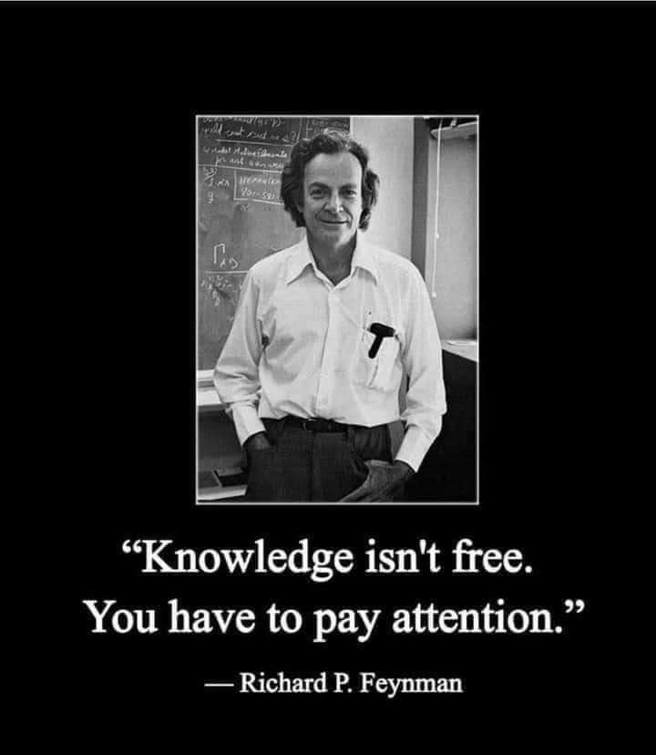
Pre-Requisite

Slide 10
Course Evaluation
Final Examination: 70%
Continuous Assessment: 30%
Written test
Assignments/Project

Slide 11
Week 9
LAUNCHING INFORMATION TECHNOLOGY APPLICATIONS PROJECTS

Slide 12
Presentation Outline
Information Technology Applications
Characteristics of Personal and Enterprise System
Impact of ICT Applications
Enterprise Systems Project: Project Proposal

Slide 13
INFORMATION TECHNOLOGY APPLICATIONS
There are basically two categories of IT applications, they are:
Single-user System/Personal System: An IT system used by only one person. A system that stands alone and is not interconnected with other companies or shared by other people.
• Enterprise System: Usually involves the same types of components as a personal system, plus server or mainframe, database, and network. It is generally a shared system.

Slide 14
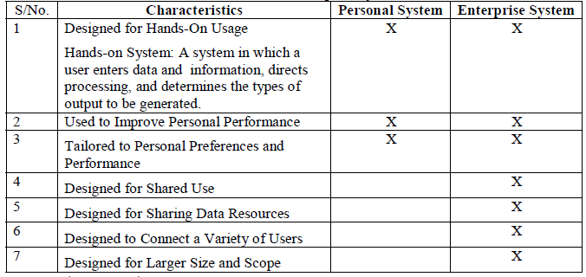
CHARACTERISTICS OF PERSONAL AND ENTERPRISE SYSTEM

Slide 15
IMPACT OF IT APPLICATIONS
Improved Productivity
Productivity: The relationship between the results of an activity (output) and the resources used to create those results (inputs).
Personal Productivity Software: Software packages that permit activities to be completed more quickly, allow more activities to be completed in a particular period of time, or allow a task to be completed with fewer resources.
Greater Effectiveness
Effectiveness: The extent to which desirable results are achieved.
Increased Creativity and Innovation

Slide 16
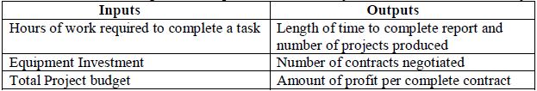
Relationship between an activity and resources in Productivity

Slide 17
ENTERPRISE SYSTEMS PROJECT
These are projects designed for organizations to promote efficient and safe use of data across the networks within their organizations.
Systems Development: The process of examining a business situation, designing a system solution to improve that situation, and acquiring the human, financial, and information technology resources needed to develop and implement the solution.
Project Management: The process of planning, organizing, integrating, and overseeing the development of an IT application to ensure that the project’s objectives are achieved and the system is implemented according to expectations.

Slide 18
PROJECT PROPOSAL
Project Proposal: A proposal for a systems project prepared by users or systems analysts and submitted to a steering committee for approval.
• Steering Committee Review
Steering Committee: A group of people from various functional areas of a business that determines whether a systems development project proposal is desirable and should be pursued.

