Slide 1



Efficient illuminant correction in the Local, Linear, Learned (L³) method
François G. Germain, Iretiayo A. Akinola, Qiyuan Tian,
Steven Lansel, and Brian A. Wandell
February 9, 2015

Slide 2
Overview
Motivation
Illuminant correction in L³
Natural-100 chart
Results

Slide 3
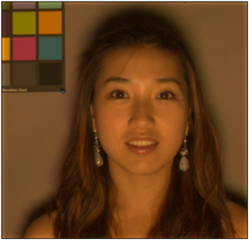
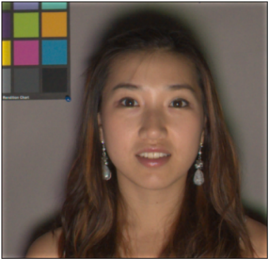
Motivation: Illuminant correction
Illuminant correction: transform the image to remove the color shift between the scene illuminant and a target illuminant.
Why? To account for the perceptual phenomenon of color constancy.
Color constancy: phenomenon in which the color appearance of an object (e.g., a white shirt) remains constant across light conditions.
Scene under
Tungsten light
Scene under
D65 (“white”) light

Slide 4


Illuminant correction
Typical image processing pipeline:
L³ image processing pipeline:
Sensor
Display
Sensor
Correction
Illuminant
correction
Denoising
Demosaicking
L³ pipeline

Slide 5
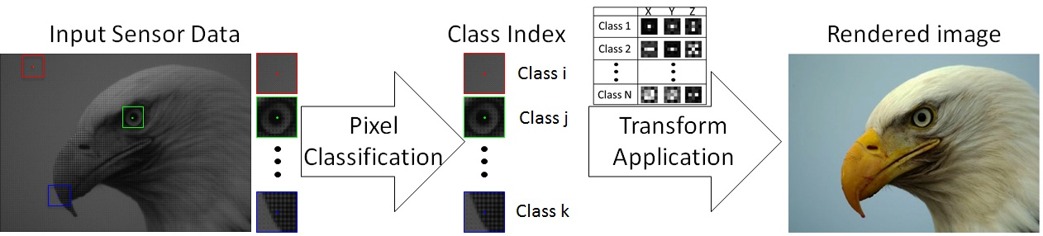
Illuminant correction in L³ (1)
L³ pipeline
L³ table
Typical L³ table: ~500 transforms

Slide 6
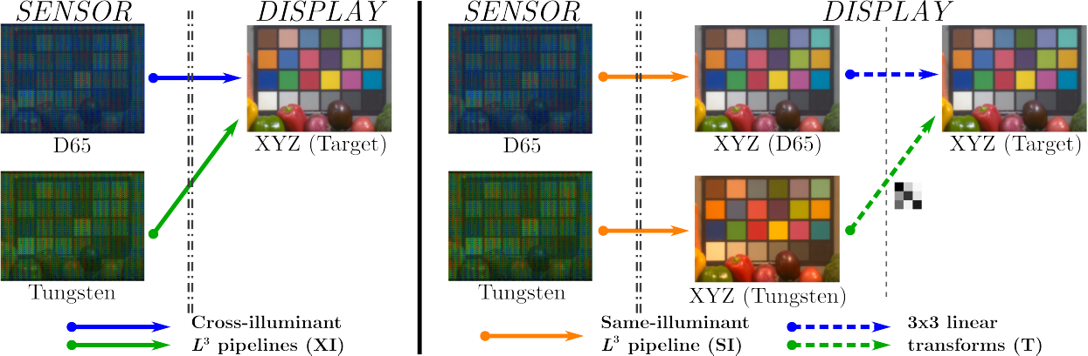
Illuminant correction in L³ (2)
L³ illuminant correction – Cross-illuminant architecture
One L³ table
per illuminant
L³ pipeline

Slide 7
Illuminant correction in L³ (3)
L³ illuminant correction – Same-illuminant architecture
One single L³ table
One illuminant correction
transform per illuminant
Illuminant
correction
L³ pipeline

Slide 8
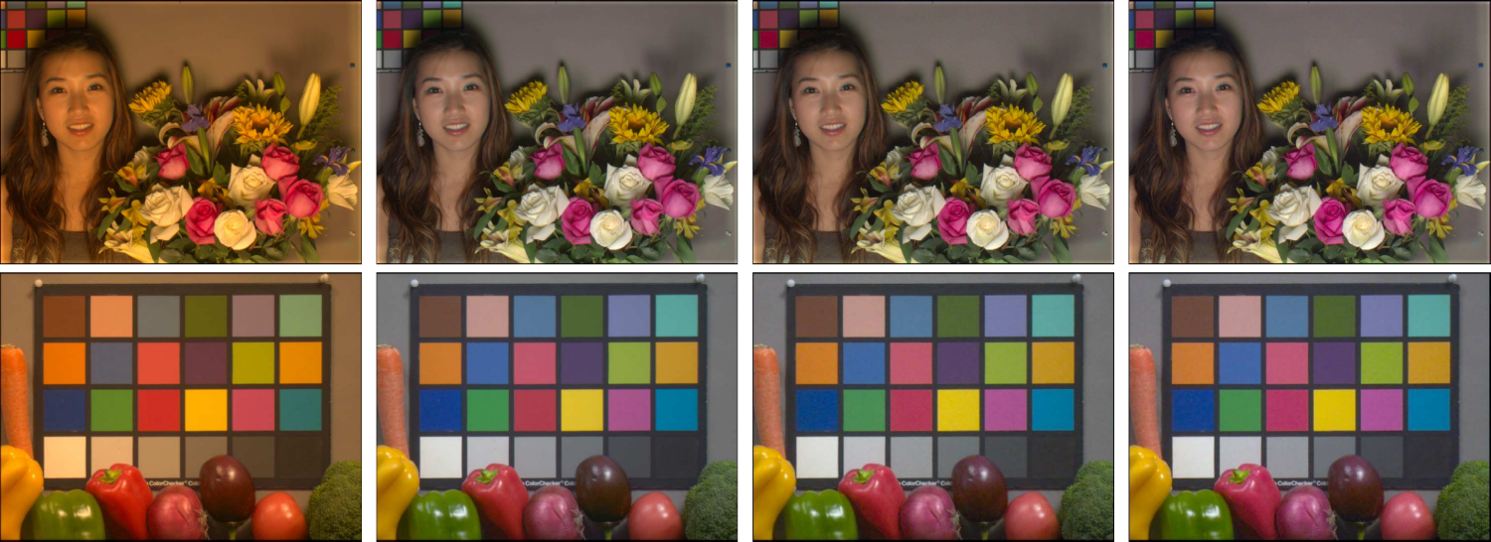
Example 1: Tungsten light
Scene under
Tungsten light
Scene under
D65 light
XI_{Tun}
SI_{D65}–T

Slide 9
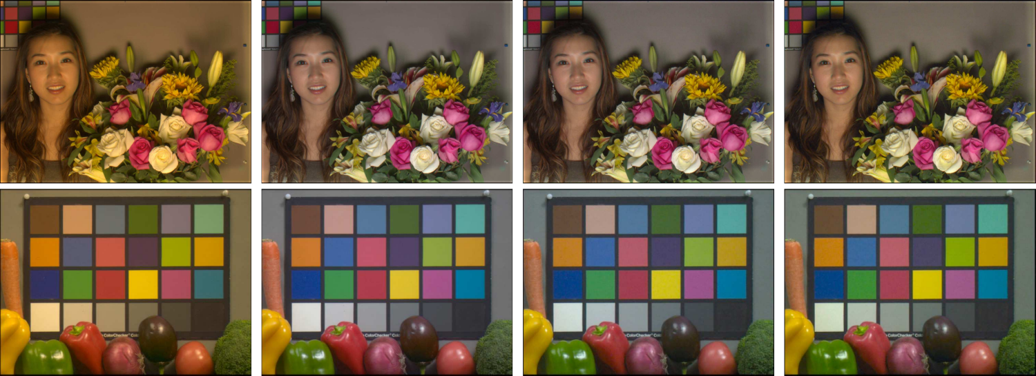
Example 2: Fluorescent light
Scene under
Fluorescent light
Scene under
D65 light
XI_{Flu}
SI_{D65}–T

Slide 10
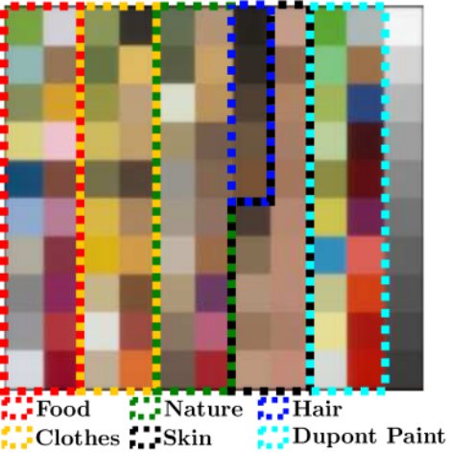
Natural-100 chart
Multi-spectral natural samples
Nature
7-component
PCA
Clothes
Skin
Clustering
Nature
Nature
Selection
Clothes
Clothes
Skin
Skin

Slide 11
Same-illuminant L³
The choice of the training data produces different optimized same-illuminant L³ tables.
Sensor data
under D65 light
SI_{D65}
Image data
under D65 light
Sensor data
under Tungsten
light
Image data
under Tungsten
light
SI_{Tun}
Sensor data
under an ensemble
of illuminants
Image data
under an ensemble
of illuminants
SI_{Ens}

Slide 12
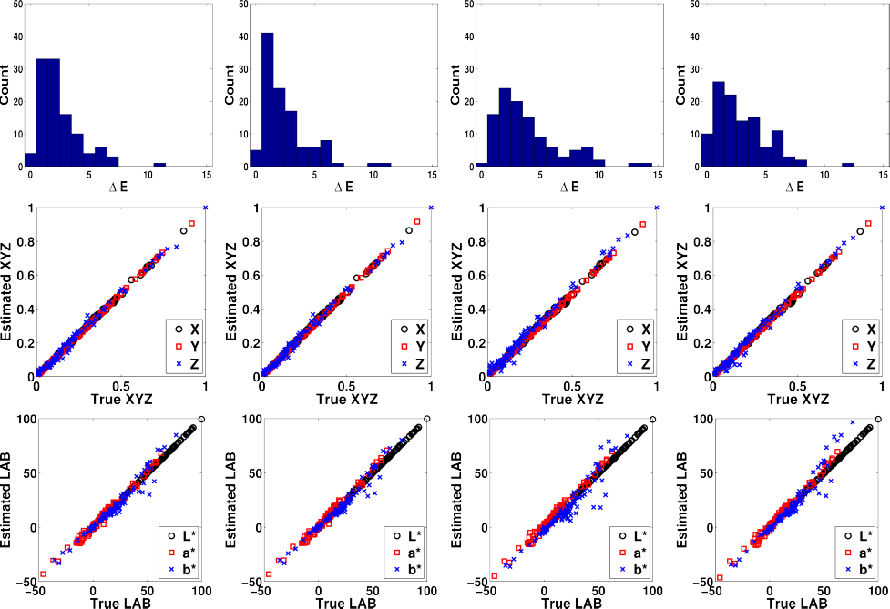
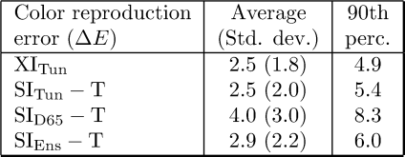
Results (Natural-100)
XI_{Tun}
SI_{Tun} – T
SI_{D65} – T
SI_{Ens} – T

Slide 13
Conclusion
Illuminant correction can be performed efficiently using a single same-illuminant L³ table followed by an illuminant correction transform.
Replacing the cross-illuminant L³ tables with the same-illuminant table with transform costs very little in color reproduction accuracy.
Different options exist for the same-illuminant L³ table. We suggest training the table on an ensemble of illuminants.

Slide 14
Acknowledgements

