Slide 2
Superficial layers of oral mucosal are some combination of FAD and keratin
Matlab
Can we predict the tongue measurements we make with linear combination of FAD and keratin emissions* longpass filter?
Use the measurements of the powder for FAD and keratin made in Tulio’s lab
Do we need to include collagen? (see collagen power measurements made in Tulio’s lab)
Do we need to include blood?
Do we reduce the weight on keratin for the lower lip measurements?

Slide 3
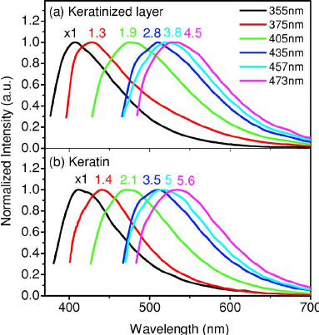

Slide 4
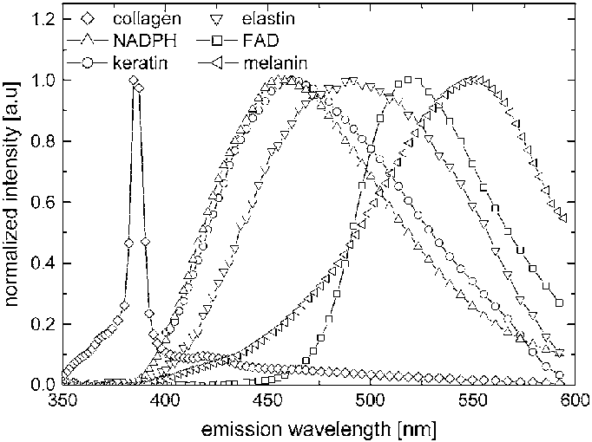

Slide 5
Keratin
The emission spectrum of keratin is broad and overlaps with both NADH and FAD emission
Plot emissions of keratin from Wu&Gu and from DaCosta 2003

Slide 6
Keratin
The emission spectrum of keratin is broad and overlaps with both NADH and FAD emission
Plot emissions of keratin from Wu&Gu and from DaCosta 2003
z

Slide 7
Spectral fluorescence measured for different excitation lights with different longpass filters on the PR670 nm light
Peak of emissions is at an excitation wavelength that is less than 400 nm
As the excitation wavelength increases, the amount of fluorescence decreases, as one would expect

Slide 8
This is how much of the emitted light passes thru a 360 (?) nm LP filter
This is how much of the emitted light passes thru a 425 nm LP filter

Slide 9
Use the EEM for Keratin from DaCosta
The left part of the curve is due to a longpass filter placed over the detector.
The amplitude of the emissions is arbitrary and scaled to one. This is because we do not know the concentration of keratin.
I scaled the amplitude to demonstrate that the measurements could be consistent with DaCosta data
DaCosta
Wu & Gu
Powder measured in lab

Slide 10
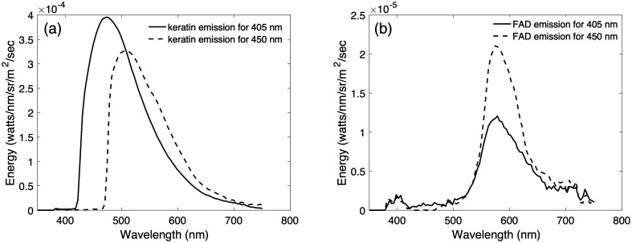
Keratin
The emission spectrum of keratin is broad and overlaps with both NADH and FAD emission
Plot emissions of keratin from Wu&Gu and from DaCosta 2003

Slide 11
Compare keratin powder measurements (Tulio’s lab) to what is predicted by DaCosta emission spectra for keratin * longpass filter

Slide 12
Compare FAD powder measurements (Tulio’s lab) to what is predicted by DaCosta emission spectra for FAD * longpass filter

