Slide 2
Outline
Purpose
Demonstrate that we are measuring tissue fluorescence and not reflected light
SNR
Linearity
Testing hypotheses about source of tissue fluorescence
Non-negative matrix factorization
Bulk fluorescence (uncertainty surrounding emission spectra)
Porphyrin fluorescence (porphyrins, chlorophyll)

Slide 3
Empirical observations
Tissue autofluorescence in healthy individuals
Notes:
Measurements support hypothesis that emitted light is absorbed by blood (see dip in fluorescence at peak wavelengths for blood absorbance)
We measure porphyrin fluorescence on tongue, but not on lower lip
For some individuals, we measure chlorophyl fluorescence on tongue after eating a salad

Slide 4
Measurements to address these questions
First question is always: Are we measuring fluorescence?
Second question is what are the possible sources of fluorescence

Slide 5
1. Are we measuring fluorescence?
Quantify SNR
Compare fluorescence signal to noise (SNR). The signal should be higher than expected noise
Signal should increase linearly with excitation light level
Expected noise is measured by illuminating a target with 414, 450 and 520 nm lights and measuring the light that passes through the longpass filter * tongue fluorescence. Plot that as the baseline noise above which tissue fluorescence should be higher.
Do this for different excitation light levels

Slide 6
Linearity
Fluorescence increases with intensity
Plot radiance at 525 nm for different levesl?
Need to show that the increase in intensity is due to fluorescence and not reflected light
Measure light spectra using PR670 with white calibration target at different levels
Measure light spectra with using PR670 with longpass filter and white calibration target at different levels
Or use non-fluorescent paper that I ordered
Maximum possible reflected light is estimated by multiplying the light that passes through the longpass filter and the tongue (and lip) reflectance
Note that the white calibration target does contain fluorescence

Slide 7
ToDo
Purpose: demonstrate that we are measuring tissue fluorescence
Fluorescence linearity
For each of the linearity plots, measure the light that passes through the 450 nm longpass filter and multiply by tongue fluorescence to predict expected tongue reflectance
For each of the linearity plots, plot expected tongue reflectance
Fluorescence photobleaching
Illuminate with excitation light with constant intensity and make multiple measurements of tissue fluorescence. Expect amplitude to decrease with each successive measurement
Do this for excitation lights with different intensities. Expect effect of photobleaching to be bigger for higher intensities
Calibration
For all plots of tissue fluorescence, always measure excitation light intensity in the same experiment (for calibration purposes) and always plot the expected tissue reflectance with the measured tissue fluorescence

Slide 8
1. What are the possible sources of fluorescence?
Using nnmf (non-negative matrix factorization), we can identify at least two spectral components. Bulk tissue fluorescence and porphyrins (chlorophyll after eating a salad). Porphyrins (and chlorophyll) were only measured on the tongue and not on the lower lip
Create a linear model to predict bulk tissue fluorescence as weighted combinations of FAD, collagen, and keratin
Make predictions fof 415, 450 and 520 nm excitation lights, such that weight on FAD should be highest for 450 excitation light
Also need to account for the absorbance of emitted light by blood
Notes:
Measurements support hypothesis that emitted light is absorbed by blood (see dip in fluorescence at peak wavelengths for blood absorbance)
We measure porphyrin fluorescence on tongue, but not on lower lip
For some individuals, we measure chlorophyl fluorescence on tongue after eating a salad

Slide 9
ToDo
Purpose: test hypotheses about source of tissue fluorescence
Non-negative matrix factorization
This has been done to some extent already
Use nnmf as an analysis tool
Empirical measurements of fluorophores (powder form)
For each excitation light (e.g. 405, 415 and 450), empirically measure spectral emissions of the fluorophores in powder form
Use these as spectral basis functions, replacing nnmf factors
Empirical measurements of tissue fluorescence
For each excitation light (e.g. 405, 415 and 450), empirically measure tissue fluorescence on tongue and lower lip (already did this)
Determine if we can predict tissue fluorescence as weighted combination of spectral basis functions for fluorophores measured empirically for each light

Slide 10
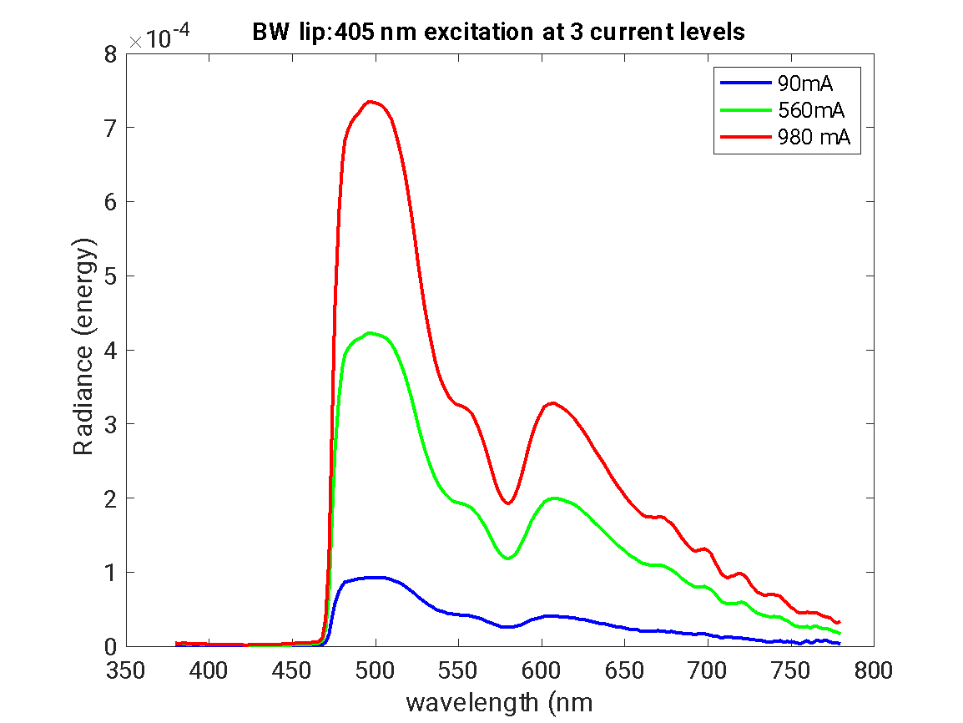

Slide 11
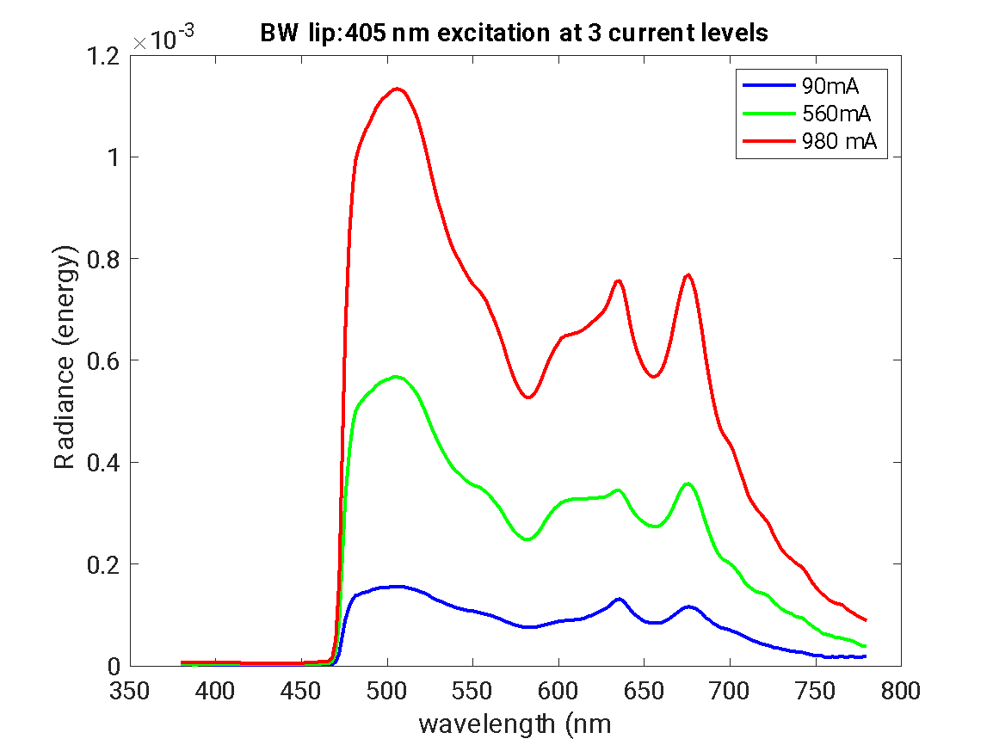
Dip at 580 due to blod absorption

Slide 12
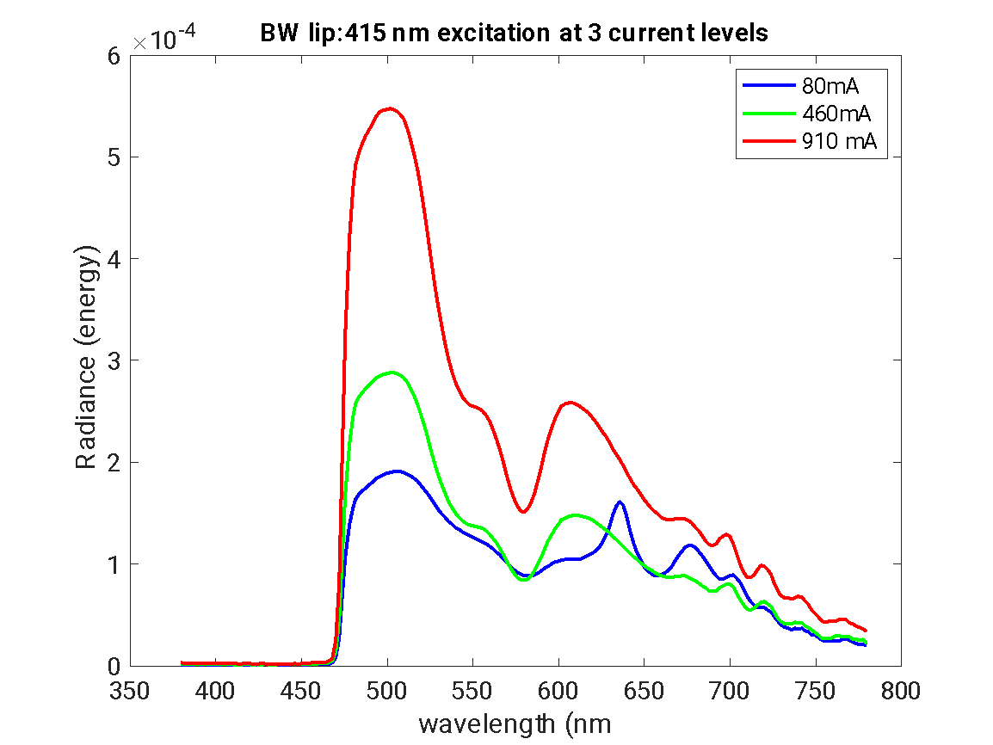

Slide 13
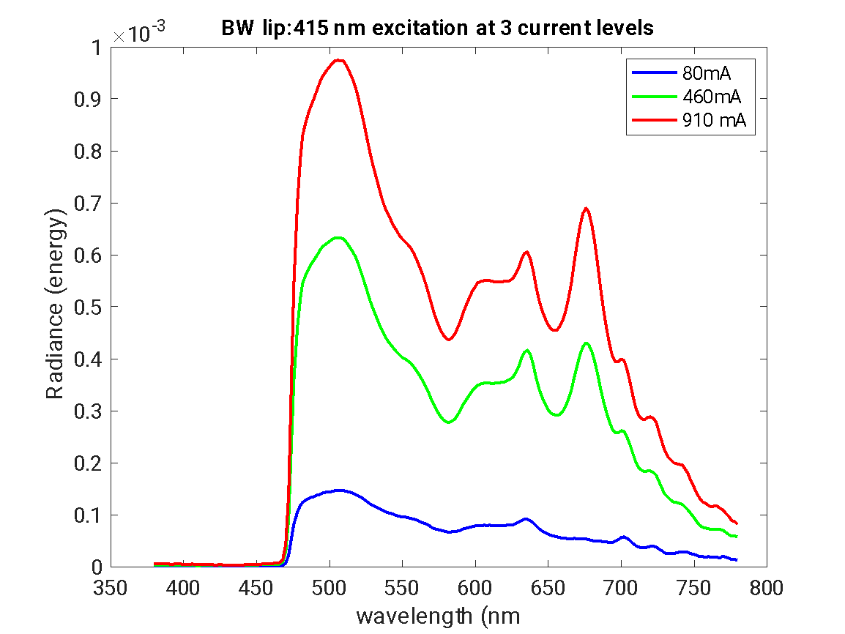

Slide 14
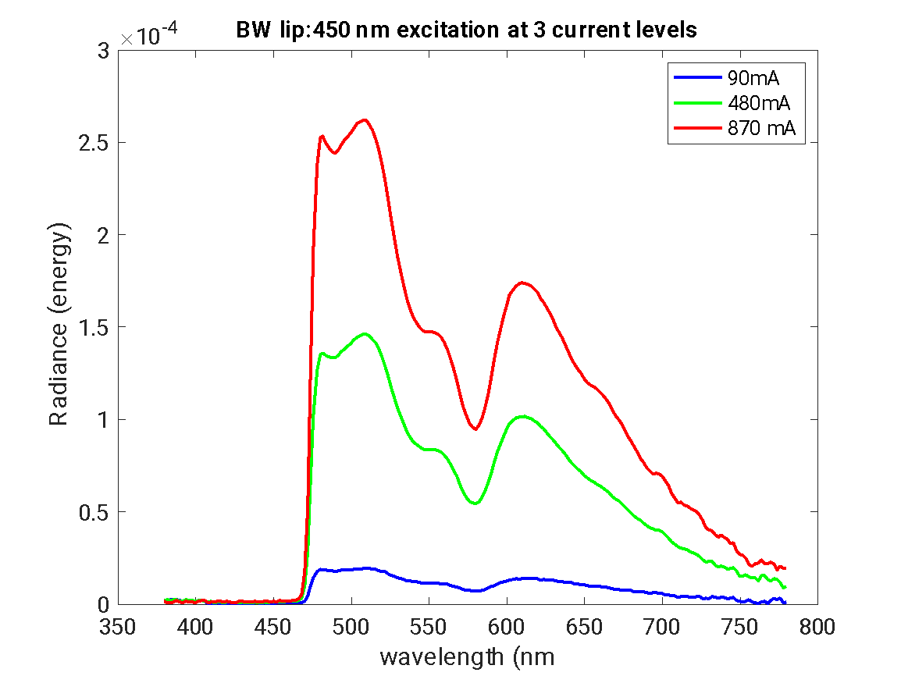

Slide 15
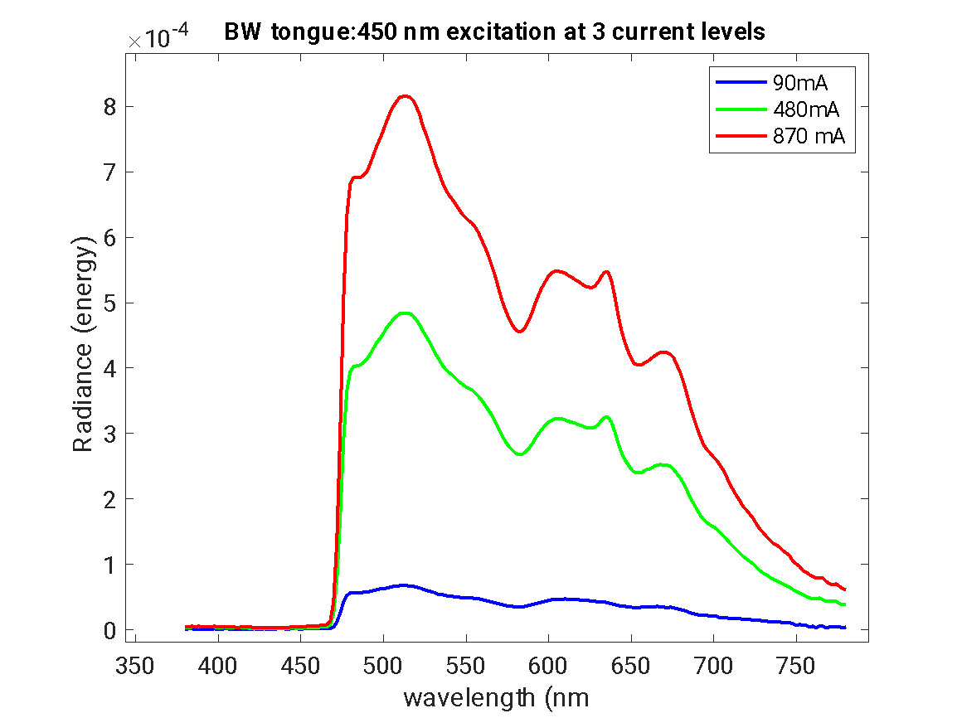

Slide 16
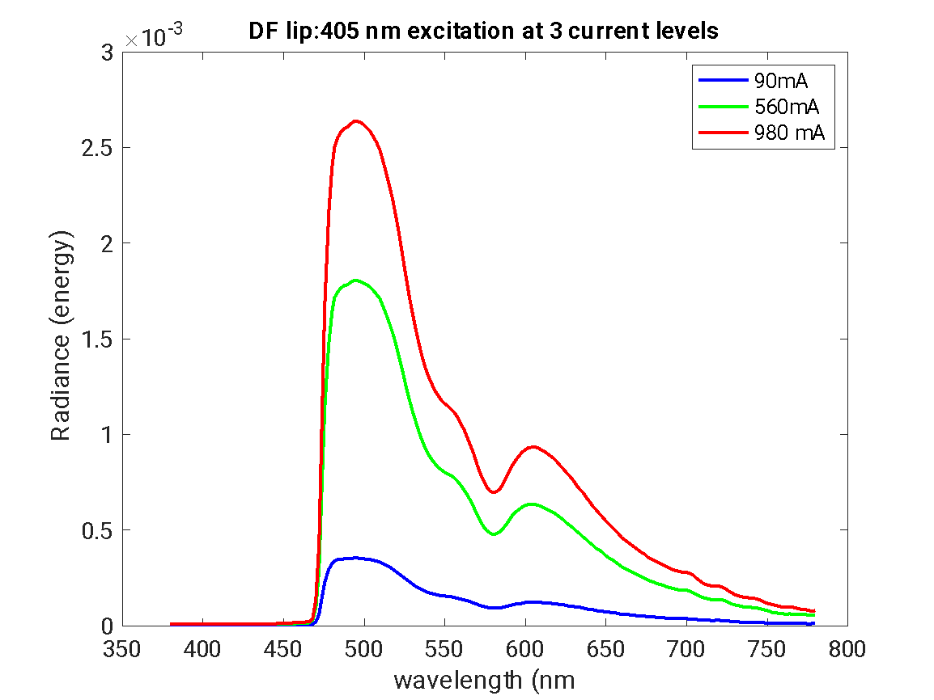

Slide 17
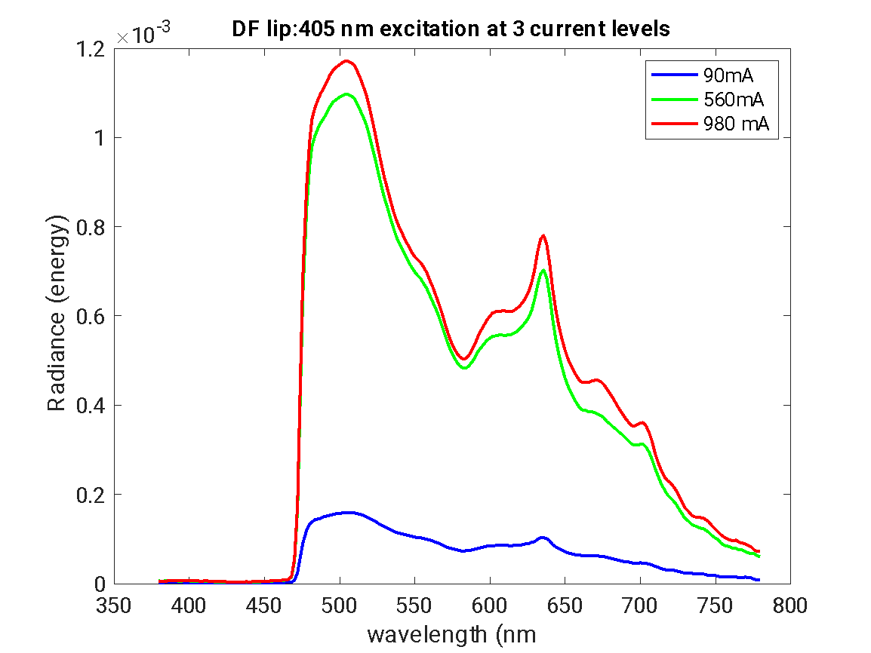

Slide 18
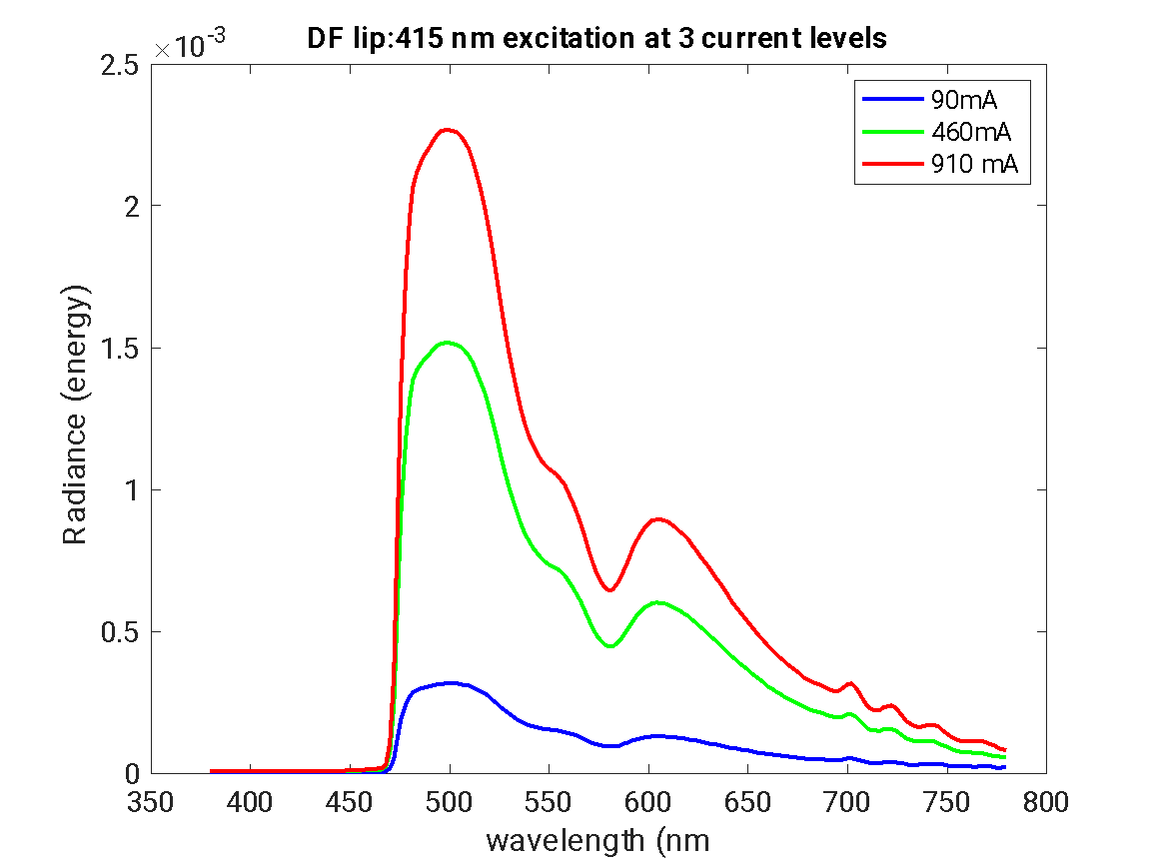

Slide 19
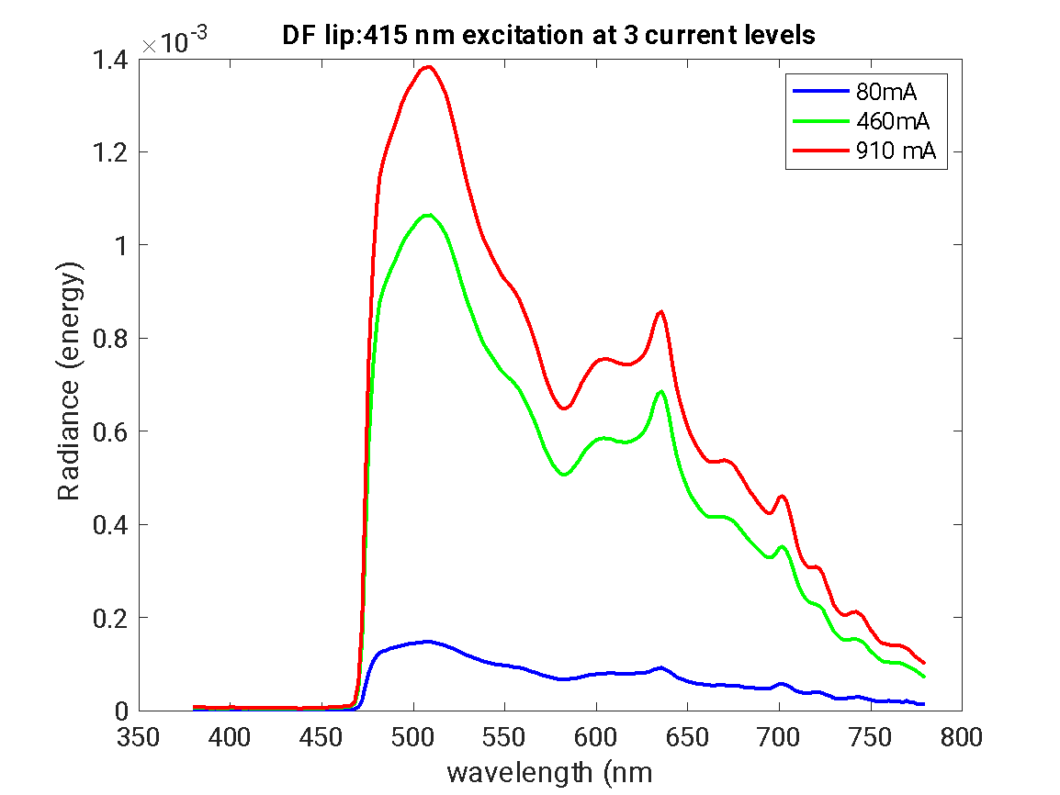

Slide 20
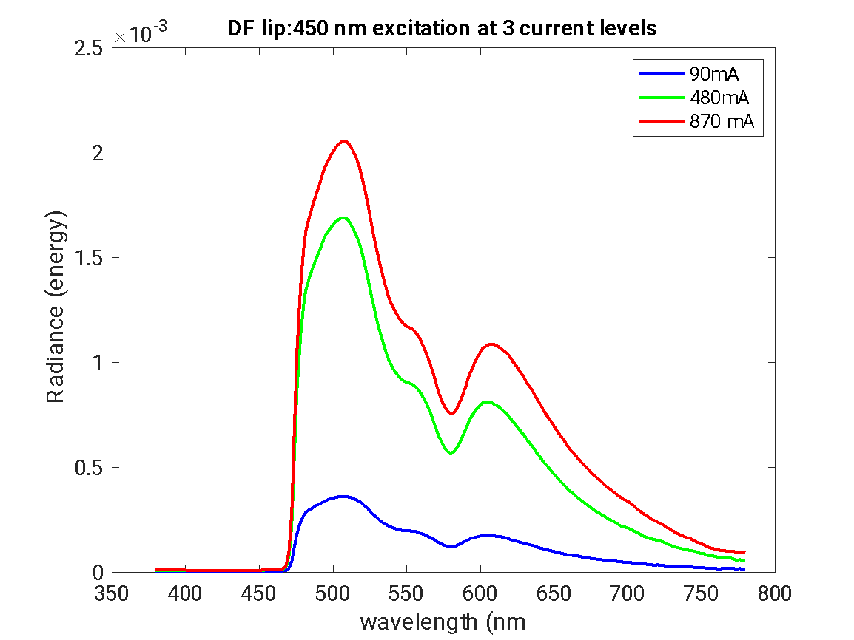

Slide 21
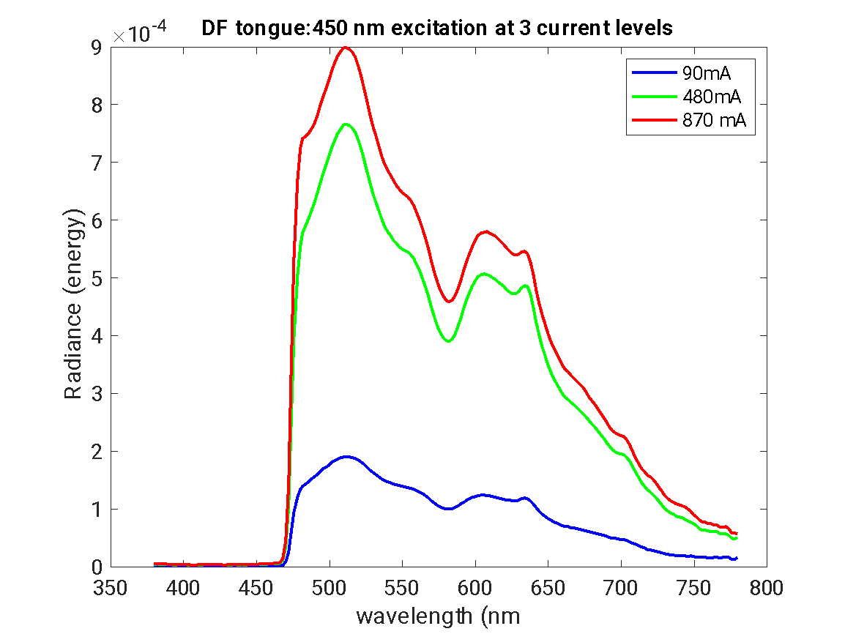

Slide 22
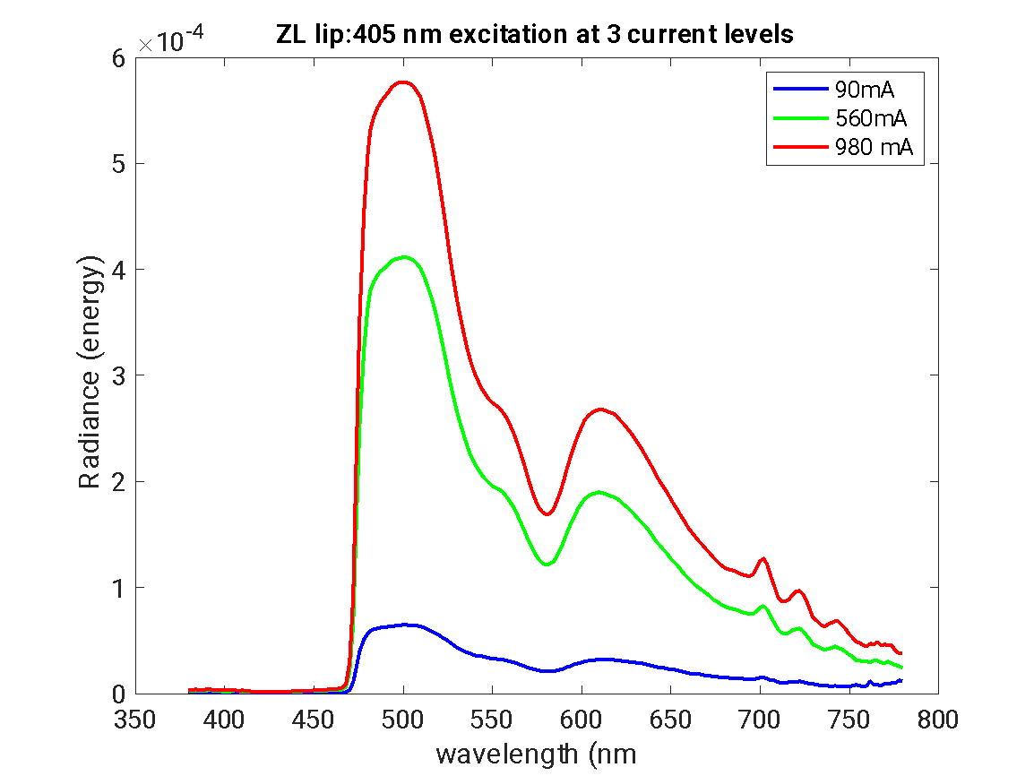

Slide 23
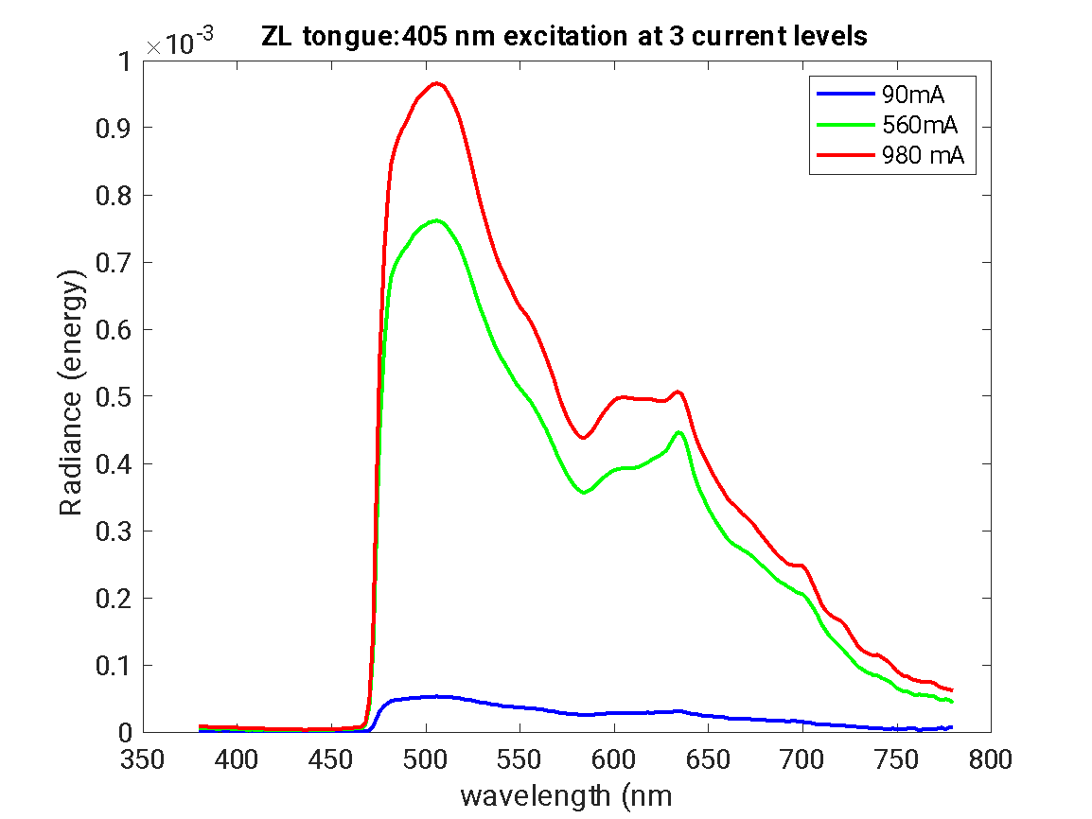
Dip at 580 due to blood absorption

Slide 24
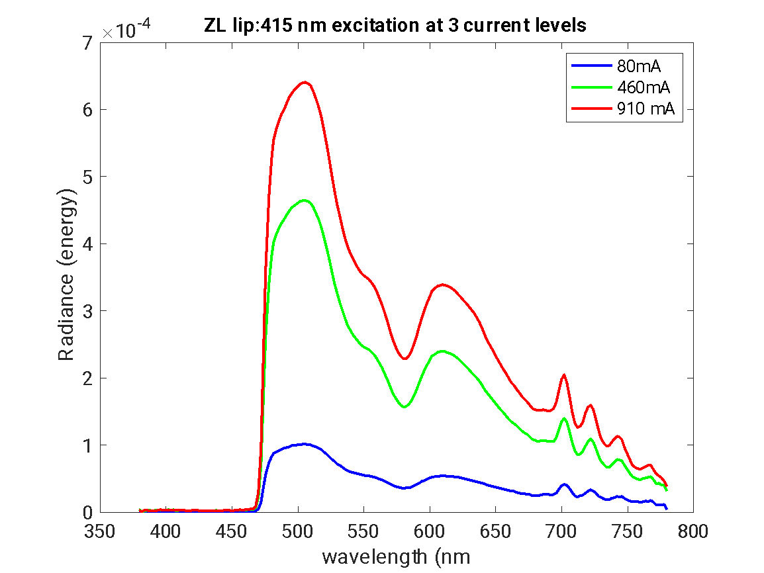
Dip at 580 due to blood absorption

Slide 25
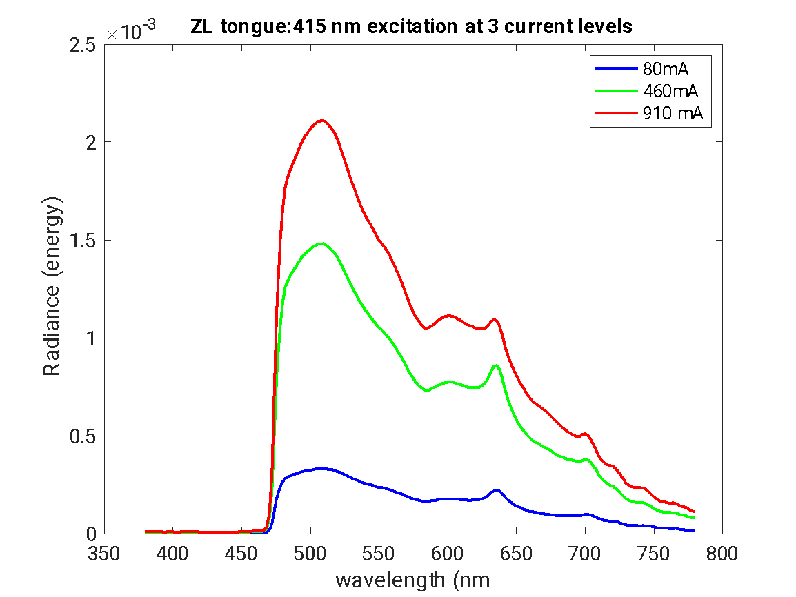

Slide 26
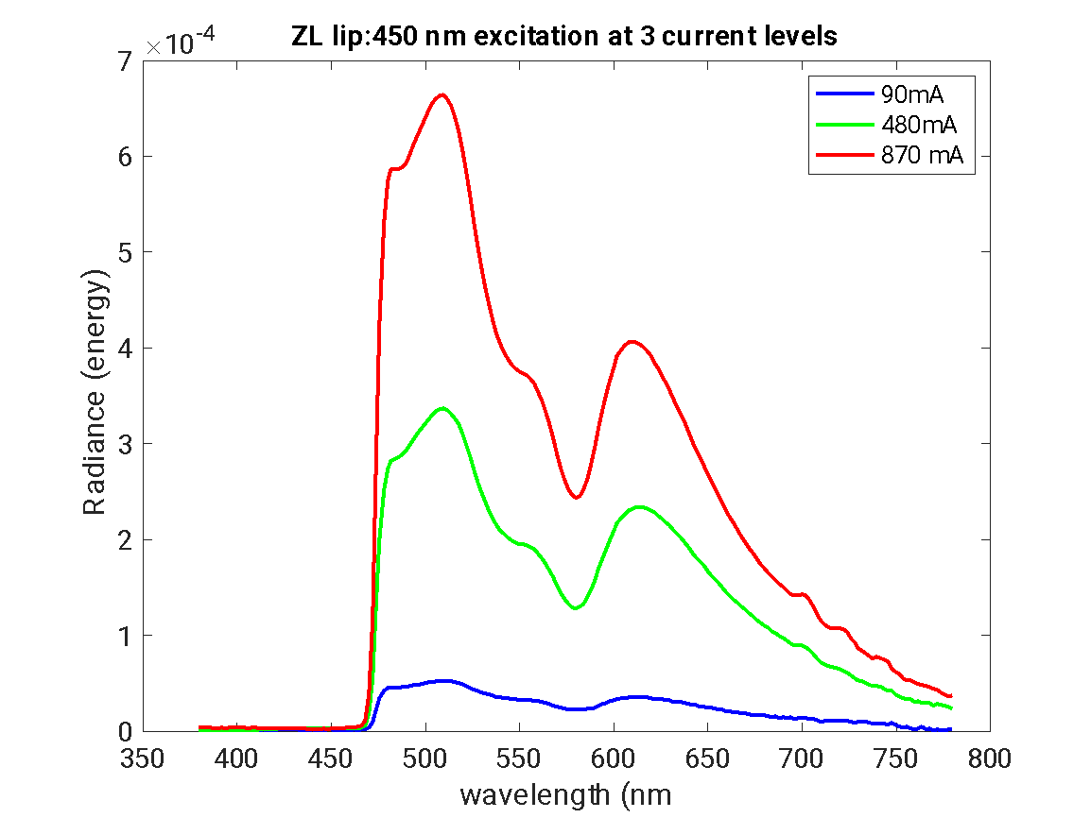

Slide 27
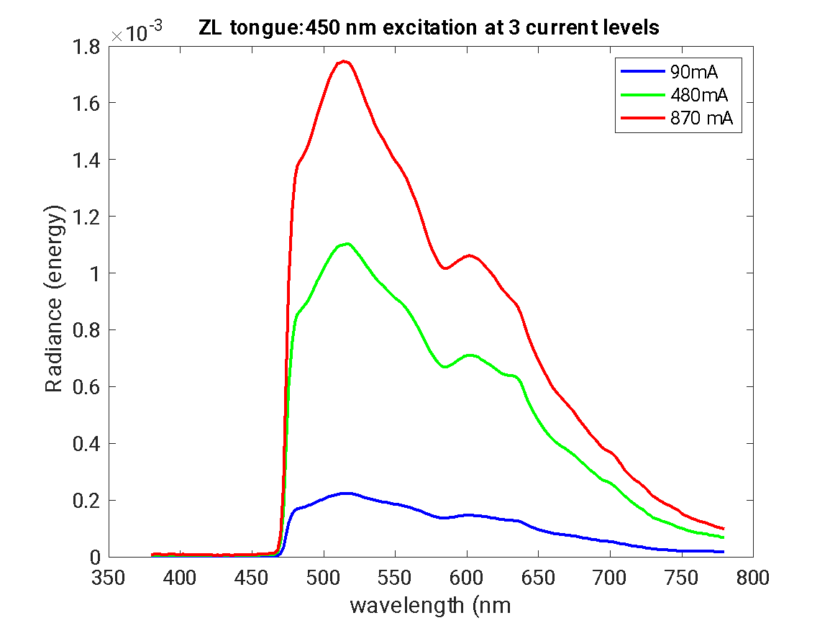

Slide 28
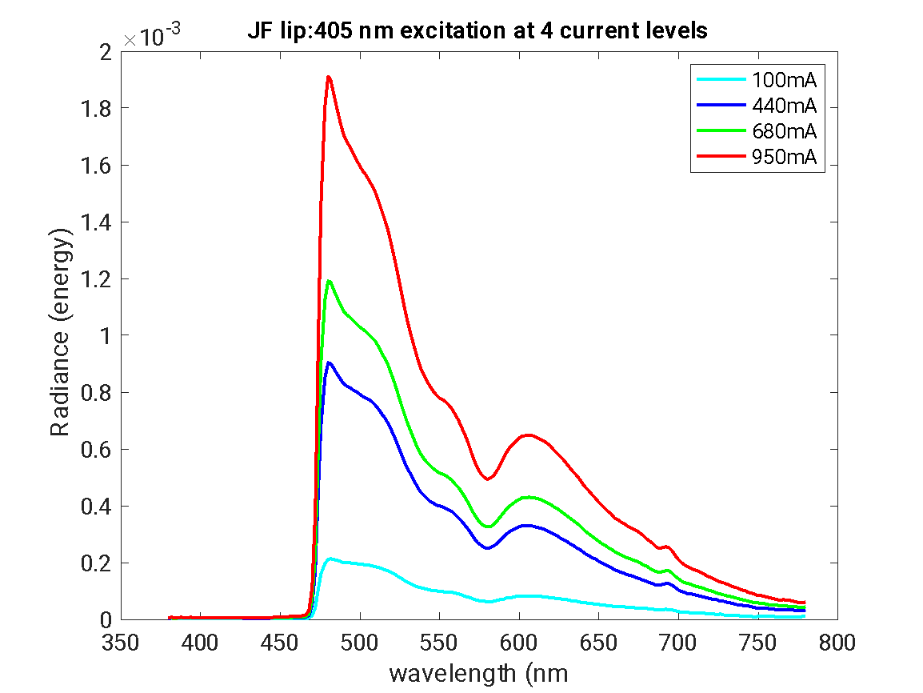

Slide 29
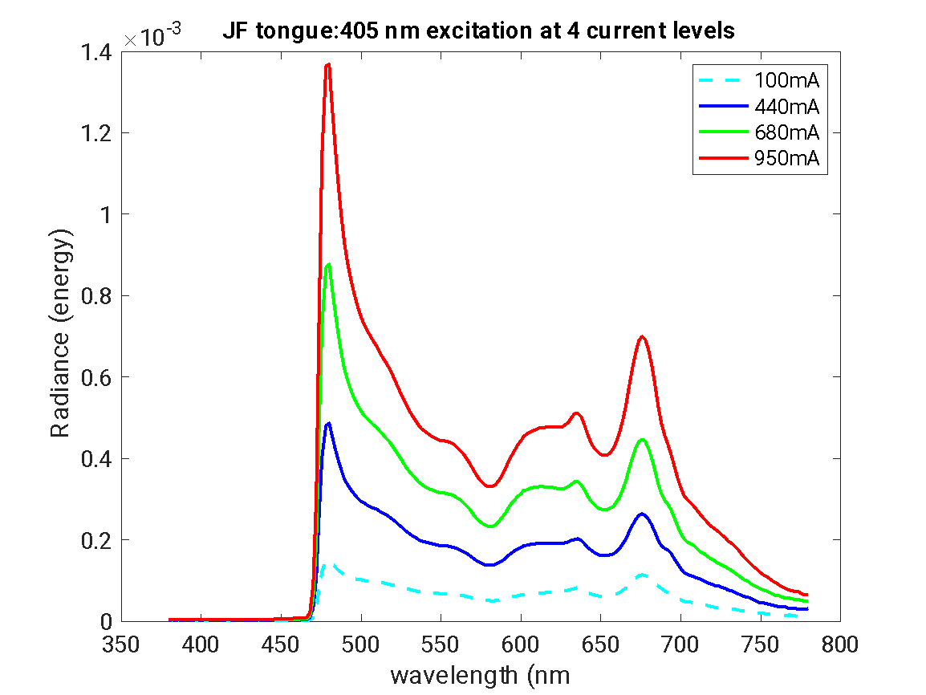

Slide 30
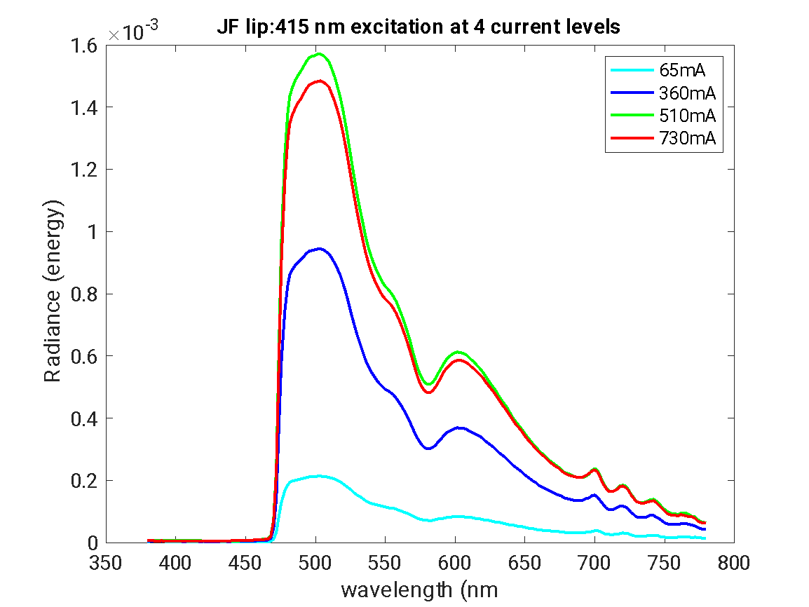

Slide 31
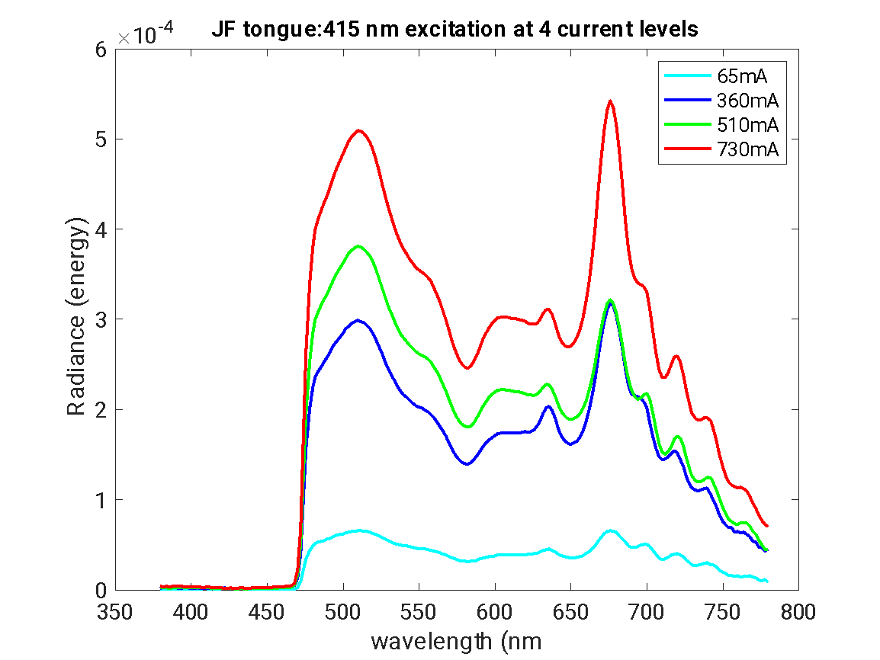

Slide 32
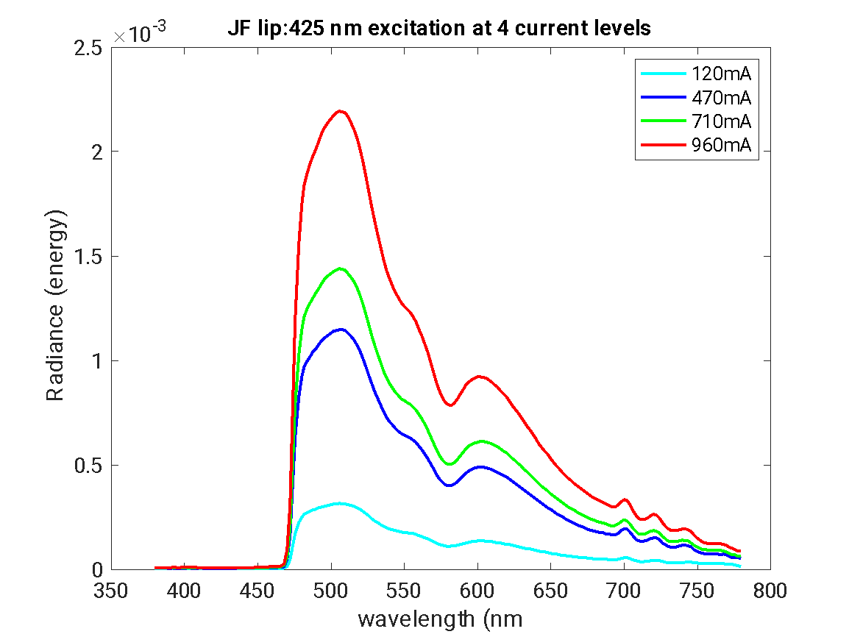

Slide 33
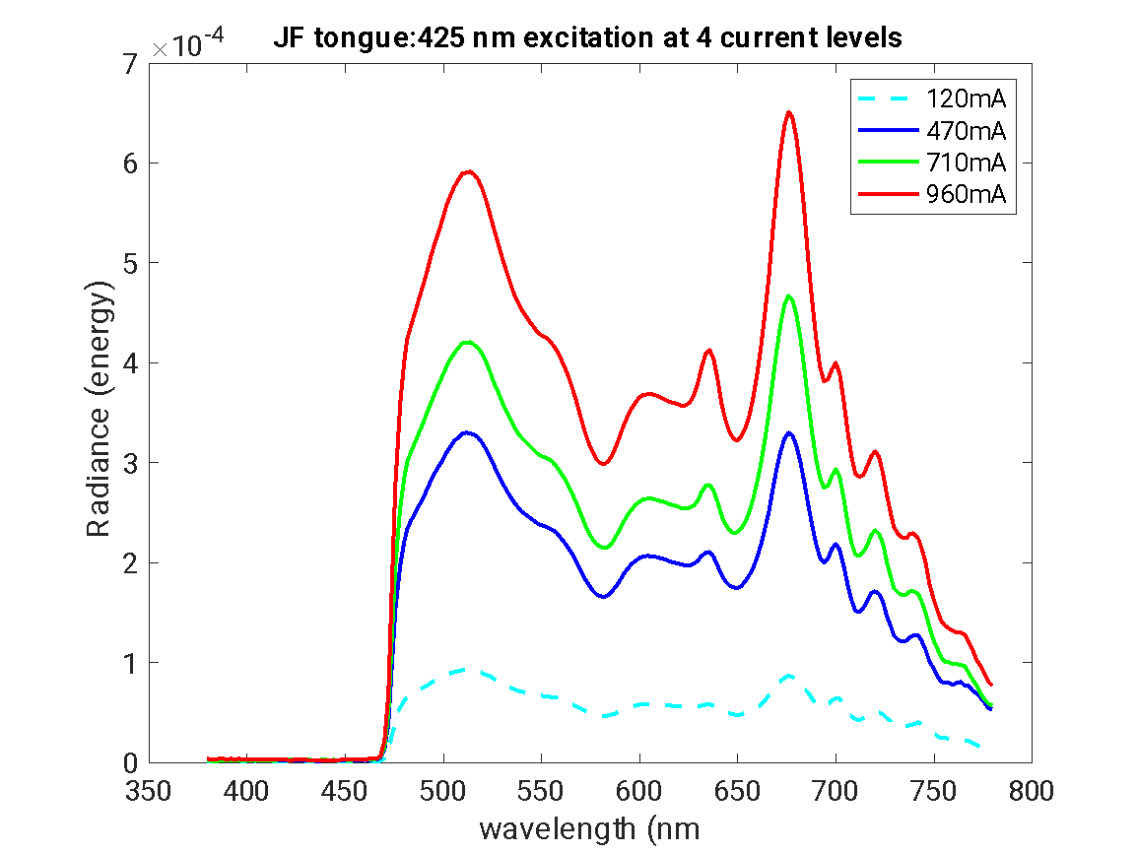

Slide 34
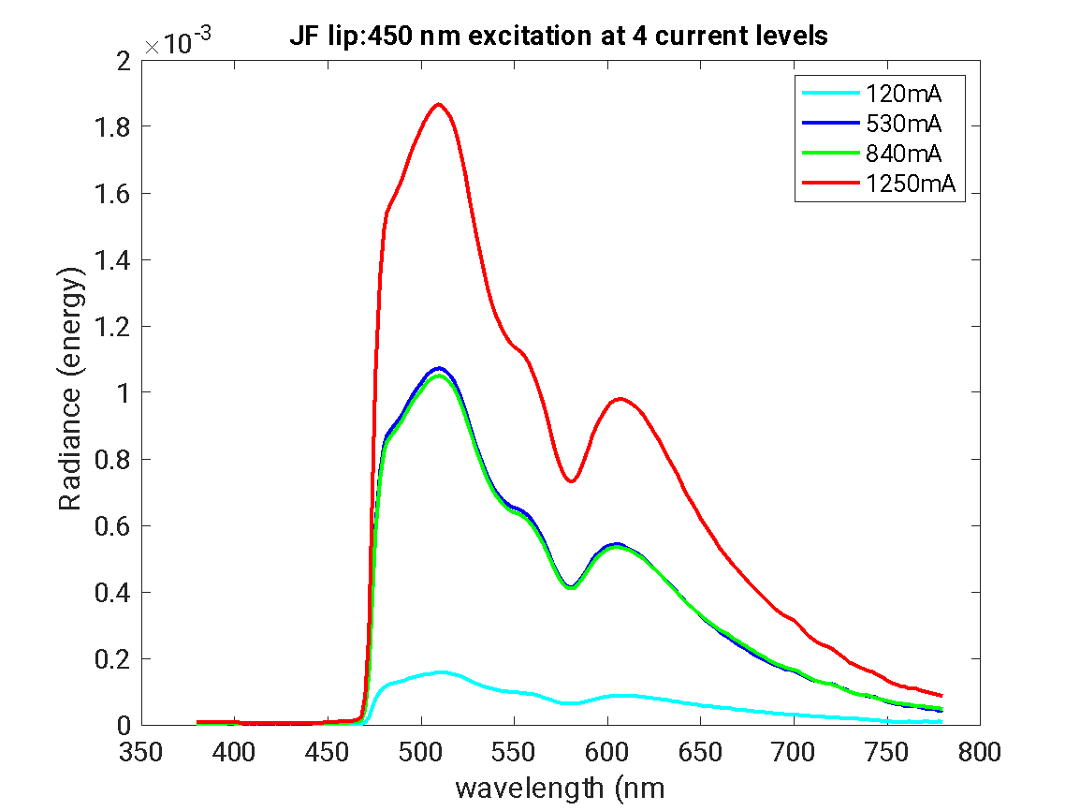

Slide 35
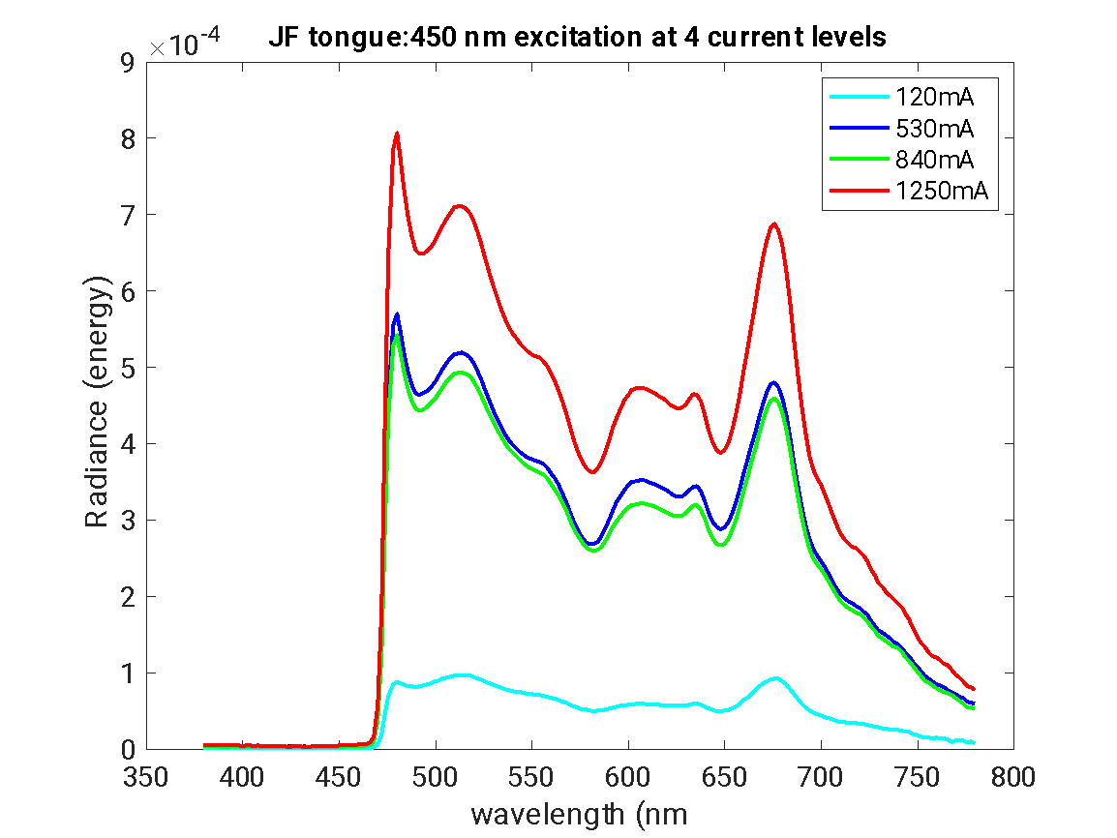

Slide 36
Experiment to distinguish between quenching and photobleaching
 | Photobleaching | Quenching
Reversibility | generally irreversible. Once a fluorophore is photobleached, it permanently loses its ability to fluoresce | The fluorescence can be restored when the quenching condition is removed.
Mechanism | due to photon-induced chemical damage and covalent modification of the fluorophore molecule. | arises from various competing processes that induce non-radiative relaxation of excited state electrons to the ground state, without chemical alteration of the fluorophore.
Cause: | prolonged exposure to excitation light. | caused by various factors such as collisions with other molecules, complex formation, or energy transfer processes.
Time scale: | occurs over longer time scales, often during extended imaging sessions. | can occur rapidly, even on the timescale of fluorescence lifetimes.
Molecular state: | involves permanent changes to the molecular structure of the fluorophore. | does not involve chemical changes to the fluorophore molecule.

Slide 37
Quenching
Redo experiment/measurements to show that
Fluorescence decreases across series of measurements with constant light intensity - quenching or photobleaching?
Light intensity does not decrease across series of measurements – not due to decrease in light over time
tissue fluorophores can quench very rapidly, with half-lives ranging from a few seconds to a minute or so, depending on the illumination intensity.
see differences between quenching or photobleaching
Higher excitation power leads to faster photobleaching. Reducing the excitation power can significantly slow down the bleaching rate, though the relationship is non-linear.
So, if the intensity of the light is higher, we should see this effect bigger for photobleaching – Check to see if we have data that shows this

Slide 38
Reversibility:
Quenching is often reversible, while photobleaching is irreversible.
Test: Remove the suspected quenching agent or change environmental conditions. If fluorescence recovers, it was likely quenching rather than photobleaching.
Experiment: turn off the light, wait, then measure again with light? Challenge: holding the tongue or lip steady in same location

Slide 39
Time course
Photobleaching typically occurs gradually over time with continued UV exposure.
Quenching usually happens more rapidly.
Observe the fluorescence intensity over time. A sudden drop suggests quenching, while a gradual decline indicates photobleaching.
Is this a sudden drop?

Slide 40
measuring tissue fluorophore photobleaching can potentially cause some tissue damage, but the extent depends on several factors:
Light exposure: Photobleaching involves exposing the tissue to light, which can cause photochemical damage. The amount of damage depends on the intensity and duration of light exposure .
Photodynamic effects: An important class of photobleaching events are photodynamic, involving the interaction of fluorophores with light and oxygen. This can produce reactive oxygen species that can chemically modify other molecules in living cells .
Heat generation: Some photobleaching methods can generate heat, which may damage tissues if not properly controlled .
Tissue type and preparation: Different tissues and fluorophores have varying susceptibility to photobleaching and associated damage .
Experimental design: Proper experimental design can minimize tissue damage
Using lower light intensities or shorter exposure times
Employing antifade reagents or oxygen scavengers
Using longer wavelength excitation light to reduce phototoxicity
Optimizing fluorophore concentration and imaging conditions
Potential benefits: In some cases, controlled photobleaching can actually be beneficial for reducing autofluorescence in tissues, potentially improving subsequent imaging or analysis .
Recovery: Some tissues may recover from mild photobleaching effects, especially if kept in cool, dark conditions .
In summary, while measuring tissue fluorophore photobleaching can potentially cause some tissue damage, careful experimental design and appropriate precautions can minimize this damage. The extent of damage would depend on the specific experimental conditions and tissue type being studied.

Slide 41
Excitation intensity dependence:
Photobleaching rate increases with higher UV excitation intensities.
Quenching is generally less dependent on excitation intensity.
Test: Vary the UV excitation intensity and observe the rate of fluorescence loss.
Not sure that I want to do this experiment …

Slide 42
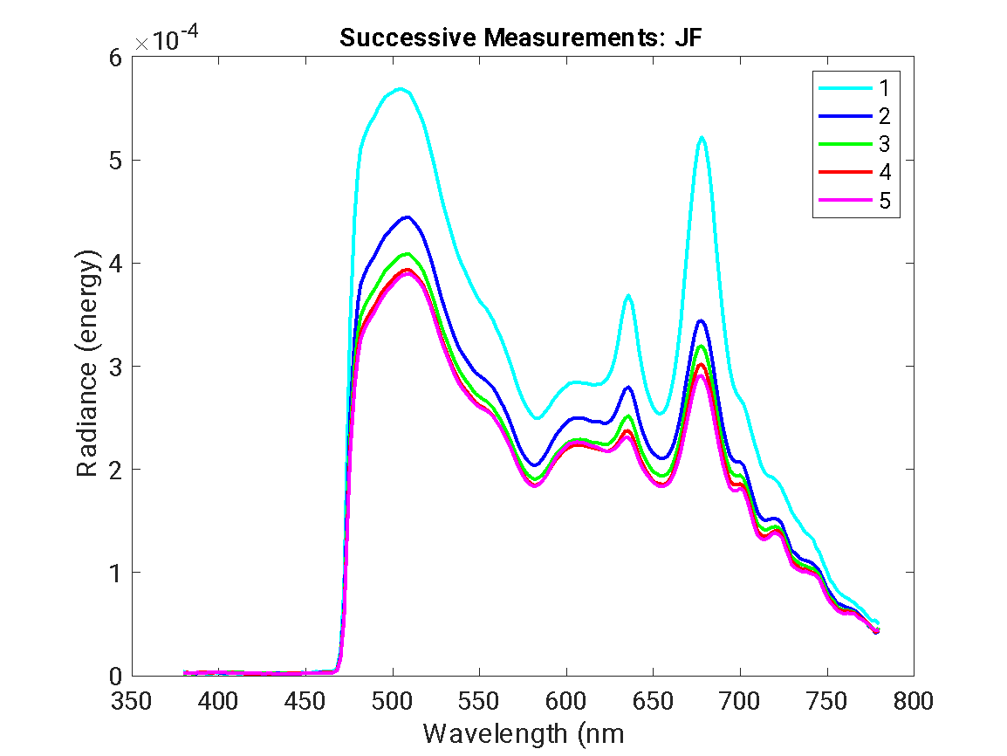
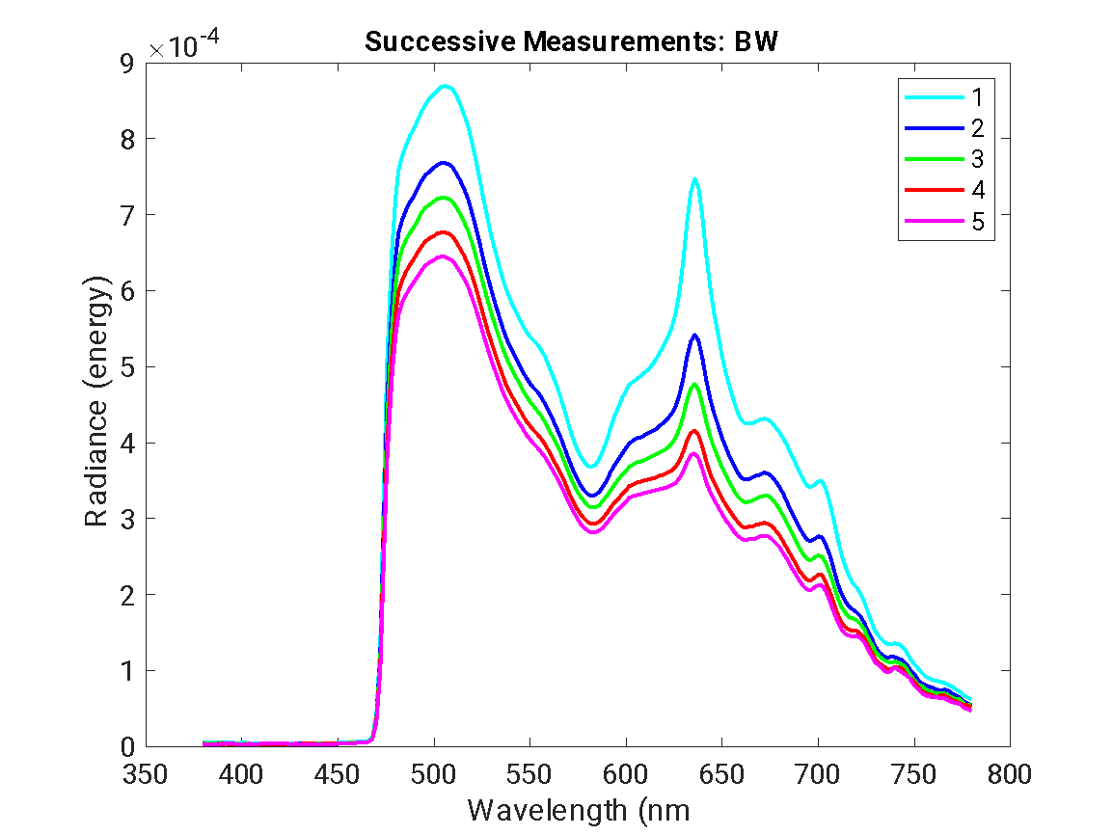
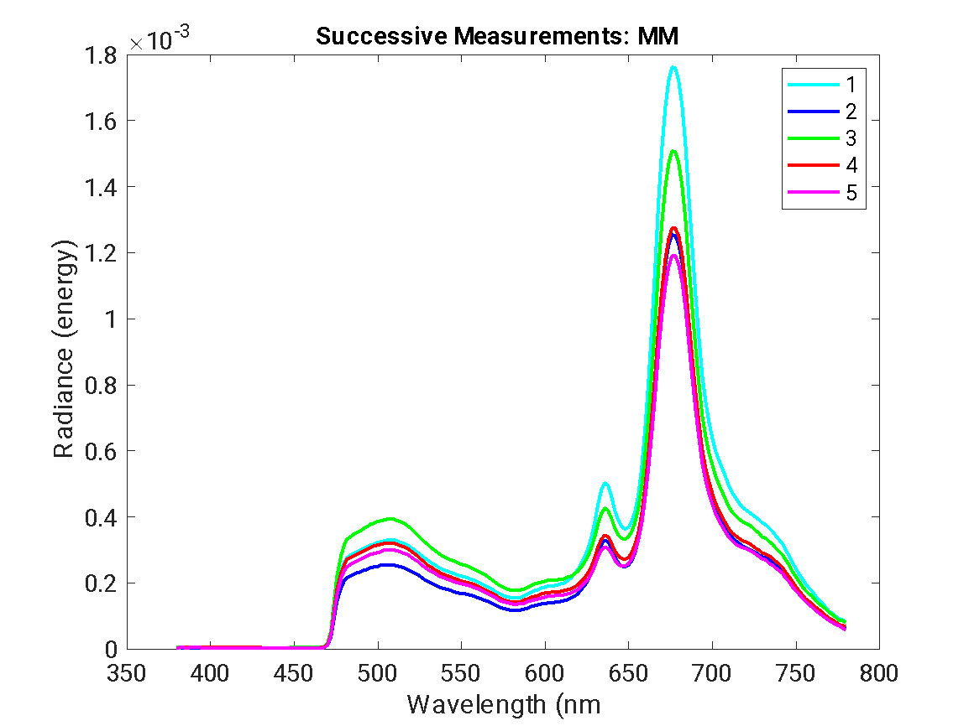
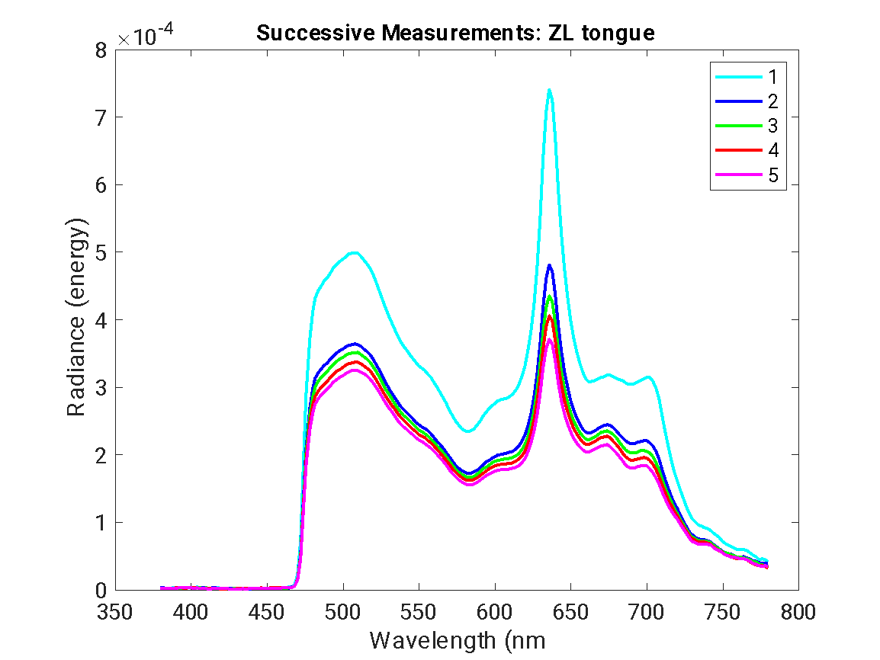
Spectral changes
Photobleaching often leads to changes in the emission spectrum shape.
Quenching usually affects overall intensity without changing spectral shape.
Analyze the emission spectrum over time to detect changes.
The shape seems to be the same

Slide 43
Excitation intensity dependence
Photobleaching rate increases with higher UV excitation intensities.
Quenching is generally less dependent on excitation intensity.
Test: Vary the UV excitation intensity and observe the rate of fluorescence loss.

Slide 44
Fluorescence lifetime measurements:
Quenching typically shortens the fluorescence lifetime.
Photobleaching does not affect the lifetime of remaining intact fluorophores.
Use time-resolved fluorescence techniques to measure lifetimes.
Do this experiment with Yi Xue (UC Davis) or Laura Marcu?

Slide 45
Recovery experiments:
Perform FRAP (Fluorescence Recovery After Photobleaching) experiments.
Rapid recovery suggests quenching, while slow or no recovery indicates photobleaching.

Slide 46
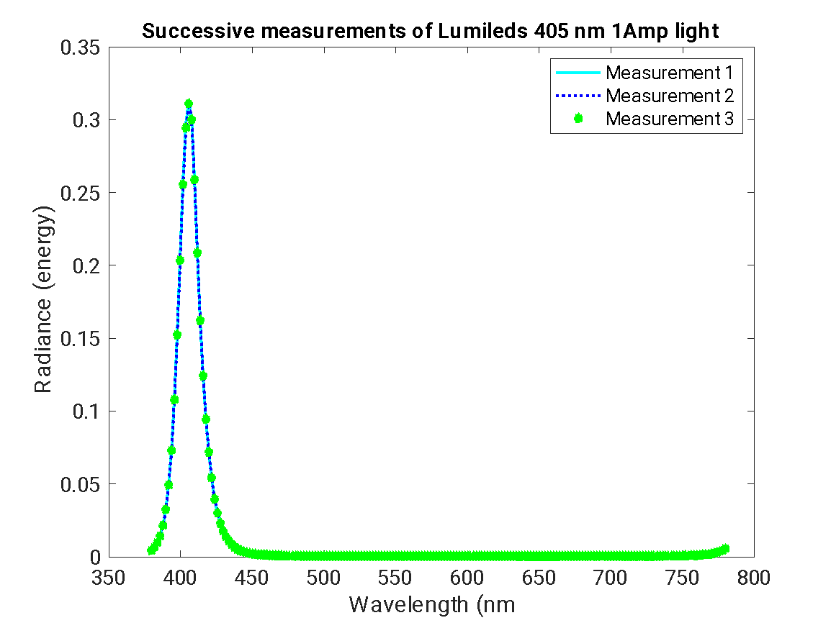
Notes:
/Oral Cancer Screening/Spectral Data/Lab Measurements/2024-03-19';

Slide 47
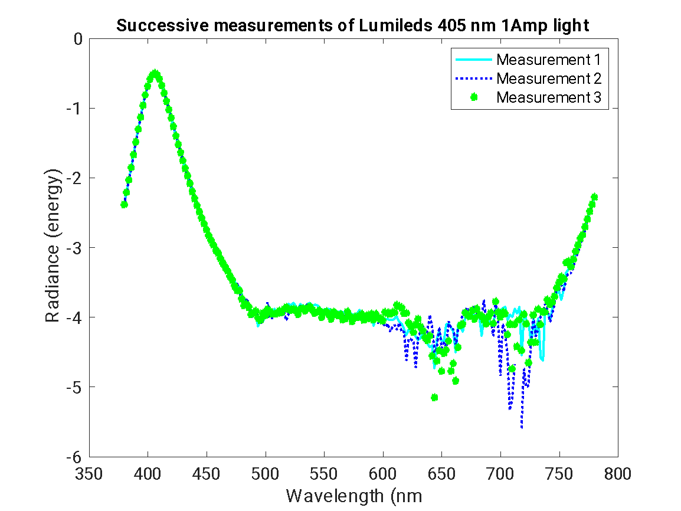

Slide 48
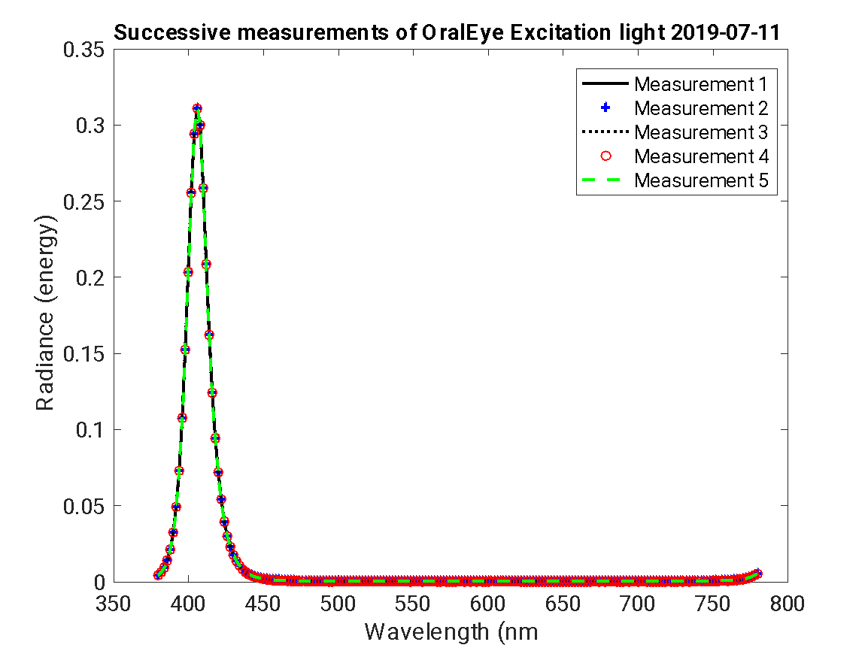

Slide 49
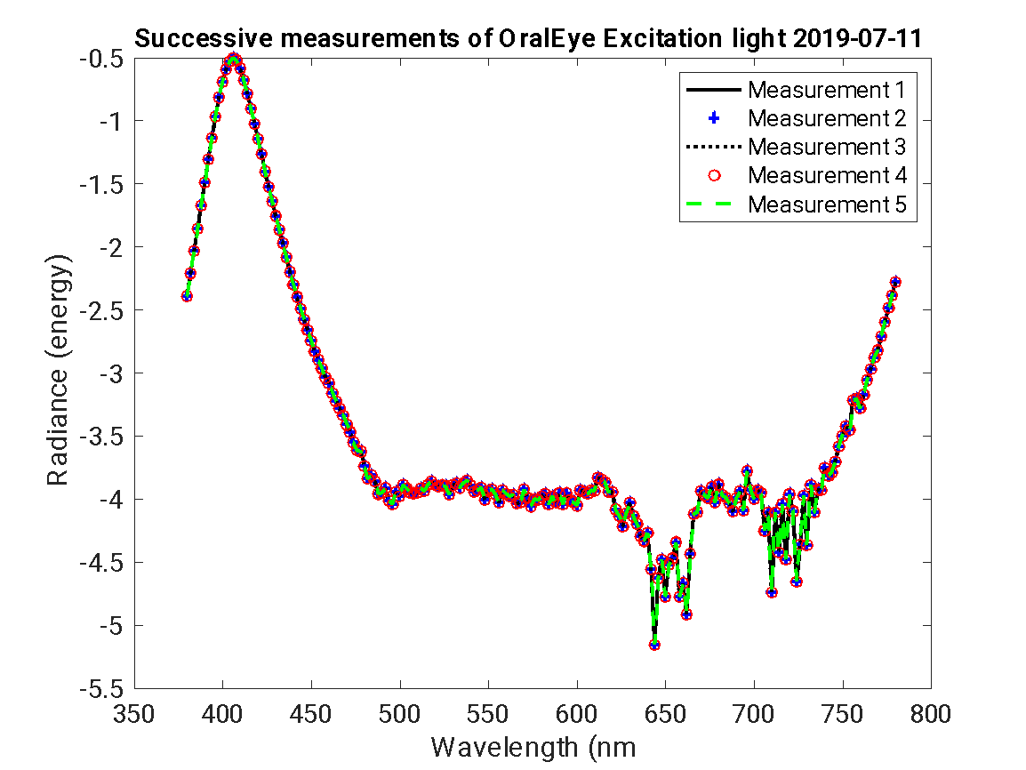

Slide 54
Effect of excitation light
Fluorescence emission should be higher at 550 nm for 450 nm excitation light
The best strategy is to measure fluorescence of fluorophores (powder form) for the different lights. And then use the spectral emissions for each light as the basis functions for that light.
And determine whether the lip and tongue fluorescence can be considered a linear combination of these basis functions

Slide 55
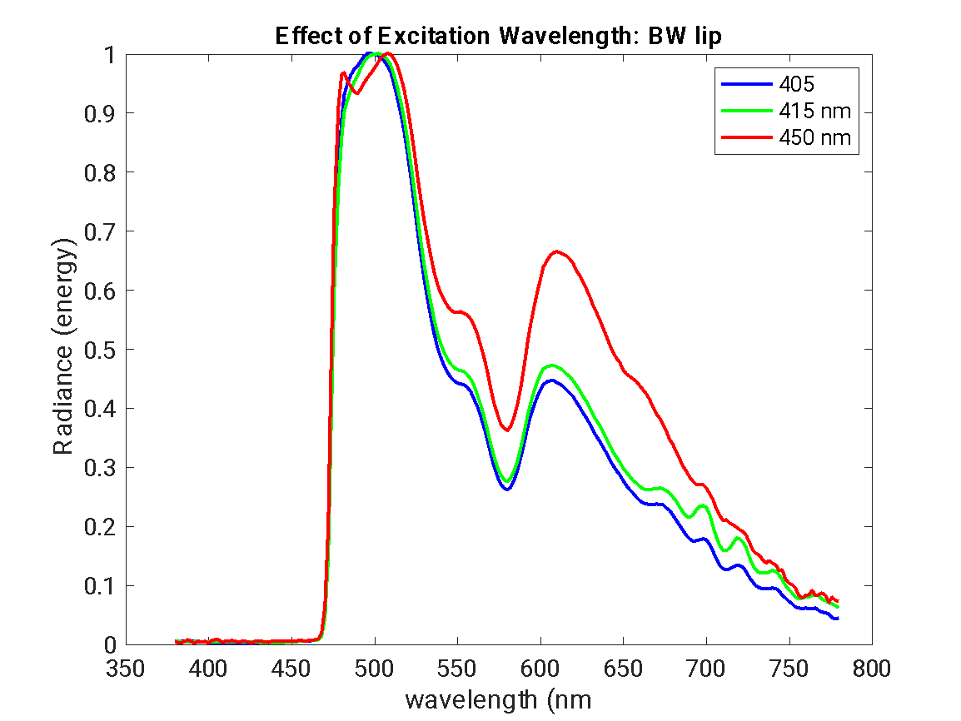

Slide 56
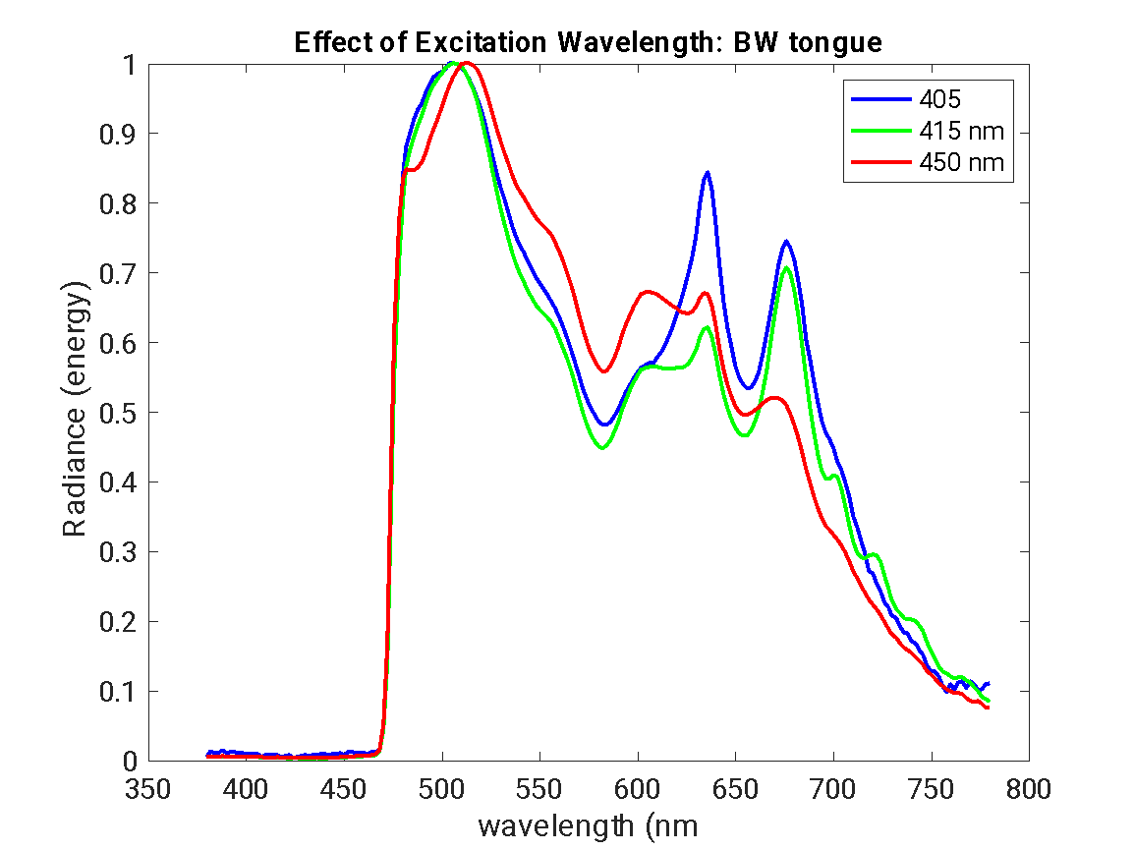

Slide 57
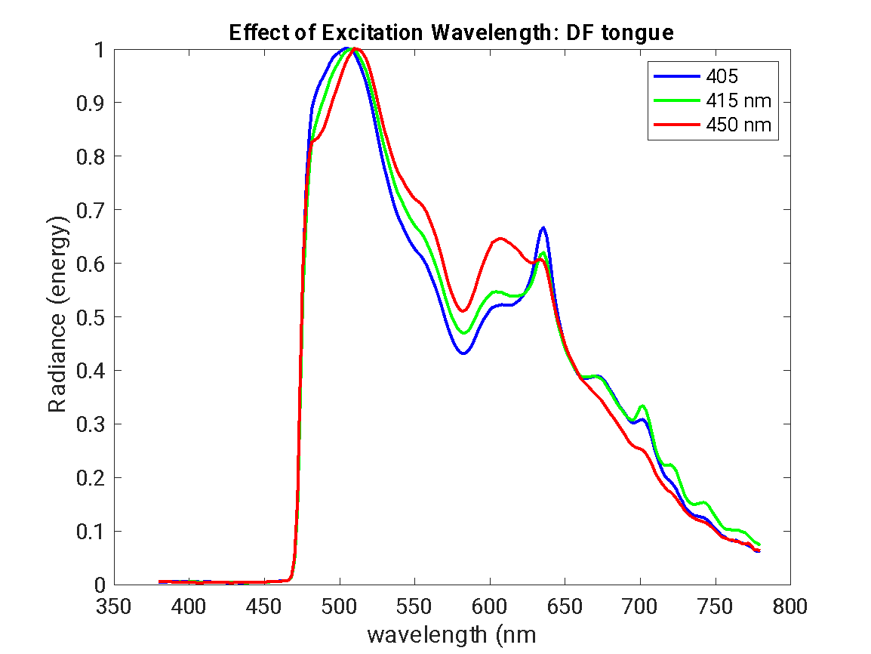

Slide 58
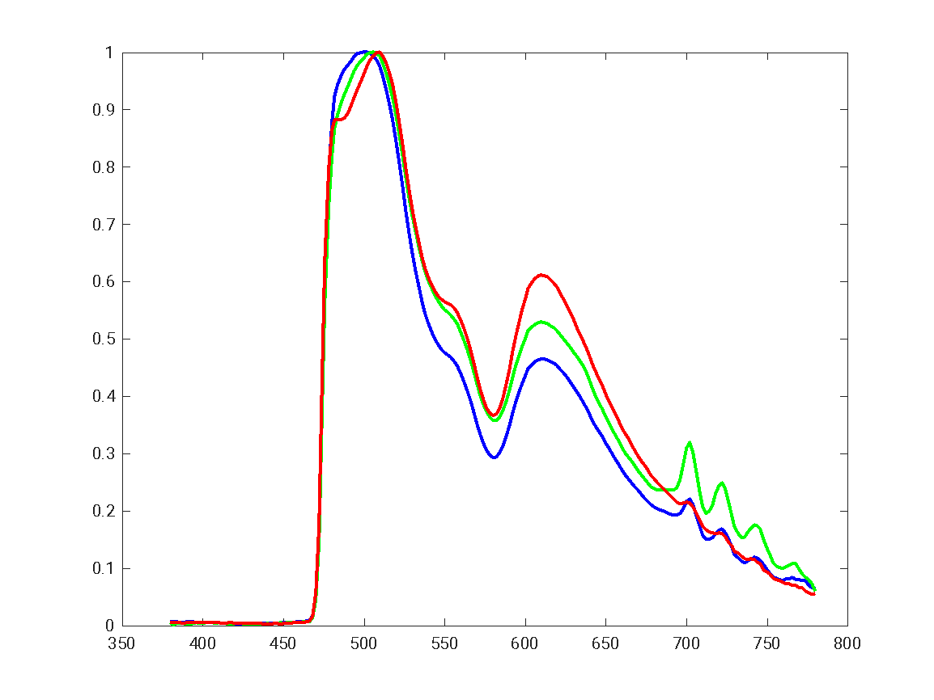

Slide 59
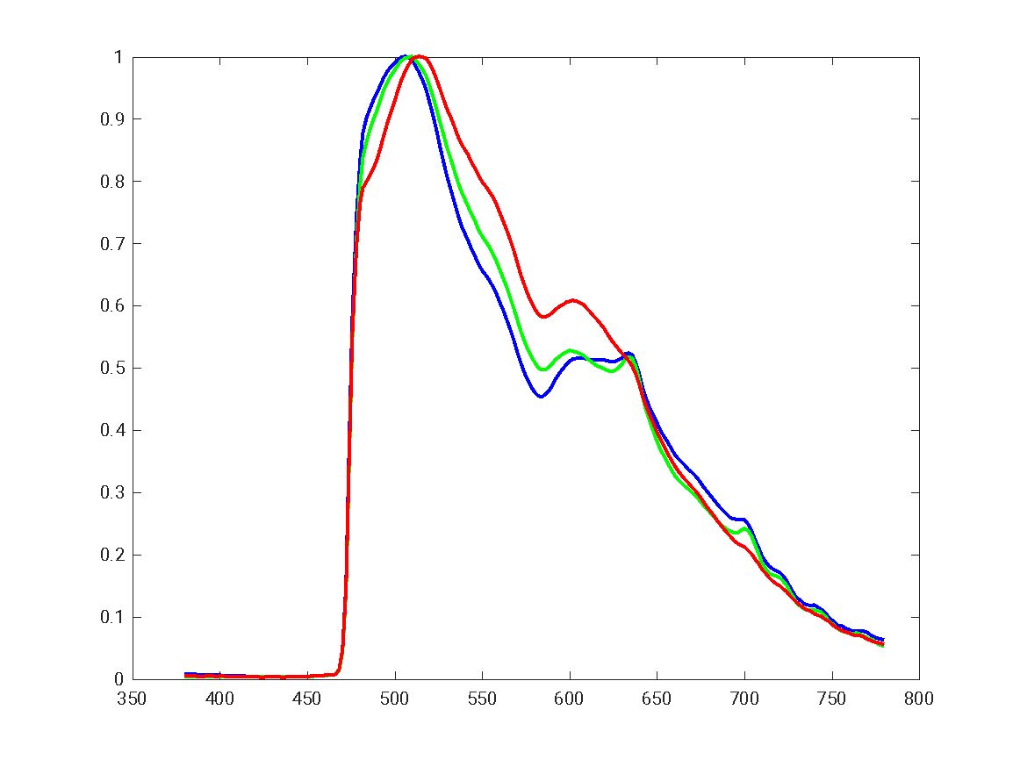

Slide 60
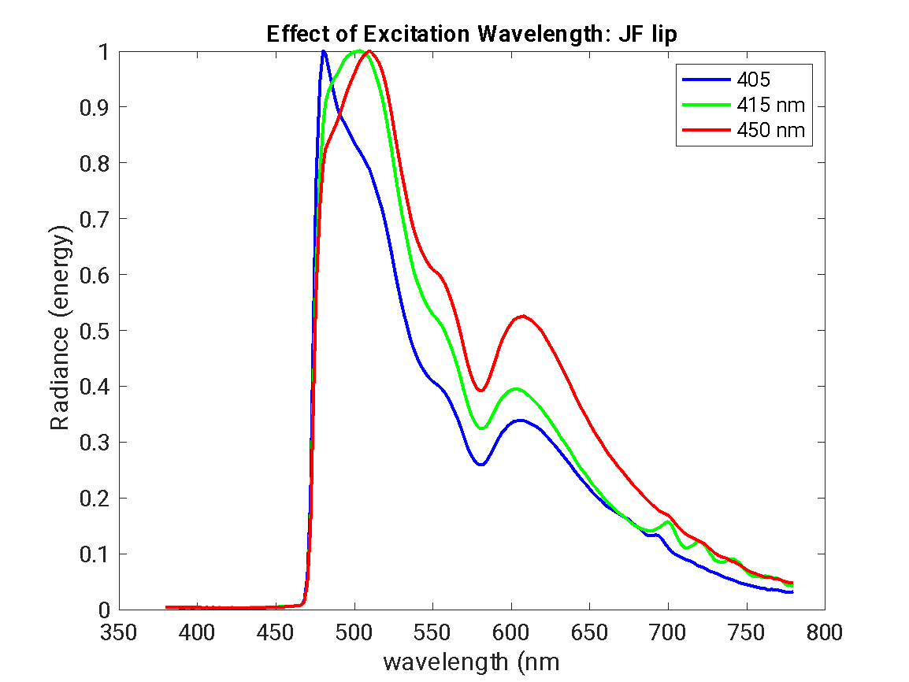

Slide 61
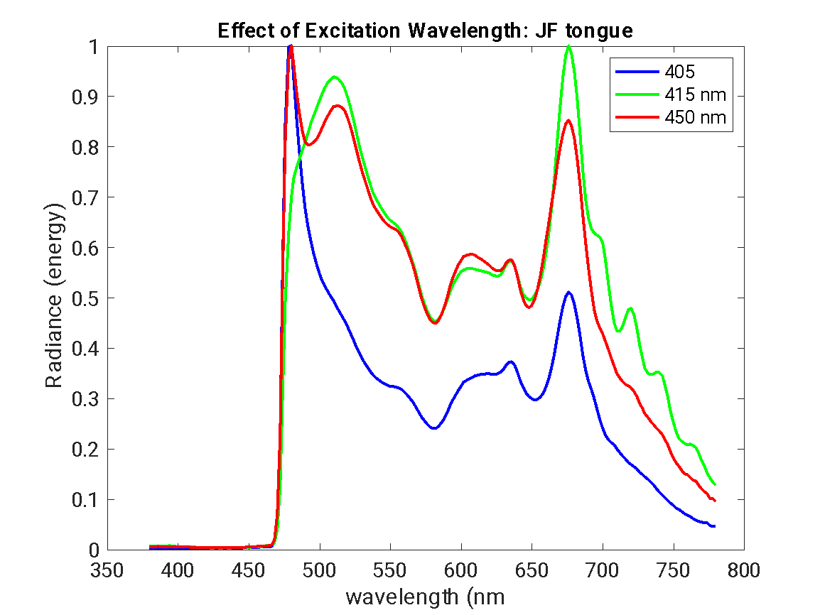

Slide 62
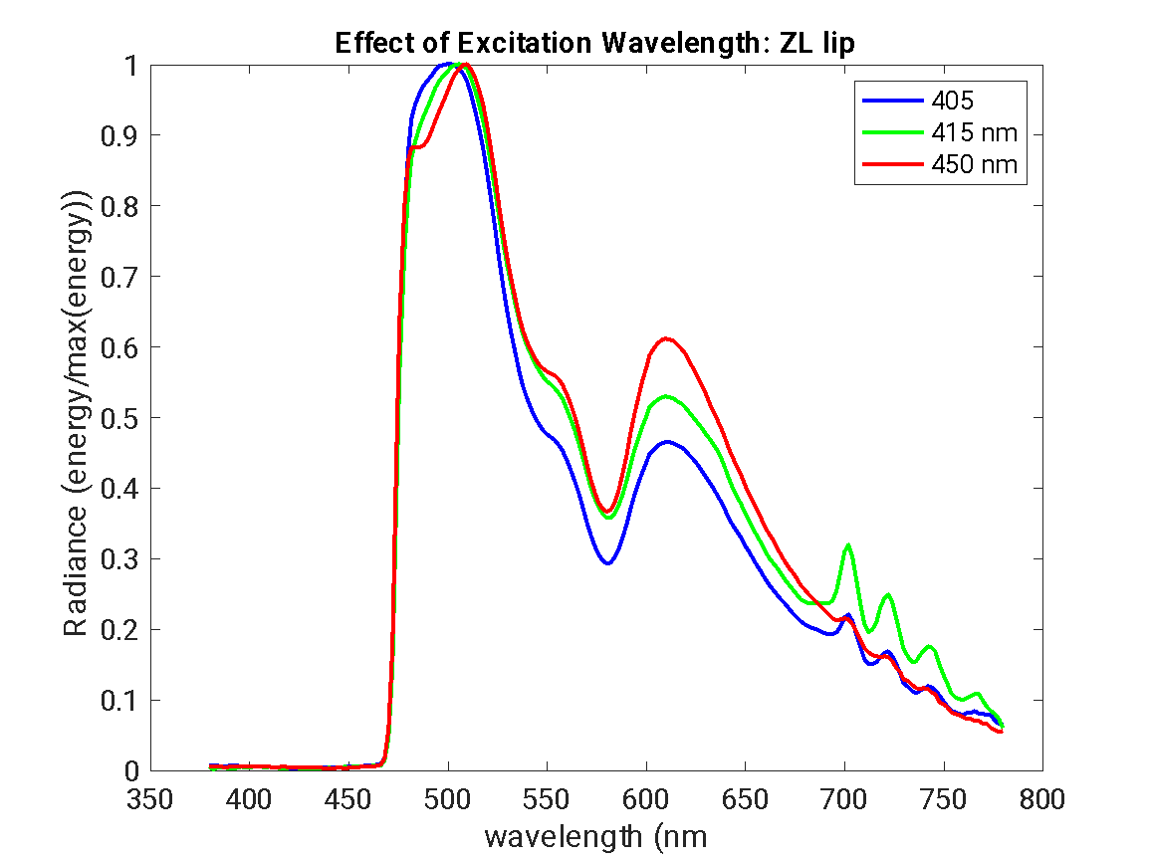

Slide 63
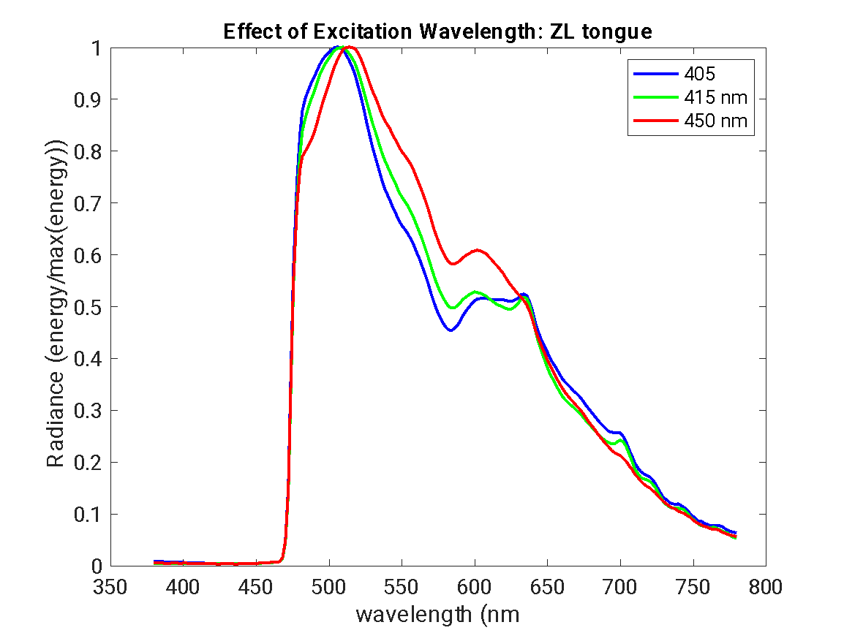

Slide 65
Absorption of light by blood
Highest absorption at 420 nm
“The Soret band is an intense absorption peak in the blue region of the visible spectrum, typically around 400-420 nm, that is characteristic of porphyrin-containing compounds like hemoglobin and other heme proteins.”
Second highest absorption at 550, and then 580
“Hemoglobin has a double peak absorption in the 550 nm and 580 nm wavelength range, which are referred to as the Q bands.”
“The Q bands arise from electronic transitions within the porphyrin ring structure of the heme group in hemoglobin”
“The exact wavelengths and intensity of the Q bands can be influenced by factors like the oxygenation state and pH of the hemoglobin environment.”
Should see valleys at 540 and 550
Maximum emission for FAD at 550 nm
Fluorescence should be higher at 550 nm for 450 nm excitation light than for 405 of 415 nm light

Slide 66
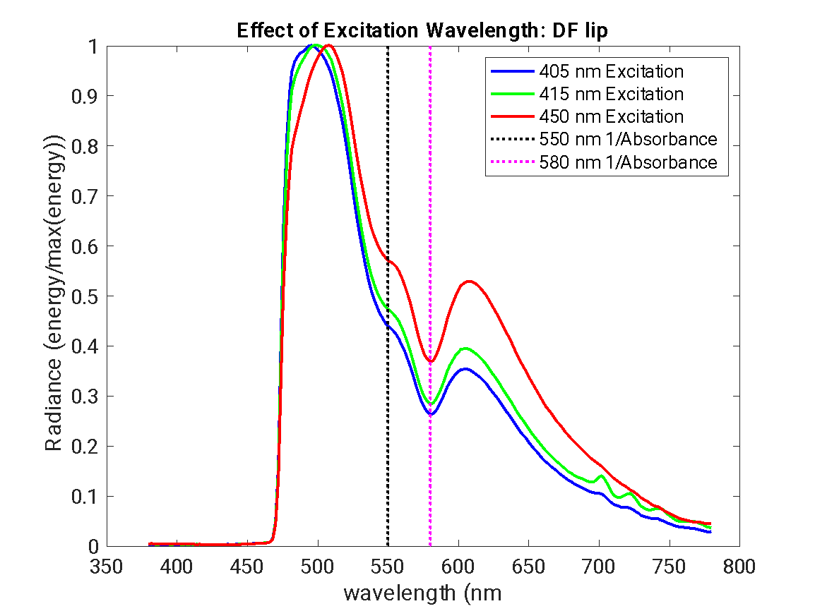
Interesting that we see shift in peak fluorescence, but not change in dips where we expect light absorption by blood – this is what we would expect
We do not see porphyrin fluorescence signature in lower lip measurements

Slide 67
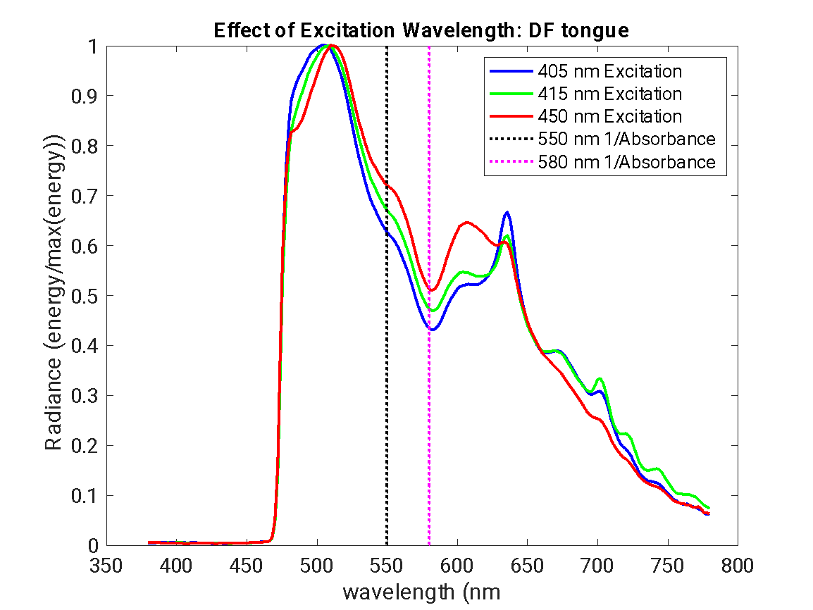
We do see porphyrin fluorescence signature in tongue measurements

Slide 68
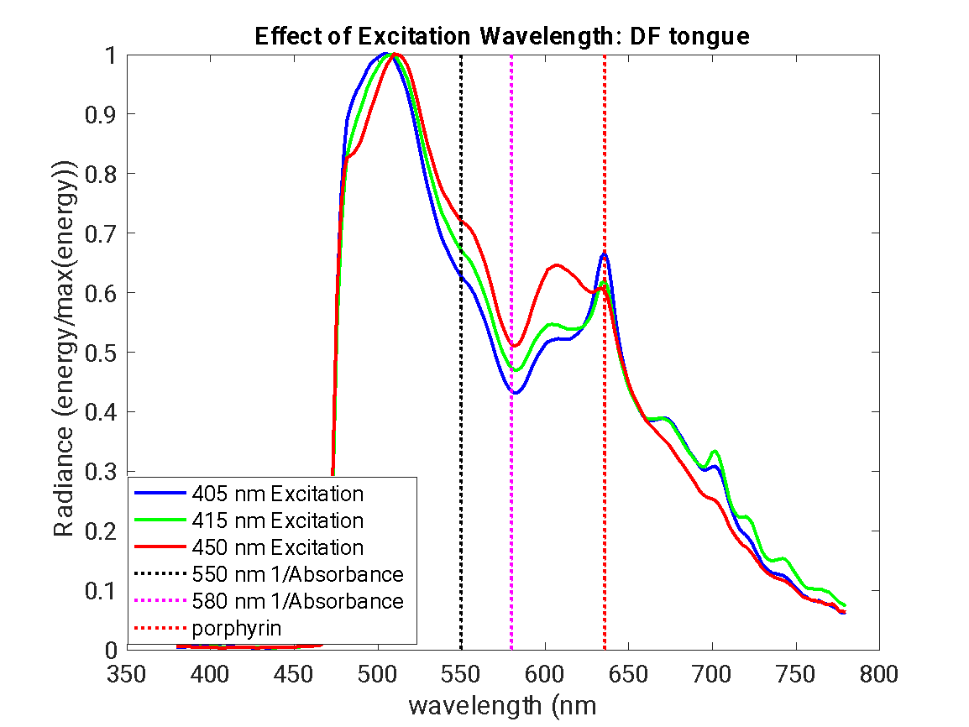

Slide 69
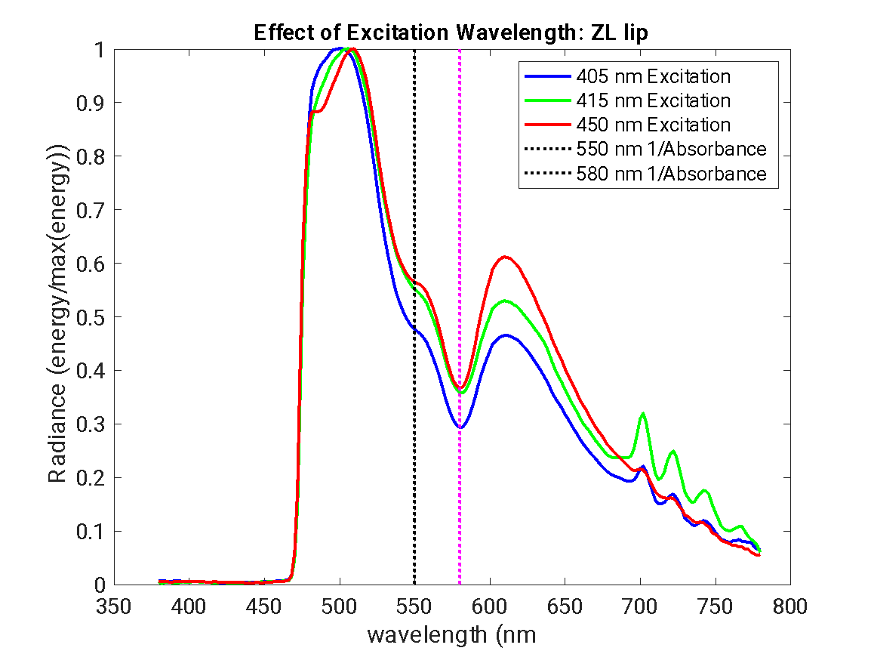
We do not see porphyrin fluorescence signature in lower lip measurements

Slide 70
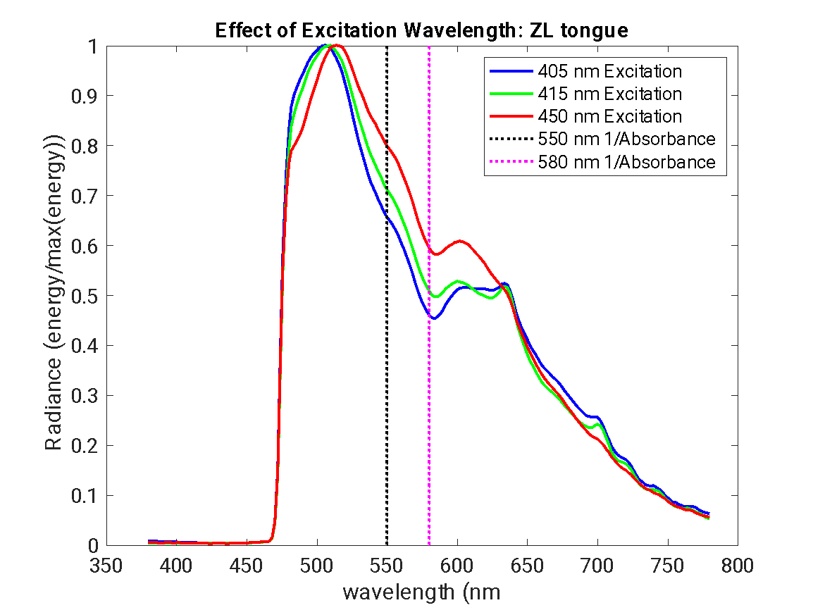
We do see porphyrin fluorescence signature in tongue measurements

Slide 71
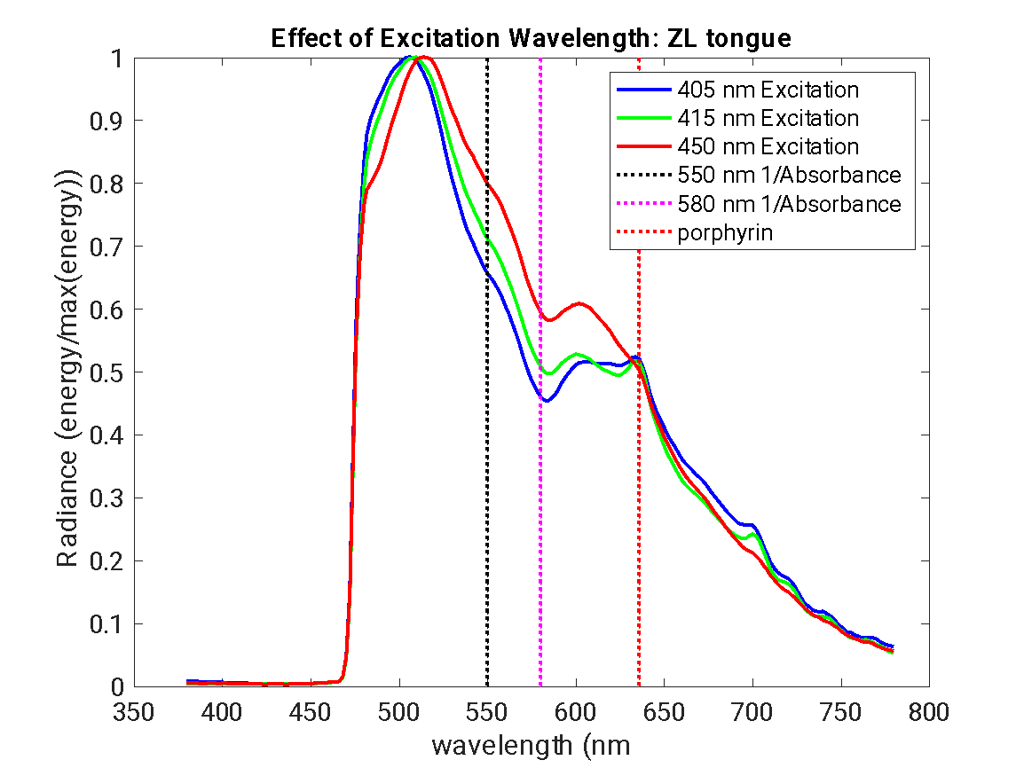

Slide 72
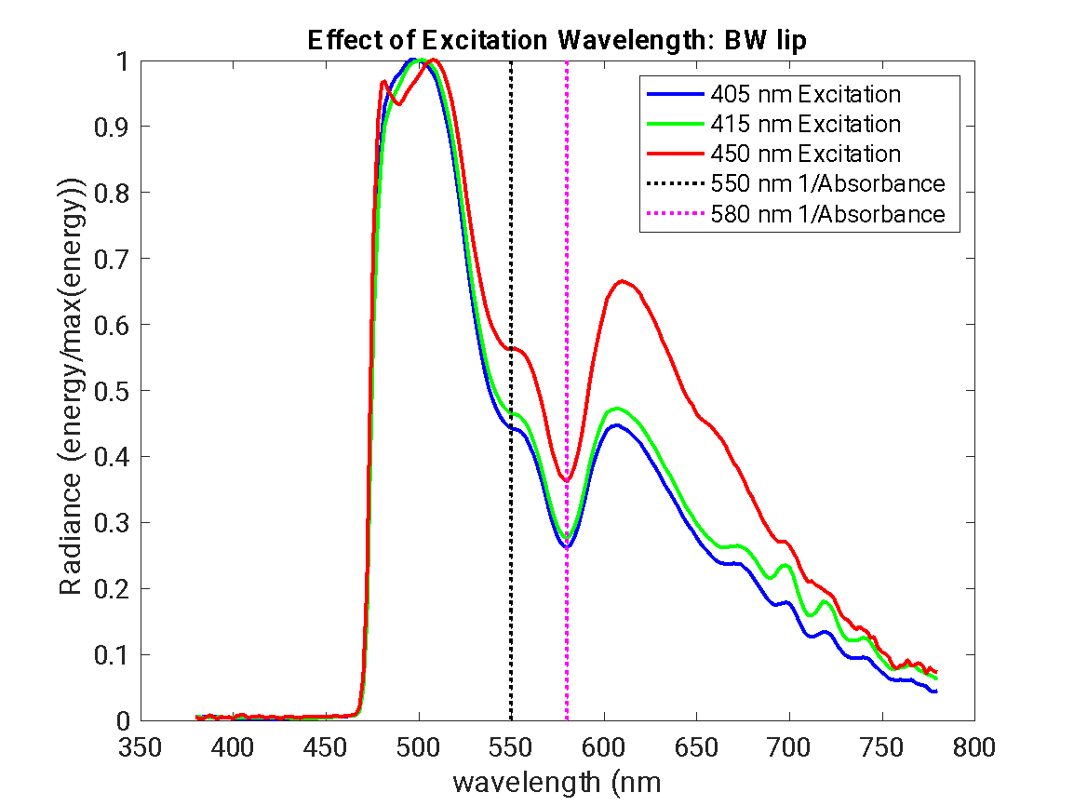
We do not see porphyrin fluorescence signature in lower lip measurements

Slide 73

We do see porphyrin fluorescence signature in tongue measurements

Slide 74

TODO: replot with absolute and not normalized amplitude
Should see that peak emission at 675 is higher for 405 nm light than for 415 and 450
Note that the “chlorophyll” fluorescence signature is not present always.
For JF and BAW, the signature is only present when measurements were made after eating salad for lunch

Slide 75

We do not see porphyrin fluorescence signature in lower lip measurements

Slide 76

We do see porphyrin fluorescence signature in tongue measurements

Slide 77

TODO: replot with absolute and not normalized amplitude
Should see that peak emission at 675 is higher for 405 nm light than for 415 and 450
Note that the “chlorophyll” fluorescence signature is not present always.
For JF and BAW, the signature is only present when measurements were made after eating salad for lunch

Slide 78

Measurements of lettuce from salad JF’s salad

Slide 79

Chlorophyll excitation
Chlorophyll emission

Slide 80


Slide 81

Chlorophyll fluorescence is present after lunch and higher amplitude than other sources

