Slide 1
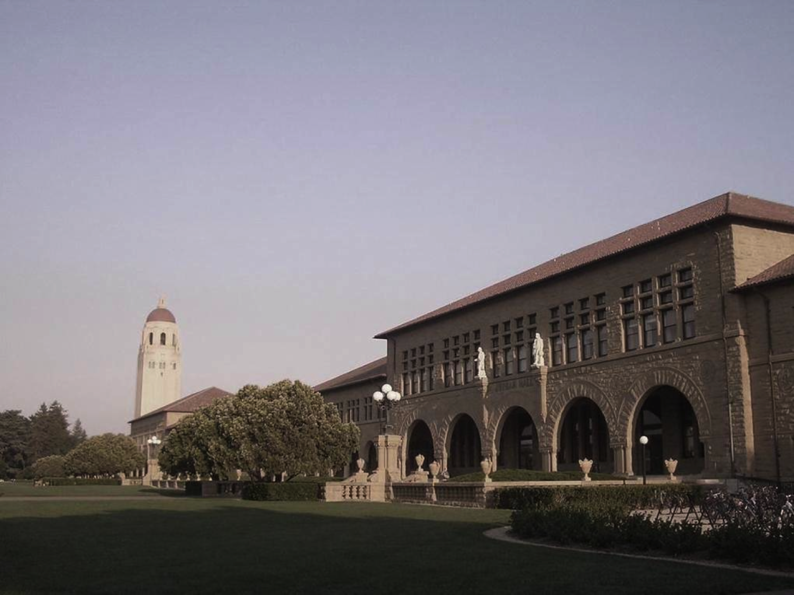

Slide 2

keratin
Epithelial – FAD, NADH
Stromal – Collagen, blood, elastin

