Slide 1
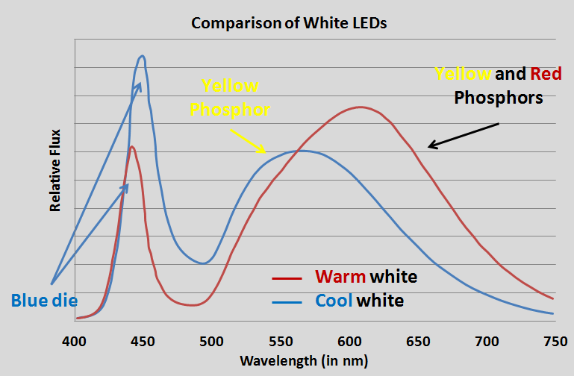

Slide 2
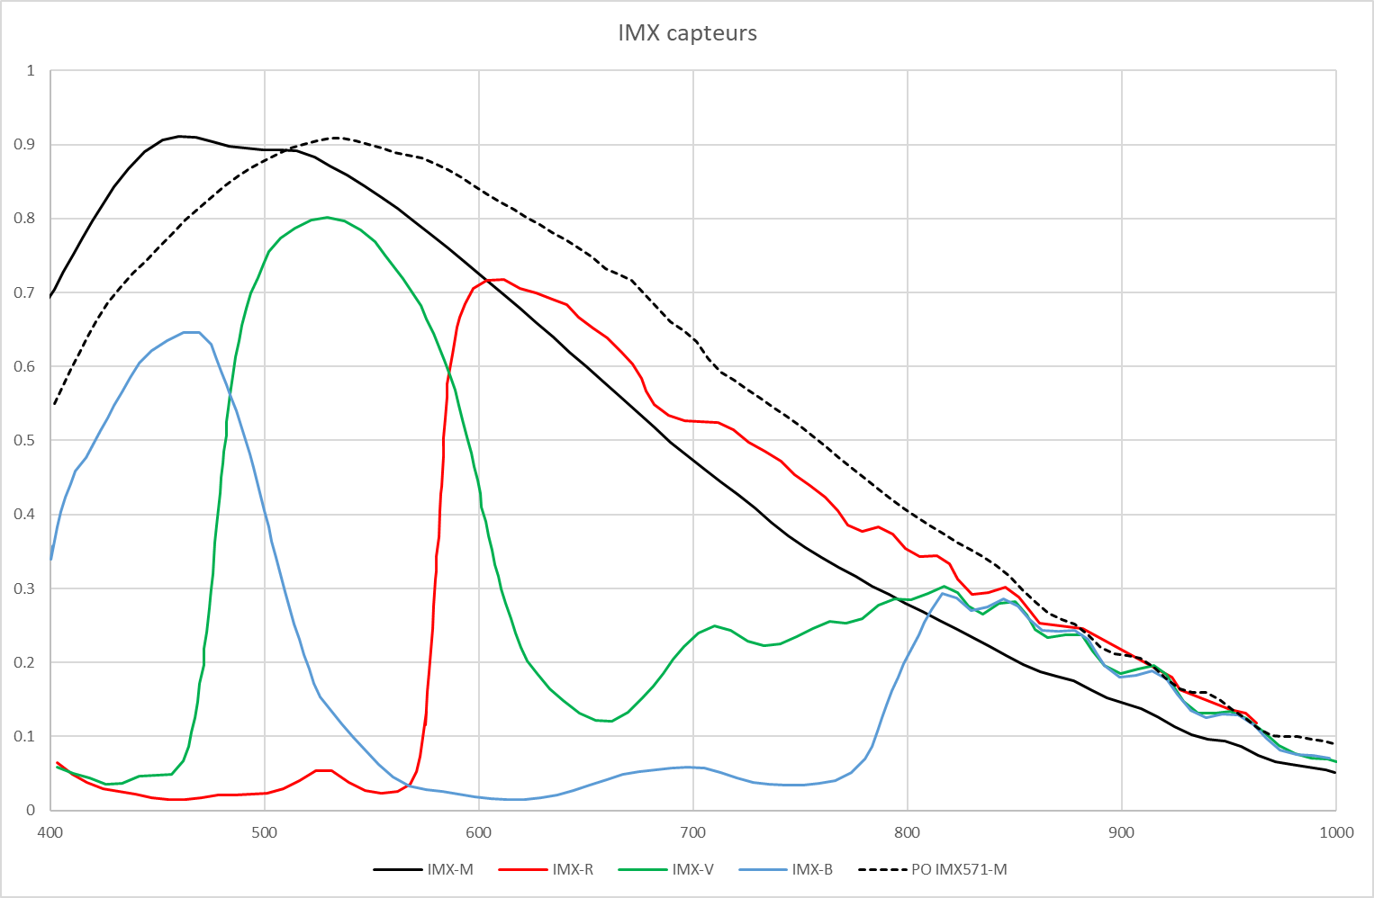

Slide 3
Cool white
400
450
500
550
600
650
700
750

Slide 4
More blood will make B, G and R pixels lower values, with B the most discriminative
Cool white
400
450
500
550
600
650
700
750

Slide 5
Warm white
400
450
500
550
600
650
700
750

