Slide 2
Non-matrix factorization of the tongue

Slide 3
Non-matrix factorization of the tongue (N=4 before lunch, different intensities)
Should include a plot of % variance accounted for as function of number of factors
Mostly likely, two factors account for most of the variance

Slide 4
Non-matrix factorization of the tongue (includes data from one subject after lunch)
Should include a plot of % variance accounted for as function of number of factors
Mostly likely, three factors account for most of the variance

Slide 5
Non-matrix factorization of the lip (N=4 before lunch, different intensities)
Should include a plot of % variance accounted for as function of number of factors
Mostly likely, one factor accounts for most of the variance

Slide 6
Non-matrix factorization of the tongue (includes data from one subject after lunch)
Notes:
s_nmfAnalysis.m
Should report % variance accounted for a function of the number of factors

Slide 7
Possible fluorophore basis

Slide 8
We are attempting to explain the bulk tissue fluorescence by a linear combination of spectral emissions. Since we do not know the concentration of the fluorophores, we scale between 0 and 1.
Notice that between 500 and 600 nm you cannot differentiate between collagen, keratin and NADH.

Slide 11
Challenging, if not impossible, to isolate and quantify the individual contributions of collagen, elastin, keratin, NADH, and FAD in tissue fluorescence measurements, especially in-vivo tissue.
Broad absorption spectra – means fluorophore can be excited over a wide range of wavelengths
Broad spectral emissions – means fluorescence emissions of different fluorophores overlap
Influenced by environmental factors
Concentrations and distributions are unknown (use of OCT to image different tissue layers – to isolate collagen/elastin)
Absorption of light by chromophores
see Vazquez-Portalatin, N., Alfonso-Garcia, A., Liu, J. C., Marcu, L., & Panitch, A. (2020). Physical, biomechanical, and optical characterization of collagen and elastin blend hydrogels. Annals of biomedical engineering, 48, 2924-2935.

Slide 12
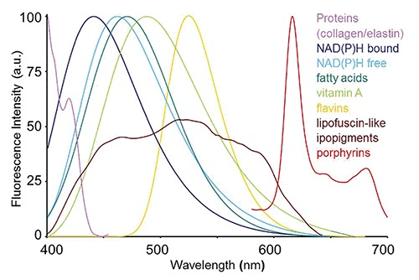
Can we model fluorophores as positively skewed normal with peak known but bandwidth variable?
Endogenous fluorophores | Biological constituents | Autofluorescence (exc) / (em) ranges | Autofluorescence photophysical fingerprints and possible correlated alterations
Cytokeratins | Intracellular fibrous proteins | (280-325 nm) / ( nm) | Spectral shape and emission amplitude
Collagen/Elastin | Extracellular fibrous proteins | (330-340 nm) / (400-410 nm) (350-420 nm) / (420-510 nm) | Excitation light birifrangence effects spectral shape and emission amplitude, depending on maturation degree in eldering and fibrosis
NAD(P)H | Coenzymes of key enzymes in redox reactions | (330-380 nm) / (440, 462 nm, bound, free) | Spectral shape, emission amplitude
Flavins | Coenzymes of key enzymes in redox reactions | (350-370;440-450 nm) / (480/540 nm) | (NAD(P)Hbound/free, NAD(P)Htotal/oxidized _{flavins} ratios, depending on aerobic/anaerobic energetic metabolism, antioxidant defense, inflammation, carcinogenesis
Protoporpyrin IX and porphyrin derivatives | Protein prostetic group | (405 nm) / (630-700 nm) | Spectral shape, emission amplitude and photosensitivity, depending on heme and iron altered metabolism
See Croce, A. C., & Bottiroli, G. (2014). Autofluorescence spectroscopy and imaging: a tool for biomedical research and diagnosis. European journal of histochemistry: EJH, 58(4), 2461
Notes:
Keratin https://iopscience.iop.org/article/10.1088/2050-6120/aca507

Slide 13
Can we model fluorophores as positively skewed normal with peak known but bandwidth variable?
Fluorophore | Peak
Collagen | 380 nm 400-410 nm 440-450 nm | Collagen I is characterized by an emission band between 360 and 510 nm with a peak at 390 nm
Elastin | broad emission band between 360 and 600 nm with a peak around 410 nm 420-510 nm (Croce & Bottiroli) | but see Palero, peak is at higher wavelength
FAD | 520-530 540 nm (Croce & Bottiroli)
NADH | 460 440-460 (Croce & Bottiroli)
Keratin | 465 (Palero) 495-525 (Croce & Bottiroli)
Notes:
Keratin https://iopscience.iop.org/article/10.1088/2050-6120/aca507

Slide 14
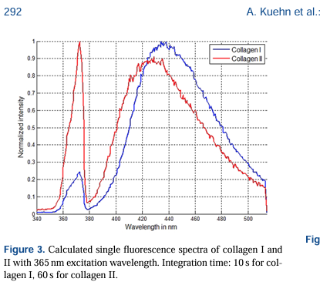
Kuehn, A., Graf, A., Wenzel, U., Princz, S., Mantz, H., & Hessling, M. (2015). Development of a highly sensitive spectral camera for cartilage monitoring using fluorescence spectroscopy. Journal of Sensors and Sensor Systems, 4(2), 289-294.

Slide 15
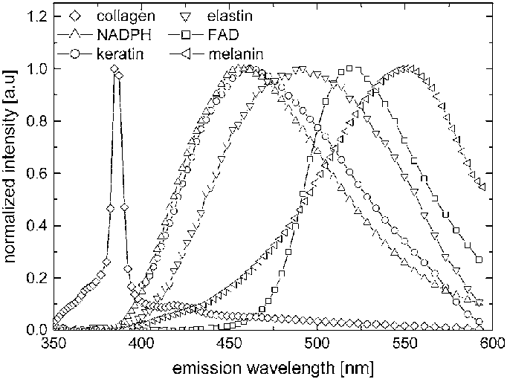
Palero, J. A., De Bruijn, H. S., Sterenborg, H. J., & Gerritsen, H. C. (2007). Spectrally resolved multiphoton imaging of in vivo and excised mouse skin tissues. Biophysical journal, 93(3), 992-1007.
Normalized measured spectral emission of pure samples of keratin (circles), NADPH (upright triangles), FAD (squares), collagen fiber (diamonds), elastin (inverted triangles), and melanin (left triangles) using 764 nm excitation wavelength

Slide 16
Keratin
Elastin
FAD
Notes:
https://journals.physiology.org/doi/full/10.1152/ajpheart.1999.277.2.H698

Slide 17
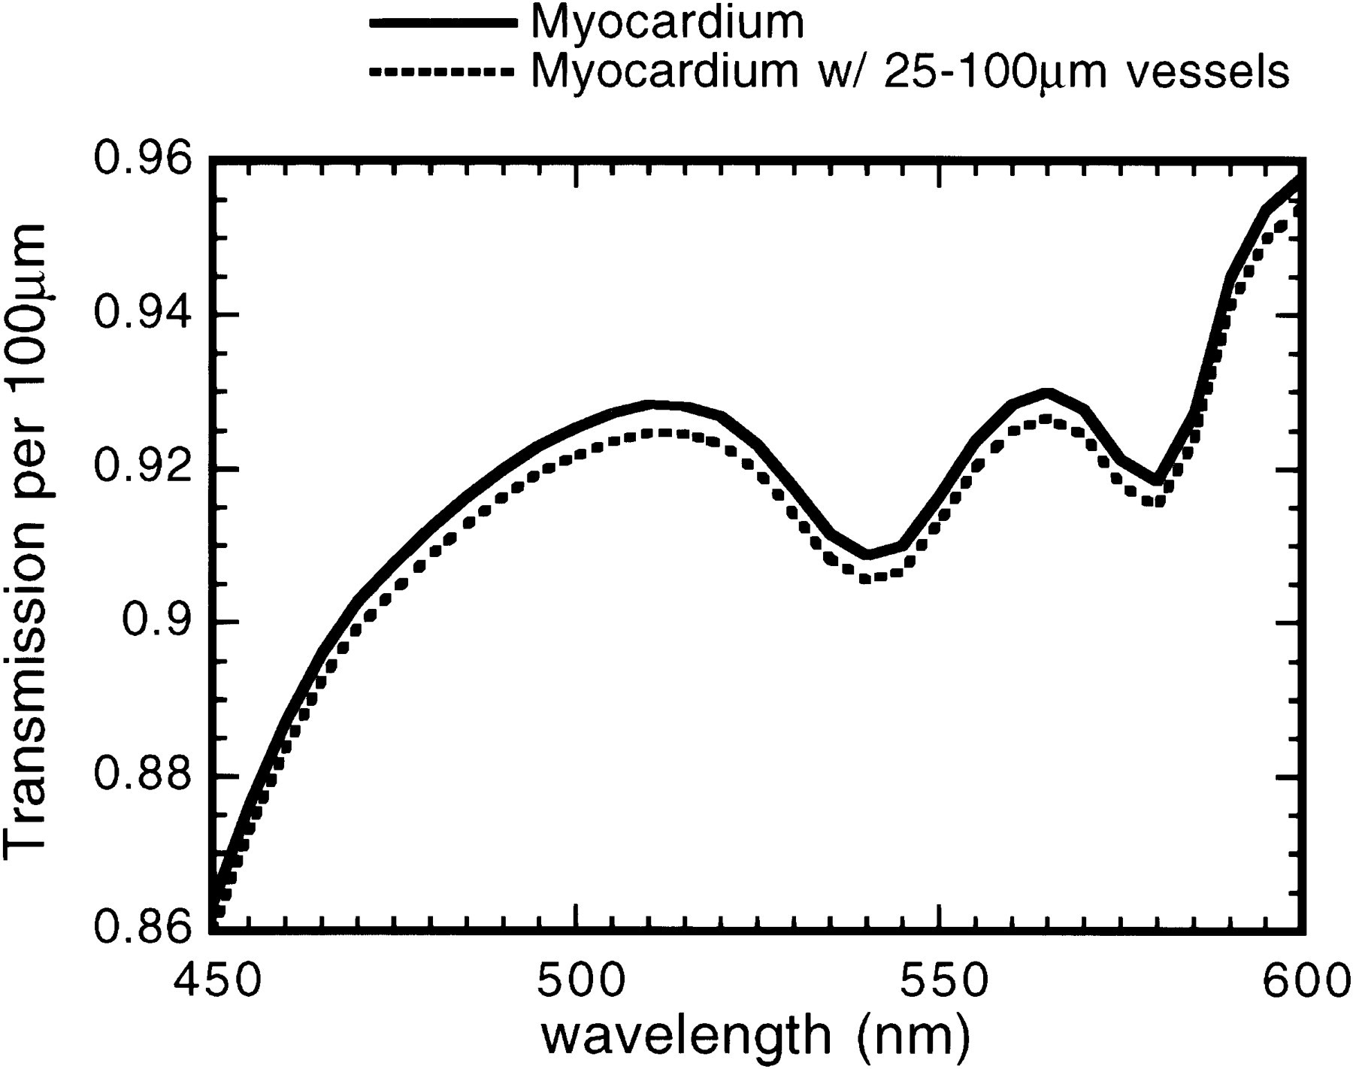
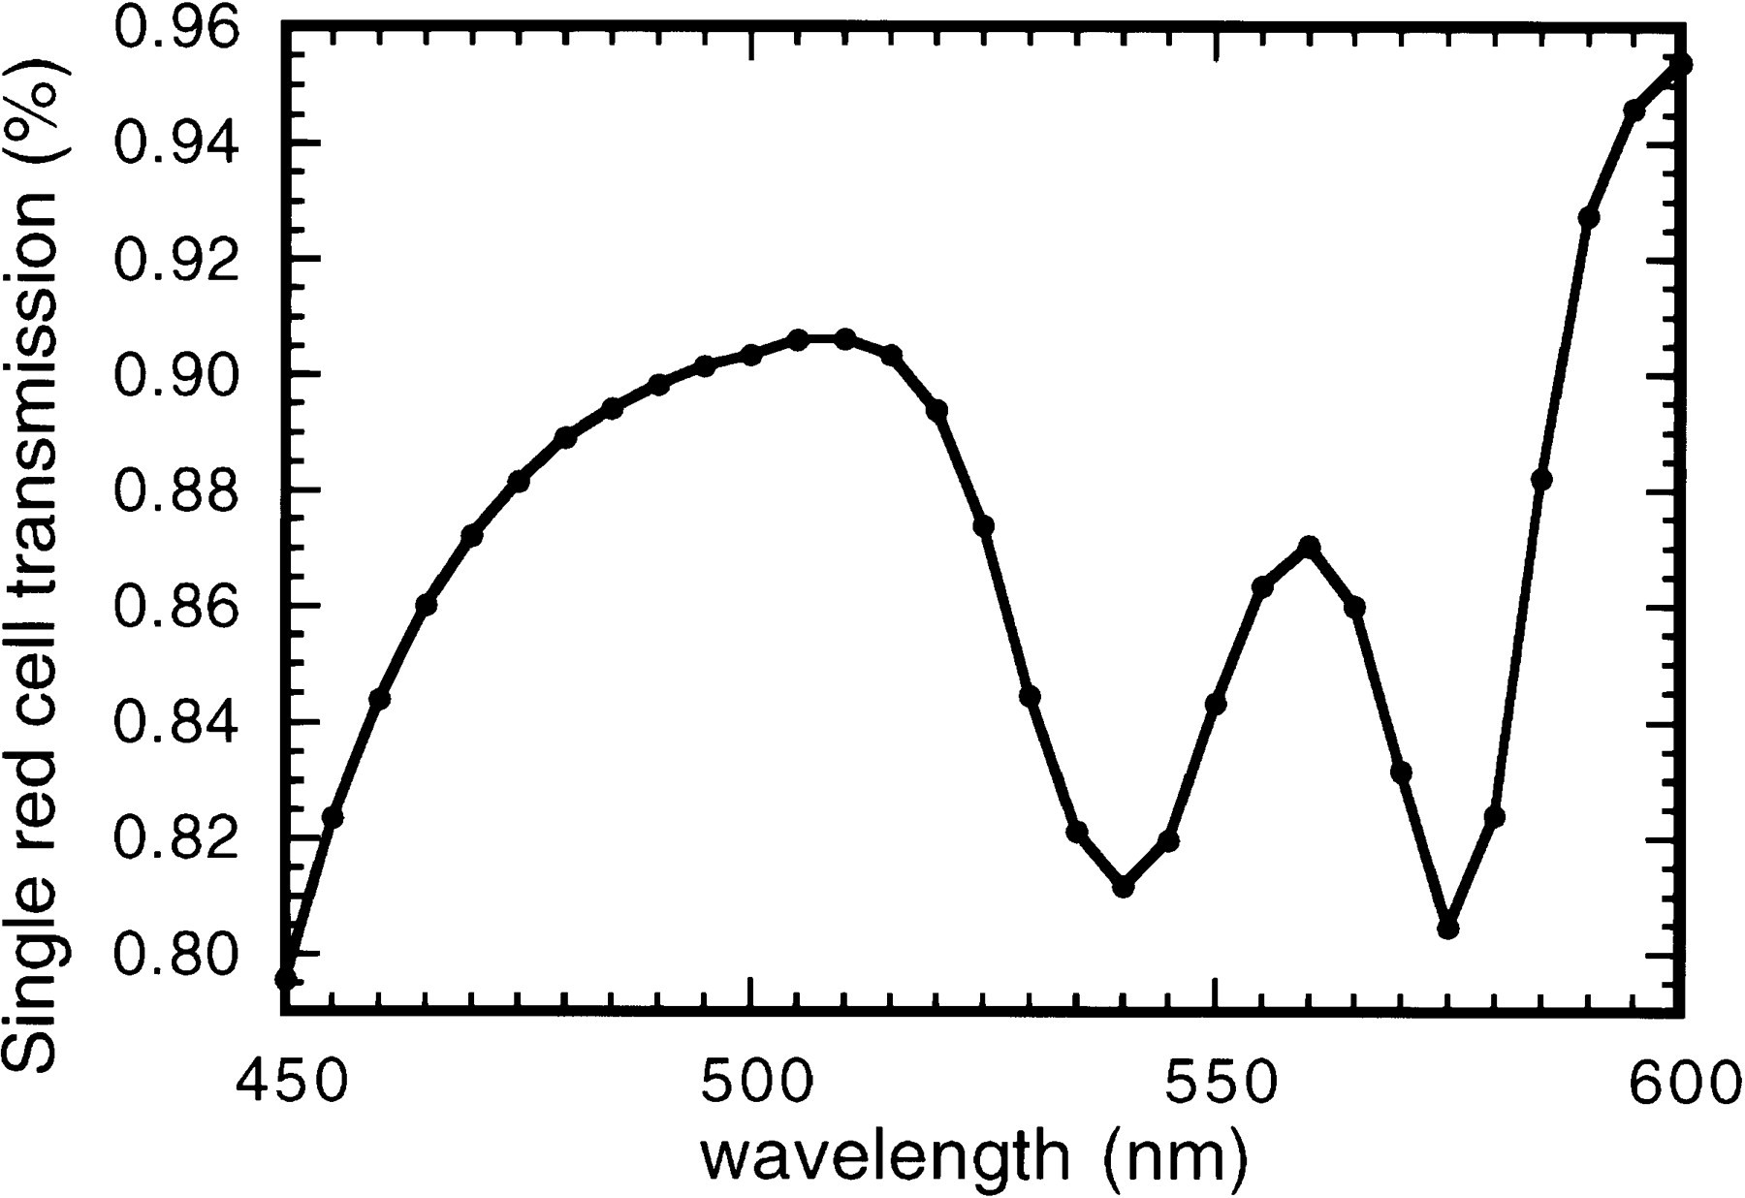
Fig. 2.Single red blood cell (RBC) transmission spectra as a function of wavelength (450–600 nm) at 5-nm intervals.
Fig. 4.Transmission spectra through 100 μm of heart tissue (solid line) and through 100 μm of heart tissue with 25–100 μm of vessels (dotted line), with vessel density calculated by Patterson et al. (13). Blood content in these vessels has insignificant effect on extremes of myocardial spectra.
Gandjbakhche, A. H., Bonner, R. F., Arai, A. E., & Balaban, R. S. (1999). Visible-light photon migration through myocardium in vivo. American Journal of Physiology-Heart and Circulatory Physiology, 277(2), H698-H704.
Notes:
Reference 13 is Patterson, M. S., Chance, B., & Wilson, B. C. (1989). Time resolved reflectance and transmittance for the noninvasive measurement of tissue optical properties. Applied optics, 28(12), 2331-2336.

Slide 18
Notes:
https://journals.physiology.org/doi/full/10.1152/ajpheart.1999.277.2.H698

Slide 19
Notes:
https://journals.physiology.org/doi/full/10.1152/ajpheart.1999.277.2.H698

Slide 20
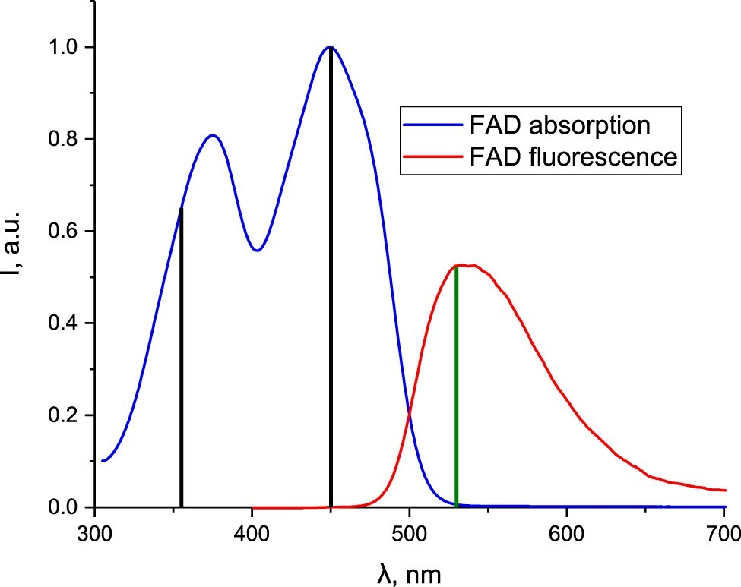
Beltukova, D. M., Danilova, M. K., Gradusov, I. A., Belik, V. P., Semenova, I. V., & Vasyutinskii, O. S. (2022). Polarised fluorescence in FAD excited at 355 and 450 nm in water–propylene glycol solutions. Molecular Physics, 120(18), e2118186.
Figure 1. Absorption and fluorescence spectra of FAD in water. Black and green vertical lines indicate the excitation and fluorescence wavelengths, respectively

Slide 24
The spectral bandwidth of FAD fluorescence is approximately 40-50 nm, with a peak emission around 520-530 nm

Slide 26
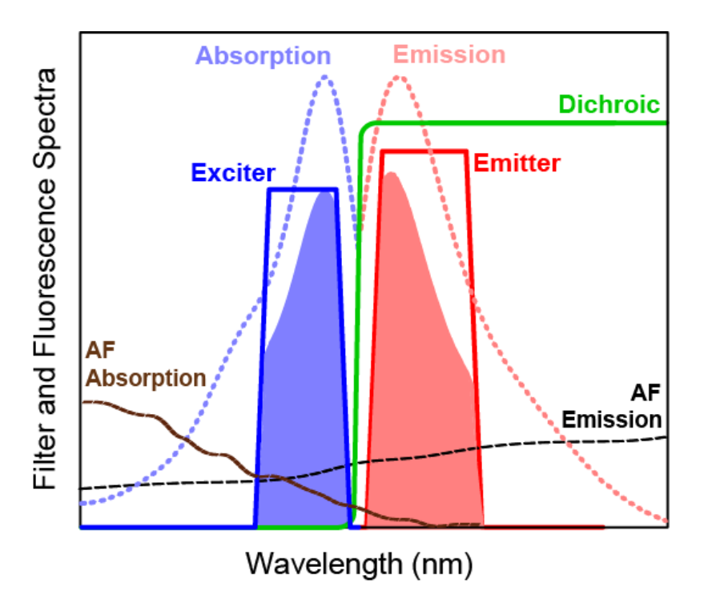
Notes:
https://www.idex-hs.com/resources/resources-detail/spectral-modeling-in-fluorescence-microscopy

Slide 27
Collagen: emission peak around 400-405 nm
Elastin: emission peak around 400 nm
NADH: emission peak around 440-460 nm
FAD: emission peak around 535 nm3

Slide 29
Attenuate collagen more than FAD because more blood in stromal layer? Pavlova et al 2009 who estimate that the fraction of volume occupied by blood in stromal layer is .10 to 20% compared to 0.2 and 0.3% in superficial stromal layer
Also more keratin on tongue than lower lip and this is not attenuated by blood

Slide 30
Try lip at 450 nm illumination
Porphyrins should be less prominent
FAD should be higher

Slide 31
500
600
700

