Slide 1
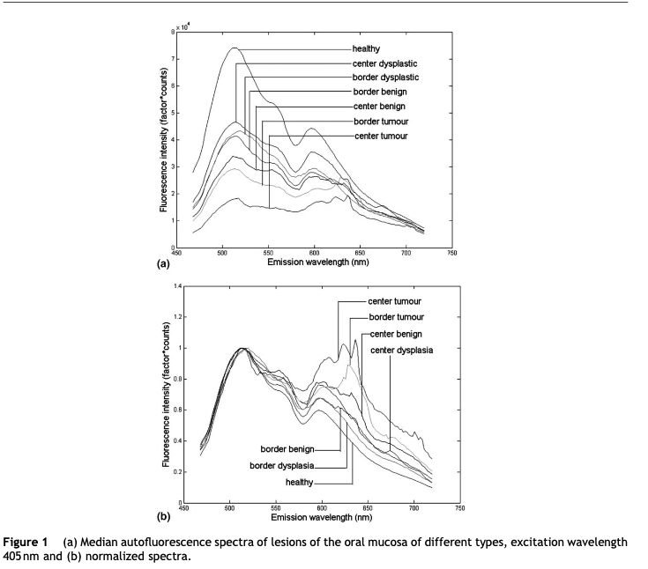
De Veld, D. C. G., Witjes, M. J. H., Sterenborg, H. J. C. M., & Roodenburg, J. L. N. (2005). The status of in vivo autofluorescence spectroscopy and imaging for oral oncology. Oral oncology, 41(2), 117-131

Slide 2
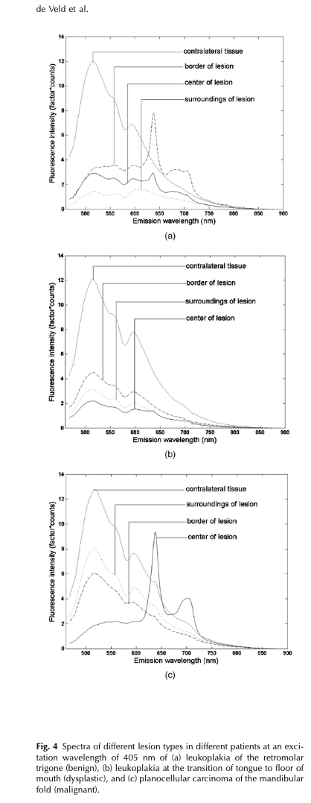
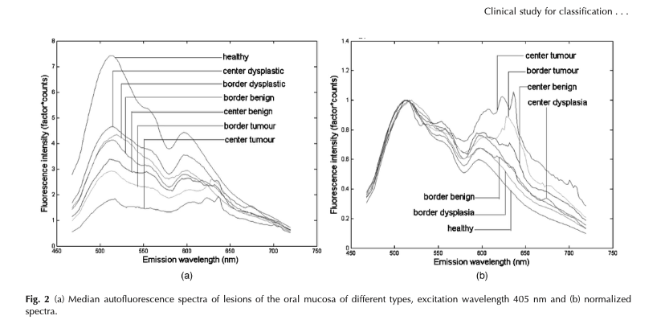
de Veld, D. C., Skurichina, M., Witjes, M. J., Duin, R. P., Sterenborg, H. J., & Roodenburg, J. L. (2004). Clinical study for classification of benign, dysplastic, and malignant oral lesions using autofluorescence spectroscopy. Journal of biomedical optics, 9(5), 940-950.

Slide 3
de Veld, D. C., Skurichina, M., Witjes, M. J., Duin, R. P., Sterenborg, H. J., & Roodenburg, J. L. (2004). Clinical study for classification of benign, dysplastic, and malignant oral lesions using autofluorescence spectroscopy. Journal of biomedical optics, 9(5), 940-950.

Slide 4
635 nm

Slide 5
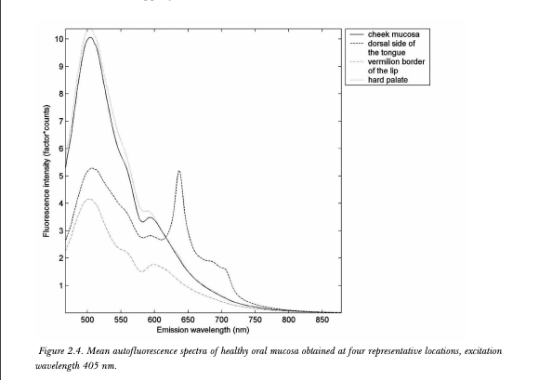
Purely empirical data – very much like what we measure
de Veld et al used fiber optics
Cheek mucosa (Veld et al)
de Veld, D. C., Skurichina, M., Witjes, M. J., Duin, R. P., Sterenborg, D. J., Star, W. M., & Roodenburg, J. L. (2003). Autofluorescence characteristics of healthy oral mucosa at different anatomical sites. Lasers in Surgery and Medicine: The Official Journal of the American Society for Laser Medicine and Surgery, 32(5), 367-376.
Lower lip mucosa (Joyce)
Dorsal tongue (Joyce)
This study shows that most mucosal linings in the oral cavity can spectroscopically be regarded as nearly identical. The fluorescence intensity has its maximum between 500 and 510 nm and is comparable to values found in other studies for excitation at approximately the same wavelength, in vivo as well as in vitro [10,13,28–30]. A prominent dip in fluorescence emission was seen in most spectra around 575 nm, as well as a less pronounced dip around 540 nm, as has been observed before [10,13,28,30].
Dorsal tongue (Veld et al)
Spectra recorded at other wavelengths are not shown because they look very similar. All spectra show dips around 540 and 577 nm that are caused by oxyhemoglobin absorption

Slide 6
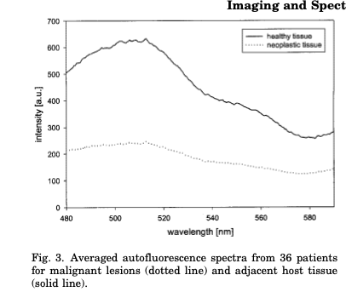
Betz CS, Mehlmann M, Rick K, Stepp H, Grevers G, Baumgartner R, Leunig A.
Autofluorescence imaging and spectroscopy of normal and malignant mucosa in patients with
head and neck cancer. Lasers Surg Med 1999;4:323–334.
Endoscope positioned 12 mm from the tissue , reported measurements 470 - 600 nm

Slide 7
Normal
Betz et al 1999
Neoplastic

Slide 8
Betz et al 1999
Normal

Slide 9
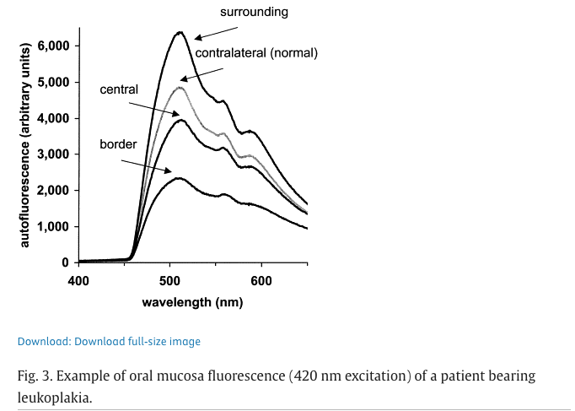
van Staveren HJ, van Veen RL, Speelman OC, Witjes MJ, Star WM, Roodenburg JL.
Classification of clinical autofluorescence spectra of oral leukoplakia using an artificial neural net-
work: A pilot study. Oral Oncol 2000;3:286–293.

Slide 10
van Staveren et al 2000
(“surrounding tissue”)

Slide 17
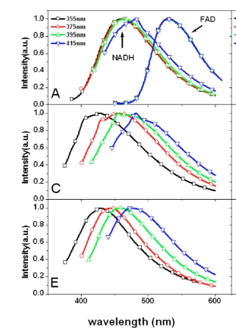
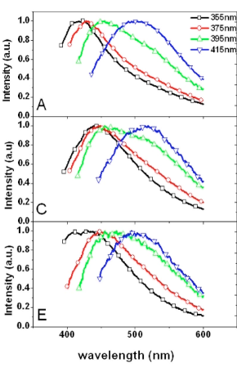
Normalized single-photon excited spectral signals … from different tissue layers.
a, Keratinized epithelium;
c, : nonkeratinized epithelium;
e, stromal layer.
Normalized single-photon excited spectral signals
a, NADH peak at 460 nm and
FAD peak at 530 nm ;
c, keratin;
e, collagen.
From Zheng et al 2008, Fig 4
From Zheng et al 2008, Fig 3
Keratin
Collagen
Notes:
Not sure why he thinks that

Slide 19
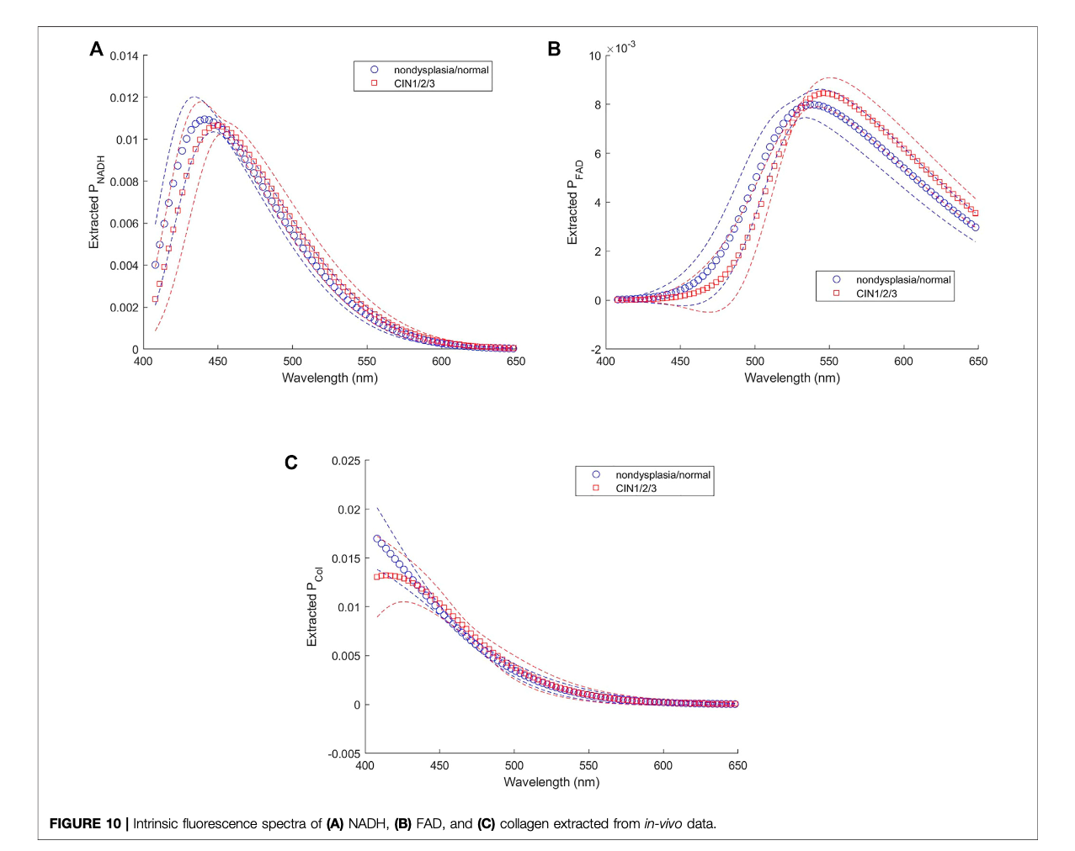
Lin, G. S., Tu, S. C., Mok, C. I., Huang, T. H., Chen, C. H., Wei, L. H., & Sung, K. B. (2022). Non-Invasive Quantification of Layer-Specific Intrinsic Fluorescence From Mucosa of the Uterine Cervix Using Monte-Carlo-Based Models. Frontiers in Physics, 10, 865421.
the in-vivo spectral emissions were first measured using a fiber optic spectroscopy system, then calibrated using phantoms and MC simulations. Subsequently, a two-layer MC model, combined with iterative curve fitting of reflectance spectra and a genetic algorithm-based fitting of fluorescence spectra, was employed to extract the layer-specific intrinsic fluorescence of the key fluorophore
In-vivo Measurement: During colposcopy, the probe was gently placed on the surface of the cervical mucosa at both visually suspicious sites (identified by the physician after acetic acid application) and normal-appearing control sites2 . A slight pressure of about 6 kPa was applied2 .
•
Excitation of Fluorescence: An ultraviolet light-emitting diode (UV LED) with a central wavelength of 365 nm was used to excite the autofluorescence of key fluorophores in the cervical mucosa, primarily collagen crosslinks, NADH, and FAD

