Slide 1

Cloudberry: Interactive Analytics and Visualization on Large-Scale Data The Cloudberry Team

Slide 2
Why Cloudberry?
“Eat your own dog food”
A general-purpose middleware system
Support analytics and visualization
Interactive: sub-second response time

Slide 3
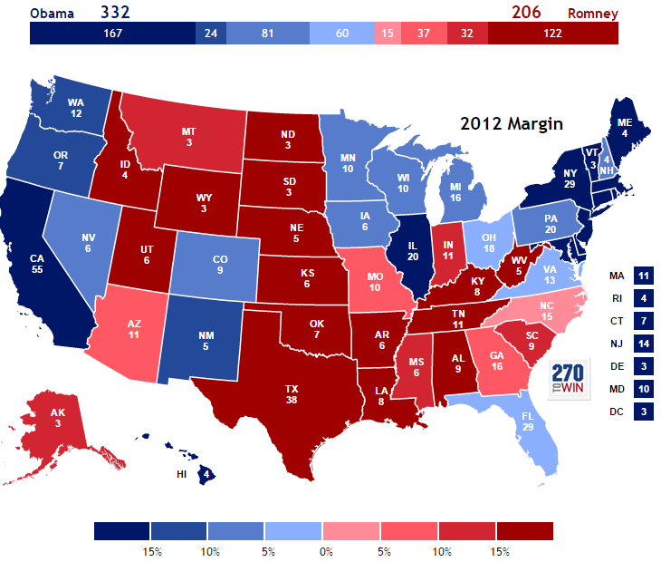
Presidential election 2012

Slide 4
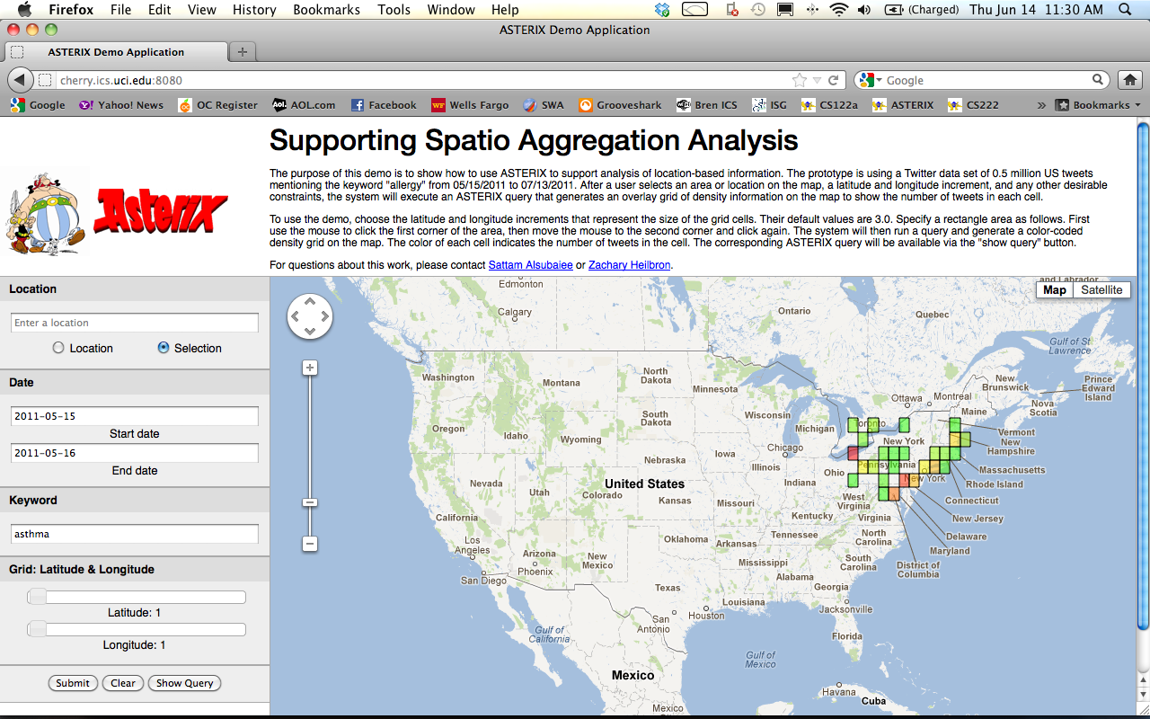
First attempt: “Cherry demo”

Slide 5
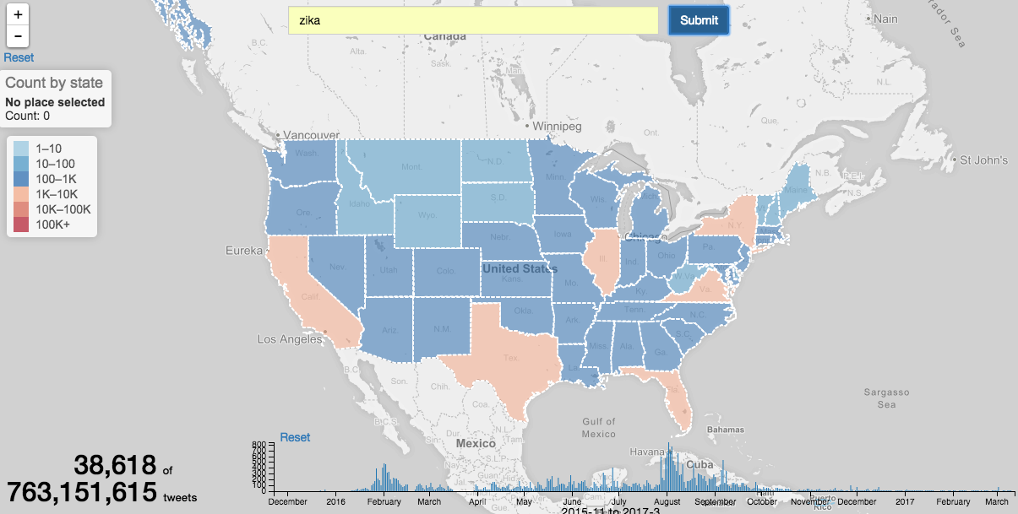
Our TweetMap in 2017

Slide 6
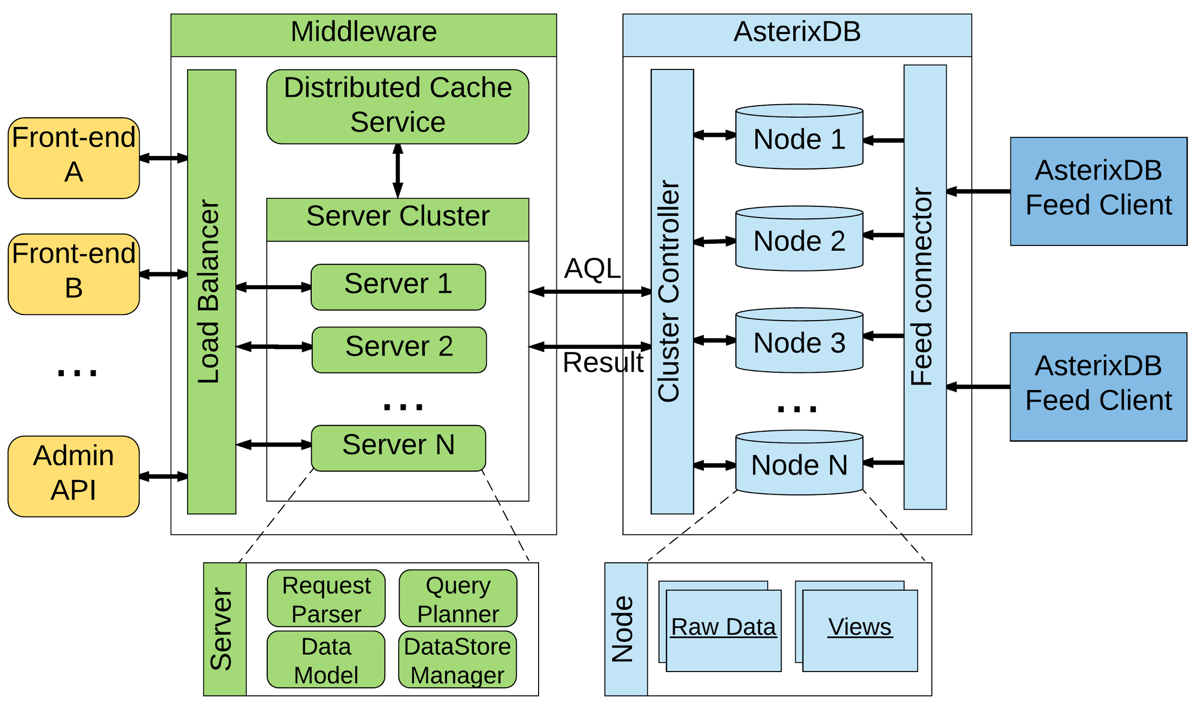
Cloudberry: architecture

Slide 7
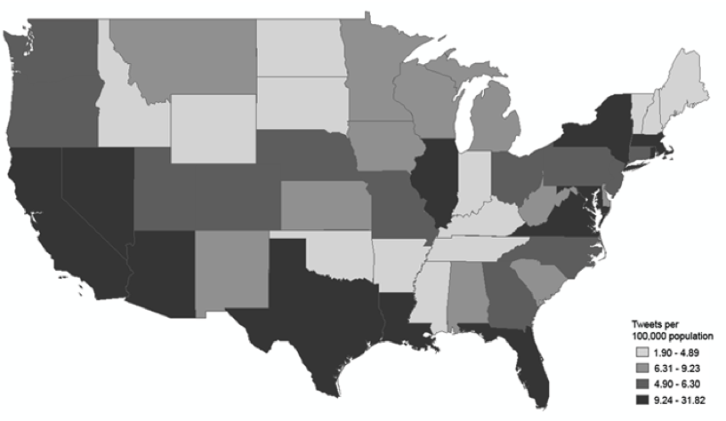
A use case: Zika analysis
Use of Twitter Data to Track the 2016 Zika Virus Epidemic in the United States
Shahir Masri¹, Jianfeng Jia², Chen Li², Guofa Zhou¹, Ming-Chieh Lee¹, Guiyun Yan¹, Jun Wu^{1*}

Slide 8
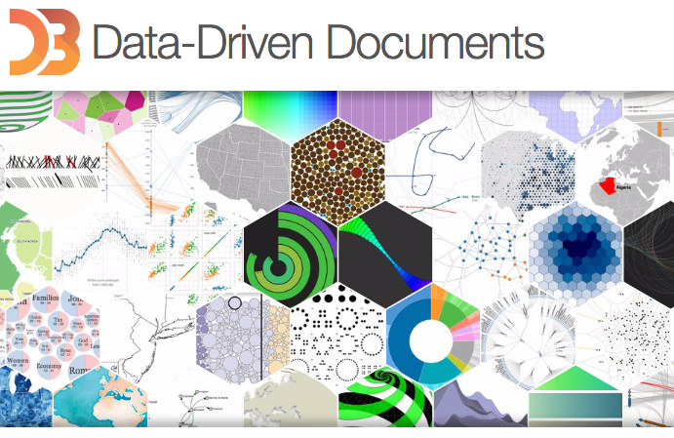
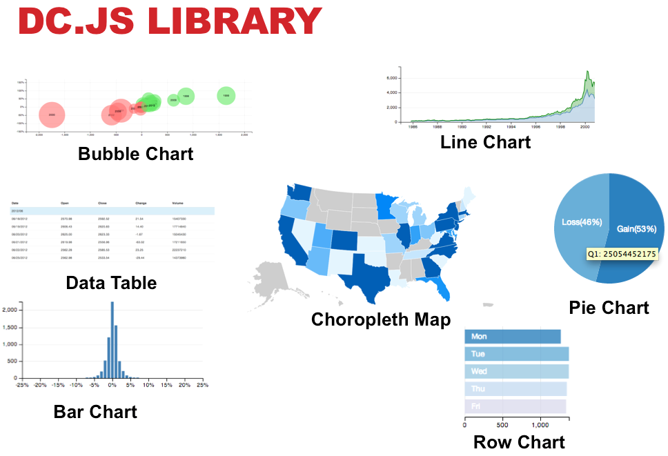
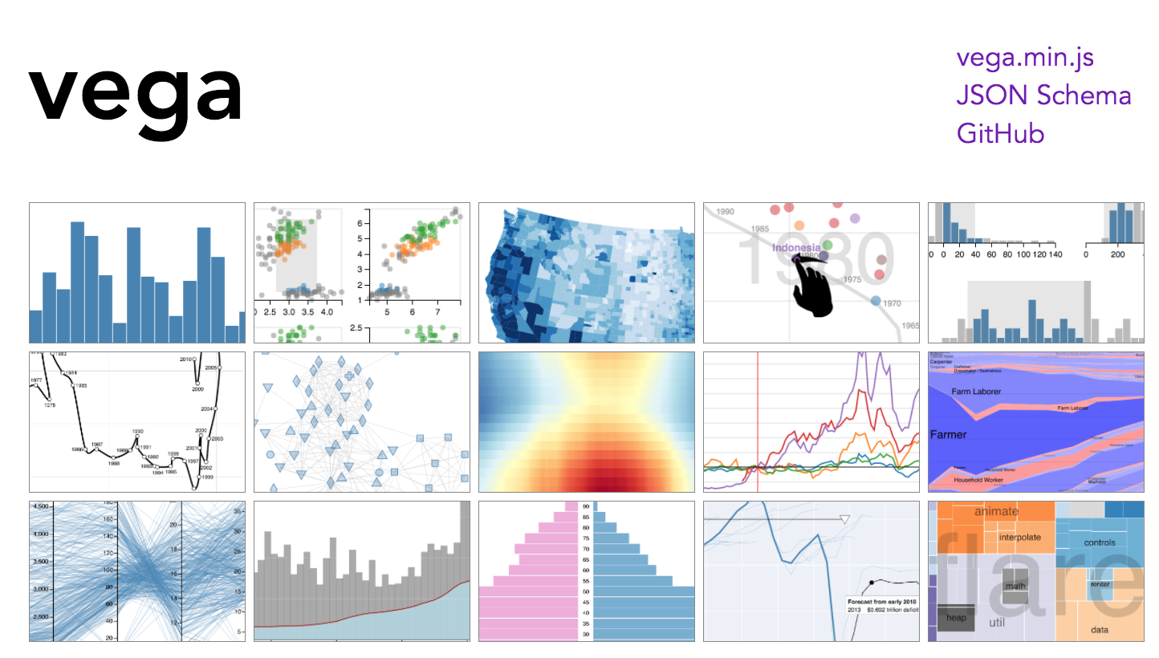
Many front-end tools can be used

Slide 9
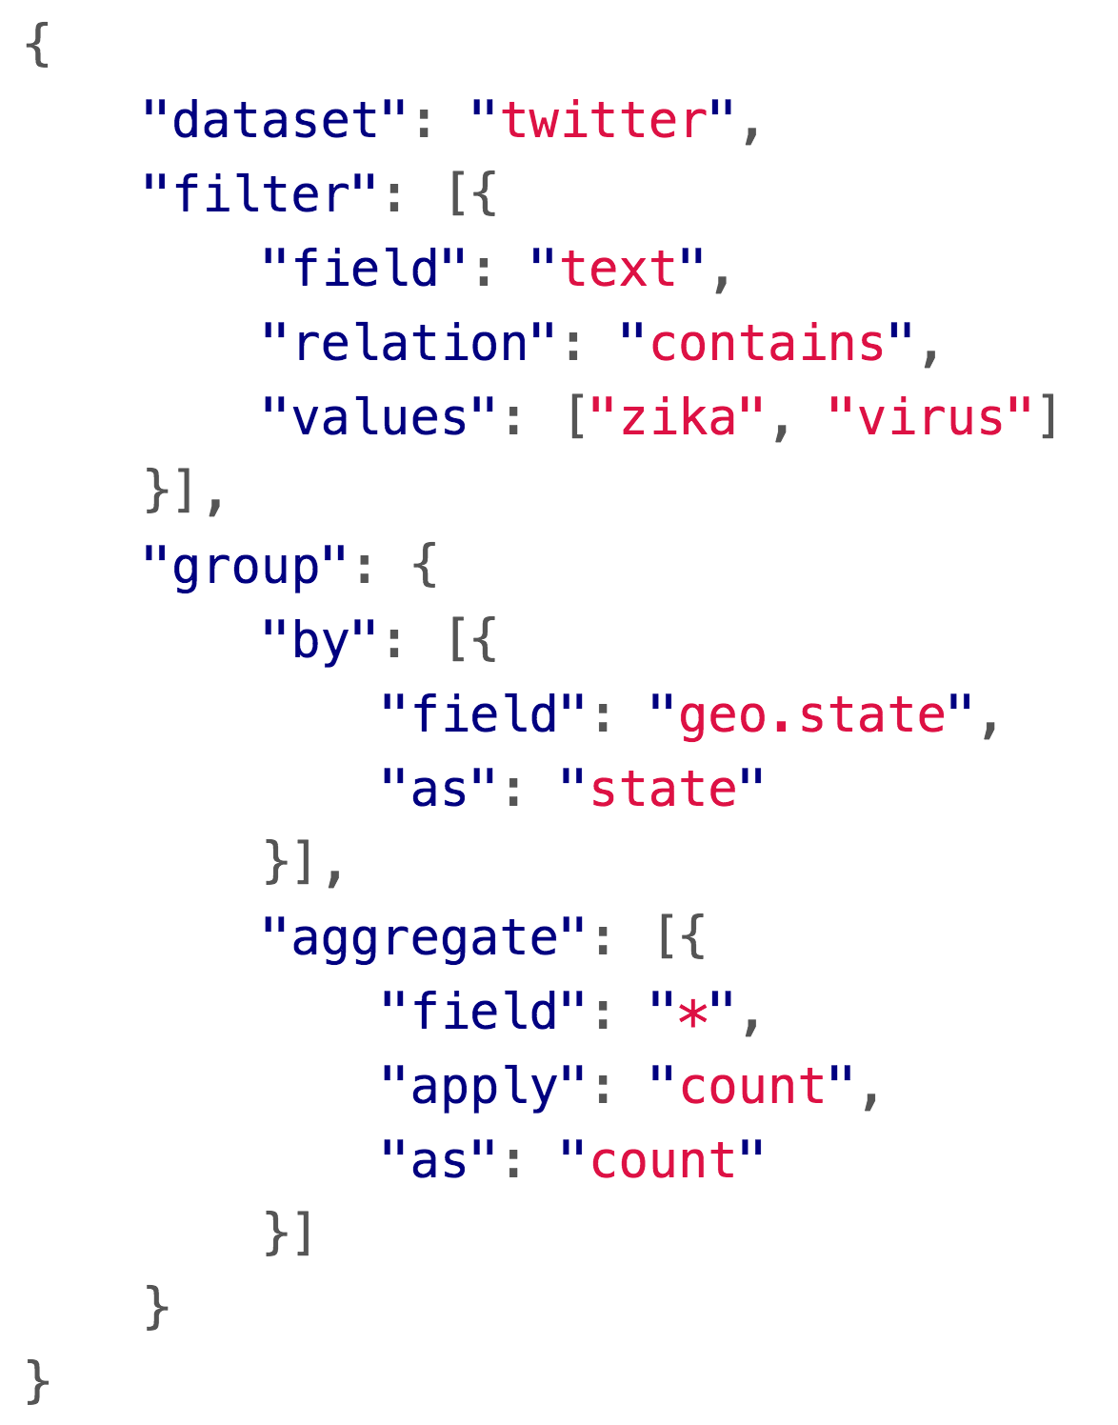
API Example: # of “Zika Virus” tweets per state

Slide 10
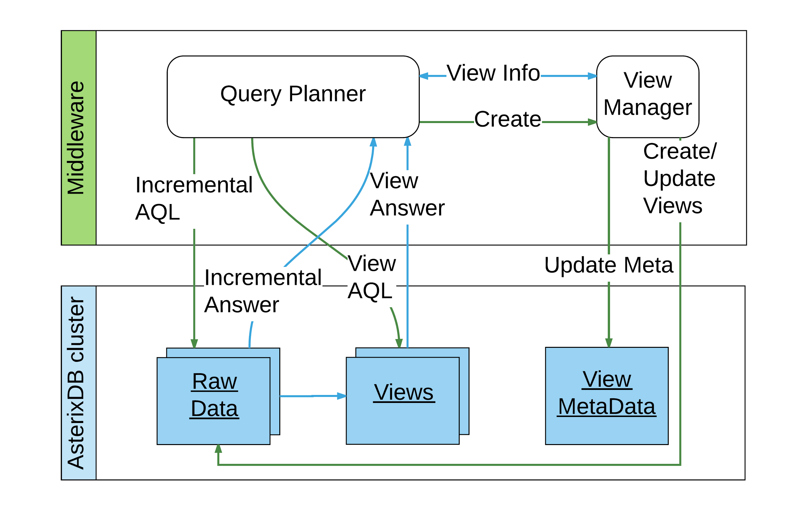
View caching and incremental computation

Slide 11
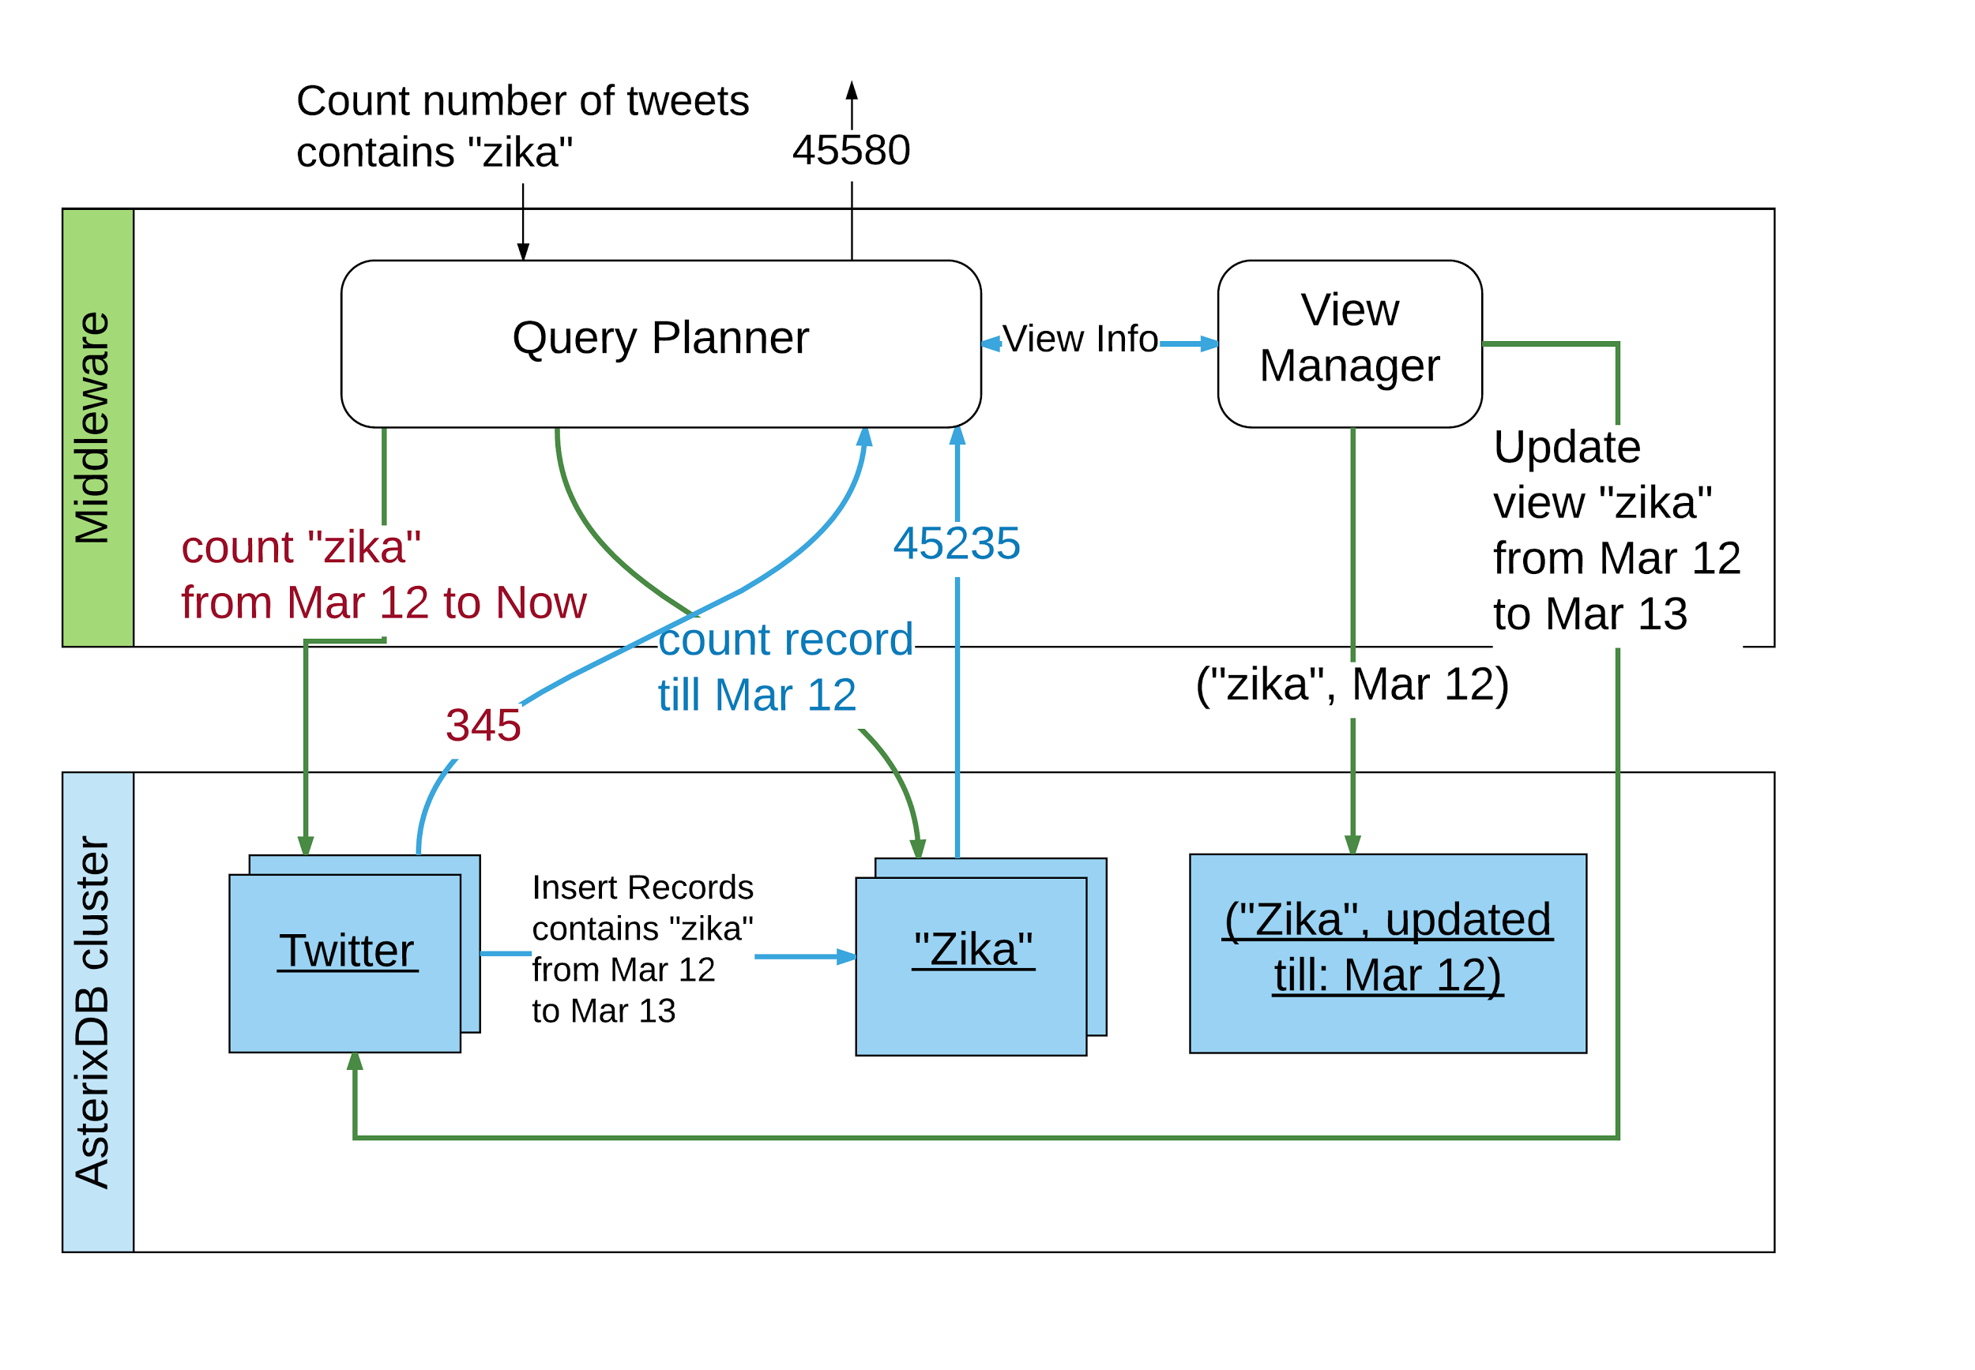
View caching and incremental computation

Slide 12
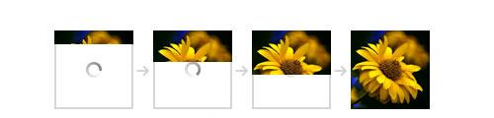
What if no views? Query Slicing
Notes:
Response time saving come from
The view is small
The base dataset time predicate is small

Slide 13
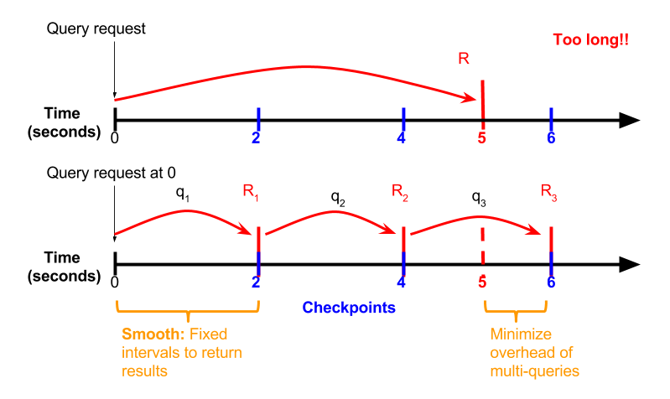
Query slicing

Slide 14
Open challenges
Other frontend solutions
Advanced techniques for answering queries using views
Middleware caching
Visualizing large number of records on the frontend
Other data domains

Slide 15
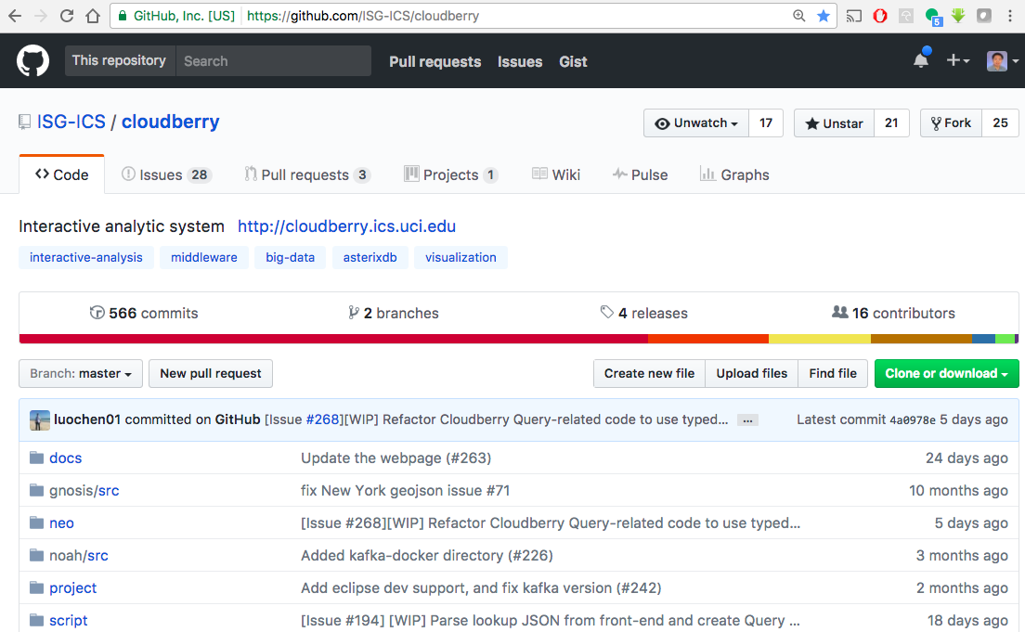
Open source

Slide 16
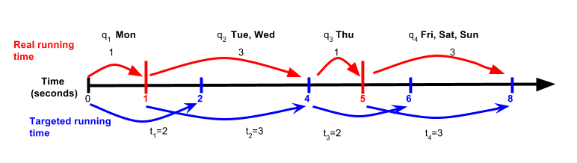
Dynamically updating slicing interval value
Dataset: Twitter(id: int, day: date, text: string)
Query: count number of tweets talking about “zika” from last week
Notes:
Deadline: 2s Slicing on “day”

