Slide 1



Revealing the Hidden Impact of Top-N Metrics on Optimization in Recommender Systems
Lukas Wegmeth
Tobias Vente
Lennart Purucker
46th European Conference on Information Retrieval
Lukas.Wegmeth@uni-siegen.de
www.isg.beel.org
@LWegmeth

Slide 2
Problem
Hyperparameter Optimization
Grid Search
Random Search
Discrepancy?
Optimized Model
Model Training
Evaluation
Similarity
Log Loss Cross Entropy
Classification
@ TOP-N
Ranking
@ TOP-N
Discrepancy!
Notes:
The goal is an optimized model
We use HPO to achieve this model
Within HPO, we train models with some loss functions or similarity
Then evaluate model hyperparameters with top-n metrics
Grid Seach or Random Search determine which is the best model based on the evaluation metrics
There is a known discrepancy between loss functions and ranking top-n metrics. Loss functions have no concept of a ranking.
Is there also a discrepancy between top-n metrics and an optimized model? Do top-n metrics indicate the actual performance of a model?

Slide 3






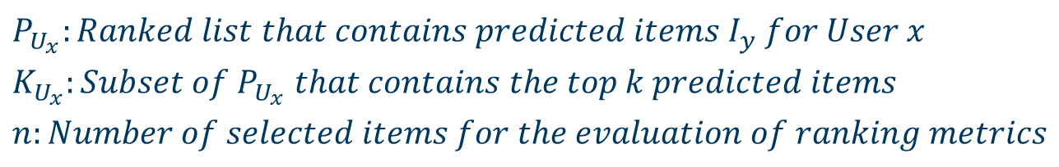





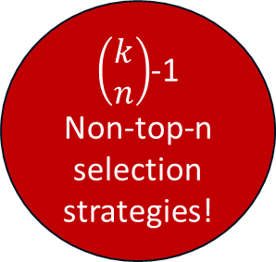


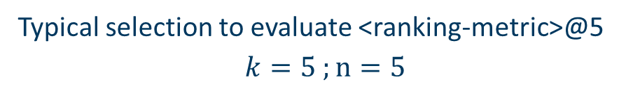






Selection Strategies
$$P_{U_{x}}:Ranked list that contains predicted items I_{y} for User x$$
$$K_{U_{x}}:Subset of P_{U_{x}} that contains the top k predicted items$$
$$n:Number of selected items for the evaluation of ranking metrics$$
Typical selection to evaluate <ranking-metric>@5
$$k=5 ;n=5$$
Alternative selection to evaluate <ranking-metric>@5
$$k=6 ;n=5$$
$$P_{U_{x}}$$
$$P_{U_{x}}$$
$$I_{1}$$
$$K_{U_{x}}$$
$$I_{1}$$
$$K_{U_{x}}$$
$$I_{2}$$
$$I_{2}$$
$\left(\begin{matrix}k \\ n\end{matrix}\right)$-1
Non-top-n
selection
strategies!
Top-n
selection strategy
$$I_{3}$$
Non-top-n
selection strategy
$$I_{3}$$
$$I_{4}$$
$$I_{4}$$
$$I_{5}$$
$$I_{5}$$
$$I_{6}$$
$$I_{6}$$
…
…
$$I_{|P_{U_{x}}|}$$
$$I_{|P_{U_{x}}|}$$
Notes:
P is the ranked list of predicted items for user U
K is a subset of P with the top-k items
N is the number of selected items for evaluation
The typical evaluation of ranking metrics @ 5 looks like this.
Alternatively we could also look at more items and select any five items from the larger list.
We call the typical way of selecting items the top-n selection strategy.
Any alternative selection strategy is called non-top-n selection strategy
Notable there are K over n many non-top-n selection strategies

Slide 4
Research Questions
RQ1 Does the selection of items other than the top-n during the evaluation of recommender systems yield improved predictive accuracy for specific algorithms, domains, or data sets?
RQ2 If there are cases where selecting items other than the top-n improves predictive accuracy, is there a significant impact of top-n metrics on optimization?
Notes:
We can provide evidence for the introduced discrepancy if we show that there exist non-top-n selection strategies that outperform the top-n selection strategy.
Furthermore we test for the impact on optimziation of such findings.

Slide 5
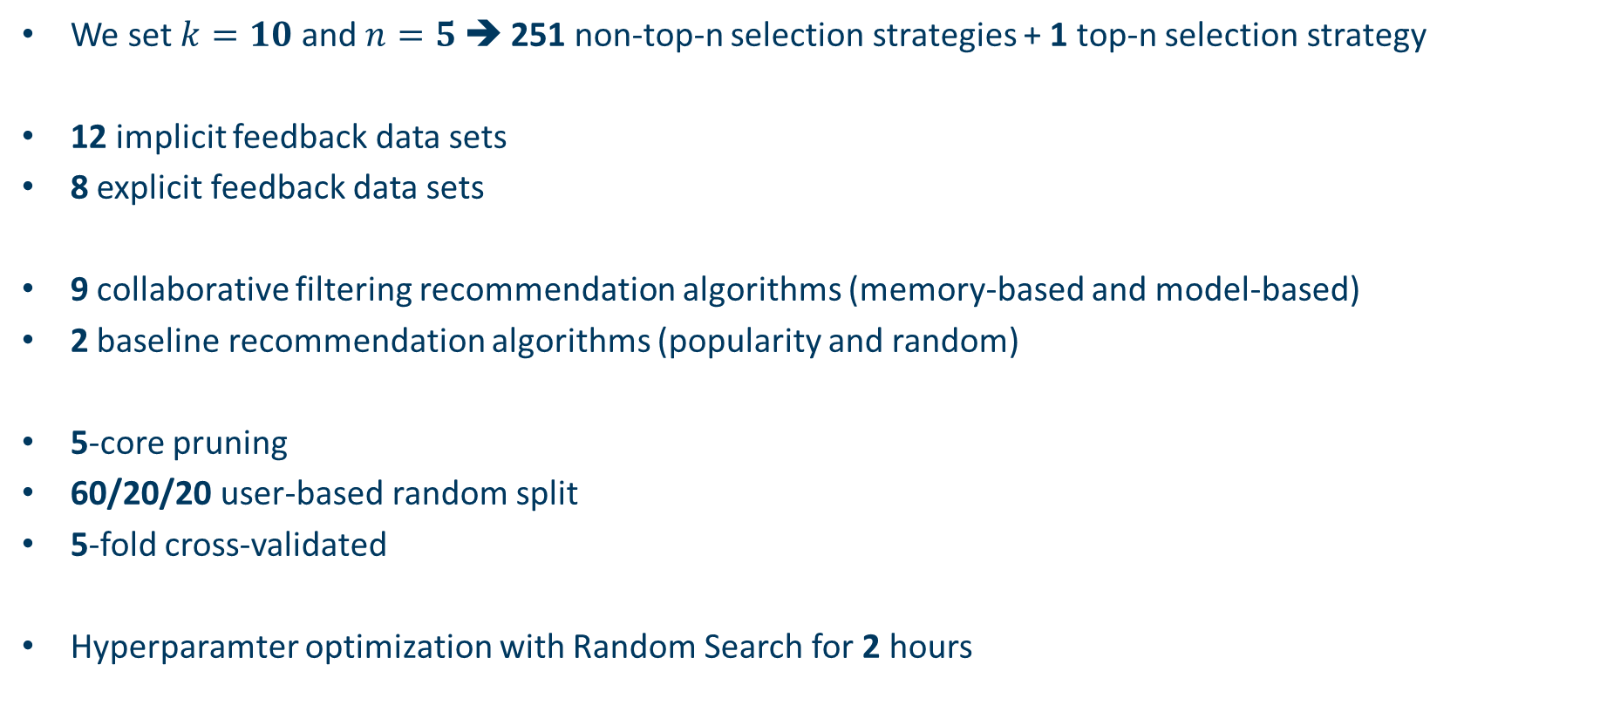
Exploratory Study: Method
We set $k=10$ and $n=5$ ➔ 251 non-top-n selection strategies + 1 top-n selection strategy
12 implicit feedback data sets
8 explicit feedback data sets
9 collaborative filtering recommendation algorithms (memory-based and model-based)
2 baseline recommendation algorithms (popularity and random)
5-core pruning
60/20/20 user-based random split
5-fold cross-validated
Hyperparamter optimization with Random Search for 2 hours
Notes:
K and n chosen due to popular metrics and computational overhead
A set of popular recsys data sets
Explicit feedback analyzed separately
E.g. itemknn and mf
Sanity checks
As usual in many papers
User-based to avoid cold-start
To reduce the impact of randomness
To validate only on optimized models

Slide 6
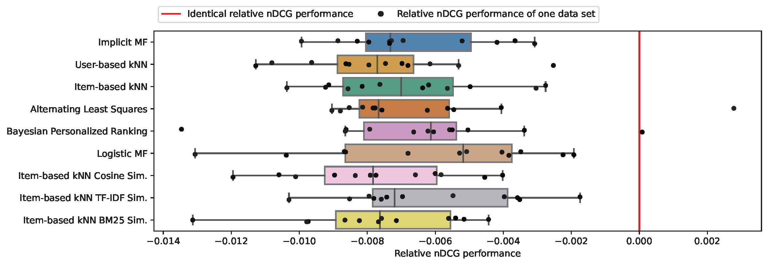
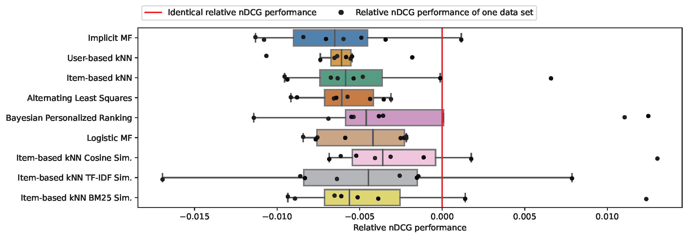
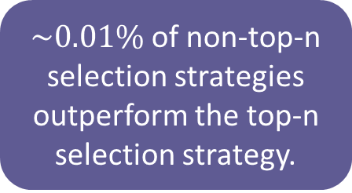
Exploratory Study: Results Part 1
Implicit feedback data sets
RQ1 Does the selection of items other than the top-n during the evaluation of recommender systems yield improved predictive accuracy for specific algorithms, domains, or data sets?
$\sim 0.01\%$ of non-top-n selection strategies outperform the top-n selection strategy.
Explicit feedback data sets
Notes:
Reminder for RQ1; graphic shows the best non-top-n selection strategy of each data set on each algorithm (black dots) versus the top-n performance (red line)
Circled dots are cases where the best non-top-n beats the top-n
Only 0.01% of selection strategies but positively answers RQ1

Slide 7
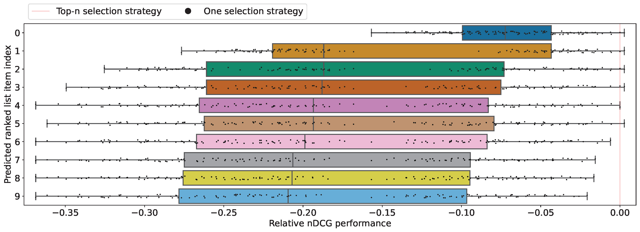
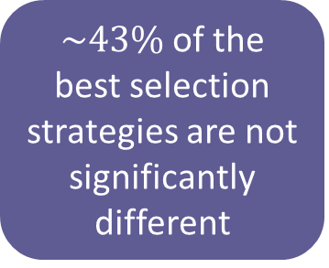
Exploratory Study: Results Part 2
RQ2 If there are cases where selecting items other than the top-n improves predictive accuracy, is there a significant impact of top-n metrics on optimization?
$\sim 43\%$ of the best selection strategies are not significantly different
Notes:
Reminder rq2; black dots show the performance of a selection strategy if the index on the y axis was chosen. Red line is the top-n performance
The red rectangle shows selection strategies that are not significantly different which are around 43% of selection strategies

Slide 8
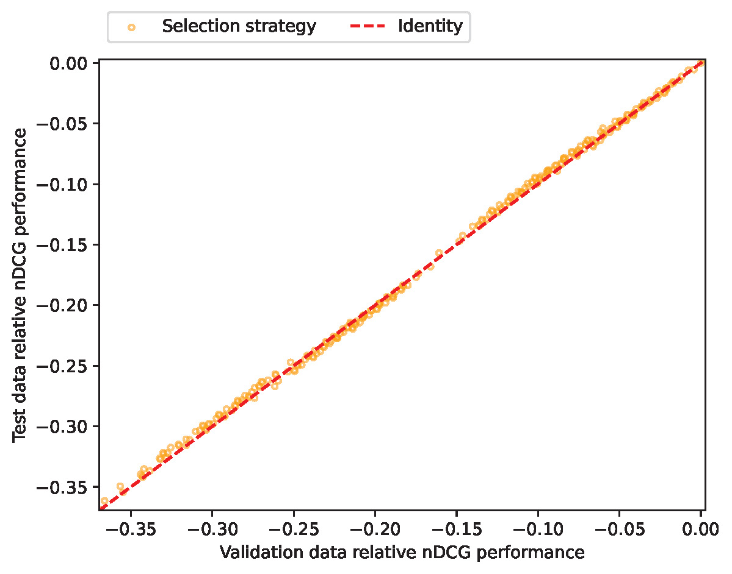
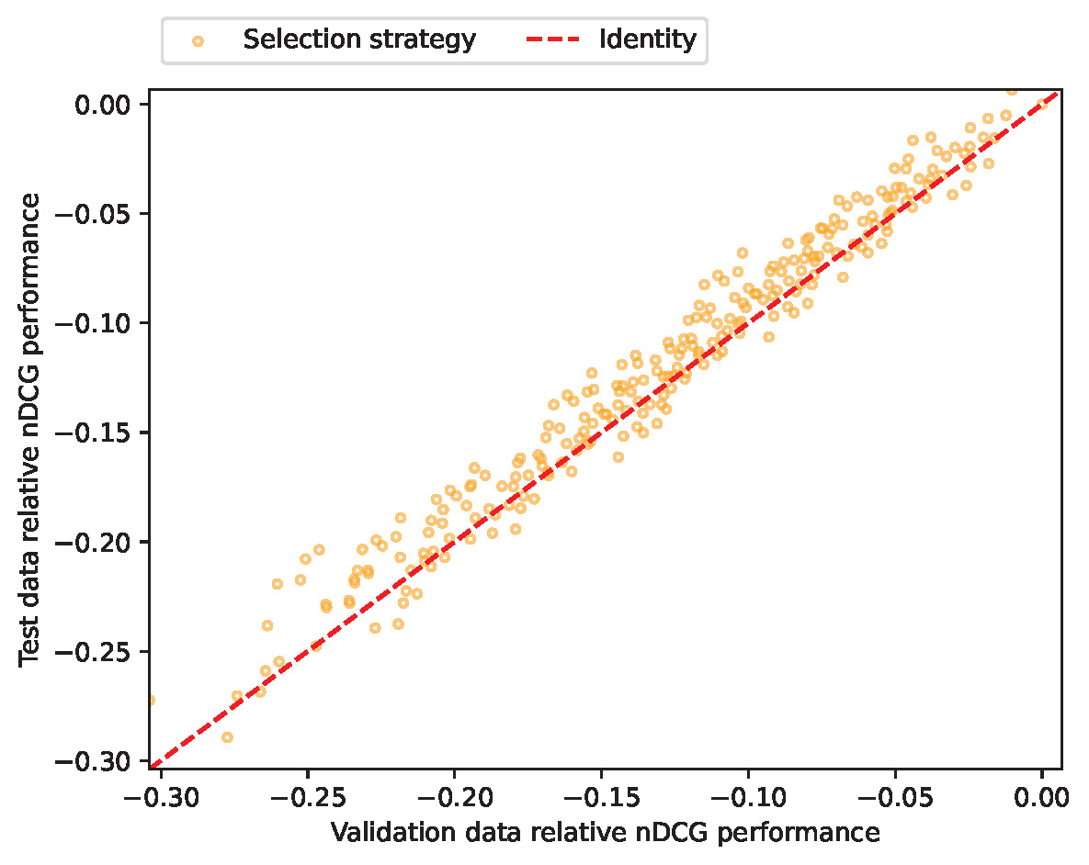
Exploratory Study: Results Part 3
Adressa-One-Week
MovieLens-100K
Selection strategies generalize from validation to test (Pearson > 0.99)
Notes:
1. Selection strategies generalize from validation to test

Slide 9
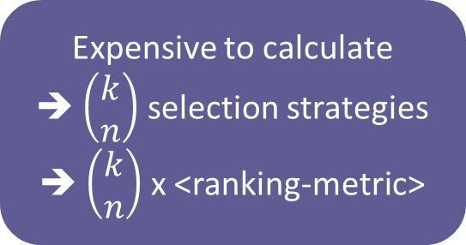
Exploratory Study: Results Part 4
Adressa-One-Week
MovieLens-100K
Expensive to calculate
➔ $\left(\begin{matrix}k \\ n\end{matrix}\right)$ selection strategies
➔ $\left(\begin{matrix}k \\ n\end{matrix}\right)$ x <ranking-metric>
Notes:
1. But the exhaustive search is very expensive. More efficient methods could be found

Slide 10
Conclusion
We cleared any doubts of the hidden impact of top-n metrics on optimization as a confounding factor for the evaluation and reproducibility of traditional collaborative filtering algorithms.
We found no evidence indicating a practical benefit in optimizing with selection strategies other than the top-n!
!
Notes:
We show that top-n metrics are not a confounding factor in the optimization of recommender systems
Additionally, there is likely no benefit in optimization selection strategies due to the time complexity

Slide 11

Links
Revealing the Hidden Impact of Top-N Metrics
on Optimization in Recommender Systems
https://code.isg.beel.org/scoring-optimizer
https://isg.beel.org/people/lukas-wegmeth/
https://isg.beel.org/people/tobias-vente/
https://ml.informatik.uni-freiburg.de/profile/purucker/

