Slide 1
匠
TAKUMI
Expert knowledge, captured. Craftsmanship, inherited.
Preserving & Transferring Tacit Technical Expertise to Future Generations
JETRO-PS-03 · Thapar Japan Hackathon 2026 — Bridging Tradition and Innovation
Team [NAME] · [Member 1] · [Member 2] · [Member 3] · [Member 4]
trigger 0.40 V (rise) — TRIGGERED · LOCKED
CAPTURE ▸ EXTRACT ▸ REVIEW ▸ APPROVE ▸ PRACTICE
OFFLINE-CAPABLE · RECORDINGS STAY LOCAL · ZERO PAID API

Slide 2
The knowledge leaves before it is written down
Japan's master technicians are retiring faster than apprenticeships can replace them. What they know lives in hands and judgement — not manuals. A retiring expert takes decades of micro-decisions with them.
What a single 3-minute demonstration actually contains
WHY VIDEO ALONE FAILS
Rules never written “Connect the ground clip first — tip-first can float and damage the front end.”
Unstructured — a 5-minute video holds ~40 micro-decisions nobody can search
Unverified — transcripts mis-hear; no link from claim to evidence
Untested — watching is not doing; nothing checks the trainee
Unowned — the expert never confirms what AI inferred
The math behind the feel “500 mV/div — 2 V needs 4 of 8 divisions, leaving headroom for overshoot.”
Rules of thumb “Two cycles on screen — enough to judge period and symmetry.”
Failure diagnosis “Park the level on the noisy flat top and the display jitters all day.”
Recovery moves “Enable trigger, walk the level to a clean rising crossing, stop.”
Evidence: bundled expert demonstration on oscilloscope setup & signal troubleshooting (5 steps extracted, 3 gaps flagged for the expert).

Slide 3
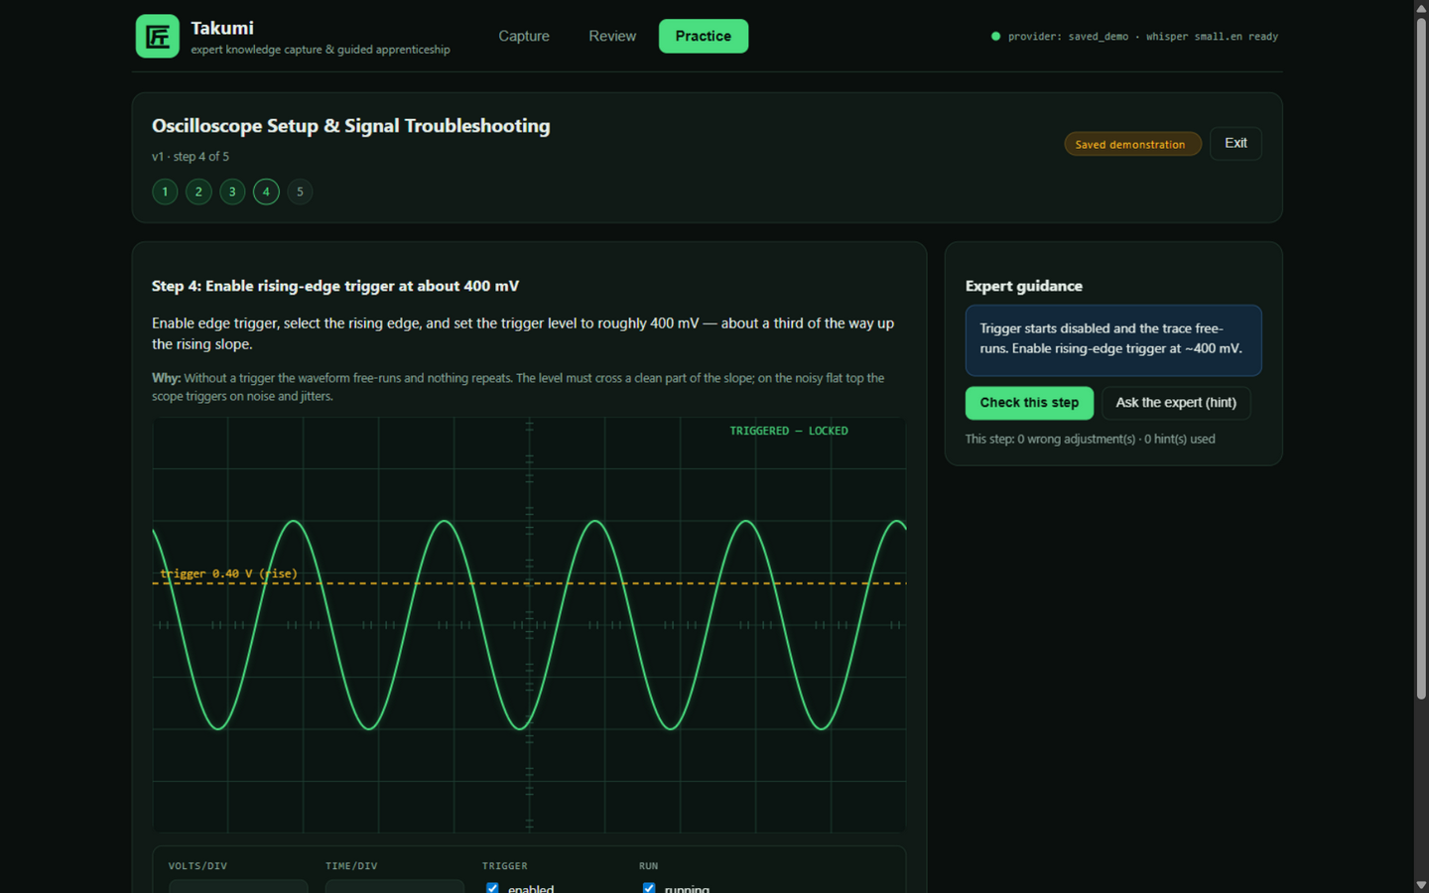
One video becomes a lesson a trainee can practice
1
2
3
4
5
▸
▸
▸
▸
CAPTURE
EXTRACT
REVIEW
APPROVE
PRACTICE
≤5-min demo video; stays on-device
local transcription + AI draft with evidence links
expert corrects, answers gaps, sees provenance
only approved versions reach trainees
simulator scores decisions, cites the expert
DESIGN PRINCIPLES
The expert stays the author — nothing trains without approval
Every claim links to a verbatim transcript moment
Missing knowledge stays visibly incomplete, never invented
Practice checks decisions; bench observation stays human
Live prototype — feedback quotes the expert's own recovery rule.

Slide 4
Built like an instrument: local by default
RECORDING
TRANSCRIBE
EXTRACT (provider adapter)
VALIDATE
video/audio · local disk, never uploaded
▸
faster-whisper small.en · CPU INT8 · on-device
▸
structured JSON + verbatim evidence refs
▸
schema + evidence-vs-transcript check
EXTRACT PROVIDERS
LESSON STORE
REVIEW & APPROVE
PRACTICE
NVIDIA NIM (gated) · Ollama local · bundled offline
SQLite · draft/approved versions · attempts
▸
expert editor; approval gating; version history
▸
scope simulator · server-recomputed scores
STACK
GUARANTEES ENFORCED IN CODE
React + TypeScript + Vite — canvas oscilloscope simulator
FastAPI + SQLite (WAL) — background jobs with progress & failure states
faster-whisper INT8 on CPU — extraction caching, bounded LLM requests
Single-command offline demo — frontend served by the backend
Recordings stay on-device; only transcript text reaches a hosted model, if enabled
No silent switching to paid providers — auto only steps down: hosted → local → offline
Unapproved lessons invisible to trainees — 403 enforced server-side
Hallucinated citations rejected — quotes must match the transcript

Slide 5
Verified the way engineers verify — not slideware
16/16
100%
0
5
automated end-to-end checks passing
offline demo capability — zero network, zero keys
paid API calls in the default configuration
guided simulator steps incl. a recovery scenario
What the automated suite proves
What we ran live
Trainee cannot fetch an unapproved lesson — 403, server-enforced
Out-of-range or non-matching evidence references rejected before review
Approval blocked while any follow-up question is unresolved
Attempt scores recomputed server-side — client cannot fake a 100
Data survives restart; interrupted jobs marked failed, never stuck
Full browser walkthrough: capture → review (answers + approval) → practice (all 5 steps) → attempt stored
Wrong adjustment penalised exactly as designed (95/100 with one mistake)
Provider failure paths: malformed AI output, dead provider, oversized upload — all fail loudly with guidance
Health & provider readiness surfaced in the UI (hosted/local/offline provenance)
Planned effectiveness study (disclosed, small-sample): trainees with Takumi vs. conventional written instructions — measure completion time, mistakes, assistance needed. No effectiveness claims until measured.
Source: Takumi test suite & verification log, docs/VERIFICATION.md, October 2026.

Slide 6
Where Takumi goes after the bench
Business hypothesis — to be validated with customers, not assumed
Organisation subscription for teams that must inherit skills: Japanese SMEs onboarding an Indian workforce, maintenance & vocational training institutes, and manufacturing partners — the exact corridor JETRO serves. Pilots would measure time-to-competence before any pricing claim.
WHO PAYS
WHY US
PILOT PLAN
Factories, training institutes, service organisations with retiring experts and rotating trainees.
Evidence-verified lessons, expert-in-the-loop approval, offline-capable — built for shop floors, not just offices.
3 departments · 2 lessons each · measure time-to-competence and mistakes vs. current handover method.
THE ASK
One JETRO-introduced factory or training partner for a real pilot recording
Mentor feedback on the evidence-validation approach for industrial know-how
18 OCT Round-1 submission 24–25 OCT live build & pitch — demo runs offline from one command
匠 Takumi — bridging tradition and innovation, one demonstration at a time.

