Slide 1
USAMIS
University Student Academic Management Information System
Engineering Design & Implementation · Jinling Institute of Technology
Yaseen Hussain (2422486012) · Supervisor: Prof. Li Wei · Oct 2026

Slide 2
Why an MIS, not a database
Fragmented academic data → role-filtered management information
• Raw academic data (scores, fees, enrollments) is fragmented and hard to act on.
• USAMIS transforms it into information that supports decisions:
• – early at-risk intervention (GPA < 2.5)
• – fee-collection monitoring (62.5% collected, defaulters listed)
• – course-capacity planning (enrolled vs maximum)
• – accountability (append-only audit trail)
• Same data, different information per role (admin / registrar / lecturer / finance / student).

Slide 3
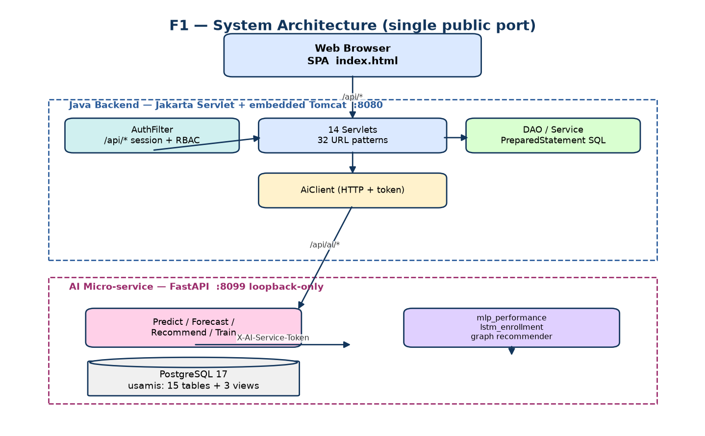
Architecture
One public port; AI reached only through the backend

Slide 4
Modules M-01 … M-10
10 modules, 34 functional requirements
# | Module | Users
M-01 | Authentication & Authorization | all
M-02 | User & Role Management | admin
M-03 | Student Records | admin, registrar
M-03 | Course Catalog → M-04 | admin, registrar
M-05 | Enrollment | admin, registrar
M-06 | Grades & Transcripts | admin, lecturer
M-07 | Fees & Payments | admin, finance
M-08 | Reports & Dashboard | admin, registrar, finance
M-09 | System Audit Log | admin
M-10 | AI Decision Support | all staff; student self-scoped

Slide 5
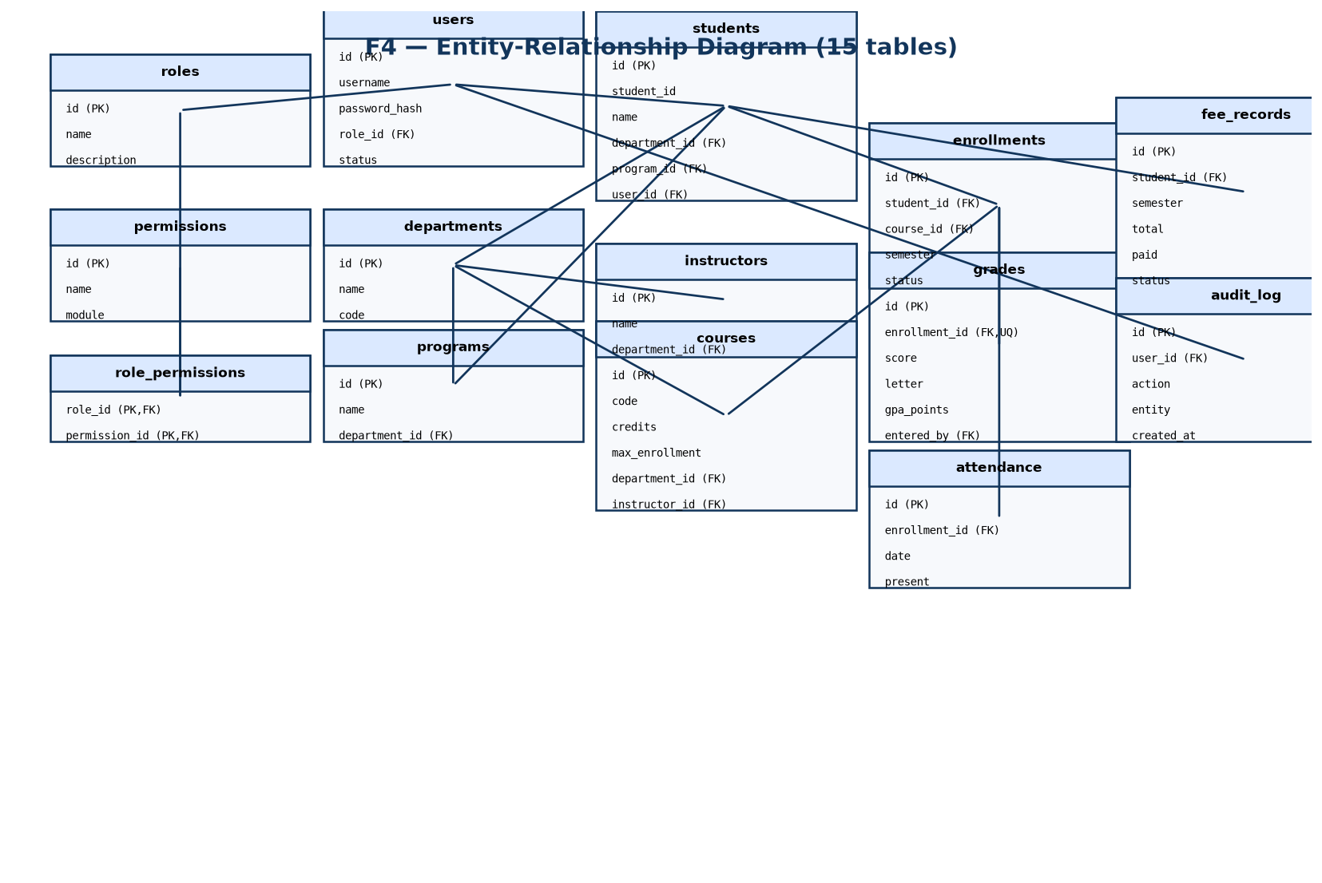
Data model
3NF · 15 tables · 21 foreign keys · 3 computed views

Slide 6
Security — defence in depth
Verified, not assumed
Layer | Mechanism
Credentials | BCrypt (cost 12), no plaintext
Session | HttpOnly, SameSite=Strict, 60-min TTL
Access | AuthFilter + per-servlet RBAC; 5 roles / 13 permissions
Database | 21 FKs, UNIQUE/CHECK constraints, parameterized SQL
Anti-IDOR | students self-scoped on every endpoint
Audit | append-only; denials recorded
AI isolation | loopback-only, token-gated, fail-closed 503

Slide 7
AI Decision Support (M-10)
Isolated FastAPI service, real metrics
Model | Metric | Value
mlp_performance | R² | 0.7573
mlp_performance | MAE / RMSE | 5.0688 / 6.3194
mlp_performance | Risk precision / recall / F1 | 0.8185 / 0.9055 / 0.8598
lstm_enrollment | val RMSE (scaled) | 0.24971
• Trained on a synthetic generator (disclosed); threshold = 60.
• Graceful degradation: AI down → /api/ai/* 503, rest of app unaffected.

Slide 8
Verification
Every number from a run
Suite | Result
smoke-test.ps1 | 23 / 23 PASS
verify-ai.py | 19 / 19 PASS
pytest | 14 / 14 PASS
Total | 56 / 56 PASS
RBAC per role | verified
IDOR probes | no leaks
• Verdict: READY for course scope.
• Build compiles; single-port AI works end to end.

Slide 9
Conclusion
• A genuine MIS: collects, processes, transforms, distributes, protects academic information.
• Meets the SRS, extended by the AI module (M-10).
• 56/56 automated checks; RBAC + anti-IDOR verified live.
• Single public port; AI isolated, token-gated and fail-closed.
• Honest limitations disclosed (synthetic training data; no saved ROC artifacts).

