Slide 1
USAMIS
Four-layer academic management
OpenCV QR attendance and early academic-risk modelling
Yaseen Hussain • 2422486012
Jinling Institute of Technology
30 October 2026
USAMIS / 1
Notes:
Introduce the project as university academic management. Explain that the updated presentation covers the four logical software layers and a visual QR plus deep-learning demonstration.
Source: https://github.com/ISI0007/USAMIS-PROJECT-Python-/tree/492517e6a32d1ded0f7176460c9283d8afd5035e
Local upgrade: docs/FOUR_LAYER_UPGRADE.md, app/algorithms/neural_risk.py, app/algorithms/qr_decoder.py.

Slide 2
Project purpose and scope
Centralize student records, enrollment, grades, attendance and fees.
Give each role the permissions and records needed for its work.
Make attendance capture visible and demonstrate a trained neural network.
Keep official academic decisions governed by rules and staff review.
USAMIS / 2
Notes:
Explain the original problem: scattered records, duplicate enrollment and weak access control. The extension supports the existing academic workflow. Parent is a sixth role in current code, beyond the original five-role report.
Source: https://github.com/ISI0007/USAMIS-PROJECT-Python-/tree/492517e6a32d1ded0f7176460c9283d8afd5035e
Local upgrade: docs/FOUR_LAYER_UPGRADE.md, app/algorithms/neural_risk.py, app/algorithms/qr_decoder.py.

Slide 3
Four logical software layers
1 PRESENTATION
Templates, forms, dashboards and QR upload
2 APPLICATION
Flask routes, authentication, permissions and HTTP
3 ACADEMIC PROCESSING AND ALGORITHMS
Academic rules, OpenCV decoding and neural modelling
4 DATA
SQLAlchemy, repositories, PostgreSQL and model artifacts
USAMIS / 3
Notes:
These layers share one Flask deployment. Layer 3 is Academic Processing and Algorithms. Security checks occur at the application boundary; database constraints remain authoritative. Legacy routes sometimes query ORM models directly, so do not claim a fully strict adjacent-only dependency architecture.
Source: https://github.com/ISI0007/USAMIS-PROJECT-Python-/tree/492517e6a32d1ded0f7176460c9283d8afd5035e
Local upgrade: docs/FOUR_LAYER_UPGRADE.md, app/algorithms/neural_risk.py, app/algorithms/qr_decoder.py.

Slide 4
Layer 1: Presentation
Purpose: collect user input and explain the returned result.
Screens: login, academic pages, QR scanner and model comparison.
Input: forms or QR image. Output: confirmation, records or model score.
Code: app/templates/ and app/static/.
Independent check: every Jinja template parses without a running server.
USAMIS / 4
Notes:
Input is not trusted merely because the browser validates it. The server repeats checks. Mention app/templates/attendance/scanner.html and app/templates/predictions/neural.html.
Source: https://github.com/ISI0007/USAMIS-PROJECT-Python-/tree/492517e6a32d1ded0f7176460c9283d8afd5035e
Local upgrade: docs/FOUR_LAYER_UPGRADE.md, app/algorithms/neural_risk.py, app/algorithms/qr_decoder.py.

Slide 5
Layer 2: Application
Purpose: receive requests and control who may perform an action.
Flask routes check authentication, role permissions and CSRF.
The controller calls processing services and returns HTML or errors.
Code: feature blueprints, security decorators and neural_views.py.
Independent check: HTTP success, denied access and invalid-input tests.
USAMIS / 5
Notes:
Show an example POST route. The controller checks identity and permission, then invokes Layer 3. The new neural route never runs training during a web request.
Source: https://github.com/ISI0007/USAMIS-PROJECT-Python-/tree/492517e6a32d1ded0f7176460c9283d8afd5035e
Local upgrade: docs/FOUR_LAYER_UPGRADE.md, app/algorithms/neural_risk.py, app/algorithms/qr_decoder.py.

Slide 6
Layer 3: Academic Processing and Algorithms
Algorithm | Academic purpose | Type
Enrollment eligibility | Status, prerequisites, capacity | Rules
Grade and GPA | Published-grade calculations | Rules
Fee balance | Decimal-safe balances | Rules
QR decoding and validation | Read image; validate session | Computer vision + rules
Logistic regression | Predictive comparison | Machine learning
4–32–16–1 neural network | Early academic-risk experiment | Deep learning
USAMIS / 6
Notes:
This is the computation layer requested by the teacher. Services orchestrate the work; algorithm modules do not import Flask or SQLAlchemy. OpenCV QRCodeDetector detects and decodes QR pixels: https://docs.opencv.org/4.x/de/dc3/classcv_1_1QRCodeDetector.html
Source: https://github.com/ISI0007/USAMIS-PROJECT-Python-/tree/492517e6a32d1ded0f7176460c9283d8afd5035e
Local upgrade: docs/FOUR_LAYER_UPGRADE.md, app/algorithms/neural_risk.py, app/algorithms/qr_decoder.py.

Slide 7
Layer 4: Data
Purpose: persist records and enforce relational integrity.
PostgreSQL stores 22 application tables with keys and constraints.
SQLAlchemy models and migrations define the academic schema.
Risk repository reads dated CSV and saves a versioned JSON model.
Independent check: SQL execution, fresh migrations and schema comparison.
USAMIS / 7
Notes:
The actual implementation has 22 application tables. User roles are stored in users.role; the older multi-role ER diagram should be replaced. Model JSON and dated CSV are file-backed repositories, not PostgreSQL training-history tables.
Source: https://github.com/ISI0007/USAMIS-PROJECT-Python-/tree/492517e6a32d1ded0f7176460c9283d8afd5035e
Local upgrade: docs/FOUR_LAYER_UPGRADE.md, app/algorithms/neural_risk.py, app/algorithms/qr_decoder.py.

Slide 8
QR attendance through all four layers
1
Student uploads QR image
2
Route checks identity and CSRF
3
OpenCV decodes; service validates
4
PostgreSQL records attendance
The result returns to the student’s attendance page.
USAMIS / 8
Notes:
Teacher opens a session. The student signs in and submits a photo or image. OpenCV extracts the token without following the decoded URL. HMAC verification, expiry and enrollment checks precede a database write. An ordinary camera link now asks for POST confirmation.
Source: https://github.com/ISI0007/USAMIS-PROJECT-Python-/tree/492517e6a32d1ded0f7176460c9283d8afd5035e
Local upgrade: docs/FOUR_LAYER_UPGRADE.md, app/algorithms/neural_risk.py, app/algorithms/qr_decoder.py.

Slide 9
What makes the QR demonstration meaningful
OpenCV reads actual pixels from a photograph or saved QR image.
A signed, expiring code identifies the lecturer’s course session.
The server rejects tampered codes and students outside the course.
Repeated scans keep one attendance record for that course and day.
The uploaded image stays in memory and is not saved.
USAMIS / 9
Notes:
This feature is image decoding rather than deep learning. It demonstrates acquisition, validation and persistence. Do not claim QR proves physical presence: an active code can be shared. The application does not store the uploaded image.
Source: https://github.com/ISI0007/USAMIS-PROJECT-Python-/tree/492517e6a32d1ded0f7176460c9283d8afd5035e
Local upgrade: docs/FOUR_LAYER_UPGRADE.md, app/algorithms/neural_risk.py, app/algorithms/qr_decoder.py.

Slide 10
Deep learning: early academic-risk network
4 inputs
32 ReLU units
16 ReLU units
1 sigmoid
→
→
→
Previous average • attendance • early assessment • credit load
Target: a later failure outcome after the recorded snapshot date
Advisory experiment. No automatic changes to academic records.
USAMIS / 10
Notes:
This is a trainable multilayer perceptron implemented in NumPy. Hidden layers use ReLU; output uses sigmoid. Backpropagation minimizes binary cross-entropy with L2 regularization. Architecture is a project design choice. Keras structured-data examples: https://keras.io/examples/structured_data/
Source: https://github.com/ISI0007/USAMIS-PROJECT-Python-/tree/492517e6a32d1ded0f7176460c9283d8afd5035e
Local upgrade: docs/FOUR_LAYER_UPGRADE.md, app/algorithms/neural_risk.py, app/algorithms/qr_decoder.py.

Slide 11
Training data and evaluation design
600 synthetic student snapshots for a reproducible classroom experiment.
359 training students, 120 validation students and 121 test students.
Fit normalization on training data only; stop using validation loss.
Compare against logistic regression using the same features and splits.
Use observed historical outcomes before claiming institutional accuracy.
USAMIS / 11
Notes:
One snapshot per student. Data owners must ensure features were actually available at snapshot time; dates alone cannot prove that. Minimum-row checks are software guards, not adequate-sample guarantees. A later-cohort evaluation remains necessary.
Source: https://github.com/ISI0007/USAMIS-PROJECT-Python-/tree/492517e6a32d1ded0f7176460c9283d8afd5035e
Local upgrade: docs/FOUR_LAYER_UPGRADE.md, app/algorithms/neural_risk.py, app/algorithms/qr_decoder.py.

Slide 12
Held-out results on synthetic data
Model | Validation F1 | Test precision | Test recall | Test F1
Logistic regression | 0.772 | 0.725 | 0.806 | 0.763
Neural network | 0.750 | 0.754 | 0.839 | 0.794
Validation selects logistic regression for this experiment.
Both models remain available for comparison. These results are synthetic.
USAMIS / 12
Notes:
These are measured results from the fixed-seed classroom simulation, not real-student accuracy. Validation F1 selected logistic regression. Do not change that decision using the test set. Neural test F1 is higher in this particular split, but its validation score is lower.
Source: https://github.com/ISI0007/USAMIS-PROJECT-Python-/tree/492517e6a32d1ded0f7176460c9283d8afd5035e
Local upgrade: docs/FOUR_LAYER_UPGRADE.md, app/algorithms/neural_risk.py, app/algorithms/qr_decoder.py.

Slide 13
SQL integrity and schema corrections
22 application tables share the same SQLAlchemy schema definition.
Avatar column now belongs to an explicit migration.
Application startup no longer changes database structure.
QR-token uniqueness now matches between models and migrations.
SQL dump restored successfully; all table counts match.
USAMIS / 13
Notes:
Both a generated schema.sql bootstrap and the migration chain were executed in separate empty PostgreSQL databases. Alembic metadata comparison returned no differences in each. This checks schema consistency, not every conceivable concurrency or production issue.
Source: https://github.com/ISI0007/USAMIS-PROJECT-Python-/tree/492517e6a32d1ded0f7176460c9283d8afd5035e
Local upgrade: docs/FOUR_LAYER_UPGRADE.md, app/algorithms/neural_risk.py, app/algorithms/qr_decoder.py.

Slide 14
Independent checks and complete workflows
Scope | Evidence
Layer 1 | All Jinja templates parse
Layer 2 | Login, permissions, HTTP errors and responses
Layer 3 | Neural learning, serialization and QR pixel decoding
Layer 4 | PostgreSQL persistence; successful full SQL restore
Complete workflows | Image upload to saved attendance; form to model result
USAMIS / 14
Notes:
Explain isolation: Layer 1 compiles without a web server; pure Layer 3 algorithms train/decode without a database; Layer 4 uses a disposable PostgreSQL database. HTTP integration tests join all four. See scripts/verify_layers.ps1 and docs/VERIFICATION_2026_10_30.md for exact evidence.
Source: https://github.com/ISI0007/USAMIS-PROJECT-Python-/tree/492517e6a32d1ded0f7176460c9283d8afd5035e
Local upgrade: docs/FOUR_LAYER_UPGRADE.md, app/algorithms/neural_risk.py, app/algorithms/qr_decoder.py.

Slide 15
What is already done and what is new
EXISTING FOUNDATION
Academic records, enrollment, grades, attendance, fees, roles, audit logs, parent portal and QR session links.
THIS UPGRADE
OpenCV image scanner, neural experiment, held-out comparison, schema corrections and a four-layer explanation.
USAMIS / 15
Notes:
Distinguish inspected baseline functionality from the new work and test evidence. Existing adapters may use stub providers. Do not imply external SMS or payment connections were verified.
Source: https://github.com/ISI0007/USAMIS-PROJECT-Python-/tree/492517e6a32d1ded0f7176460c9283d8afd5035e
Local upgrade: docs/FOUR_LAYER_UPGRADE.md, app/algorithms/neural_risk.py, app/algorithms/qr_decoder.py.

Slide 16
Best-fit additions and later options
Option | Recommendation | Reason
OpenCV QR + neural experiment | Implement now | Visible academic workflow and measured complexity
Prerequisite graph planner | Next, if time permits | Useful course ordering without a training dataset
LSTM attendance sequence model | Defer | Needs genuine weekly histories and later outcomes
Face recognition / Transformer | Defer | Additional data and validation are not established
USAMIS / 16
Notes:
The recommended scope matches available academic tabular data and the teacher’s request. A prerequisite graph is a useful deterministic extension but is not implemented by this upgrade. LSTM requires longitudinal sequences. Face recognition is unnecessary for the current objective and introduces extra validation and data requirements.
Source: https://github.com/ISI0007/USAMIS-PROJECT-Python-/tree/492517e6a32d1ded0f7176460c9283d8afd5035e
Local upgrade: docs/FOUR_LAYER_UPGRADE.md, app/algorithms/neural_risk.py, app/algorithms/qr_decoder.py.

Slide 17
Remaining work before final submission
Replace the original report’s stale architecture, SQL and placeholders.
Use the report supplement and captured screens with 194 passing tests.
Rehearse the QR scan with the actual phone and classroom network.
Explain synthetic data honestly and collect historical data for future work.
USAMIS / 17
Notes:
The implementation is testable, but classroom preparation includes a physical-phone trial and synchronized report screenshots. A real historical dataset is required for any real-world predictive-performance claim. Keep these limitations explicit during the viva.
Source: https://github.com/ISI0007/USAMIS-PROJECT-Python-/tree/492517e6a32d1ded0f7176460c9283d8afd5035e
Local upgrade: docs/FOUR_LAYER_UPGRADE.md, app/algorithms/neural_risk.py, app/algorithms/qr_decoder.py.

Slide 18
Demonstration and viva sequence
1. Explain each layer and point to its code folder.
2. Scan a QR image, then show the saved attendance record.
3. Demonstrate a rejected code and a duplicate scan.
4. Compare neural and logistic results, then try an academic snapshot.
5. Explain the data limitations and the next validation step.
USAMIS / 18
Notes:
Suggested talk: 1) show the four-layer diagram; 2) log in as a teacher and open a session; 3) log in as the enrolled student and upload a QR image; 4) show the persisted attendance row; 5) open /predictions/neural as administrator; 6) compare the two models; 7) explain why synthetic evaluation is not real-world validation. The new algorithm has two hidden layers and learned weights; QR decoding itself is classical computer vision.
Source: https://github.com/ISI0007/USAMIS-PROJECT-Python-/tree/492517e6a32d1ded0f7176460c9283d8afd5035e
Local upgrade: docs/FOUR_LAYER_UPGRADE.md, app/algorithms/neural_risk.py, app/algorithms/qr_decoder.py.

Slide 19
Verified demonstration records
Academic data | Verified count
Students / teachers / illustrated profiles | 8 / 2 / 10
Courses / offerings / enrollments | 44 / 44 / 231
Grades / attendance records | 217 / 868
Synthetic snapshots / trained experiments | 600 / 1
Full tests / browser checks | 194 passed / 25 passed
USAMIS / 19
Notes:
Fictional demo records. The SQL export includes 600 research snapshots and a trained experiment; illustrated PNG files are shipped with the application and SQL stores their paths. All 194 automated tests passed, and 25 browser checks returned HTTP 200.
Source: https://github.com/ISI0007/USAMIS-PROJECT-Python-/tree/492517e6a32d1ded0f7176460c9283d8afd5035e
Local upgrade: docs/FOUR_LAYER_UPGRADE.md, app/algorithms/neural_risk.py, app/algorithms/qr_decoder.py.

Slide 20
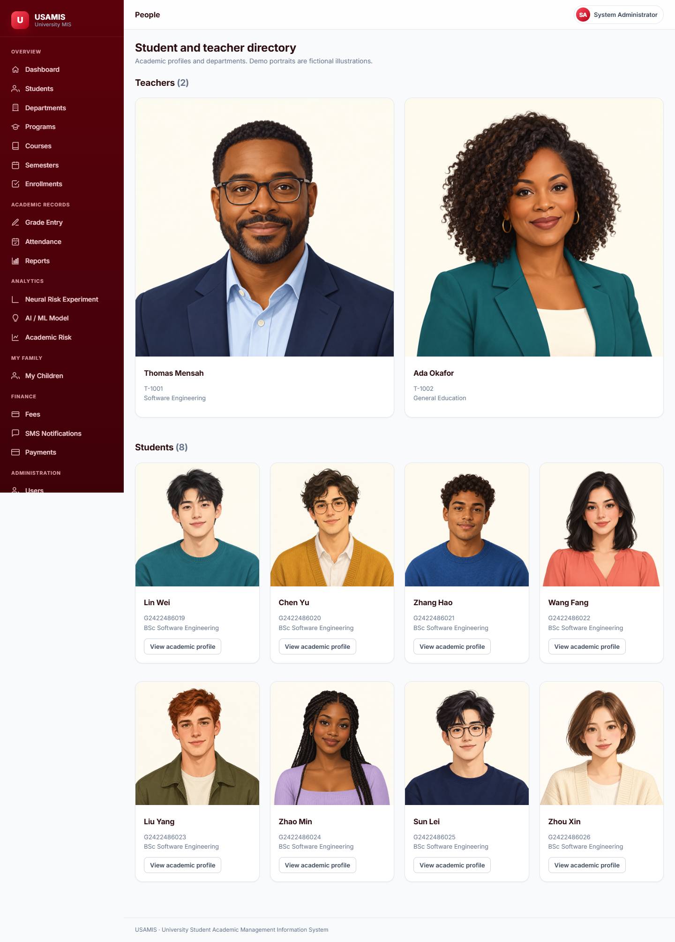
Fictional student and teacher profiles
All ten people have illustrated profile images.
USAMIS / 20
Notes:
Actual local preview screenshot captured 30 October 2026. All ten people have illustrated profile images.
Source: https://github.com/ISI0007/USAMIS-PROJECT-Python-/tree/492517e6a32d1ded0f7176460c9283d8afd5035e
Local upgrade: docs/FOUR_LAYER_UPGRADE.md, app/algorithms/neural_risk.py, app/algorithms/qr_decoder.py.

Slide 21
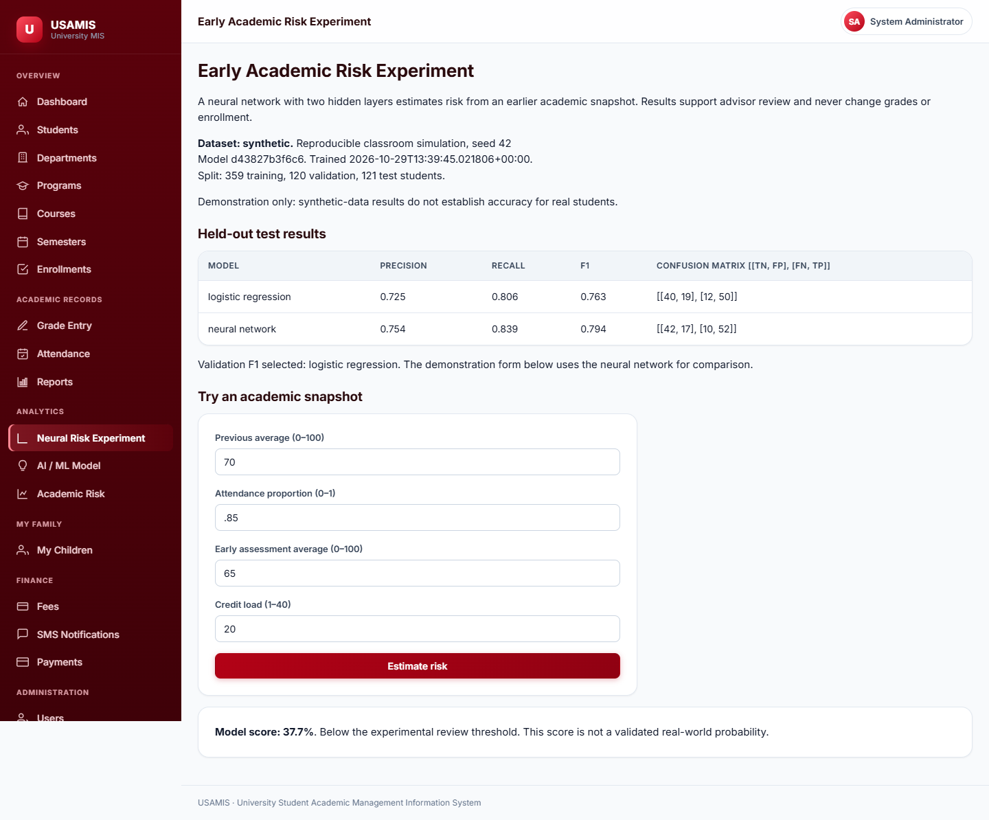
Trained neural experiment in the application
Measured comparison and an interactive academic snapshot.
USAMIS / 21
Notes:
Actual local preview screenshot captured 30 October 2026. Measured comparison and an interactive academic snapshot.
Source: https://github.com/ISI0007/USAMIS-PROJECT-Python-/tree/492517e6a32d1ded0f7176460c9283d8afd5035e
Local upgrade: docs/FOUR_LAYER_UPGRADE.md, app/algorithms/neural_risk.py, app/algorithms/qr_decoder.py.

Slide 22
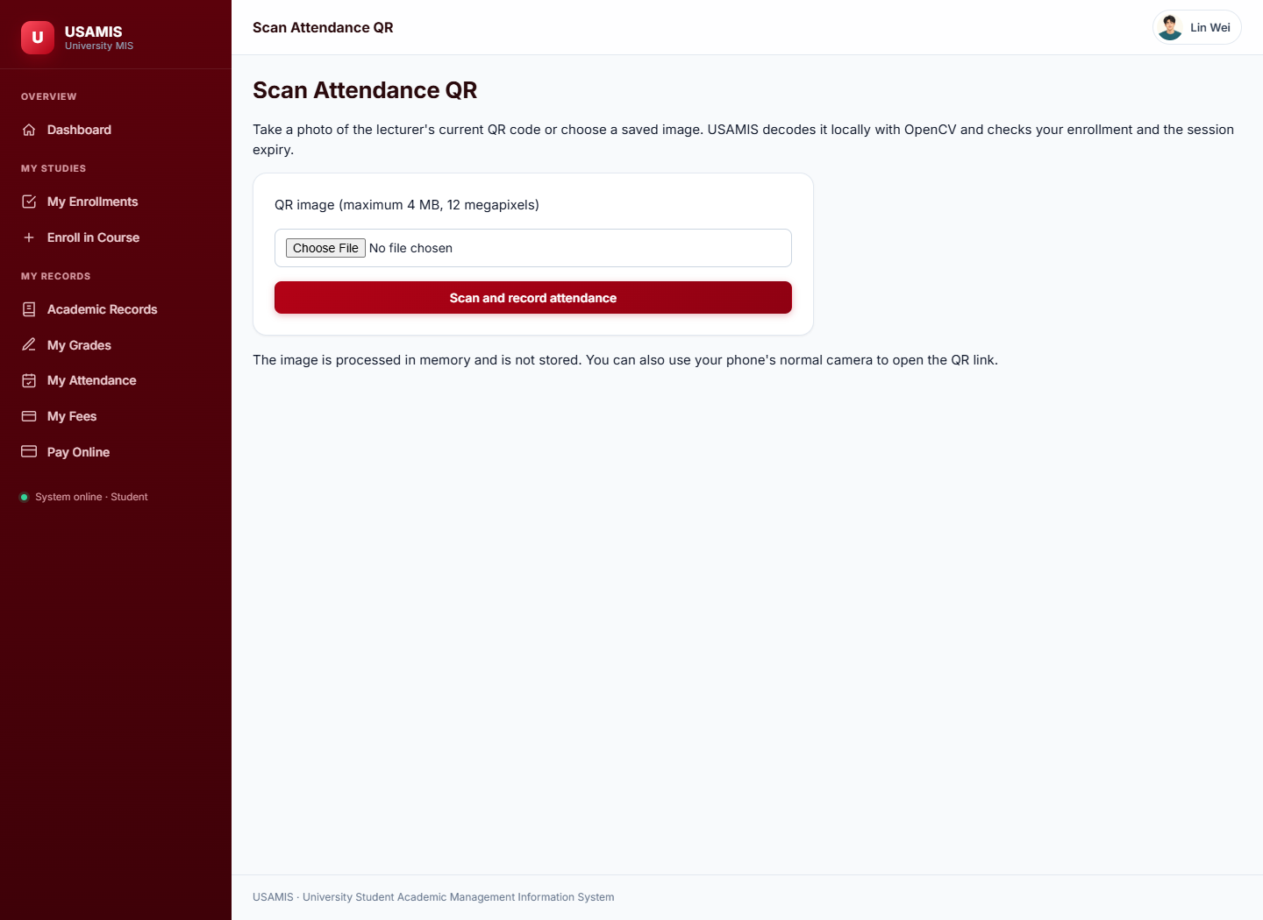
OpenCV attendance image upload
Signed session validation connects image decoding to attendance records.
USAMIS / 22
Notes:
Actual local preview screenshot captured 30 October 2026. Signed session validation connects image decoding to attendance records.
Source: https://github.com/ISI0007/USAMIS-PROJECT-Python-/tree/492517e6a32d1ded0f7176460c9283d8afd5035e
Local upgrade: docs/FOUR_LAYER_UPGRADE.md, app/algorithms/neural_risk.py, app/algorithms/qr_decoder.py.

