Slide 1
University Student Academic Management
Information System (USAMIS)
A Role-Based Management Information System using Python, Flask & PostgreSQL
USAMIS-Python · Yaseen Hussain · 2422486012 · 30 October 2026

Slide 2
Problem Statement
• Student records are scattered across paper and spreadsheets.
• No single authenticated entry point for staff roles.
• Duplicate and inconsistent data across departments.
• Management reports are slow to produce and error-prone.
• Weak control over who may view or edit records.
• Fee tracking and result processing are manual and unreliable.

Slide 3
Project Objectives
• Centralise all student academic records in one database.
• Provide one login for all roles with username + password.
• Enforce Role-Based Access Control (RBAC) on the server.
• Manage students, courses, enrollment, grades, attendance, fees.
• Prevent duplicate records and unauthorized access.
• Generate live management reports from real data.
• Maintain an audit log of sensitive actions.

Slide 4
Scope & User Roles
• Administrator — users, roles and audit log.
• Registrar — student records, courses and enrollment.
• Teacher — grades, attendance and QR sessions.
• Finance officer — fee assessments and payments.
• Student and parent — authorized academic information.
• Fictional demo profiles include eight students and two teachers.

Slide 5
Technology Stack
Layer | Technology
Language | Python 3.11
Framework | Flask (application factory, blueprints)
ORM | SQLAlchemy 2.0 / Flask-SQLAlchemy
Migrations | Flask-Migrate / Alembic
Database | PostgreSQL 17
Auth / Forms | Flask-Login, Flask-WTF, Werkzeug hashing
UI | HTML5, CSS3, vanilla JavaScript
Testing | pytest, pytest-cov

Slide 6
System Architecture
Figure 2 — four logical layers within one Flask application.

Slide 7
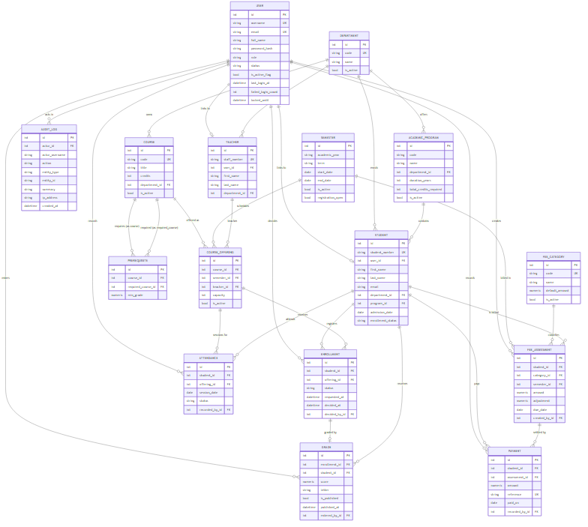
Database ER Diagram
Figure 3 — original core ER diagram; the current schema also includes research tables.

Slide 8
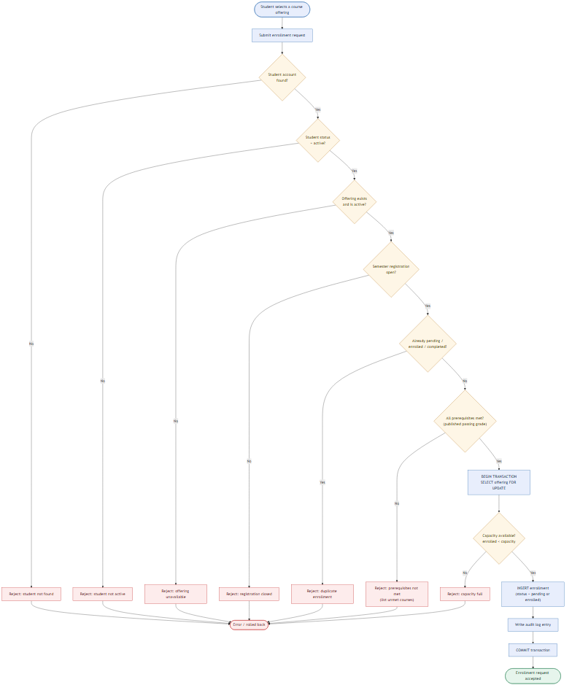
Enrollment Process Flowchart
Figure 4 — Algorithm 1 with explicit rejection paths.

Slide 9
Academic Algorithms and Deep Learning
• Enrollment: student status, prerequisites and capacity.
• Grades and GPA: credit-weighted academic results.
• Fees: decimal-safe assessments and payments.
• OpenCV: decode a QR image; validate the signed attendance session.
• Neural network: 4 inputs → 32 → 16 → 1 for an academic-risk experiment.
• Logistic regression provides a simpler comparison.

Slide 10
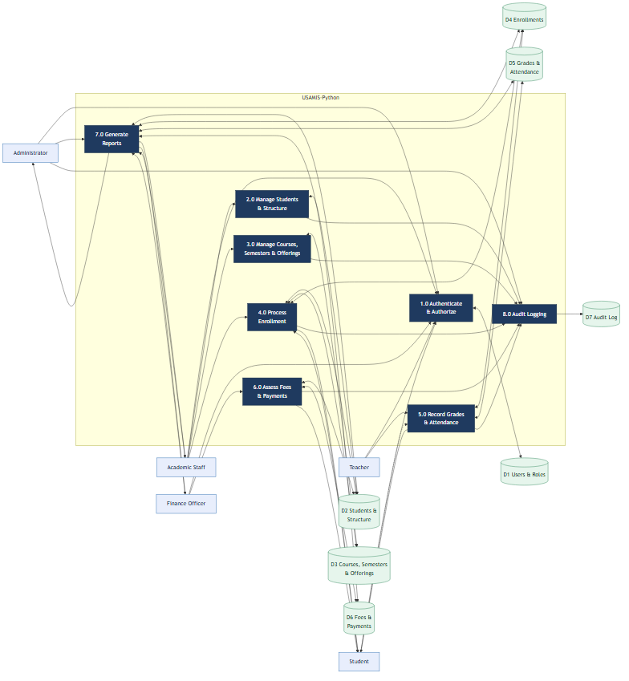
Data Flow Diagram
Figure 5 — movement of requests and academic data between actors, processes, and stores.

Slide 11
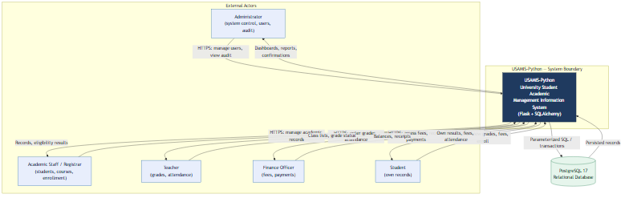
System Context
Figure 1 — USAMIS and its external actors and database.

Slide 12
Security & Access Control
• Passwords stored as salted hashes (Werkzeug).
• CSRF protection on all state-changing forms.
• Server-side RBAC on every protected endpoint.
• Ownership checks: students see only their own records.
• Login throttling plus account lockout after failures.
• Parameterized ORM queries — no SQL string concatenation.
• Audit logging of sensitive actions.
• Security headers; no debug mode in production.

Slide 13
Testing Methodology & Results
• PostgreSQL-backed unit, integration and security tests.
• Four layer responsibilities checked independently.
• Complete QR and neural-form workflows tested.
• Full suite: 194 passed, 0 failed.
• SQL dump restored into an empty database with matching counts.
• Browser checks covered administrator, teacher, student and parent.

Slide 14
Limitations & Future Work
• The neural experiment uses 600 synthetic snapshots.
• Synthetic results do not prove accuracy for real students.
• QR decoding is computer vision; the neural network is deep learning.
• A physical-phone classroom trial remains to be completed.
• External payment and SMS delivery were not tested.
• Future work: real historical data and production deployment.

Slide 15
Conclusion
• Centralised, role-based academic information system.
• Four clear code folders: frontend, backend, algorithms and database.
• OpenCV QR attendance and a trained neural-network experiment.
• Ten illustrated fictional profiles and a complete SQL demo dataset.
• 194 automated tests passed.
• Thank you — questions and demonstration.

