Slide 1
UNIVERSITY STUDENT ACADEMIC MANAGEMENT INFORMATION SYSTEM
USAMIS — Four-Layer Architecture
QR attendance with OpenCV image decoding and an early academic-risk neural experiment
Jinling Institute of Technology · Python 3.11 · Flask · PostgreSQL 17 · 30 October 2026

Slide 2
Agenda
What this deck covers
1
Project overview and scope
2
The four logical layers
3
Layer 3 — academic processing and algorithms
4
Request trace: OpenCV QR attendance
5
Request trace: neural risk experiment
6
Model architecture, training and evaluation
7
Verification evidence
8
Limitations and next steps
USAMIS · Jinling Institute of Technology
02

Slide 3
01
Project Overview
A role-based academic management information system, extended with computer vision and a research-grade neural experiment.
USAMIS · Jinling Institute of Technology
03

Slide 4
What USAMIS Does
One Flask application serving five academic roles
▪ Enrolment, academic history, attendance, fees and results in one place
▪ Departments, programmes, courses, semesters and course offerings
▪ Deterministic eligibility rules, credit-weighted GPA, published results
▪ QR session links plus photographed-code decoding with OpenCV
▪ Decimal-safe assessment, payment records and outstanding balances
▪ Generated reports, exports and an immutable audit log
USAMIS · Jinling Institute of Technology
04

Slide 5
The System at a Glance
Measured on the completed demonstration build
22
194
24
6
application tables
automated tests passed
web pages verified 200
implemented roles
Roles: Administrator, Registrar, Teacher, Finance Officer, Student and Parent. The parent portal reads a linked student's record and never writes academic data.
USAMIS · Jinling Institute of Technology
05

Slide 6
Scope Discipline
What was added and what was deliberately not
▪ OpenCV image scanning, QR POST confirmation, independent neural experiment, logistic comparison, artefact persistence
▪ Deterministic enrolment, grade/GPA and fee algorithms — official records must follow institutional rules
▪ LSTM until genuine weekly sequences exist; face recognition without a validated requirement
▪ Transformers until data scale justifies the complexity
▪ Consented historical snapshots, later-cohort evaluation, calibration checks, human review of alerts
USAMIS · Jinling Institute of Technology
06

Slide 7
02
The Four Layers
Logical responsibilities inside a single Flask process — not four separately deployed servers.
USAMIS · Jinling Institute of Technology
07

Slide 8
Layer Responsibilities
Each layer carries independent evidence
Layer
Responsibility
Code
Evidence
1. Presentation
Render pages, collect input, display results
app/frontend/templates, static
Templates compile; pages inspected
2. Application
Route requests, authenticate, authorise, adapt forms
Flask blueprints, security/
HTTP, auth and invalid-input tests
3. Academic Processing
Apply policy, orchestrate, decode QR, train and infer
backend/services, algorithms
Pure algorithm tests; real QR pixels
4. Data
Store and retrieve records and artefacts
database/models, repositories
Round-trip and persistence tests
USAMIS · Jinling Institute of Technology
08

Slide 9
Why Four Layers Matters
Separation that is checkable, not just claimed
No framework leakage
Repositories, not queries
Honest boundaries
Layer 3 algorithms contain no Flask, SQLAlchemy or PostgreSQL imports. They are testable as pure functions.
New code reaches the database through repositories. The neural route calls a service, which calls its repository.
Some legacy Flask routes still query the ORM directly. The architecture is a practical separation, not a purity claim.
Independent evidence
Compile without a server
Audit by construction
Each layer has its own verification scope in verify_layers.ps1, plus integrated request tests on top.
All Jinja templates compile standalone, proving Layer 1 is not entangled with a running application.
Every sensitive operation writes an audit row in Layer 4 as part of the same transaction.
USAMIS · Jinling Institute of Technology
09

Slide 10
03
Layer 3 — Algorithms
Deterministic policy for official records. Statistical models only for research and support.
USAMIS · Jinling Institute of Technology
10

Slide 11
Deterministic Algorithms
Explainable, reproducible, and auditable by an examiner
▪ Checks status, duplicates, prerequisites and capacity. No score, no probability — a rule outcome.
▪ Credit-weighted average of published grades, expressed on the institutional scale.
▪ Decimal-safe arithmetic with explicit status rules, avoiding floating-point drift.
▪ A student's official standing must be defensible to an appeal. Rules can be read, cited and corrected.
USAMIS · Jinling Institute of Technology
11

Slide 12
Probabilistic Components
Where statistical learning is appropriate — and where it is not
▪ Computer vision, emphatically not deep learning. A classical detector reads pixels from a photographed code.
▪ A trainable 4–32–16–1 network — this is the deep-learning component of the demonstration.
▪ The same implementation with no hidden layer. A fair, like-for-like baseline.
▪ No model changes a student's grades, enrolment or official academic standing. Ever.
USAMIS · Jinling Institute of Technology
12

Slide 13
04
QR Attendance
Acquire attendance reliably, from an image, with signature and replay protection.
USAMIS · Jinling Institute of Technology
13

Slide 14
Request Trace — OpenCV Attendance
One scan, four layers, six steps
▪ A signed-in student photographs or uploads the displayed QR image.
▪ The route checks login, the attendance permission and CSRF protection.
▪ OpenCV decodes the image; attendance logic verifies the HMAC signature, expiry, open session and enrolment.
▪ PostgreSQL stores the attendance row and an audit entry in one transaction.
▪ An existing daily record is updated, never duplicated — the operation is idempotent.
▪ The student sees confirmation and their attendance history.
USAMIS · Jinling Institute of Technology
14

Slide 15
Security Properties of Scanning
Deliberate constraints, stated plainly
Processed in memory
No URL following
POST confirms
The uploaded image is never persisted to disk. Decoding happens entirely in memory.
The decoder never follows a URL embedded in an uploaded QR code. Tampered codes are rejected.
An ordinary phone-camera QR link first shows a confirmation page. Only the POST writes attendance.
HMAC signed
Idempotent writes
Honest limitation
Session tokens are signed and time-limited, so a captured token cannot be replayed later.
A repeat scan updates the day's record rather than creating a second one.
Scanning does not prove physical presence, and cannot stop a student sharing an active code.
USAMIS · Jinling Institute of Technology
15

Slide 16
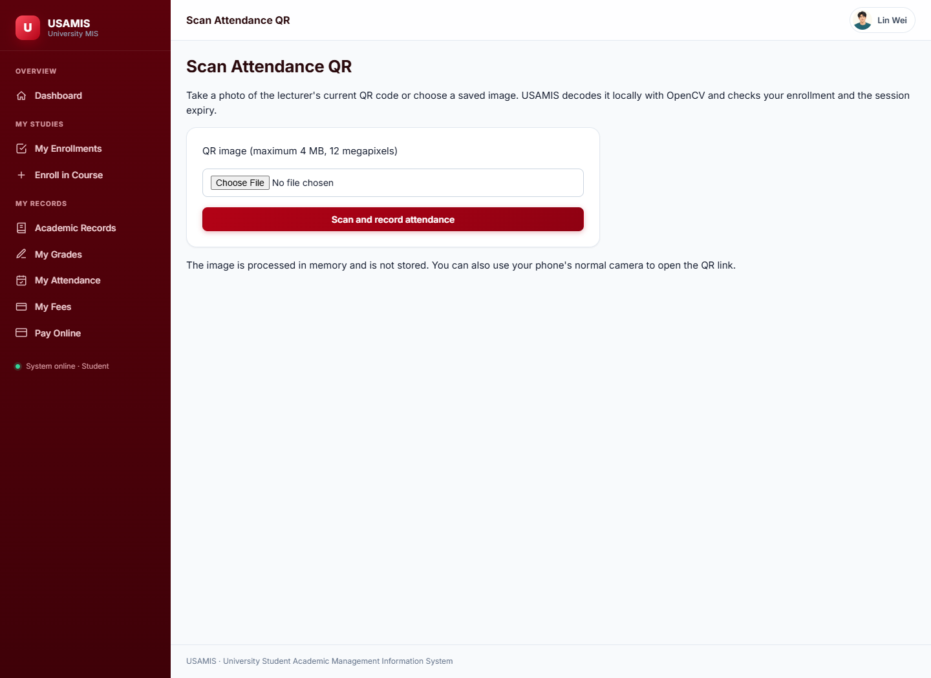
The Student Scanner
Photograph upload with live confirmation
Student view at /attendance/scanner — upload or photograph a QR code to record attendance.
USAMIS · Jinling Institute of Technology
16

Slide 17
05
Neural Risk Experiment
Can earlier academic signals identify students who need support? A measured, honest investigation.
USAMIS · Jinling Institute of Technology
17

Slide 18
The Research Question, Framed Carefully
What this experiment does and does not claim
▪ Previous average (0–100), attendance proportion (0–1), early assessment average (0–100), credit load (1–40).
▪ failed_later — an outcome observed strictly after the snapshot date.
▪ Today's cumulative database records are never converted into historical training examples.
▪ The bundled generator creates labelled synthetic examples for teaching only.
▪ 60 rows and 15 per class are software minimums, not proof of statistical adequacy.
▪ A reproducible classroom demonstration — not a validated institutional predictor.
USAMIS · Jinling Institute of Technology
18

Slide 19
Model Architecture
A small network, chosen for explainability over complexity
Element
Design choice
Rationale
Input layer
4 numeric features
Only signals available at the snapshot date
Hidden layer 1
32 ReLU units
Sufficient capacity for a small tabular problem
Hidden layer 2
16 ReLU units
Progressive compression before the decision
Output
1 sigmoid unit
Produces a probability-like score in [0,1]
Comparator
No hidden layer
Identical implementation — this is logistic regression
Implementation
NumPy backpropagation
No framework dependency; fully inspectable
USAMIS · Jinling Institute of Technology
19

Slide 20
Training Configuration
Fixed for reproducibility
42
0.03
1,200
80
random seed
learning rate
max epochs
early-stop patience
Loss: binary cross-entropy with L2 regularisation. Best validation-loss weights are restored. Normalisation is fitted on training data only — never on validation or test.
USAMIS · Jinling Institute of Technology
20

Slide 21
Evaluation Protocol
Designed so the test set cannot influence model choice
▪ Stratified approximately 60/20/20 across distinct students.
▪ Prevents the same student's examples appearing in both training and test groups.
▪ The comparator is chosen on validation only.
▪ The test group is reported afterwards and does not select the model.
▪ Precision, recall, F1, accuracy, confusion matrix and Brier score.
▪ Scores are not established as calibrated real-world probabilities.
USAMIS · Jinling Institute of Technology
21

Slide 22
Request Trace — Neural Inference
Layer 2 validates, Layer 3 computes, Layer 4 loads
Layer 1
Layer 2
Layer 3
Displays a research form and the held-out results table for comparison.
Permits users holding manage_students, validates the request and handles errors gracefully.
Validates four numerical inputs and performs forward inference.
Layer 4
Offline training
Persistence
Loads a versioned JSON artefact, with a PostgreSQL fallback if the file is absent.
Reads CSV snapshots and atomically saves the artefact — no partial writes.
risk_snapshots and risk_experiments store the dataset and trained bundle in SQL.
USAMIS · Jinling Institute of Technology
22

Slide 23
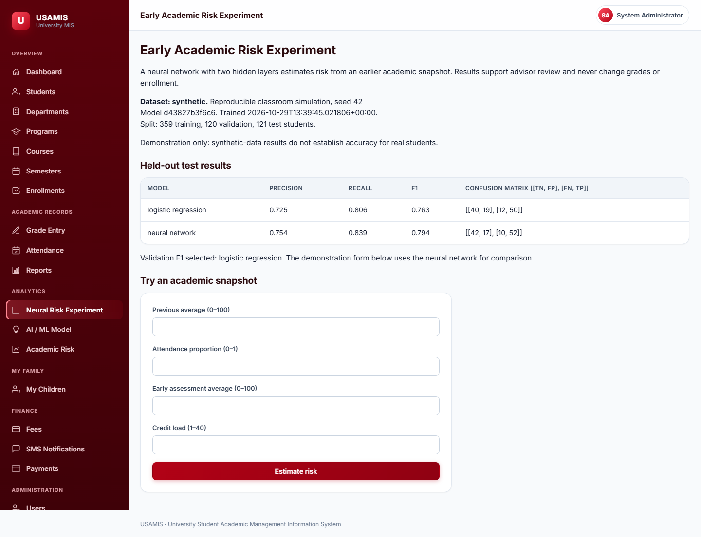
Admin — Neural Experiment
Research form and held-out model comparison
Administrator view at /predictions/neural.
USAMIS · Jinling Institute of Technology
23

Slide 24

Model Result
A single inference rendered for the user
Synthetic-data disclosure is shown alongside any score.
USAMIS · Jinling Institute of Technology
24

Slide 25
06
Verification
Claims backed by executed checks, not estimates.
USAMIS · Jinling Institute of Technology
25

Slide 26
Evidence
Recorded 30 October 2026 against the live build
194
0
4/4
25
tests passed
failures or skips
layer scopes passed
pages returned 200
Full PostgreSQL-backed suite ran in 68.01 seconds. Evidence file: instance/verification.xml. 24 pages plus one neural form submission verified across administrator, teacher, student and parent accounts.
USAMIS · Jinling Institute of Technology
26

Slide 27
What Was Actually Checked
Each item was executed, not assumed
▪ All four scopes in scripts/verify_layers.ps1 passed independently.
▪ Tests decode actual QR pixels, persist attendance, reject tampered codes, and confirm repeat scans are idempotent.
▪ Final migration metadata comparison returned an empty diff.
▪ The complete dump restored into a separate empty database; every table count matched.
▪ Eight student and two teacher profiles carry local fictional portraits — display assets, not training data.
▪ A physical-phone classroom trial remains outstanding.
USAMIS · Jinling Institute of Technology
27

Slide 28
Demonstration Database
Restored and row-counted
Entity
Count
Entity
Count
Students
8
Courses
44
Teachers
2
Course offerings
44
Departments
3
Enrolments
231
Semesters
8
Grades
217
Users
14
Attendance rows
868
Fee assessments
24
Payments
6
Research snapshots
600
Trained experiments
1
USAMIS · Jinling Institute of Technology
28

Slide 29
07
Limitations and Next Steps
Stated plainly, because a demonstration earns trust by naming its edges.
USAMIS · Jinling Institute of Technology
29

Slide 30
Honest Limitations
What this build does not establish
Synthetic metrics
No historical cohort
Not calibrated
Model scores come from generated data. They demonstrate method, not institutional truth.
Real prediction requires consented dated snapshots and later observed outcomes.
Brier score is reported, but scores are not validated probabilities.
Threshold unset
External providers
Physical trial pending
Choosing an operating threshold depends on advisor capacity — an institutional decision.
SMS and payment adapters exist; live services were not exercised. Demo records are labelled stub.
OpenCV decoding is tested on images, not yet in a live classroom.
USAMIS · Jinling Institute of Technology
30

Slide 31
Recommended Next Steps
In priority order
▪ Consented, dated, governance-approved data with later observed outcomes.
▪ Temporal validation is the only meaningful test of a predictor.
▪ Tune the decision boundary to the number of students advisors can actually support.
▪ A DAG with topological sorting can detect cycles and show a valid course order — high value, little data required.
▪ Consider richer sequence models once genuine weekly sequences exist.
USAMIS · Jinling Institute of Technology
31

Slide 32
Questions
USAMIS runs locally at http://127.0.0.1:5055 — a classroom demonstration with fictional people and synthetic training data.
Four layers, one process. Deterministic rules for official records. Statistical models for support, never authority.
194 tests passed. Four layer scopes verified. Every claim in this deck is reproducible from the repository.

