Slide 1
University Student Academic Management
Information System (USAMIS)
A Role-Based Management Information System using Python, Flask & PostgreSQL
USAMIS-Python · Version 1.0 · [Your Name] · [Student ID] · [Date]

Slide 2
Problem Statement
• Student records are scattered across paper and spreadsheets.
• No single authenticated entry point for staff roles.
• Duplicate and inconsistent data across departments.
• Management reports are slow to produce and error-prone.
• Weak control over who may view or edit records.
• Fee tracking and result processing are manual and unreliable.

Slide 3
Project Objectives
• Centralise all student academic records in one database.
• Provide one login for all roles with username + password.
• Enforce Role-Based Access Control (RBAC) on the server.
• Manage students, courses, enrollment, grades, attendance, fees.
• Prevent duplicate records and unauthorized access.
• Generate live management reports from real data.
• Maintain an audit log of sensitive actions.

Slide 4
Scope & User Roles
• Administrator — full control, users, audit log.
• Academic staff / Registrar — students, courses, enrollment.
• Teacher — grades and attendance for assigned courses.
• Finance officer — fee assessments and payments.
• Student — own profile, enrollment, grades, fees.
  – Out of scope: real payment gateway, admissions, AI/ML features.

Slide 5
Technology Stack
Layer | Technology
Language | Python 3.11
Framework | Flask (application factory, blueprints)
ORM | SQLAlchemy 2.0 / Flask-SQLAlchemy
Migrations | Flask-Migrate / Alembic
Database | PostgreSQL 17
Auth / Forms | Flask-Login, Flask-WTF, Werkzeug hashing
UI | HTML5, CSS3, vanilla JavaScript
Testing | pytest, pytest-cov

Slide 6
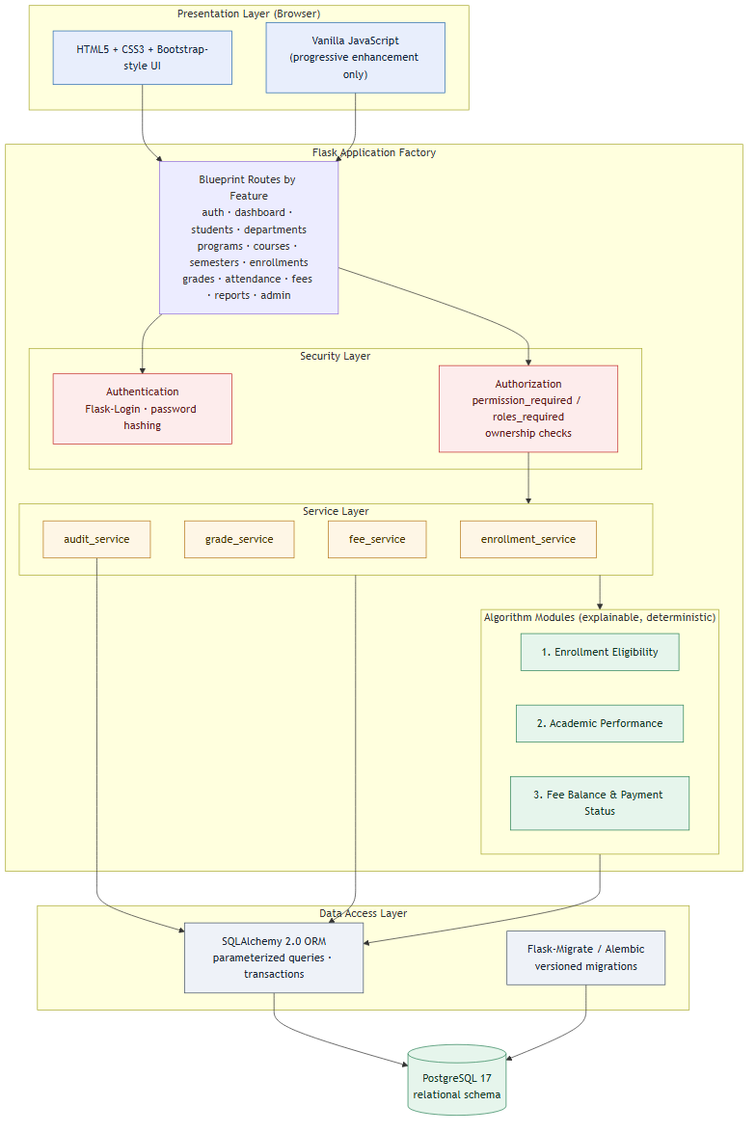
System Architecture
Figure 2 — layered architecture (blueprints, services, algorithms, data).

Slide 7
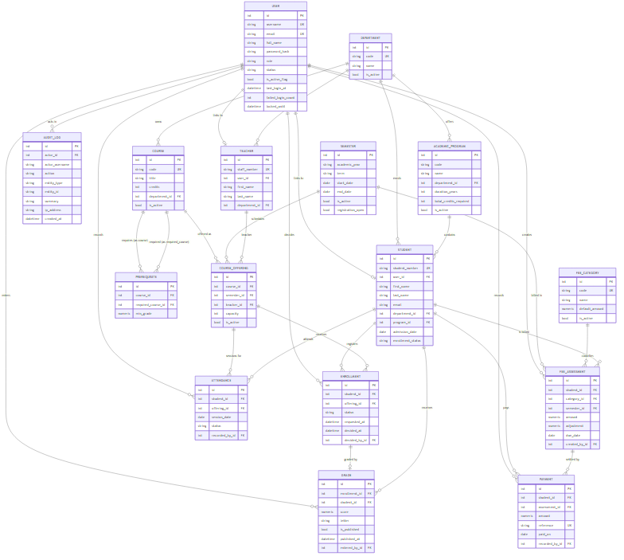
Database ER Diagram
Figure 3 — entity relationship diagram of the implemented schema.

Slide 8
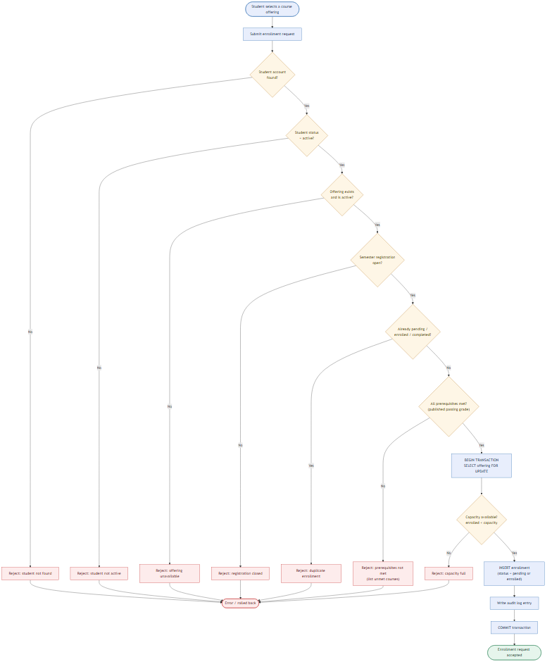
Enrollment Process Flowchart
Figure 4 — Algorithm 1 with explicit rejection paths.

Slide 9
Three Explainable Algorithms
• 1. Course Enrollment Eligibility — status, duplicates, prerequisites, capacity.
• 2. Academic Performance — credit-weighted average of published grades.
• 3. Fee Balance — assessments − adjustments − payments (decimal-safe).
  – Deterministic and unit-tested — not artificial intelligence.
  – Each returns structure: reason codes, notes, and computed detail.

Slide 10
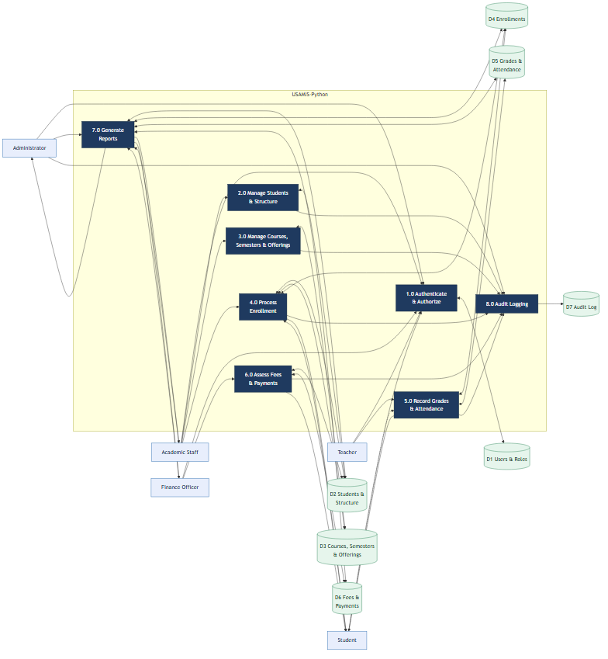
Data Flow Diagram
Figure 5 — movement of requests and academic data between actors, processes, and stores.

Slide 11
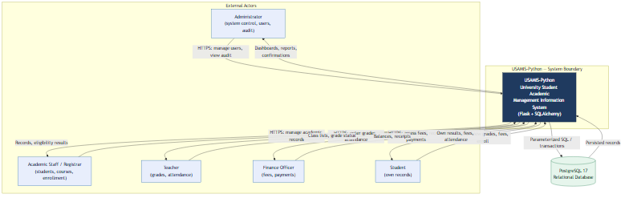
System Context
Figure 1 — USAMIS and its external actors and database.

Slide 12
Security & Access Control
• Passwords stored as salted hashes (Werkzeug).
• CSRF protection on all state-changing forms.
• Server-side RBAC on every protected endpoint.
• Ownership checks: students see only their own records.
• Login throttling plus account lockout after failures.
• Parameterized ORM queries — no SQL string concatenation.
• Audit logging of sensitive actions.
• Security headers; no debug mode in production.

Slide 13
Testing Methodology & Results
• pytest over a dedicated PostgreSQL test database.
• Unit, integration, and security test categories.
• Algorithms covered by dedicated unit tests.
• Negative security tests for access control.
• Actual result: 87 passed, 0 failed.
  – Six defects found and fixed during testing.

Slide 14
Limitations & Future Work
• Limitations:
  – Fee module records payments; it is not a payment gateway.
  – In-memory rate-limit storage by default.
• Future work:
  – Mobile client; email/SMS notifications.
  – Payment-gateway integration; QR attendance.
  – Cloud deployment with a shared rate-limit backend.

Slide 15
Conclusion
• Centralised, role-based academic management information system.
• Server-enforced access control with an audit trail.
• Three explainable algorithms, unit-tested.
• Tested (87 passing), documented, and reproducible.
• Delivered as working software with five verified diagrams.
  – Thank you — Questions & Demonstration.

