Slide 1
COMPUTER NETWORKS LABORATORY
PulseRoute
Move files.
Understand the network.
Go + React + Wails + SQLite
Implementation, verification and the remaining work
PULSEROUTE / 28 OCTOBER 2026 / ENGINEERING CHECKPOINT
01
Notes:
Introduce the project and state the evidence boundary immediately. The application is implemented in source and compiled, but current native execution is blocked by Smart App Control.

Slide 2
SCOPE
What the evidence supports
01
Earlier real loopback messaging and file-identity tests passed.
02
Current frontend, SQL schema and build checks pass.
03
Native runtime and LAN performance remain BLOCKED / NOT VERIFIED.
PULSEROUTE / 28 OCTOBER 2026 / ENGINEERING CHECKPOINT
02
Notes:
Do not describe compiled files as a fully tested application. Point to PROGRESS.md and the recorded evidence JSON.

Slide 3
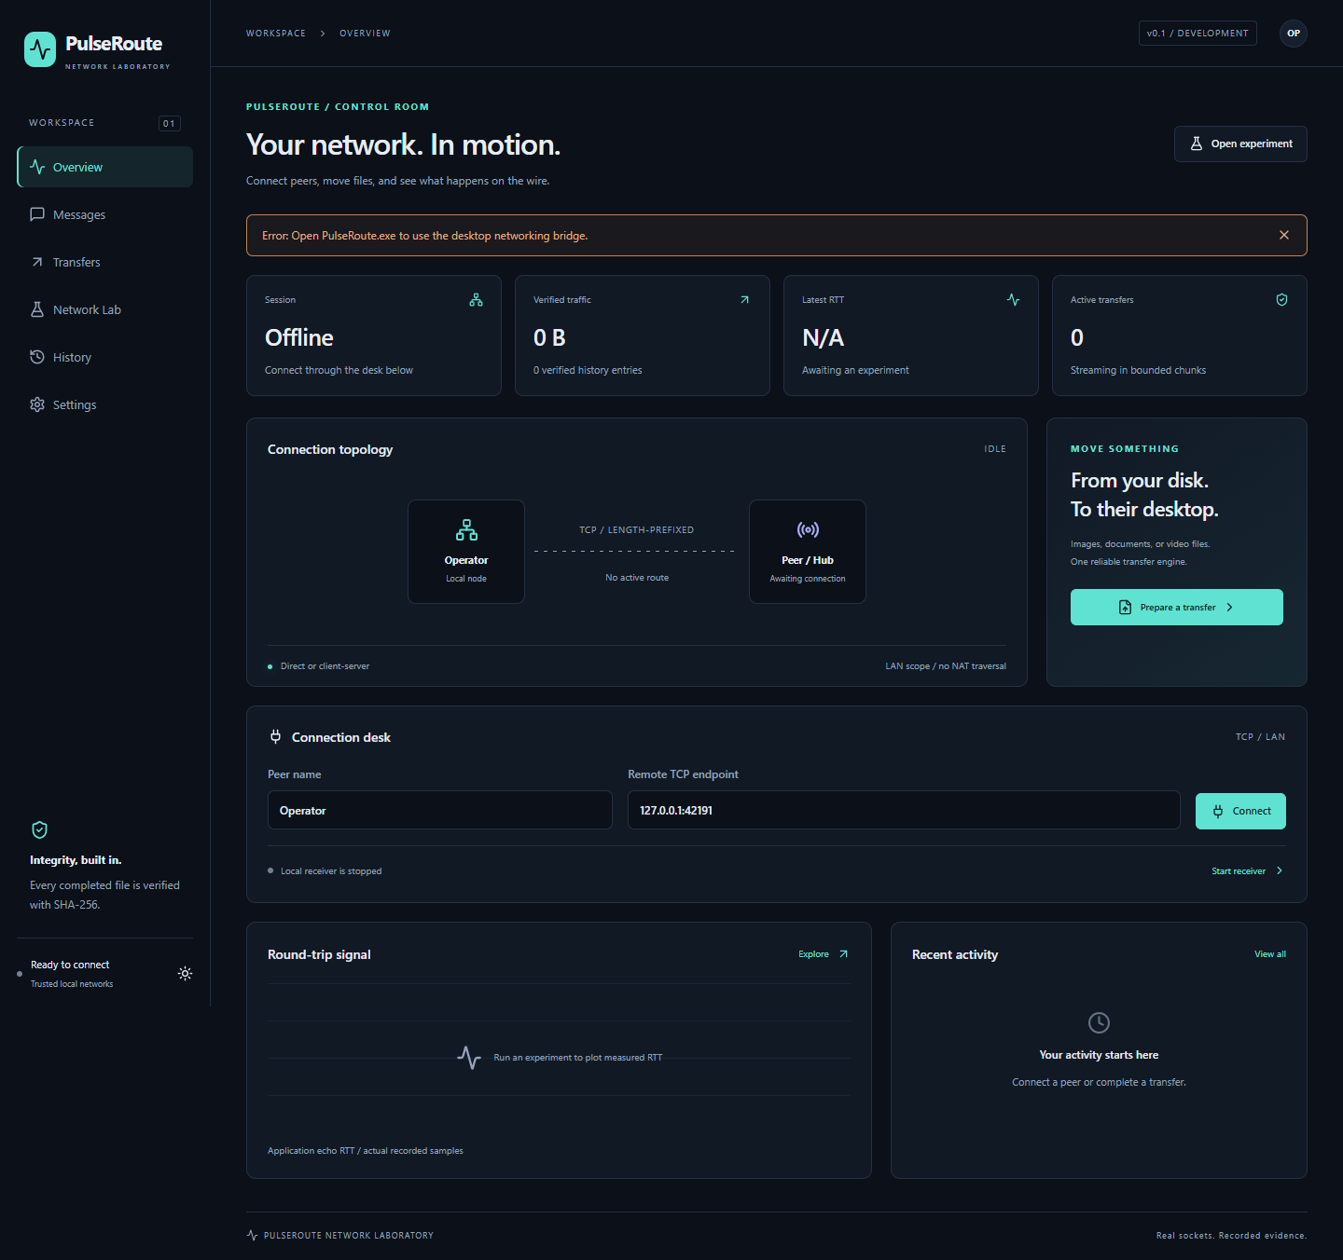
01 / FRONTEND
A workspace built around the flow
01
Six screens: overview, messages, transfers, lab, history, settings.
02
Desktop controls call exported Go service methods.
03
Dark/light styling, focus states and explicit errors.
PULSEROUTE / 28 OCTOBER 2026 / ENGINEERING CHECKPOINT
03
Notes:
Show the actual frontend screenshot. The bridge-unavailable banner is expected in browser-only verification and must not be hidden.

Slide 4
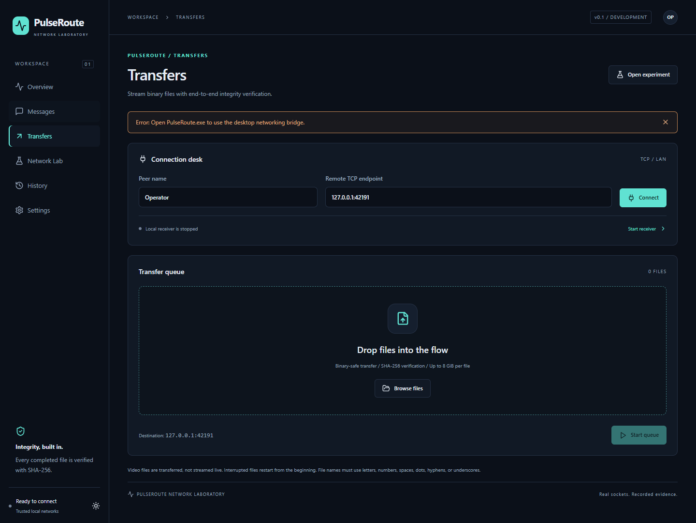
01 / FRONTEND
Queue, observe, verify
01
File picker and drop queue, then a destination endpoint.
02
Hashing, streaming, cancellation and final verification states.
03
Supported media preview; 16 MiB inline limit.
PULSEROUTE / 28 OCTOBER 2026 / ENGINEERING CHECKPOINT
04
Notes:
Explain that the screenshot is a frontend rendering. Live desktop file picker, cancellation and media playback still need approved runtime validation.

Slide 5
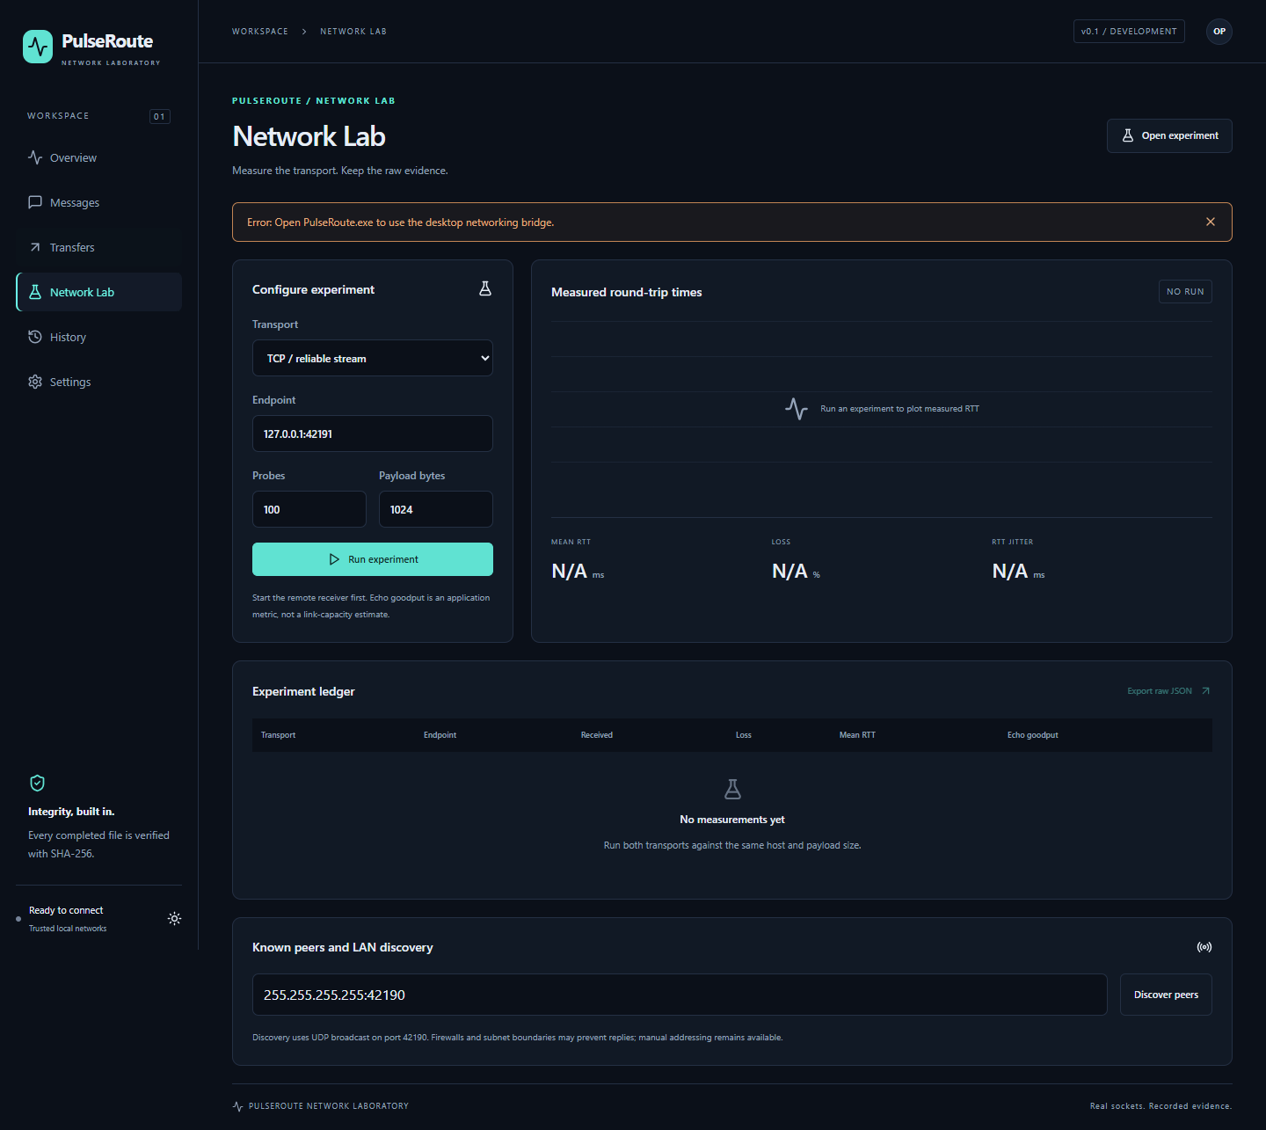
01 / FRONTEND
Measure with clear boundaries
01
TCP and UDP echo configuration share a laboratory view.
02
Charts render recorded samples only.
03
Export raw observations; empty charts remain empty.
PULSEROUTE / 28 OCTOBER 2026 / ENGINEERING CHECKPOINT
05
Notes:
There is no synthetic benchmark curve. The absence of data is intentional.

Slide 6
02 / BACKEND
One service, separate engines
bound methods
commands / progress
React + TypeScript UI
Wails service / lifecycle
TCP chat and file engine
TCP
Remote peer or hub
records
experiments
UDP
SQLite store
UDP / discovery engines
Editable implementation diagram. Verification limitations are recorded separately.
PULSEROUTE / 28 OCTOBER 2026 / ENGINEERING CHECKPOINT
06
Notes:
Use the architecture diagram to explain separation of concerns.

Slide 7
02 / BACKEND
Concurrency that can shut down
01
At most 64 active TCP handlers and bounded frames.
02
Per-connection serialized writes, deadlines and heartbeat checks.
03
Shutdown cancels tracked work before closing the database.
PULSEROUTE / 28 OCTOBER 2026 / ENGINEERING CHECKPOINT
07
Notes:
Recent lifecycle fixes compile but still require race and runtime regression tests. Do not claim a leak-free soak test.

Slide 8
02 / BACKEND
Completion means verified content
Sender
Receiver
Disk
SQLite
put: ID, name, size, digest
ready
chunks, then end
verify; sync and rename
record completion
complete: ID, size, digest
Sender hashes first. Receiver checks content before committing. Full failure paths are in the report.
PULSEROUTE / 28 OCTOBER 2026 / ENGINEERING CHECKPOINT
08
Notes:
A lost final acknowledgment can leave the sender uncertain even if the receiver has committed the file. Resume and crash reconciliation remain future work.

Slide 9
03 / ALGORITHMS AND NETWORKING
TCP and UDP expose different guarantees
01
TCP is an ordered byte stream; PulseRoute adds framing.
02
UDP preserves datagram boundaries but may lose or reorder packets.
03
The OS owns TCP congestion control; no Reno/CUBIC implementation is claimed.
PULSEROUTE / 28 OCTOBER 2026 / ENGINEERING CHECKPOINT
09
Notes:
Discuss transport versus application responsibilities. Video-file transfer is not live video streaming.

Slide 10
03 / ALGORITHMS AND NETWORKING
Useful formulas, honest interpretation
01
RTT = receive time - send time; loss uses unique replies.
02
RTT variation is smoothed with a 1/16 update factor.
03
Echo goodput is payload/time, not saturated link capacity.
PULSEROUTE / 28 OCTOBER 2026 / ENGINEERING CHECKPOINT
10
Notes:
Sequential probes, timing windows and loopback environment limit interpretation. Refer to ALGORITHMS.md for exact formulas.

Slide 11
03 / ALGORITHMS AND NETWORKING
Direct LAN versus chat hub
chat TCP
chat TCP
Client A
TCP chat hub
Client B
direct file TCP
UDP probes
Direct receiver on B
UDP echo endpoint
Editable implementation diagram. Verification limitations are recorded separately.
PULSEROUTE / 28 OCTOBER 2026 / ENGINEERING CHECKPOINT
11
Notes:
Do not imply file relay through the hub. Two-device validation remains outstanding.

Slide 12
04 / DATABASE AND RESULTS
Local, versioned persistence
settings
PK key / value
peers
PK address / name / last_seen
events
PK seq / kind / reference_id
created_at / payload
1 to many / foreign key
benchmark_sessions
PK id / protocol / address
created_at / result
benchmark_measurements
PK session_id + sequence
FK session_id / payload
Editable implementation diagram. Verification limitations are recorded separately.
PULSEROUTE / 28 OCTOBER 2026 / ENGINEERING CHECKPOINT
12
Notes:
Python SQL schema tests passed. The Go driver and restart workflow remain unverified under the execution block.

Slide 13
04 / DATABASE AND RESULTS
Observed correctness, not a speed claim
01
8 clients in the earlier messaging integration test.
02
0 B, 1 B, 65,537 B and 16 MiB files verified twice each.
03
20/20 TCP and UDP loopback echoes in the earlier test.
PULSEROUTE / 28 OCTOBER 2026 / ENGINEERING CHECKPOINT
13
Notes:
These figures come from successful test assertions. No measured RTT/goodput series was exported; do not turn these counts into performance claims.

Slide 14
04 / DATABASE AND RESULTS
The execution blocker is identified
01
Code Integrity event 3077, records 14737 and 14722.
02
Policy: VerifiedAndReputableDesktop / Smart App Control.
03
No security controls changed; code signing or an approved test environment is needed.
PULSEROUTE / 28 OCTOBER 2026 / ENGINEERING CHECKPOINT
14
Notes:
The event XML confirms policy attribution. Signed build review is separate from source correctness. SAC has no individual-app exception.

Slide 15
REMAINING WORK
The next verification gate
01
Run the current Go suite, race checks and desktop workflows.
02
Test two Windows devices and export repeatable raw benchmarks.
03
Complete hub file distribution, recovery and final review.
PULSEROUTE / 28 OCTOBER 2026 / ENGINEERING CHECKPOINT
15
Notes:
GitHub still returns 404 and no remote commit is claimed. License choice remains pending. This deck is an interim engineering presentation.

Slide 16
REHEARSAL
Live demonstration plan
01
Connect two peers and exchange text through a hub.
02
Transfer an image and video file; compare SHA-256.
03
Run both echo protocols, export data, then restart to inspect history.
PULSEROUTE / 28 OCTOBER 2026 / ENGINEERING CHECKPOINT
16
Notes:
Use DEMO.md. If runtime approval is unavailable, present the source, screenshots and honest evidence boundary instead of pretending the live demo succeeded.

