Slide 1
Multi-objective Neural Retrieval for Query AutoComplete
Rohit Patki, Sravan Bodapati, Christopher Potts

Slide 2
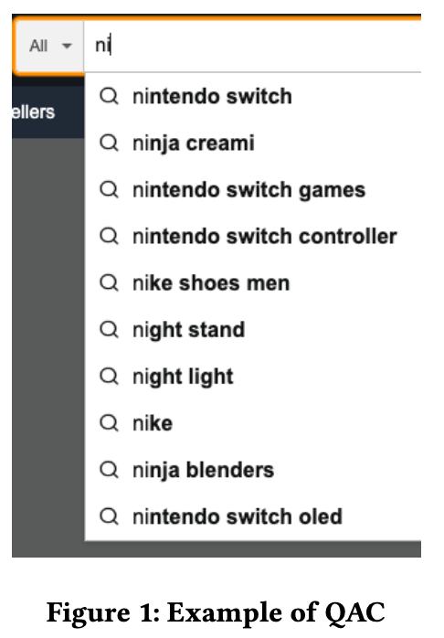
E-commerce Query Autocomplete
Customers type partial queries
Expect relevant queries for the product they have in mind
The goal is not only to save typing efforts but guide customers to better formed queries and showcase products available
Latency in tens of milliseconds

Slide 3
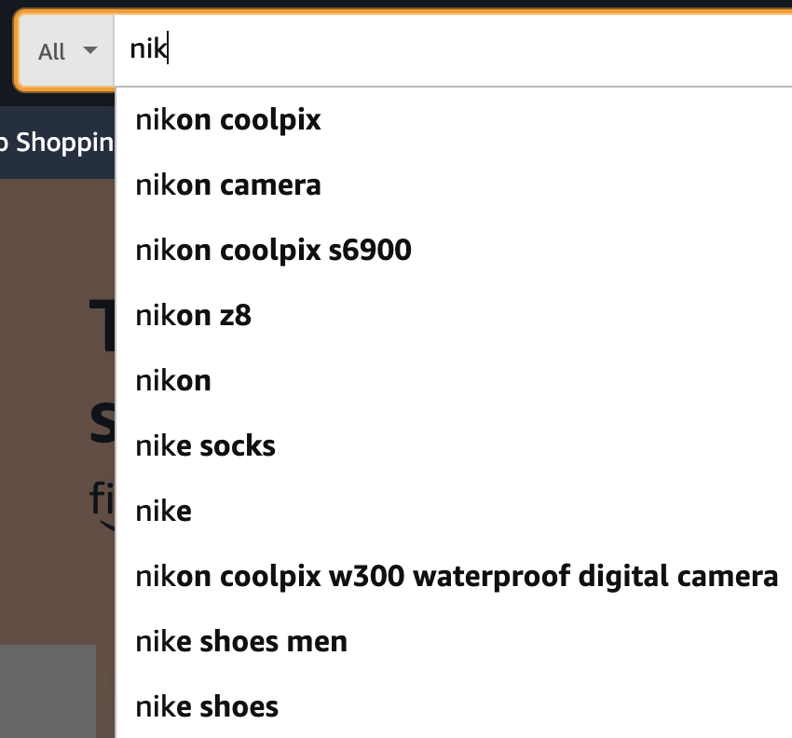
Matching and Ranking
Matching: Most popular K completions that start with the prefix typed.
Ranking: Typically use Neural networks or GBDTs and use real time features like customer session context to rank suggestions.
Past query: digital camera

Slide 4
Shortcomings of existing methods
MPC typically reduces candidate size to something reasonable so that ranking model can operate within latency
For short prefixes, total number of candidates can be huge.
MPC will drop many session relevant candidates
Past query: digital camera

Slide 5
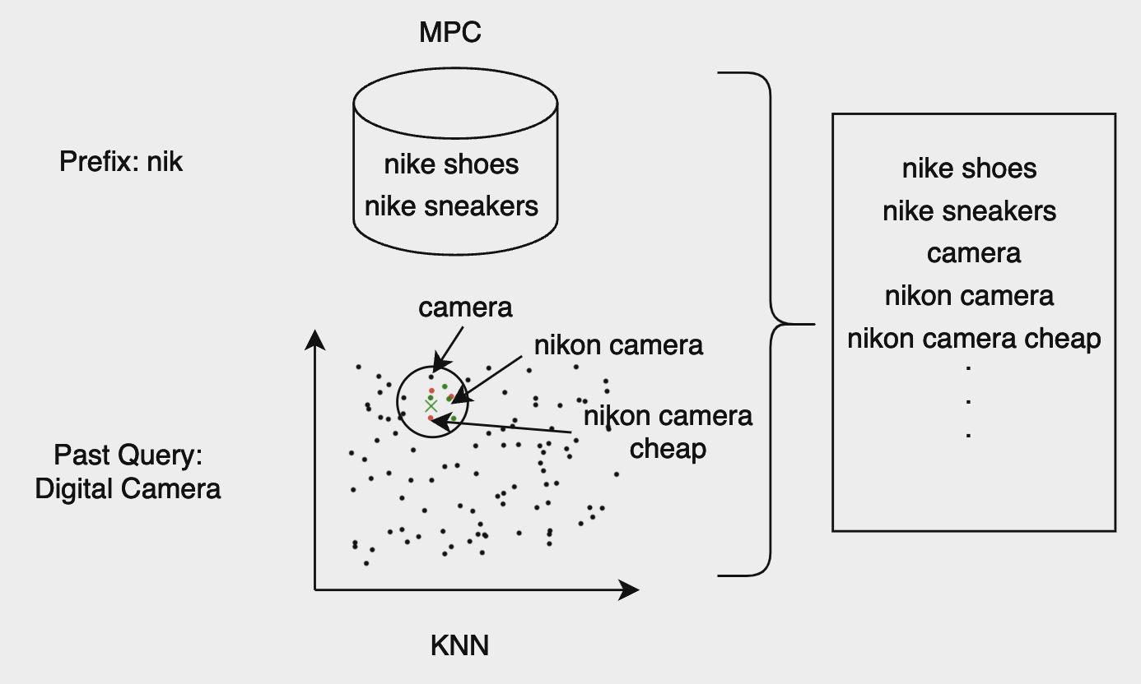
Shortcomings of existing methods
Some methods use session context to add more candidates to MPC
Common approach is to use query embeddings (e.g. BERT) and find nearest neighbors of past queries in session
No guarantee that those candidates are popular or respect the prefix

Slide 6
Goal
Improve matching step to include as many relevant candidates as possible such that they
Respect the prefix typed
Popular
Relevant to the customer’s session activity

Slide 7
Multi Objective Retrieval
We formulate the matching as a multi objective retrieval problem
The objectives are prefix awareness, popularity and session awareness
We extend dense passage retrieval (DPR) technique to include these objectives
We express each of the objectives with a vector and concatenate them to form one single representation

Slide 8
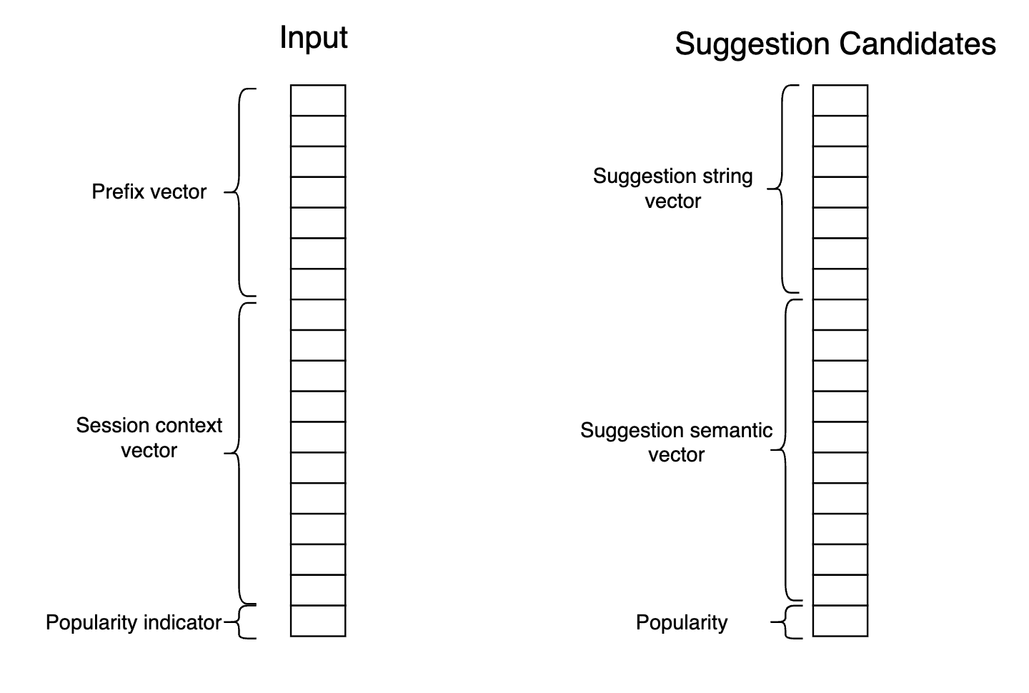
Multi Objective Retrieval
Prefix awareness: dot product of prefix vector and suggestion string vector is maximum when suggestion respects prefix
Session awareness: dot product of session context and suggestion semantic is maximum when suggestion is relevant for session
Popularity: dot product between popularity indicator and popularity is high when suggestion is popular

Slide 9
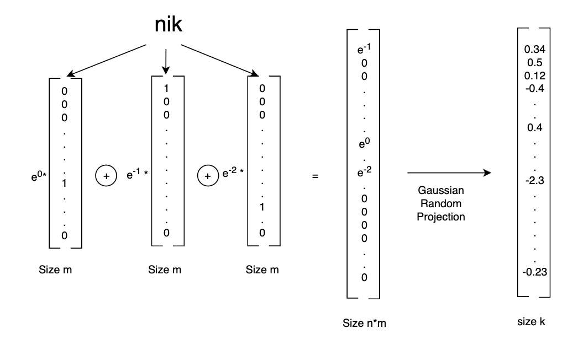
Multi Objective Retrieval
Prefix vector
Suggestion string vector
Max ‘m’ possible characters
Max ‘n’ length of prefix or suggestion
Size ‘k’ final dimension

Slide 10
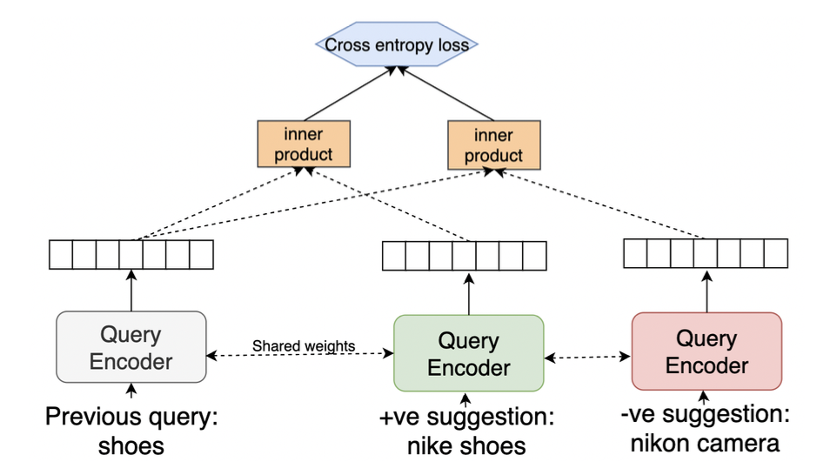
Multi Objective Retrieval
Semantic representation for past query and suggestion
BERT encoder embeddings

Slide 11
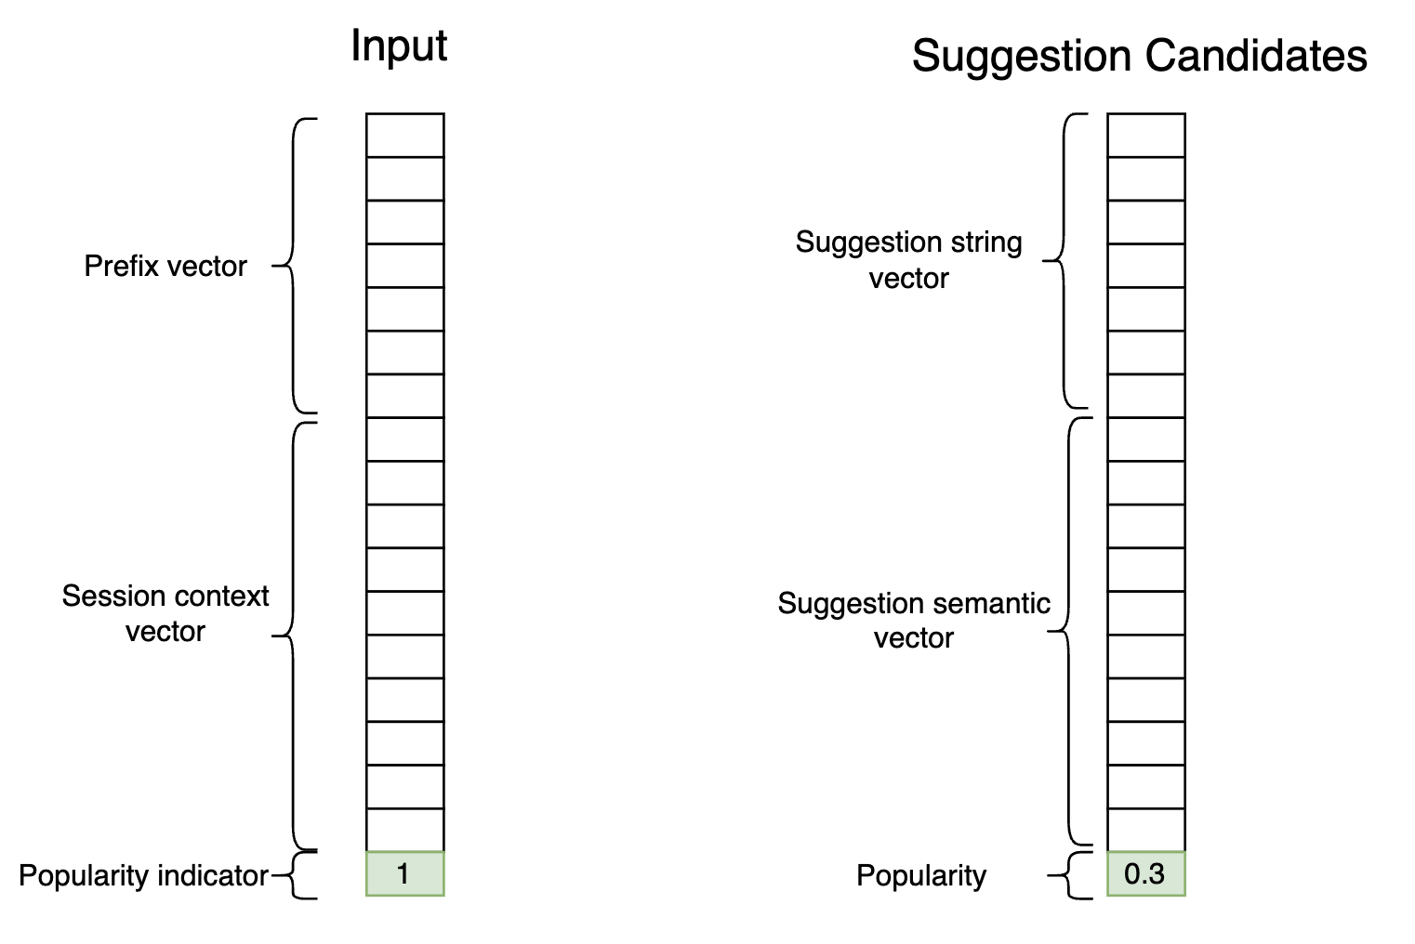
Multi Objective Retrieval
Popularity vector indicator is 1 in input vector
For suggestion vector, it is normalized popularity of the suggestion

Slide 12
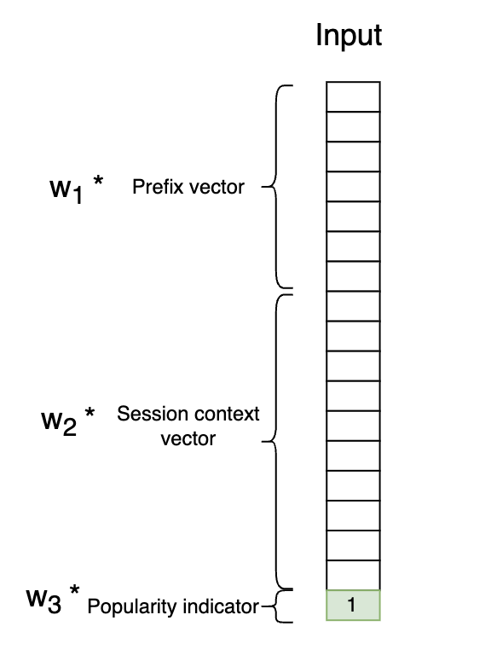
Multi Objective Retrieval
Final score with weights to balance different objectives
The dot product between input and suggestion vector becomes linear combination of three objectives
The weights can be controlled online

Slide 13
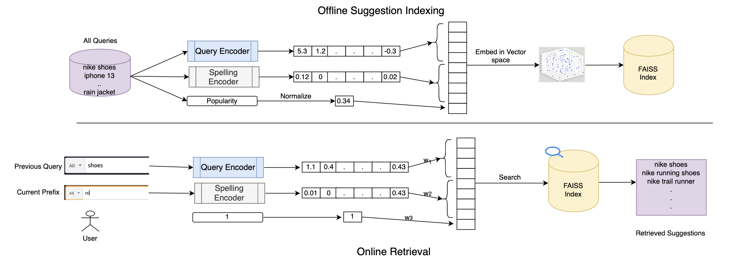
System

Slide 14
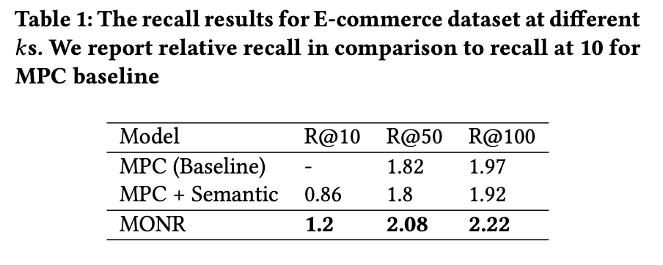
Results
Ecommerce Query Autocomplete Dataset

Slide 15
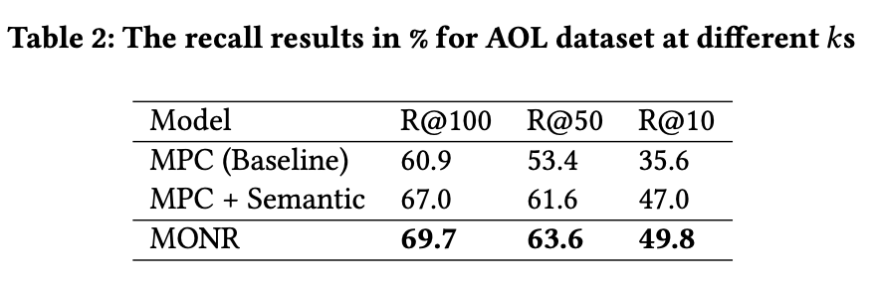
Results
AOL Query Logs

Slide 16
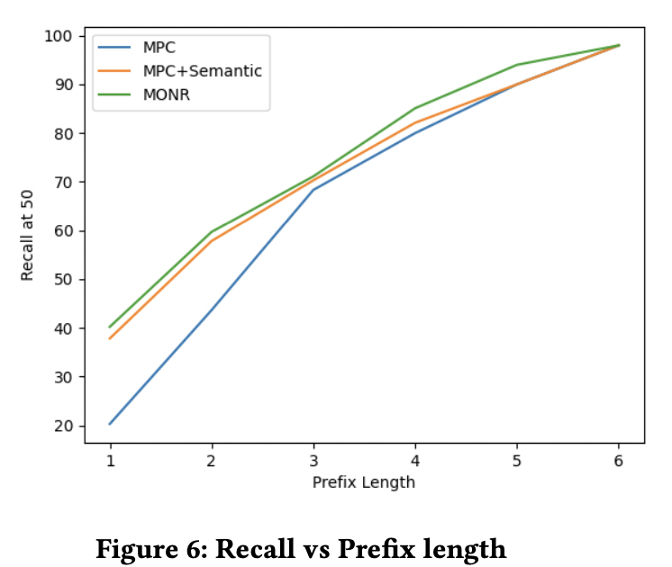
Prefix length analysis

Slide 17
Conclusion
We presented a general framework to perform dense retrieval incorporating different objectives
The framework allows for online balancing of objectives without making any changes to vector index
This framework can be extended for other objectives such as product category, current trends, conversion rate etc.

