Slide 1
Point-of-interest Re-ranking by Modeling Session Context and Geography-semantics Interaction Lang Mei

Slide 2




Background
POI Search
Location-based services
Online Navigation Applications
Online Ride-hailing Platforms

Slide 3
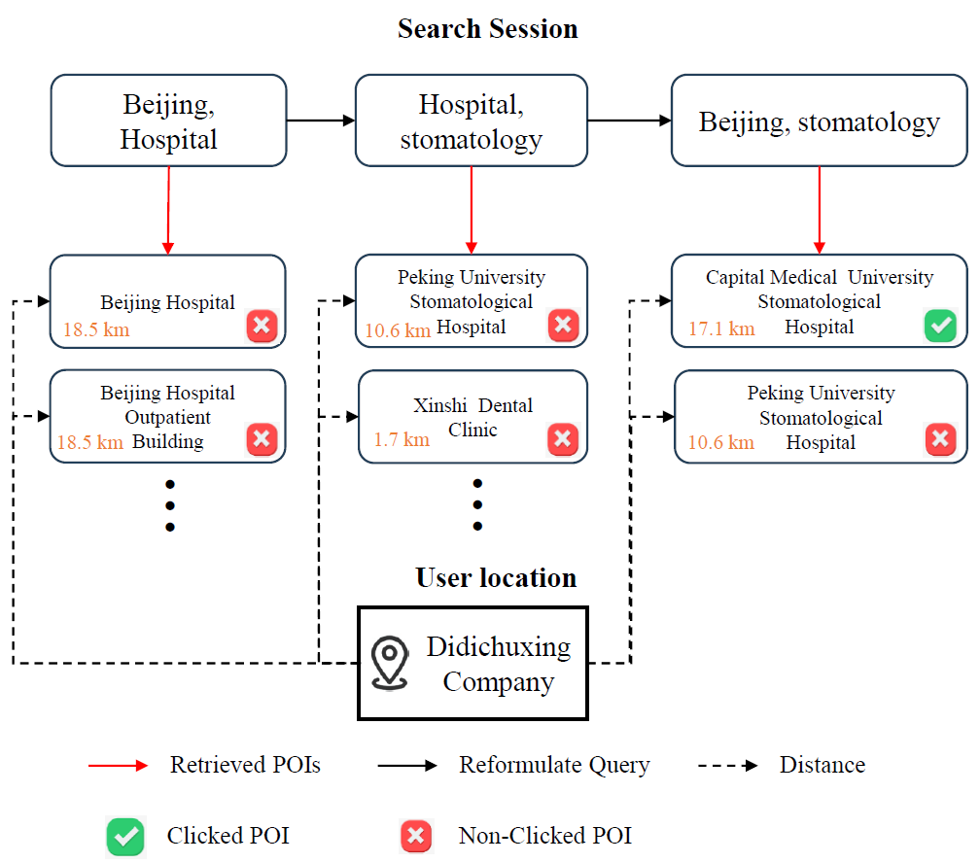
Background
POI Search Session: Re-ranking
issuing queries → → → click POI
Related Work
Ad-hoc
Session Search
Limitations:
implicit feedback (i.e., non-click)
geography-semantics context
examining ranked POIs
reformulating queries

Slide 4




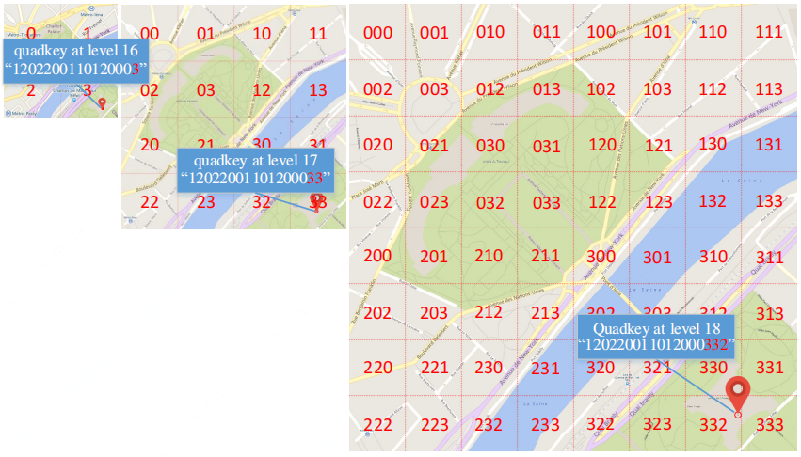

Methodology
Formulation
POI Search Session
Reformulated queries
Returned POI list at timestep t
Target POI
POI Context
Name, address, location
Geohash Code for Location
Geographical coordinates
Geographical hierarchy

Slide 5
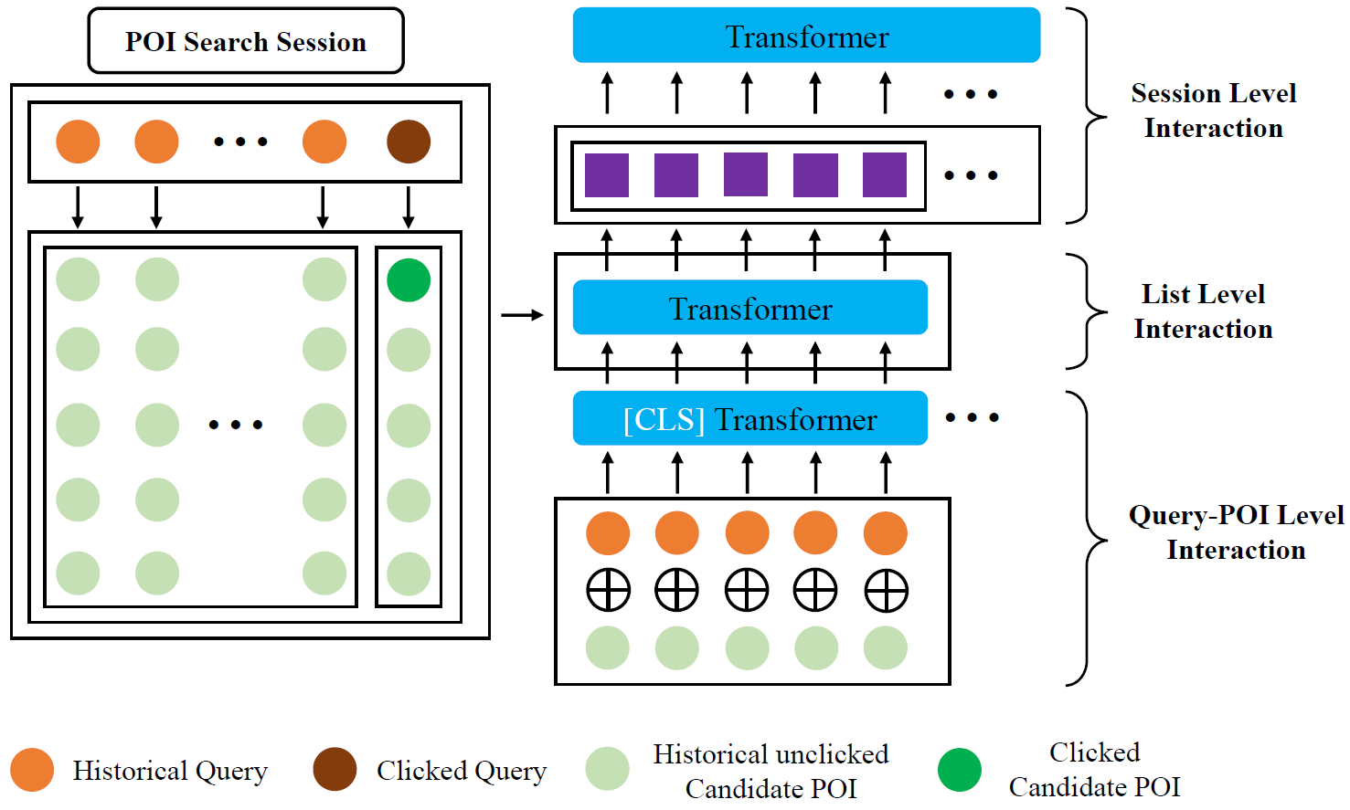
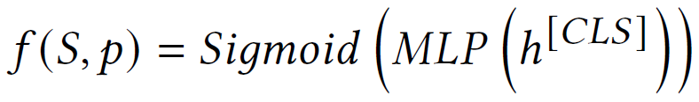
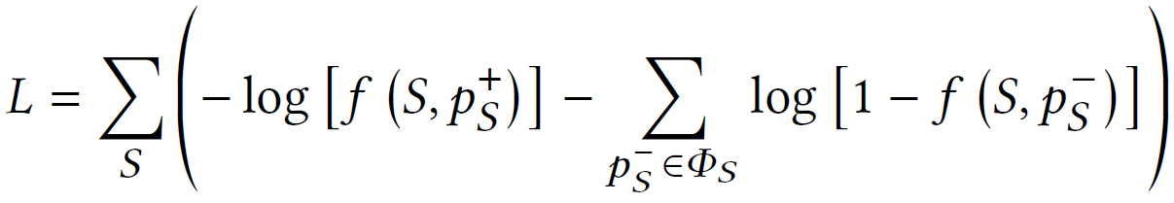
Methodology
POI Session Encoder
fine-grained interactions at three levels of granularity
Query-POI Level
List Level
Session Level
Modeling relevance
Training Objective

Slide 6
Experiment
Real-world Dataset
Didichuxing application’s data, August 2022
16,717,537 click logs (i.e., search session)
1,713,280 POIs
1,530,964 distinct queries
Evaluation
MRR@𝐾 and NDCG@𝐾, (𝐾 ∈ {1, 3, 5, 10}).
Baselines
Ad-hoc Ranking Models
LSTM-DSSM
PALM, ST-PAC, Meta ST-PAC, DrW
Ad-hoc Bert Re-ranker
Context-aware Ranking Models
HQCN (Geo)
ASE (Geo)
Session Query Bert Re-ranker

Slide 7
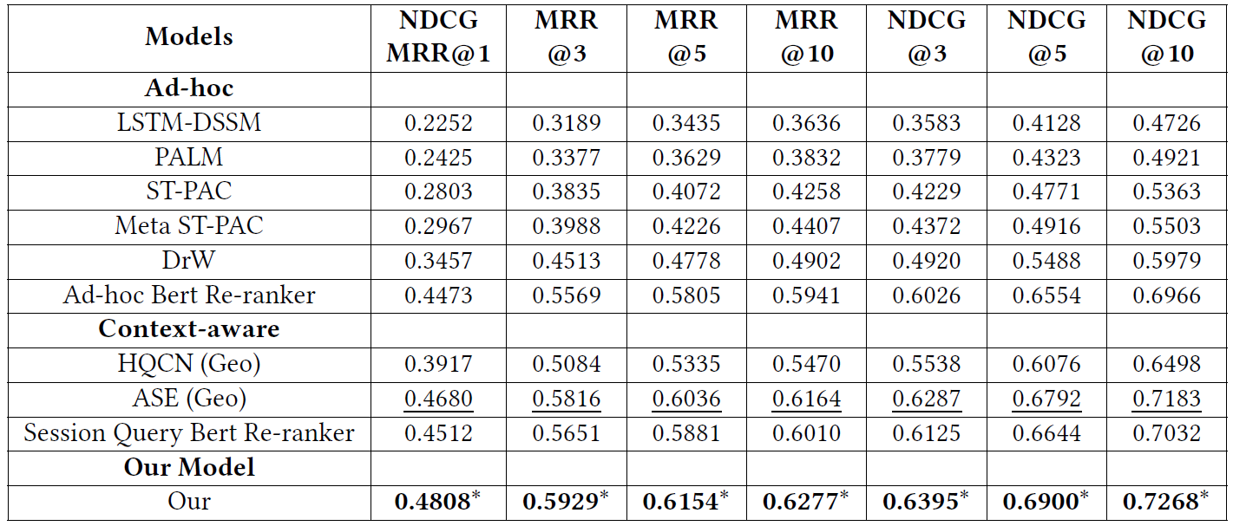
Experiment
Results and Analysis: Re-ranking Performance
Geographical context
We use paired t-test with p-value threshold of 0.05. ∗ indicates significant difference over best baselines.

Slide 8
Experiment
Results and Analysis: Re-ranking Performance
POI session context
We use paired t-test with p-value threshold of 0.05. ∗ indicates significant difference over best baselines.

Slide 9
Experiment
Results and Analysis: Re-ranking Performance
Pre-training model
We use paired t-test with p-value threshold of 0.05. ∗ indicates significant difference over best baselines.

Slide 10
Experiment
Conclusion
Re-ranking stage of the POI search
Limitations:
implicit feedback (i.e., non-click)
geography-semantics context
POI Session Encoder
query-POI level
list level
session level
Real-world datasets from Didichuxing
Future Work
Goal of the POI search system
Finding users’ target POIs in a one-time query-POI matching.
minimizing cumulative user effort throughout the entire POI search session.

Slide 11
Thanks for Listening!

