Slide 1
Control System Studio Training
-
Overview
Kay Kasemir
ORNL/SNS
kasemirk@ornl.gov
Jan. 2013

Slide 2
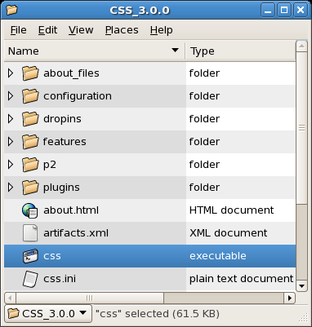
Exercise: Start CSS
Precondition:
You somehow got CSS onto your computer
Start the executable
  Linux: css
  Windows: css.exe
  Mac OS X: css.app

Slide 3
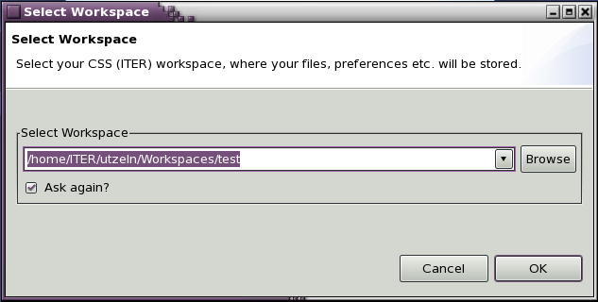
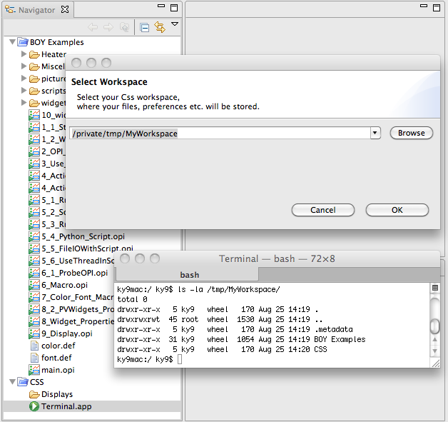
Workspace
Workspace
  Directory where you store files
  Hidden .metadata directory with settings
Most versions of CSS prompt for a workspace at startup
  Check or change later via menu File, Switch Workspace
Run only one instance of CSS per workspace!
  Each user should have own workspaces
  One for development, one for operation, …

Slide 4
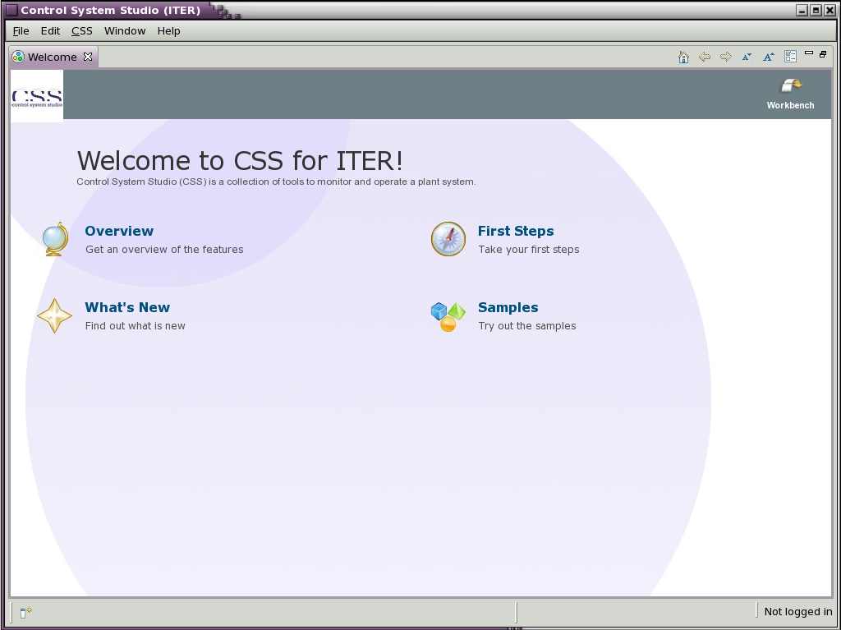
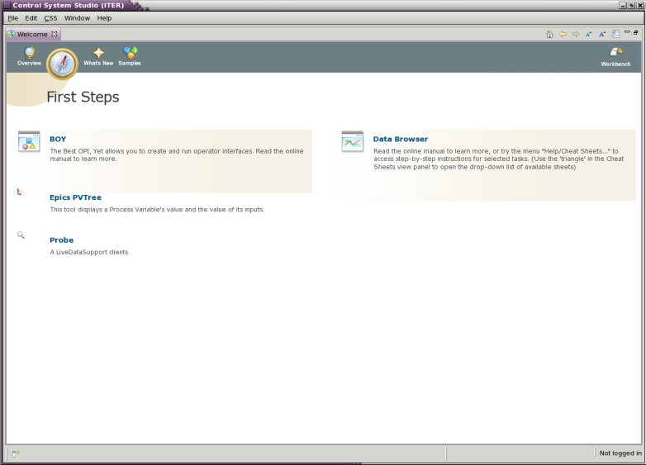
“Welcome”
Displayed when CSS opened for the first time (i.e. on a new workspace)
  Close here or here
  Re-open: Menu Help, Welcome

Slide 5
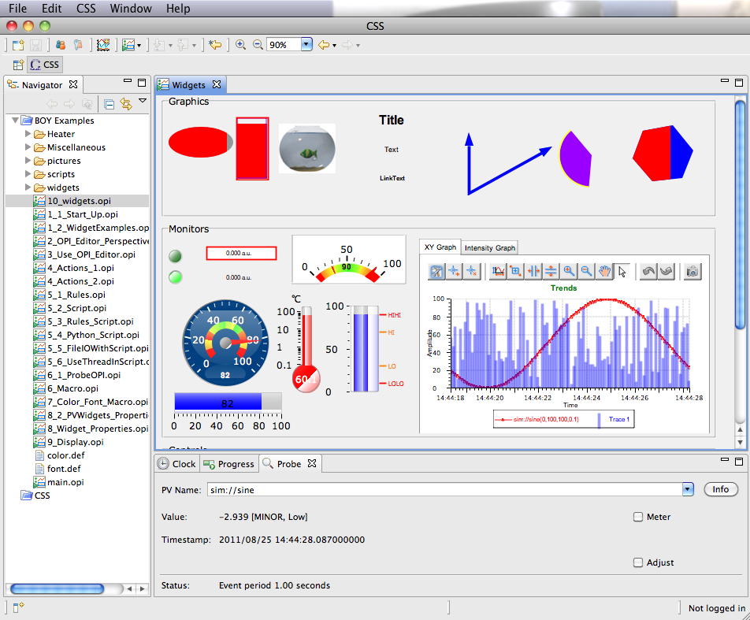
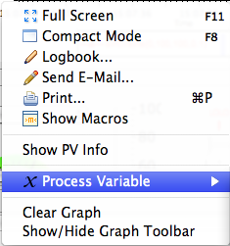
Workbench
Menu Bar
Tool Bar
Perspective Selector
Navigator “View”
Main “Editor” Area
Context Menu
(right-click)
More “Views”
in “Tabs”
Status Bar

Slide 6
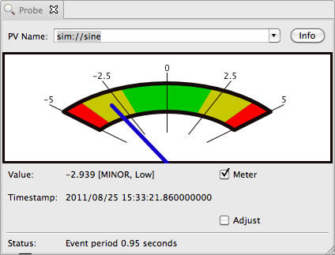
Exercise: Probe
Menu CSS, Diagnostic Tools, Probe
Enter PV name “sim://sine”
Close Probe
Open it again
Select previously entered PV from drop-down
Move Probe to other view area
Close Probe

Slide 7
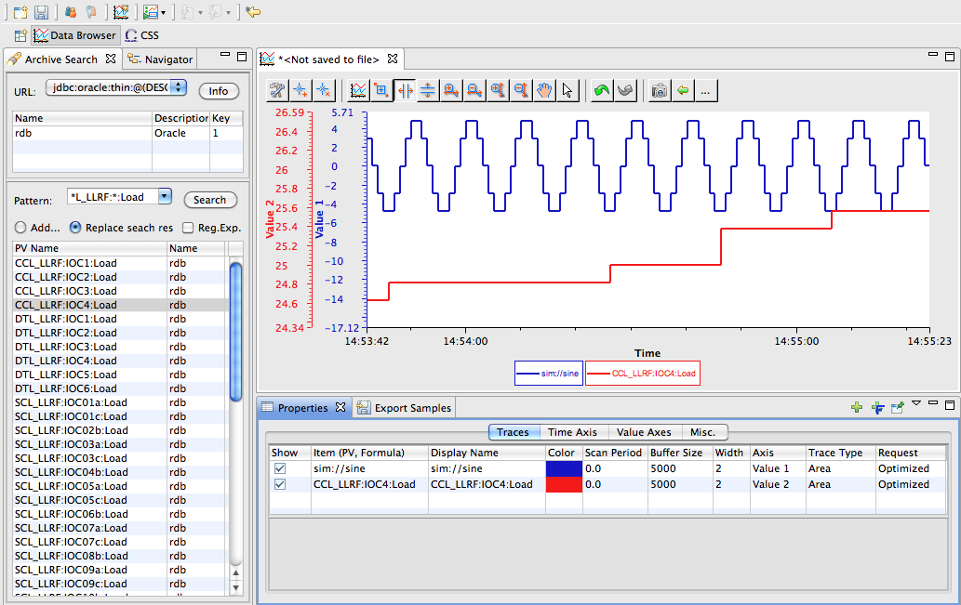
Exercise: Data Browser
Menu CSS, Trends, Data Browser
  Note change to “Data Browser” Perspective, new plot
Plot context menu, Add PV, “sim://sine”
Wait a little, use Stagger and zoom buttons
Data Browser Perspective
Main “Editor” Area
Archive Search
“View”
“Views”:
Plot Properties, Sample Export

Slide 8
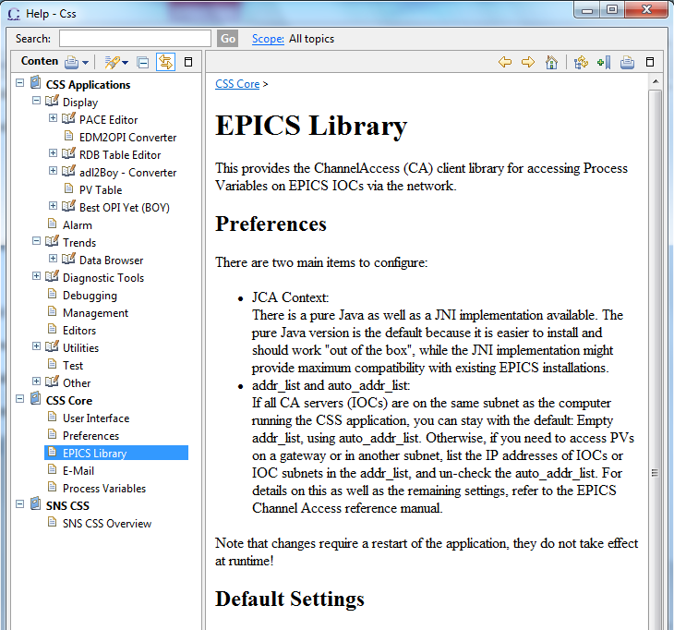
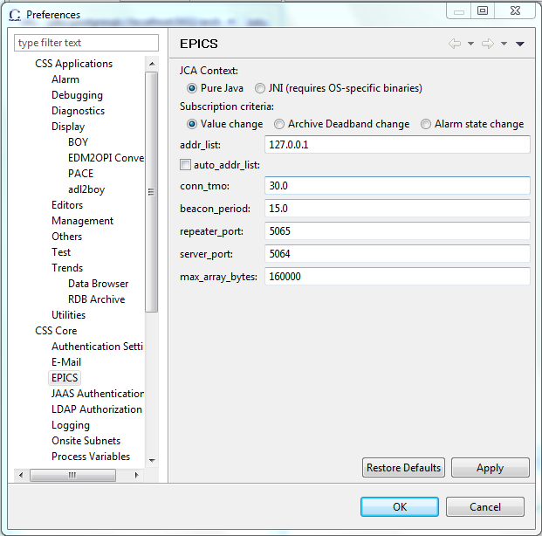
Exercise: Preferences, Online Help
Menu Edit, Preferences resp. Help, Help Content
Locate preferences and help for
  CSS Core, EPICS
  CSS Applications,
  Trends, Data Browser

Slide 9
Editors, Views, Perspectives
Editors: Central Workbench Area
  Text editor, BOY Operator Interface panel, Data Browser plot, …
    Associated with a file. “Do you want to save?” when closed.
Views: Auxiliary panels around Editors
  Probe, Properties, Navigator, …
Perspective: Arrangement of Editors and Views
  Size of editor area. Actual editors remain.
  Choice of Views. Views change when switching perspectives.

Slide 10
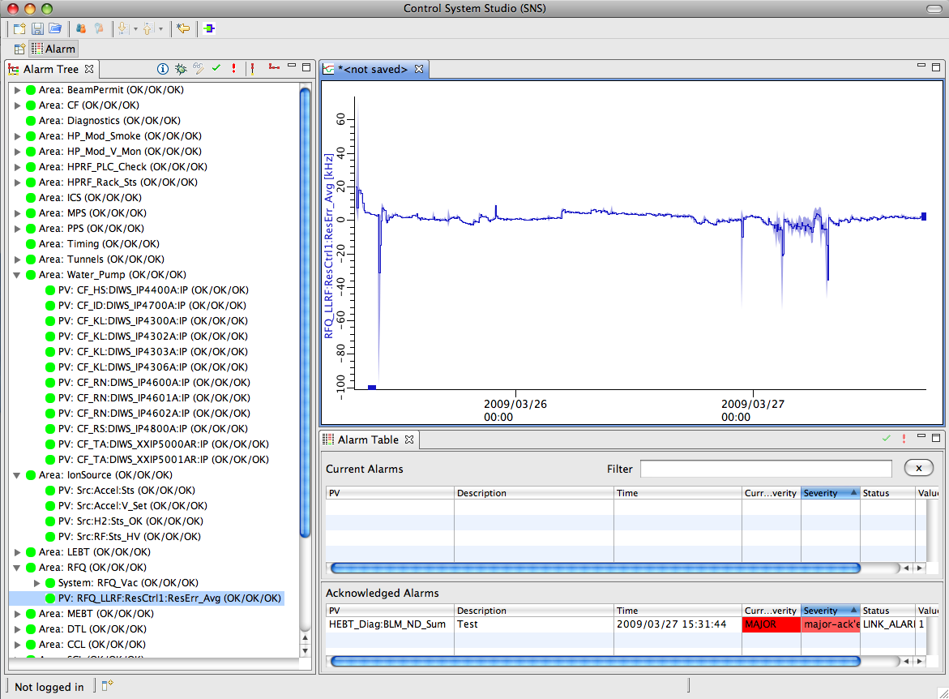
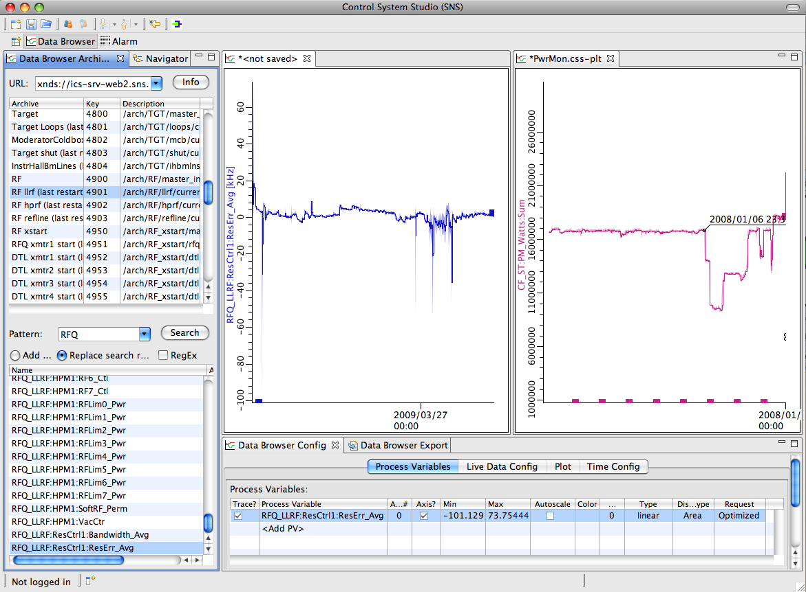
Layout Options
Editors, Views can be closed, reopened, repositioned
  Grab title of panel, move while watching black rectangle indicate possible target locations
  Arrange ‘behind’
  or ‘beside’
  other panels
Multiple Perspectives
  Use Context Menu of Perspective to Name, Save, Close, Restore

Slide 11
Editor/View Limitations
In the current release of CSS,
Editors stay in the central editor area of the screen, surrounded by multiple View areas.
Views cannot be in the editor area and vice versa.
Views can be ‘detached’ as standalone windows, but Editors stay in the workbench window. Multiple workbench windows are OK, though.
In “Eclipse 4” editors and views will be more similar.

Slide 12
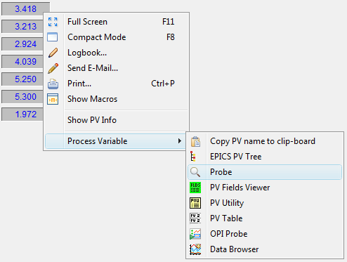
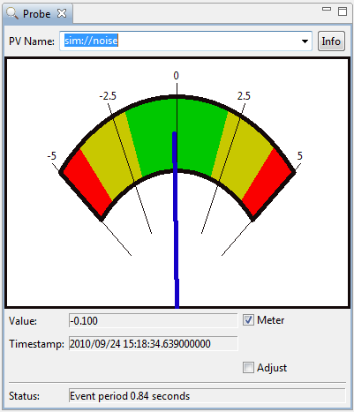
CSS PV Exchange
PV in any CSS Tool
➔ Context Menu ➔ Select other PV Tools
  Opens other tool with that PV

Slide 13
Exercise: Probe via PV Exchange
Open Probe on PV from Data Browser
  Properties Panel
  Context menu of “sim://sine” trace
  Process Variable, Probe

Slide 14
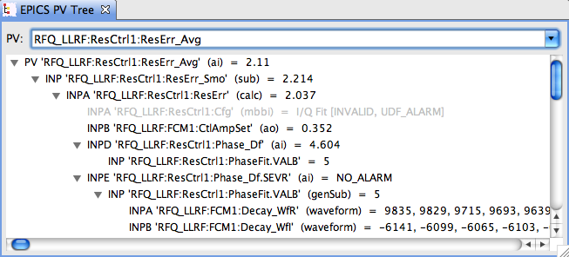
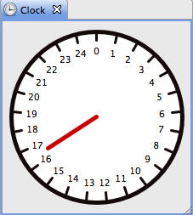
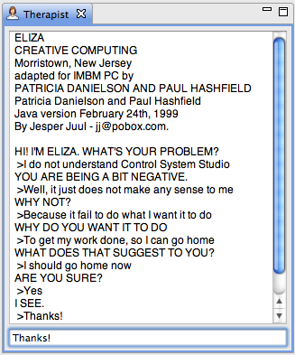
Exercise: Things to Try
EPICS PV Tree
  Trace PV links
Clock
  What’s special about it?
Therapist
  When all else fails

