Slide 1
Control System Studio Training
-
BOY
Kay Kasemir
ORNL/SNS
kasemirk@ornl.gov
A lot of material from
Nadine Utzel, ITER
and BOY online help
by Xihui Chen, SNS
Jan. 2013

Slide 2
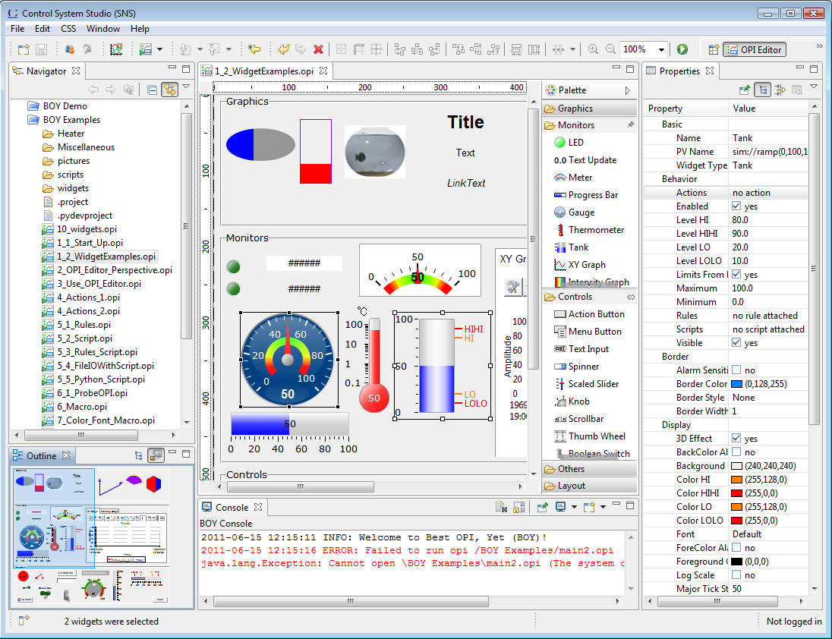
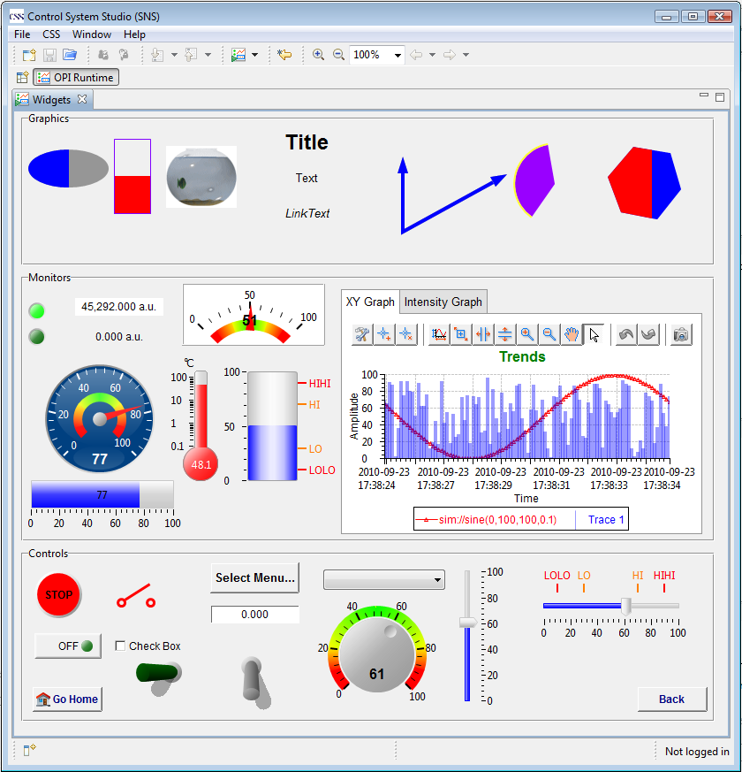
BOY – Best OPI, Yet
Operator Interface Editor Runtime
Similar to EDM, MEDM, SDS, DM2K, but possibly better

Slide 3
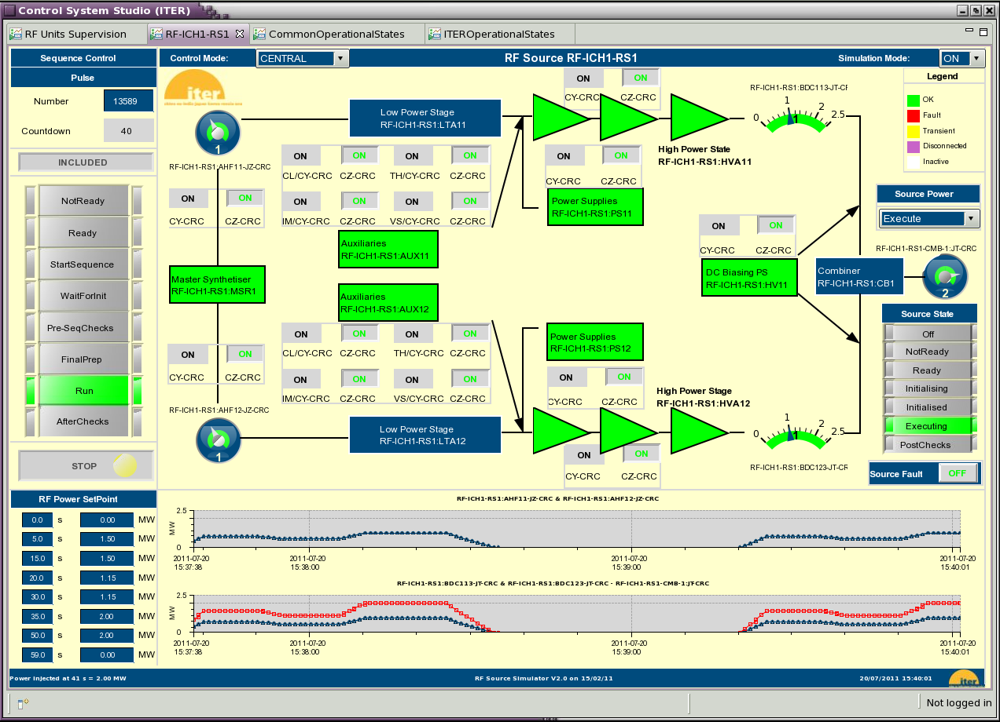
Example: ITER
Nadine Utzel

Slide 4
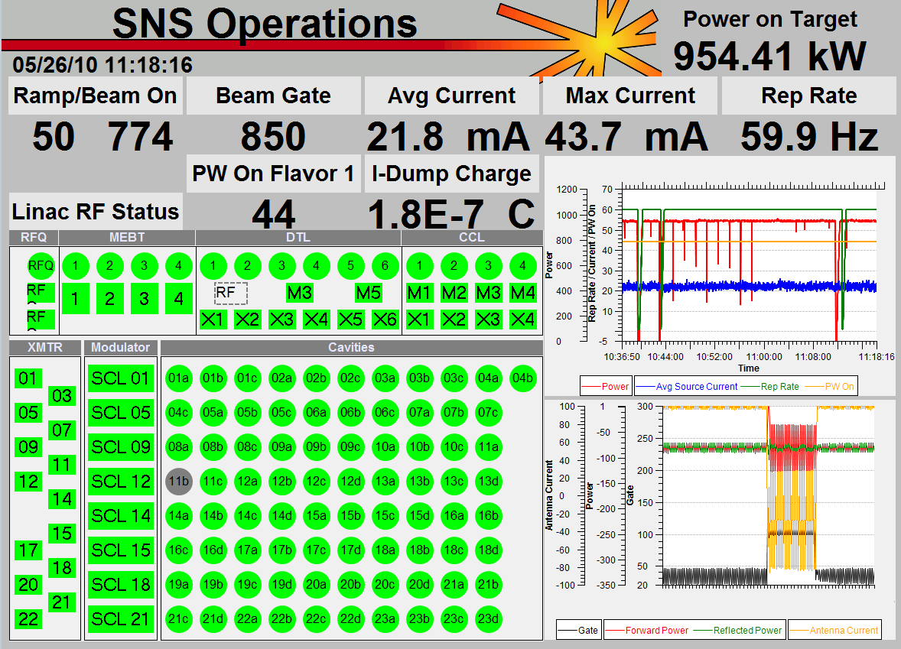
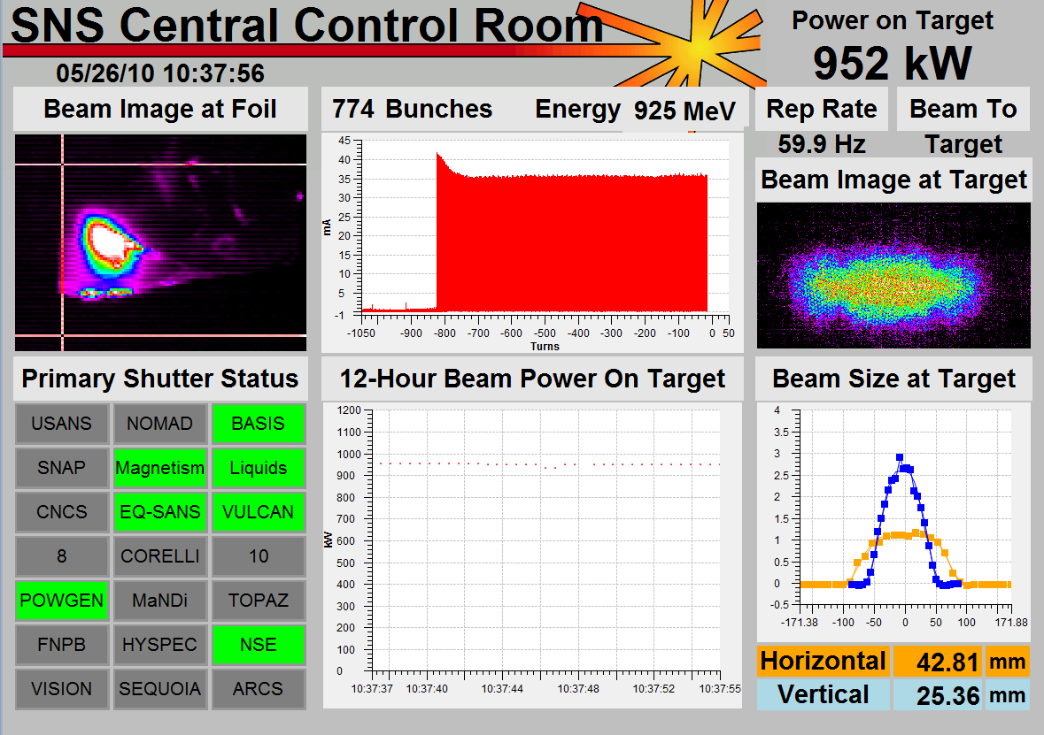
Examples: SNS
Top-level displays created by operators
Tim Southern, Nick Luciano

Slide 5
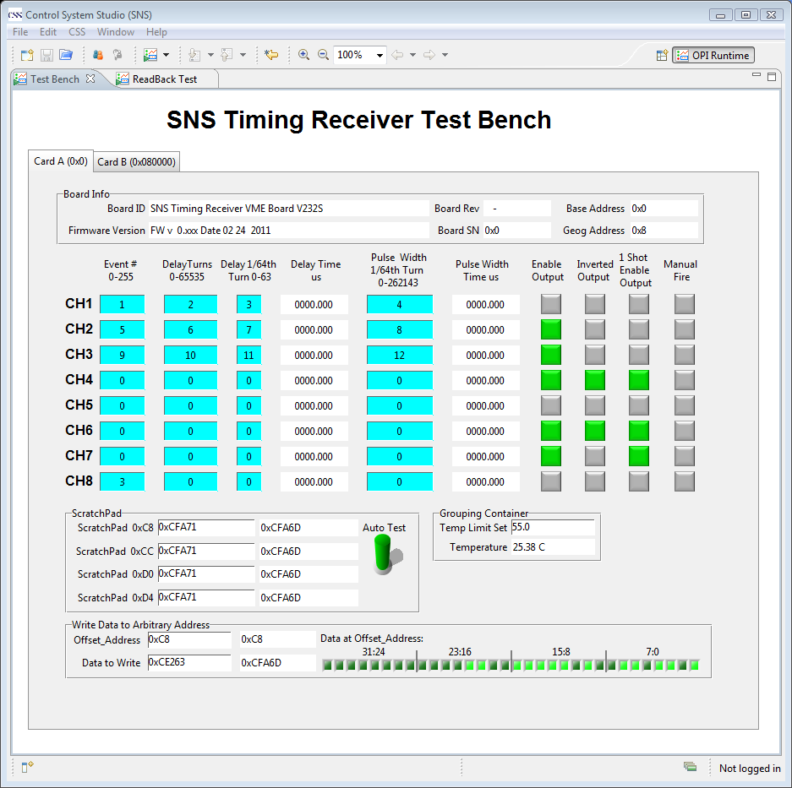
Examples: SNS

Slide 6
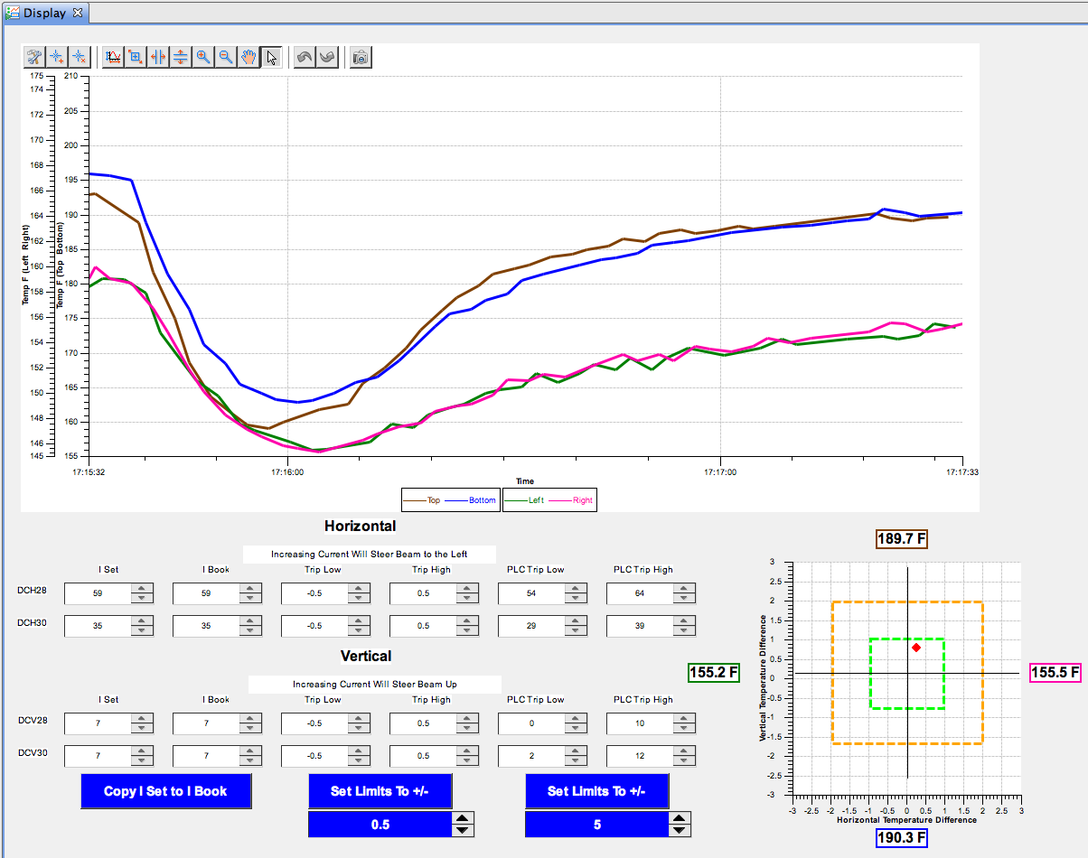
Examples: SNS “Steering” Tool
Try to get spot into the green, at least into orange
Tim Southern, Nick Luciano

Slide 7
OPI Editor

Slide 8
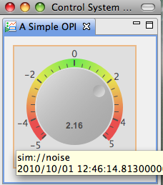
Main Idea: Simple Things are Easy
  Drag a widget, e.g. Knob, from palette to editor
  Enter the PV name in Properties view
  Click the “Run” button to execute!
What you will get
  PV value as text and via knob position
  PV severity reflected in border color
  PV name and value shown in tool-tip
  PV’s display limits set the knob’s default range
  Indicate ‘disconnected’ state via a pink border
  Widget will be greyed-out if read-only

Slide 9
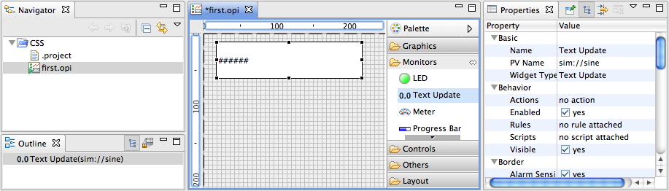
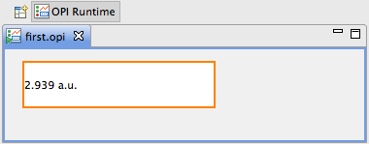
Exercise: First Display
Menu CSS,
  Display, OPI Editor Perspective
  Display, Install OPI Examples
Navigator Context menu on CSS: New, OPI File, call it “first.opi”
  Or Menu File, New, BOY, OPI File
Locate in Palette: Monitors, Text Update
  ‘Drag’ Text Update onto display grid
  Move widget around, resize
Locate Properties View
  Enter PV Name “sim://sine”
Press Run button in Toolbar

Slide 10
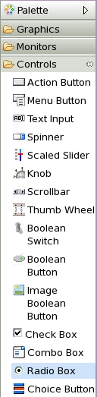
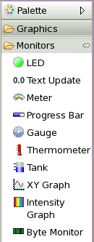
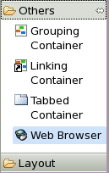
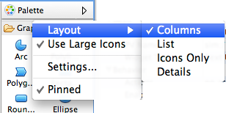
Widget Palette Hints
Many widgets, hard to see them all
Scroll
Click on section header
Try the ‘pins’
Header Context menu offers Columns mode to display Widgets as small icons in columns

Slide 11
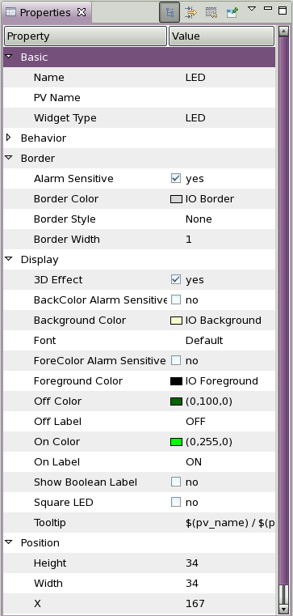
Widget Properties
Widgets are configured by setting Properties in the Properties view
Common Properties:
  Name
  Position*
  Background color
  Border
Widgets that read/write PVs:
  Basic: PV Name
  Border: Alarm Sensitive
  Behavior: Limits from PV
Position can also be modified by moving or resizing the widget in the editor, or via Toolbar buttons to align etc.

Slide 12
Exercise: Extend First Display
Locate in Palette: Controls, Knob
Drag Knob onto display
Move Knob around, resize
Locate Property PV Name for Knob
Enter “sim://sine”
Create another Knob:
  PV Name = “loc://test”,
  “Increment” = 0.1
  “Limits from PV” = no
Run
Note how the “sim://sine” Knob is really read-only, but you can change the “loc://test” PV via the Knob

Slide 13
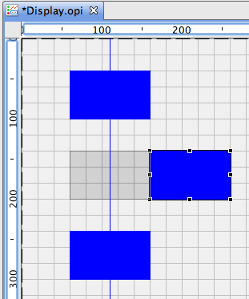
Exercise: Editing Features
Add, duplicate Widgets in various ways
  Drag & Drop from Palette
  Copy/paste, Ctrl+Drag existing widgets to duplicate
Arrange them on the display
  Snap to grid, guideline, other widgets
  Align, distribute
Select multiple widgets to
  Edit common properties
  Adjust size or move around

Slide 14

OPI Files: Run or Edit?
Default: Double-click on *.opi in Navigator opens in “OPI Runtime”, i.e. executes the display
Context menu allows to select
  Editor to edit?
  Runtime to execute?
Once you select “Editor”, that will become the double-click default
  Select “Runtime” once to restore previous default

Slide 15
Exercise: Edit vs. Runtime Mode
Close all CSS Editors (Menu File, Close All)
In the Navigator, double-click on the first.opi that you created before
  Does it open in the Editor or Runtime?
In the Navigator, open the Context Menu on first.opi and select Open With, OPI Editor.
  Close first.opi, now double-click the file in the Navigator. Does it open in the Editor?
In the Navigator, open the Context Menu on first.opi and select Open With, OPI Runtime.
  Close first.opi, now double-click the file in the Navigator. Does it open in the Runtime?

Slide 16
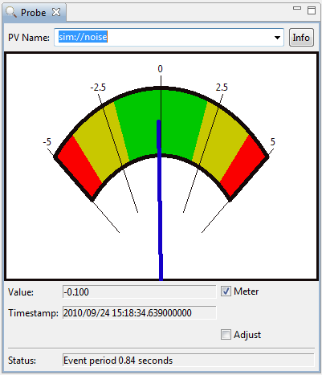
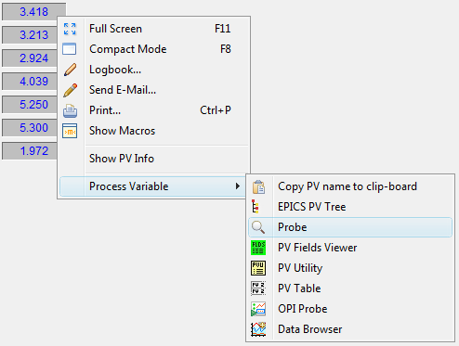
Exercise: Send PV to other CSS tools
Run the OPI that you created
Use CSS Process Variable context menu on a widget that displays a PV to open Probe

Slide 17
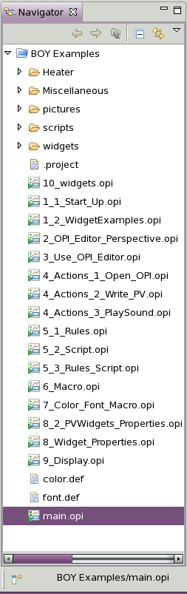
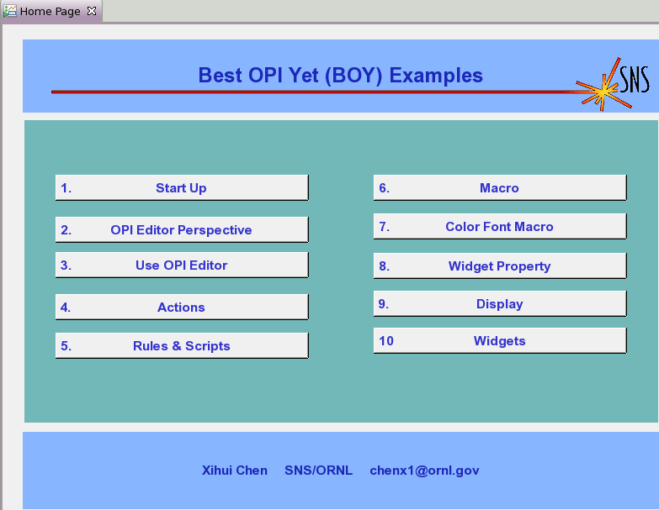
Example Displays
Installed via Menu CSS, Display, Install OPI Examples
Remember: You can Open With, .. Editor to see implementation
Note new
project named
BOY Examples
Explore the examples
Double-click on main.opi file to open
Check the “Start Up” page, which is similar to the first two exercises

Slide 18
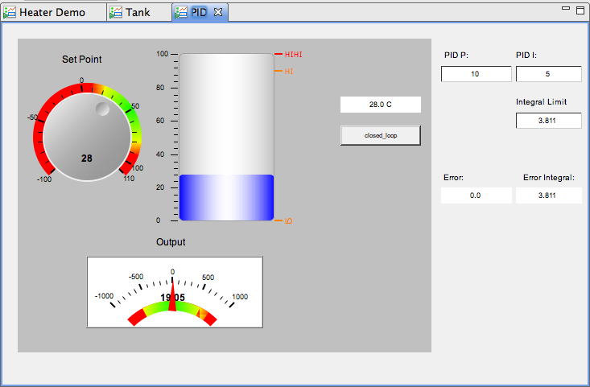
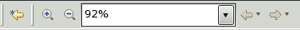
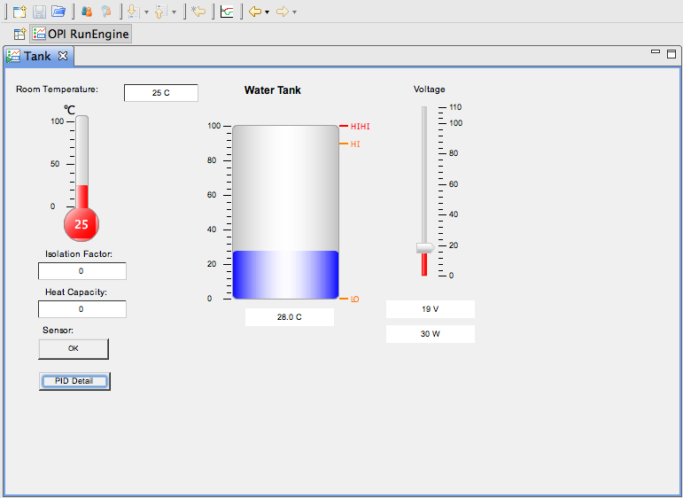
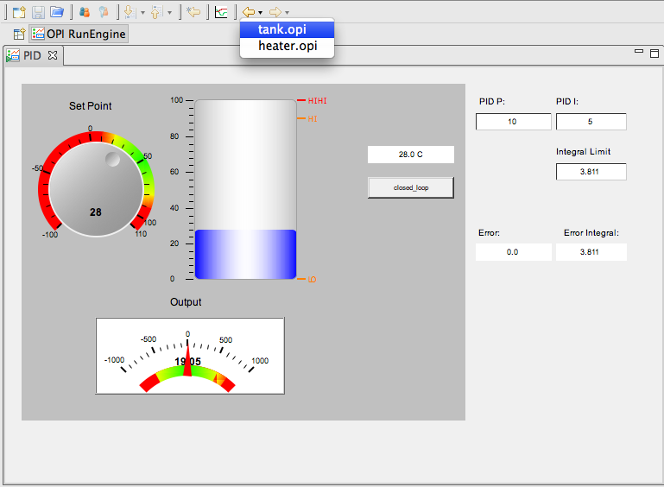
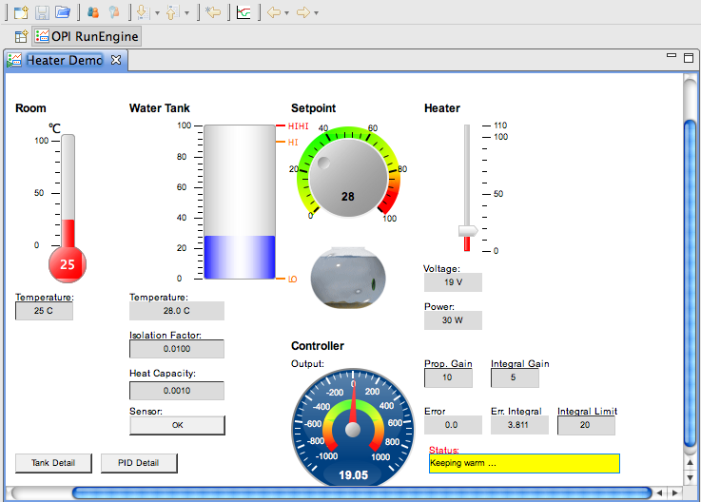
Exercise: Screen Navigation
Similar to hyperlinks in a Web Browser:
  Default: Linked display replaces the current display.
  Zoom in/out, go “back” via toolbar:
  Use context menu to open in ‘tabs’ or new Window
Try with OPI Examples: Open in tab, … Window
OPIs in ‘Tabs’

Slide 19
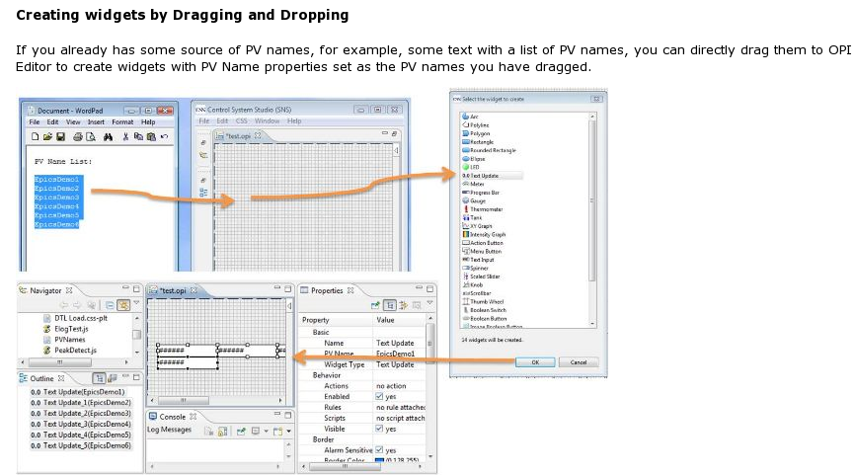
Hint: Drop PV Names
Assume you have some text document with a list of PVs
How to quickly create a display with Text Update widgets for these PVs?
  Just drag
  the names
  into the
  display
  Will be
  prompted
  for the type
  of widget

Slide 20
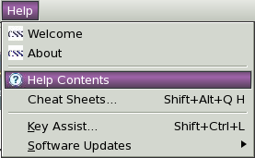
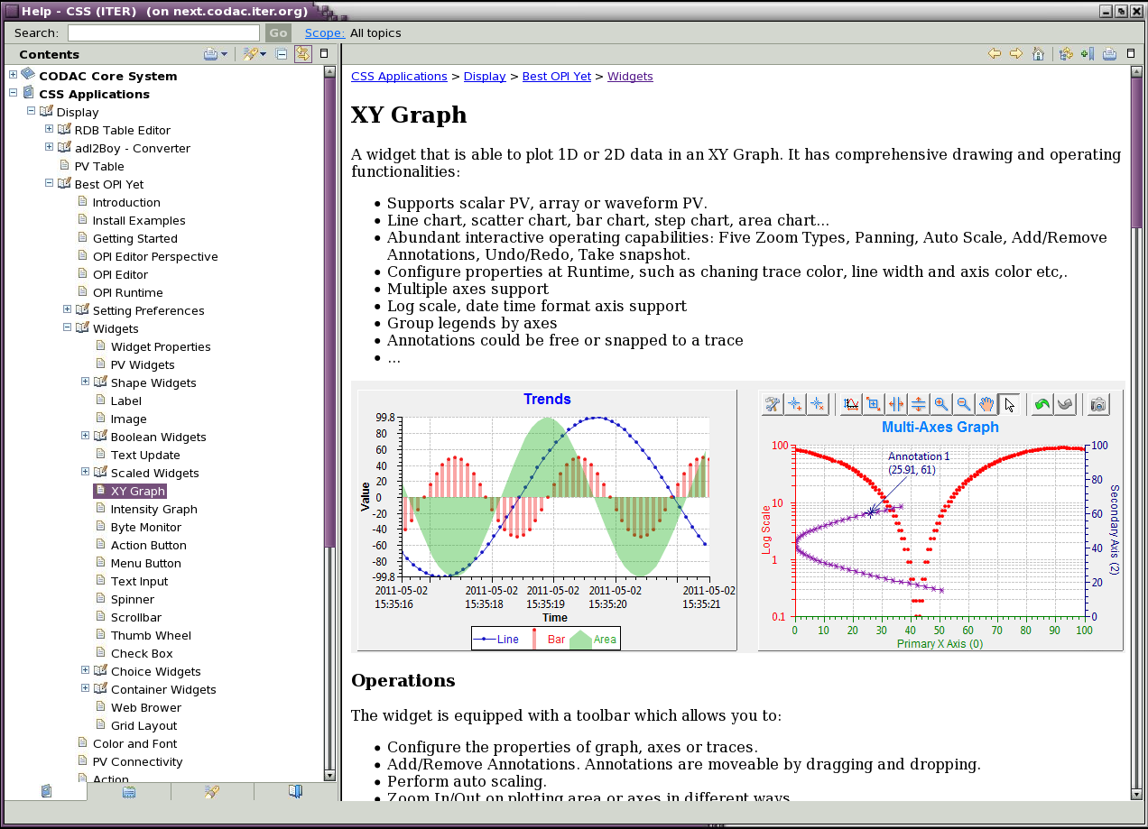
Exercise: View Online Help
Find the “Widgets” section

Slide 21
Macros
Usage: $(macro) or ${macro}
  Wherever you enter a widget property
  Most often used for (partial) PV name:
    $(pv)_setpoint
    $(pv)_readback
    Such a display can then be invoked with
    pv=“PowerSupply1” or “PowerSupply2”
Linking.opi
Macros.opi
“PS1_setpoint”
pv=PS1
pv=PS2
Macros.opi
“PS2_setpoint”
Macros.opi
“$(pv)_setpoint”

Slide 22
Macro Definition
Predefined Macros: Widget properties, see online help for name mapping
  Property “X”: Macro $(x)
  Property “Name”: Macro $(pv_name)
  Automatic: Macro $(pv_value)
    See default for the “Tool Tip” property
User-defined:
  BOY Runtime Preference Setting (-pluginCustomization ….)
  User Preference settings (CSS, Pref…, ..App.., Display, BOY, OPI Runtime)
  Macro parameter of Action that opens the *.opi file
  Display *.opi file property “Macros”
  Grouping/Linking/Tabbed Container that wraps the widgets
-
Priority
+
Example:
Macro parameter of Action will override Preference settings.

Slide 23
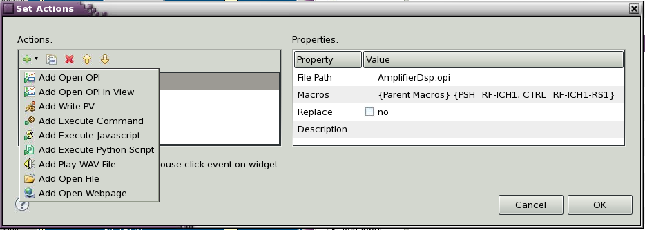
Exercise: Linking Displays with Macros
Create display file “Macros.opi”
  Label with Text “$(pv)”
  Text Update with PV Name “$(pv)”
Create display file “Linking.opi”
  Action button with “Actions” to “Open OPI”
    Use File Path for Macros.opi
    Define Macros: pv= “sim://sine”
  Add another action button (copy previous one)
    Set macro to pv=“sim://ramp”
Execute. Check that you can open the linked display
Extra: Check OPI Examples, “4. Actions”
  Can have more than one “Open OPI”
  Any widget can have “Action”. Try Label.
  Try Linking Container to display Macros.opi within Linking.opi

Slide 24
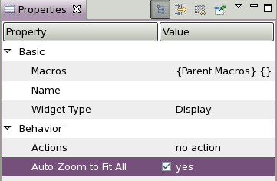
Miscellaneous
Display has an “Auto Zoom” property
  Size will adjust to fit window

Slide 25
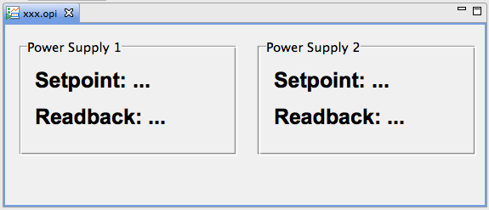
Exercise: Grouping Container
In EDM, MEDM, … we needed lines and rectangles to visually group related displays.
In BOY there is the Grouping Container
Create a display with Grouping Containers that look like this:
  Border Style=Group Box Style
  Name = Power Supply 1, Power Supply 2
  Add Labels “Setpoint:…”, “Readback:…”
Note how you can
  Move the Grouping Container an all its content
  Move Labels inside and out of the container

Slide 26
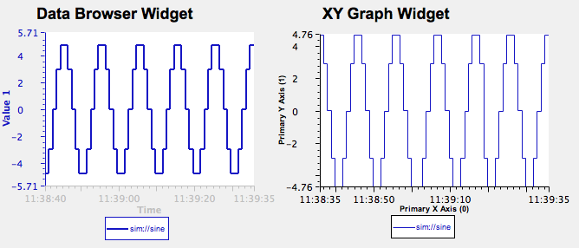
Exercise: “Striptool” type Plots of PV over Time
Try both options
  Data Browser Widget
    New Data Browser Plot, add PV
    Set desired axis and time range
    Save as *.plt
    Add Data Browser Widget to BOY
    Set its File Name to the *.plt
Can also display archived data
PV can be ‘monitored’, showing brief spikes
Fewer display options
  XYGraph Widget
    Behavior, Trigger PV: “sim://noise”
      This PV updates once a second and will trigger plot updates
    Primary X Axis(0), Time Format: “HH:MM:ss”
      To get a “time” axis
    Trace 0, Trace Type: Step Horizontally
    Trace 0, Update Mode: Trigger
    Trace 0, Y PV: Name of PV to plot
Has many more display options
Cannot show archived data
PV scanned at update rate, can miss brief spikes

Slide 27


