Slide 1
Control System Studio Training
-
BOY Details
Kay Kasemir
ORNL/SNS
kasemirk@ornl.gov
A lot of material from
Nadine Utzel, ITER
and BOY online help
by Xihui Chen, SNS
Jan. 2013

Slide 2
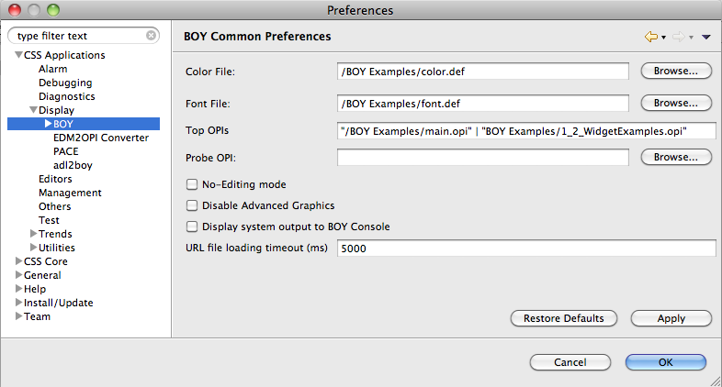
Exercise: BOY Font, Color Preferences
Menu CSS, Preferences:
  Locate the BOY settings
  Assert that the
  Color File, Font File, Top OPIs
  settings use files from the BOY Examples that we just installed:

Slide 3
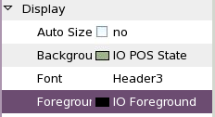
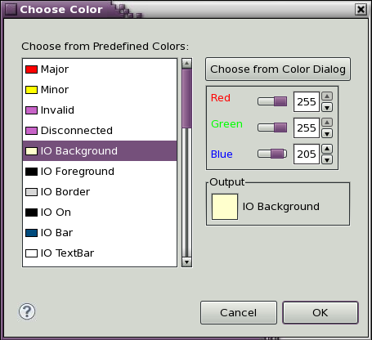
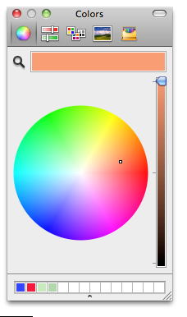
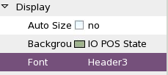
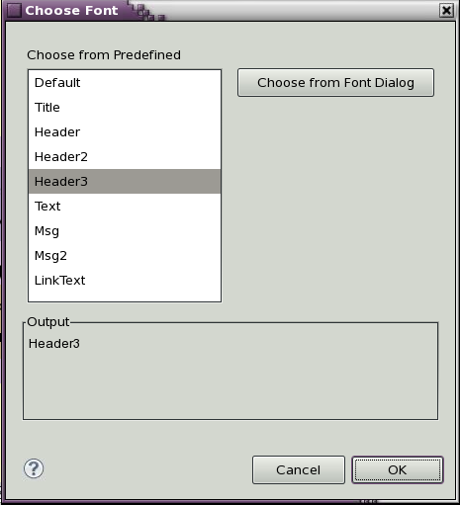
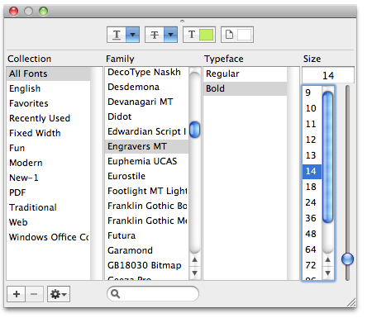
Font and Color Names
When configuring a color (foreground, background, border, …) or font (Text Update font, …), you have two options:
Pick any color or font
  RGB resp. Name, Typeface, Size
Pick a Predefined Color resp. Font
  Remember BOY Preferences, Color and Font file?
Exercise:
Explain why (b) is better.

Slide 4
Exercise: Use Predefined Fonts
Add a Label to your display
  Set font to the predefined Title font
  Set text to something like “This is the Title”
Add another Label
  Assert that it uses the “Default” font

Slide 5
Portable Usage of Fonts
Fonts differ between operating systems: “Times New” vs. “adobe-times-..” etc.
How can an OPI file “Look the same” on Windows, OS X, Linux?
If possible, install the same fonts on all your computers
  Microsoft “Office” fonts available on most Windows and Mac OS computers because they also run MS Office
  MS Office fonts are also available for Linux! Google “free office fonts Linux”
BOY fonts.def file allows system-specific tweaks
# Though using the same MS Office font
# on all operating systems, the sizes seem
# somewhat different.
# Fix that by using different sizes for
# each OS:
Default=Verdana-regular-10
Default(macosx_cocoa)=Verdana-regular-14
Default(linux_gtk)=Verdana-regular-10
# Same with “Header1”: OS X needs bigger font
# for same on-screen pixel size
Header1=Verdana-bold-24
Header1(macosx_cocoa)=Verdana-bold-36

Slide 6
Exercise: Schema File
Create a new display file “schema.opi”
  Add a Text Update
    Background Color: Yellow
    Foreground Color: Red
  Save, close the schema.opi
Menu CSS, Preferences, CSS Applications, Display, BOY, OPI Editor
  Set the “Schema OPI” to the schema.opi that you just created
Create a new OPI file
  Add a Text Update widget
  Notice its initial Background & Foreground color?

Slide 7
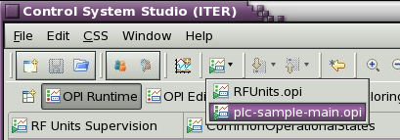
Preferences: Top OPIs, Sitewide settings
Top OPIs: Appear in Toolbar
Path names for color & font files, “Top” OPIs, Schema can be web links
  Instead of /BOY Examples/font.def
  use http://some.server.org/path/font.def
Good for site-wide files like your top-level control system screen!

Slide 8
Suggestions for your site
After gaining some experience with BOY, somebody with design talents defines which colors, fonts, … to use for displays at your site
Pick fonts that look similar on all operating systems
Create color.def, font.def, schema.opi
  Place these on a web server
  Configure CSS for your site to use the http://… paths to the *.def and schema.opi
You can put your *.opi files into CVS
  or subversion, Mercurial, GIT, …CSS can include support for these
Each night, you can publish the current *.opi files from CVS on your web server
  Point the “Topi OPIs” to http://web.server/opis/main.opi
  End users can now easily run the “current” version from the Toolbar

Slide 9
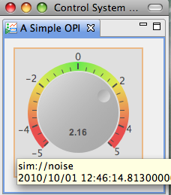
Main Idea: Simple Things are Easy
  Drag a widget, e.g. Knob, from palette to editor
  Enter the PV name in Properties view
  Click the “Run” button to execute!
There is more, but don’t go overboard!
Keep logic on the IOC.
Display is only for the display.
Don’t implement whole application in BOY.

Slide 10
Widgets and Properties Galore
Compared to EDM, MEDM, … BOY tries to offer specialized widgets
  Grouping Container instead of Lines
  LED instead of Circle-with-color-rule
  Image Button instead of Images with conditional visibility in front of invisible button
  Tabbed Container instead of embedded window, many invisible buttons, conditionally visible graphics, local PVs to update the display inside the embedded window
.. with many Properties
  Alarm sensitive Border/Background/…
  Precision, Limits, … from PV or direct entry
  Actions

Slide 11
Widgets and Properties Galore because..
Display file describes Meaning:
LED to display something, not Circle that happens to change color.
Group of related widgets, not rectangle that happens to surround something.
Border color to reflect alarm state, not arbitrary change in color.
Font name “Title”, not “Arial-bold-12”.
Displays with same Representation (Lines, circles with changing color, “Arial-bold-12”) look the same as displays with Meaning (group, LED, Title).
But they are like compiled binaries without source code. Less useful in the long run.
In the future, files with Meaning will be easier to translate for other, new tools than files with only Representation.

Slide 12
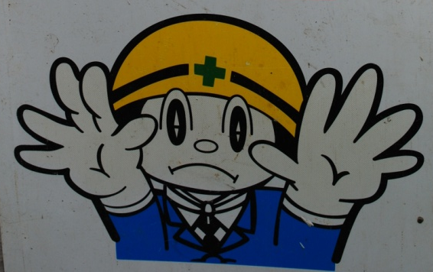
Rules & Scripts: Disclaimer
… can change any property of any widget:
  Change text of label based on a PV
    i.e. build your own Text Update
  Change color of an Ellipse based on PV
    i.e. build your own LED
Based on last slide, that is a bad idea!
Still, there are places where rules and scripts can be very powerful.
A BOY display with Rules/Scripts can replace a custom Java/Python/C/C++ application!

Slide 13
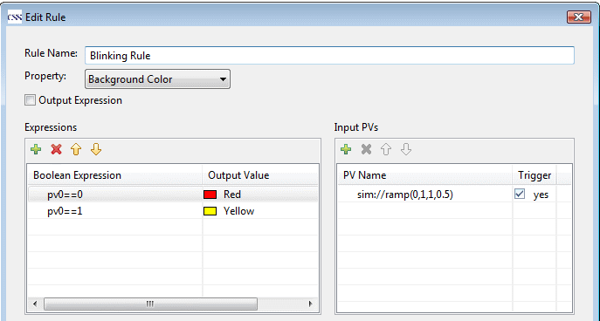
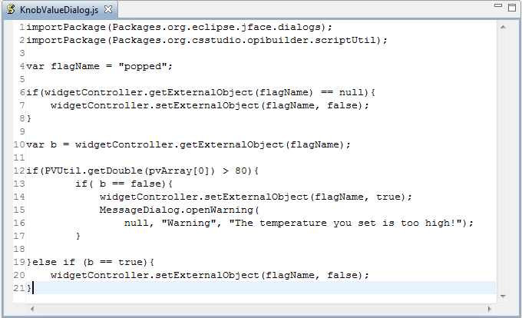
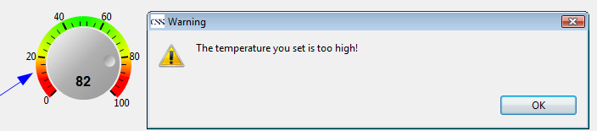
Rules, Scripts
Rules create dynamic displays
  Easy: PV → Widget Property
Scripts can to “anything”
  Read PVs,
  change widget properties,
  open dialog, …
  JavaScript or Python (Jython)

Slide 14
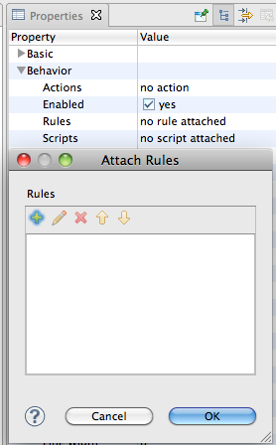
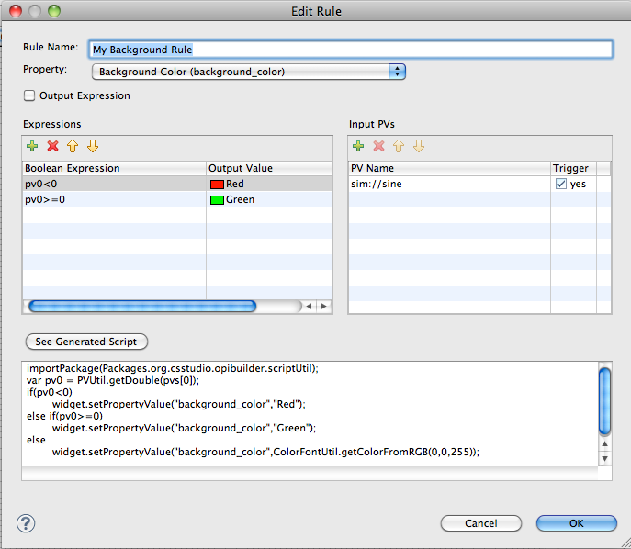
Exercise: Rule to change color of Ellipse
Create Ellipse widget
Locate its Behavior, Rules Property
Click the “no rule attached” value to open the dialog to Attach (or edit) Rules
Add a rule that changes the background color as shown between Red and Green, triggered by changes in the sim://sine PV
Press “See Generated Script”, compare with screenshot
Maybe add another TextUpdate widget to display the same sim://sine PV
Run the display

Slide 15
Rules vs. Scripts
Rules
  are simpler: One or more PVs change one property
  are closer to describing Meaning
  are internally converted to scripts, but what’s saved in the *.opi file is the Meaning: Property to adjust, expressions for rule, input PVs
  should be preferred to scripts whenever possible
Scripts
  can be pretty much any Java Script of Jython code
  can affect multiple properties, widgets, even add and remove widgets
  should be used with care, because they can be hard to maintain in the long run
    Use org.cstudio.opibuilder.scriptUtil (PVUtil, ColorFontUtil)
    Add many source code comments

Slide 16
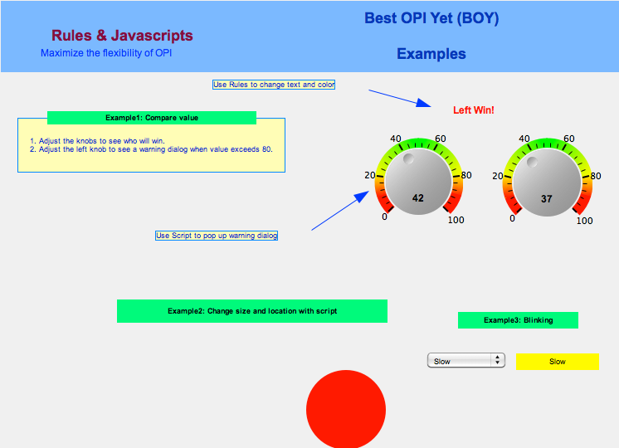
Exercise: Rules, Scripts in OPI Examples
Open BOY Examples/5_3_Rules_Script.opi, first in Runtime, then in Edit mode
Check the rules behind the “Left Win!” text above the two knobs
Check the Script
attached to the
left Knob
Check the Script
attached to the
moving circle
  How does it change
  its color?

Slide 17
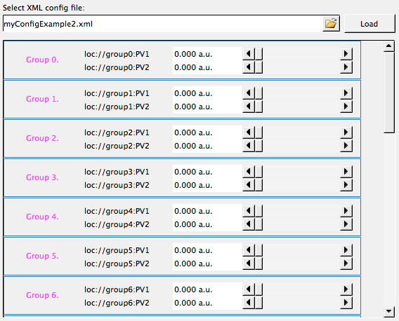
Exercise: Script-generated Displays
Open
BOY Examples/Miscellaneous/DynamicLoadWidgets/LoadWidgetsExample.opi
in Runtime mode
Enter “myConfigExample.xml”, press “Load”.
Enter “myConfigExample2.xml”, press “Load”.
  Notice a difference?
Open SubPanel.opi in Edit mode,
change it slightly by setting the color
of the “Group…” label to violet,
save, then press “Load”
on LoadWidgetsExample.opi
  See how it’s using the current version
  of SubPanel.opi?
Investigate how this is done!
  What PV is attached to the text field
  where you enter the *.xml file names?
  What PV is attached to the “Load” button?
  Note the script attached to the big Grouping Container that appears empty in edit mode, but is dynamically populated with copies of SubPanel.opi in runtime mode.
  Read that script together with myConfigExample.xml.
  Writing such a script requires knowledge of the BOY widget model.
  You don’t have to write such a script, but you should be able to understand what it does.

Slide 18
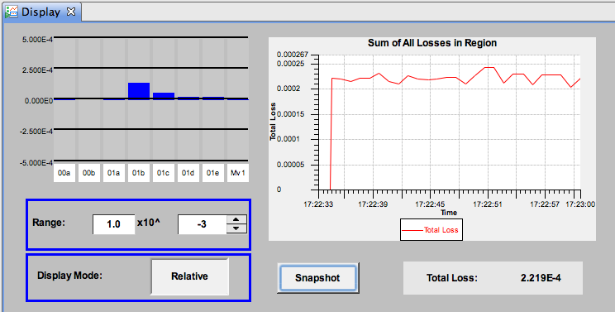
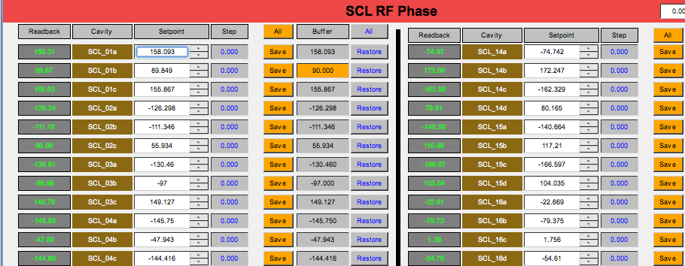
Scripts can replace custom Applications!
Display how beam loss is increased or reduced relative to a “snapshot”
Save, Adjust, maybe Restore settings
SNS operation group:
Tim Southern, Nick Luciano

Slide 19
Should Scripts replace custom Apps?
Try to keep the display tool as a display.
Add logic to the IOC, not the display.

Slide 20
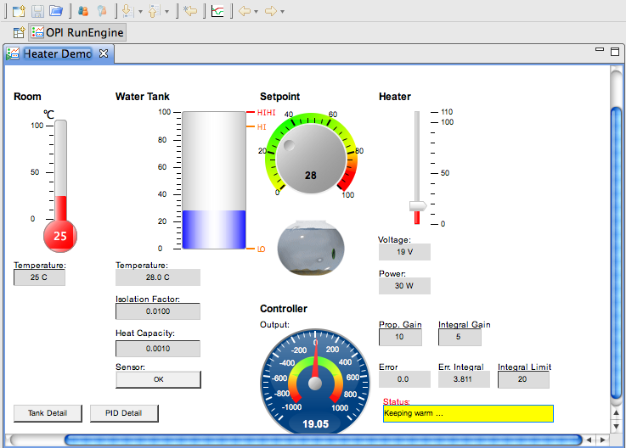
Summary
There is a lot you can do in BOY
  Macros, Rules, Scripts, …
Remember
the Main Idea:
Simply Things are Easy
  Add widget
  Enter PV Name
  Run

