Slide 1
Control System Studio Training
-
Web OPI
Kay Kasemir
ORNL/SNS
kasemirk@ornl.gov
Jan. 2013

Slide 2
Idea
Execute most CSS BOY *.opi files in a web browser
  Zero install on the client side
  Works with PCs, Laptops, Tables, Phones and most web browsers
  Even ‘write’ widgets work
  A few widget differences
  Lower update performance
  Maybe guard write access: CA Gateway, https:// proxy with login, …
  No editing of displays, only runtime

Slide 3
Tomcat Setup
Download WebOPI.war into webapps/
Place *.opi files in a new opi/ directory
Add to conf/catalina.properties:
  org.csstudio.rap.preference=/path/to/my/css_rap.ini

Slide 4
Example css_rap.ini
#EPICS configuration
org.csstudio.platform.libs.epics/auto_addr_list=false
org.csstudio.platform.libs.epics/use_pure_java=true
org.csstudio.platform.libs.epics/addr_list=127.0.0.1 192.168.1.2
org.csstudio.platform.libs.epics/max_array_bytes=160000
#WebOPI configuration
org.csstudio.opibuilder/opi_repository=/path/to/apache-tomcat-7.0.11/opi
org.csstudio.opibuilder/startup_opi=main.opi
org.csstudio.opibuilder/mobile_startup_opi=mobile.opi
org.csstudio.opibuilder/color_file=color.def
org.csstudio.opibuilder/font_file=font.def
org.csstudio.opibuilder/top_opis=main.opi
org.csstudio.opibuilder/opi_gui_refresh_cycle=200
org.csstudio.opibuilder/macros="N","North"|"W","West"|"user","demo"

Slide 5
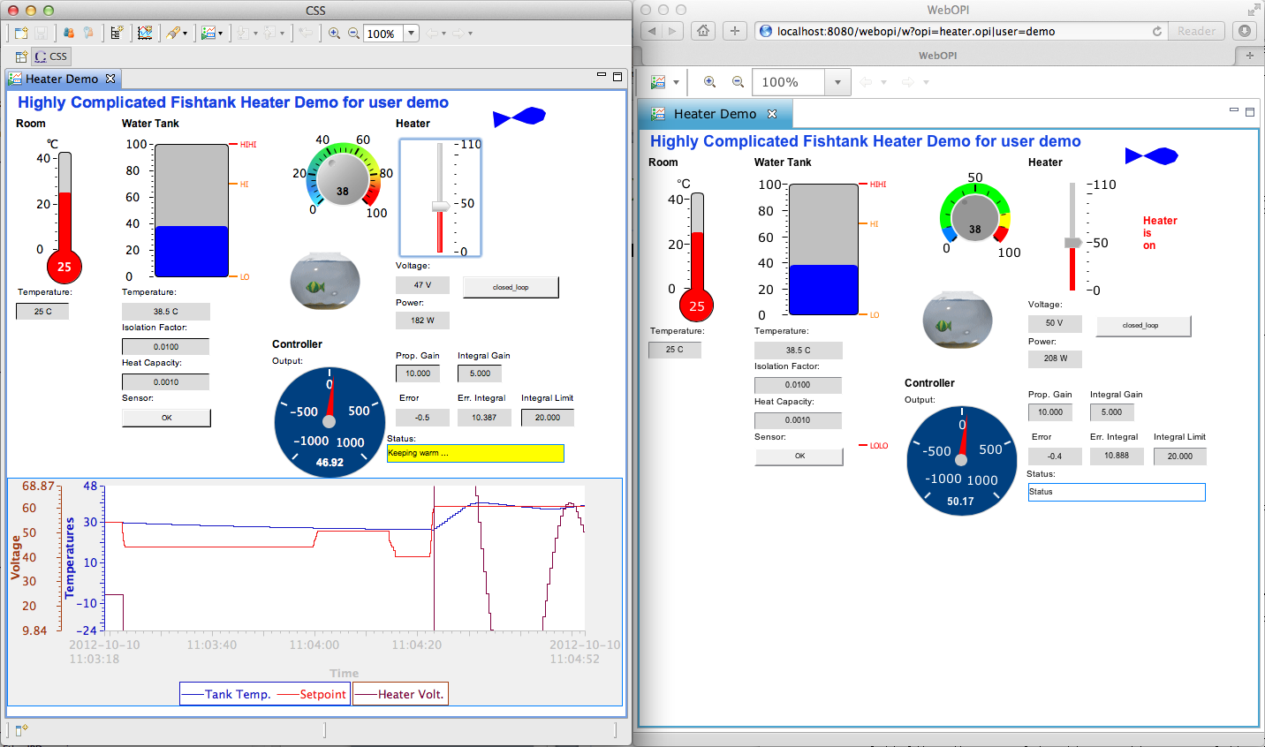
Example
URL: http://localhost:8080/webopi/w?opi=heater.opi|user=demo

