Slide 1
Control System Studio Training
-
EDM Converter
Kay Kasemir
ORNL/SNS
kasemirk@ornl.gov
Jan. 2013

Slide 2
So far…
John Hammonds (APS):
MEDM-to-BOY (*.adl to *.opi) converter
  Somewhat usable.
  ‘Asyn’ for example includes auto-converted displays.
SNS contract w/ Cosylab:
EDM-to-BOY (*.edl to *.opi) framework
  Only includes widget mapping for Label, TextUpdate, Rectangle.

Slide 3
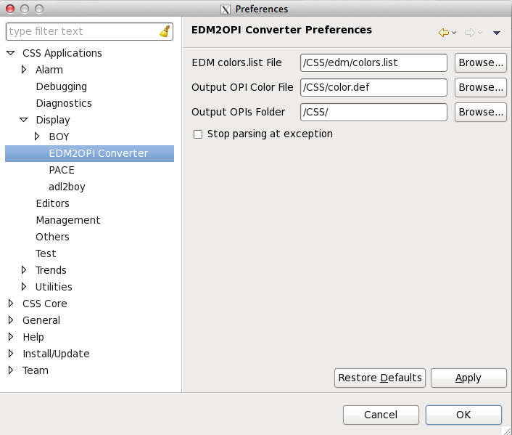
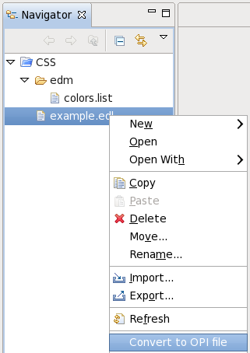
Usage

Slide 4
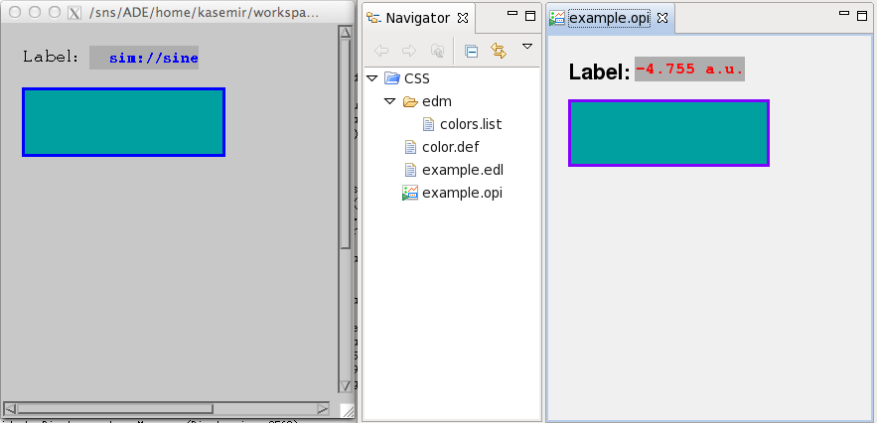
Result

Slide 5
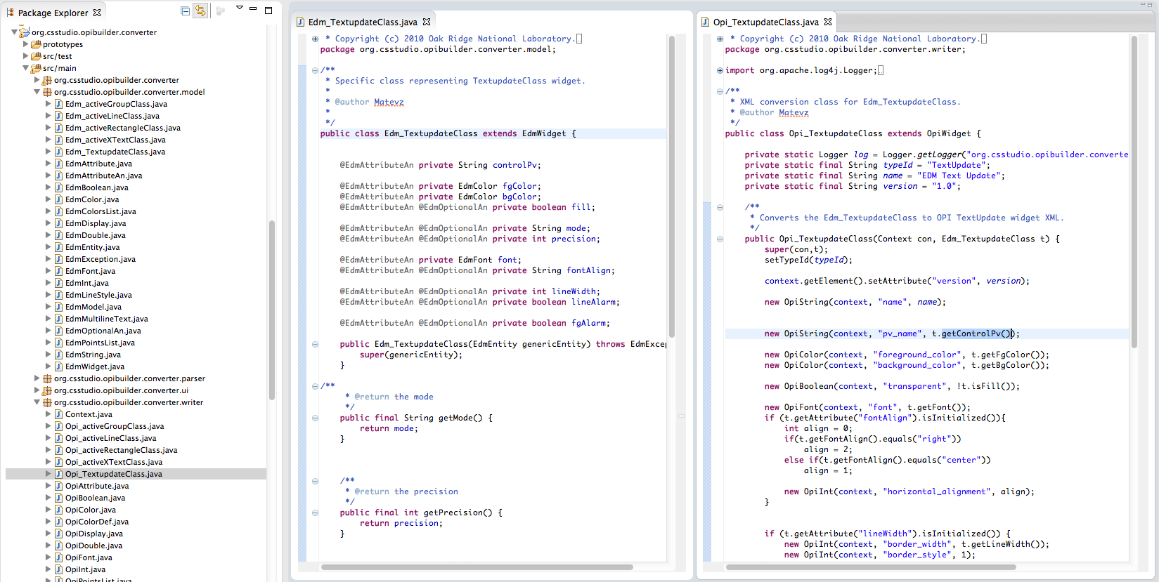
Fundamentally, Easy to Extend

Slide 6
What Should be Easy
Add most widget types
Add basic intelligence:
  Replace EDM ‘visibility’ with BOY ‘Rule’

Slide 7
What’s Impossible
“Tabs” simulated by invisible Message Buttons writing to local PVs, …
Rectangles that are really meant to create a “Group”
Invisible related display buttons that could now be “actions” attached to visible widgets

Slide 8

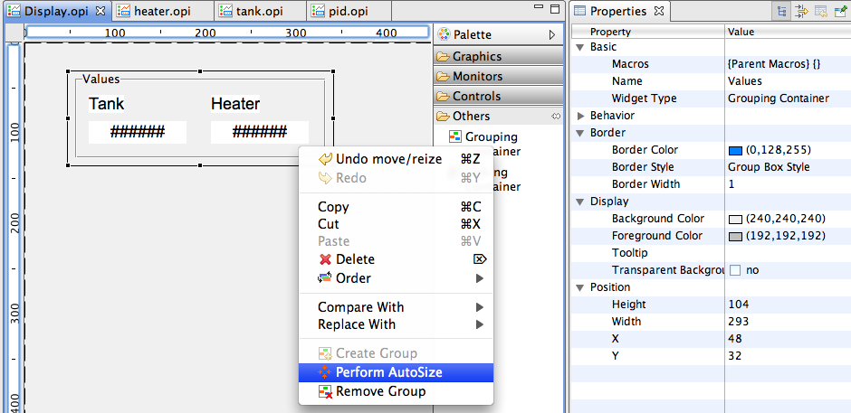
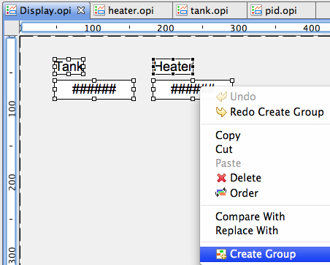
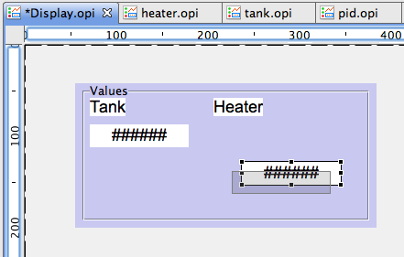
Groups
‘Group’ in EDM:
  Rectangle around widgets
  Label on top of Rectangle for group name
Looks OK, hard to edit/move
Grouping Container Example:
  Create from context of
  selected widgets,
  or drop widgets into it
  Configure name,
  move,
  (auto-)size,
  even remove.
  When moving
  widgets,
  highlight indicates
  if they’re still
  ‘inside’ container
Optical feedback when moving widget in group

Slide 9
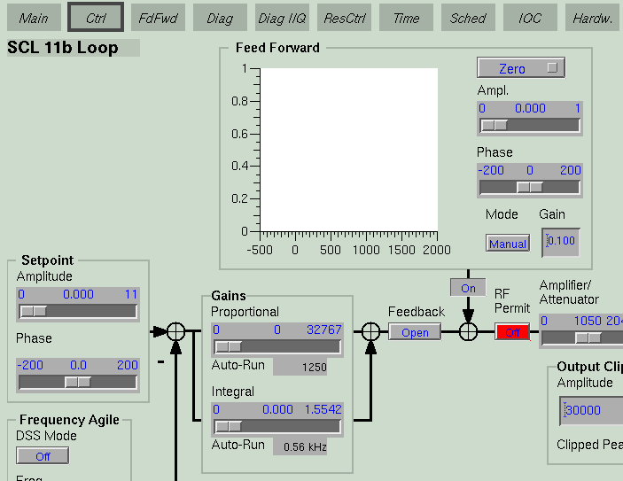
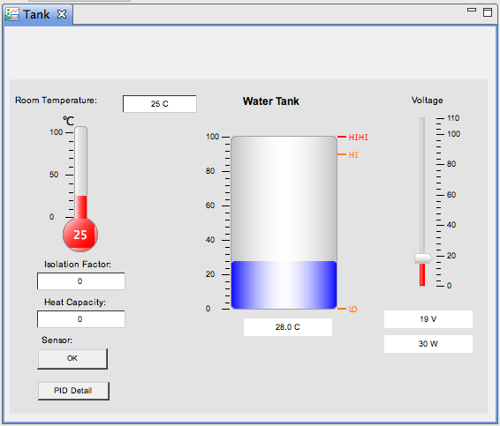
Tabs
EDM:
  Invisible button writes
  to local PV
  Rectangle etc. show/hide
  depending on value of that PV
  Embedded display shows
  different file depending on PV
BOY: Tabbing Container

Slide 10
Summary
Decent skeleton, yet still just a skeleton.
Eagerly awaiting people with time to add all the widget conversion code.

