Slide 1
Control System Studio Training
-
Hierarchical Preferences
Kay Kasemir
ORNL/SNS
kasemirk@ornl.gov
Jan. 2013

Slide 2
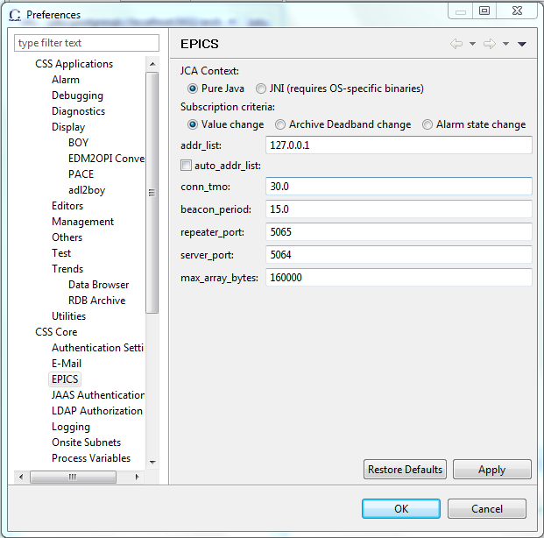
Preference GUI
Menu Edit, Preferences
  Not too hard to find
  Maybe consult associated
  Help, Help Content

Slide 3
Issue 1: What’s best for each user?
Download CSS
Run
Download CSS
Set EPICS address list
Configure email server
Disable BOY editing
Add archive data sources
…
Run

Slide 4
Issue 2: What about GUI-less tools?
Archive Engine, Alarm Server, Scan Server, … don’t have a GUI.
No Edit/Preferences…
So how do the CSS (Eclipse)
preferences work?

Slide 5
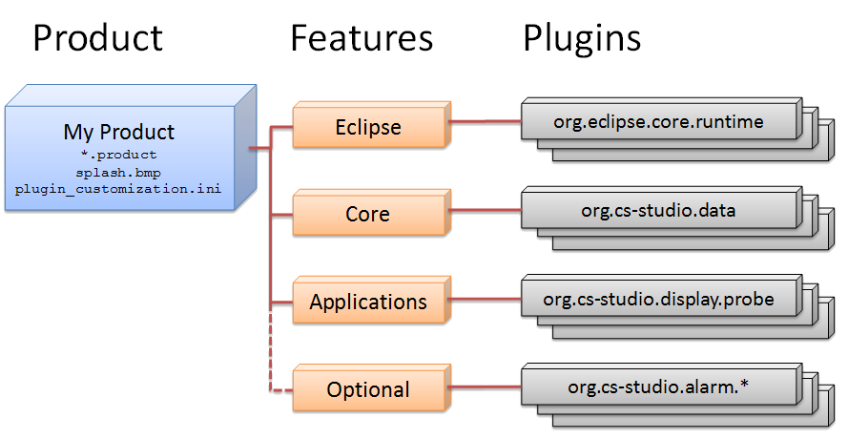
Eclipse “Product”

Slide 6
Hierarchical Preferences
Code inside plugin
Plugin’s preferences.ini
Product’s plugin_customization.ini
Command-line

Slide 7
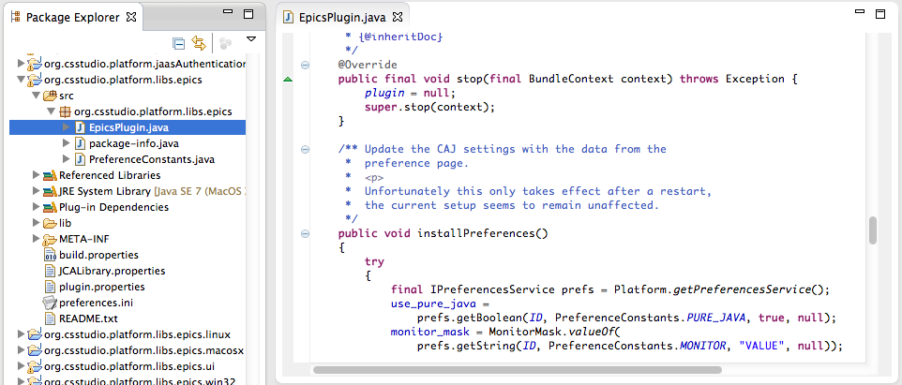
1. Code inside plugin
Would have to edit source code, recompile, …

Slide 8
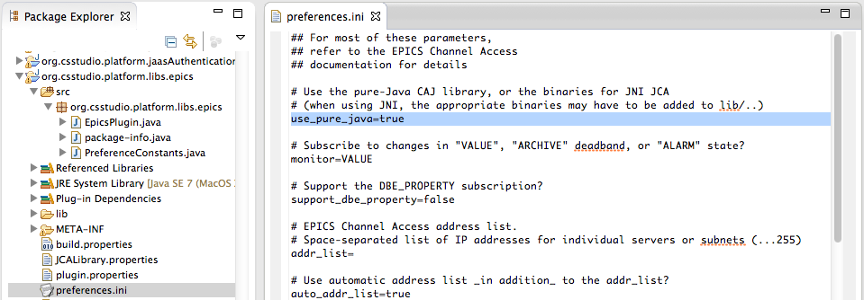
2. Plugin’s preferences.ini
Documents the available preference options, lists defaults.
Can change w/o recompilation:
Unzip the plugin .jar,
Edit the preferences.ini.

Slide 9
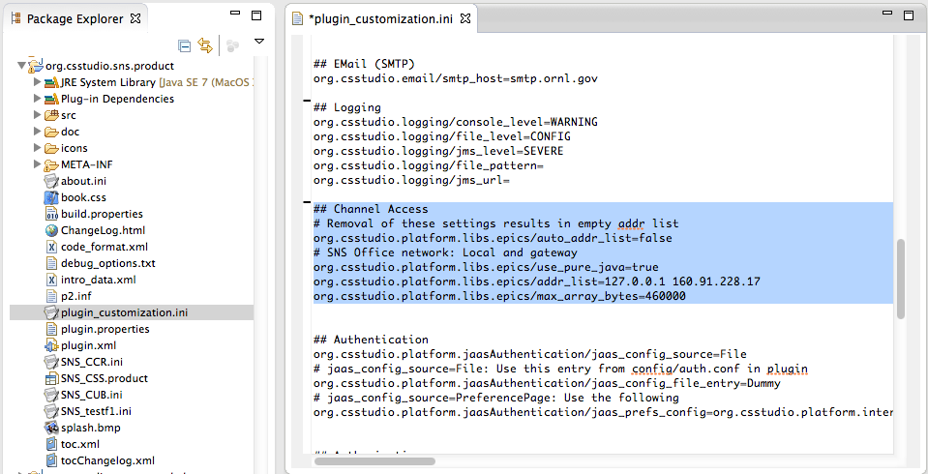
3. Product’s plugin_customization.ini
Site-specific Product sets preferences for each plugin
name.of.plugin/setting = value

Slide 10
4. Command Line
css –pluginCustomization /path/to/settings.ini
Format: Same as plugin_customization.ini
name.of.plugin/setting = value
To avoid pulling your hair out:
Do include the /path/to/…!
  File not found: No error message
Double-check name.of.plugin, name-of-setting!
  Typo: Just won’t work

Slide 11
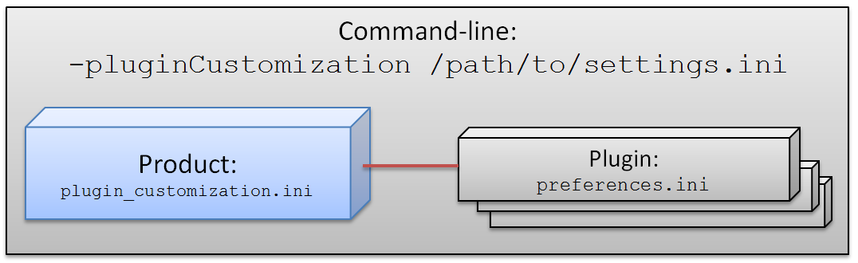
Hierarchical Preferences
org.csstudio.platform.libs.epics preferences.ini:
  addr_list=
Product’s plugin_customization.ini:
  org.csstudio.platform.libs.epics/addr_list=127.0.01
Command-line

Slide 12
Scenarios
Site-specific product:
  SNS CSS, NSLS-II CSS, …
  Best, but also more work
Use existing product
  Edit product’s plugin_customization.ini before passing on to users at your site
  Quite practical for a while
Command-line –pluginCustomization /…/x.ini
  To get started, or to support different setups for ‘Office’, ‘Control Room’, ‘Home’, …

